Slide 1
PLANNING COMMISSION
Virtual Meeting
ITEM #2
Owner/Applicant: ……….……
File Number: .…………………..
Location: ………………………..
APN: …………………….……….
Bel Aire Heights LLC
PLN 2002-00517
Ascension Drive & Bel Aire Road
041-111-130, -160, -270, -280, -320, -360
Project Description:
Consideration of a revised grading schedule and wet season grading operations for the Ascension Heights Subdivision.
PLANNING AND BUILDING DEPARTMENT
Notes:
1
Good morning Planning Commissions

Slide 2
Proposal
Revised Grading Schedule and Haul Routes
Thirteen-Month Schedule, Reduced Off-Haul
Limited Wet Weather Grading: February through April
  Completion of Phase 2A – backfill and compaction of lots 13 to Lot 19
  New Entry Road, including Underground Utilities – Phase 2B
PLANNING AND BUILDING DEPARTMENT
Notes:
2

Slide 3
HISTORY
Oct 2015 – Planning Commission review and approved
Oct 2015 – Project appealed to the Board of Supervisors
Feb 2016 – Board of Supervisors review and approval
Mar 2016 – Petition for judicial review of the approval filed
May 2018 – Court of Appeals decision upholding County approval
Dec 2018 – Planning Commission initial review of landscaping plan
Feb 2019 – Planning Commission final review and approval of landscaping plan
Sep 2019 – Planning Commission review of Grading Schedule and Haul Routes
Feb 2020 – Planning Commission approval of Grading Schedule and Haul Routes
July 2020 – Issuance of Building Permit with Grading Hard Card
PLANNING AND BUILDING DEPARTMENT
Notes:
3

Slide 4
HISTORY
Nov 2020 – Planning Commission review of Revised Grading Schedule and Haul Routes (Continued)
January 2021 – Planning Commission review of Revised Grading Schedule and Haul Routes
PLANNING AND BUILDING DEPARTMENT
Notes:
4

Slide 5
REVISED GRADING SCHEDULE SUMMARY
February 26, 2020 Planning Commission Approved Schedule allowed grading work that would take place between May 1st and September 30th (the “dry season”).
Grading commenced on July 28th, nearly three months after the intended start date
Grading work was not completed by September 30th; operating until early January with Temporary Authorization
Several unexpected events affected the project, extending the time required to complete grading work
Applicant requests authorization for a revised thirteen-month grading schedule, including authorization to continue grading throughout the “wet season” (October 1st – April 30th), subject to the conditions included in Attachment A.
PLANNING AND BUILDING DEPARTMENT
Notes:
5

Slide 6
GRADING DELAYS
Approved (2/26) grading schedule extended over the five months of the dry season (May – September).
Given July 28, 2020 start date, expected completion date would be December 27, 2020.
Revised schedule proposed by the applicant identifies August 26, 2021 as the expected completion date, approximately eight months longer than the original schedule due to a number of factors.
Rain Delays (22 days)
Underestimation of project duration and approved schedule allowed shorter work and haul hours
Smoke and COVID delays
Land clearing and site preparation occurred after the issuance of the grading hard card.
Contractor and dump site unavailable once hard-card was issued.
Cal Water and PG&E requirements changed the plan layout and grading sequence, which added considerable time.
PLANNING AND BUILDING DEPARTMENT
Notes:
6

Slide 7
COMPLIANCE WITH FEB 26, 2020 CONDITIONS
Compliance with all conditions has been verified, with the exception of the following:
CONDITION: All trucks used for hauling material to and from the site, including all empty trucks arriving at the site to haul material, shall always be covered by tarpaulins.
All haul trucks leaving the site have been covered by tarpaulins
Approximately 75% of returning trucks have not been covered
Proposed Condition of Approval in Attachment A: Any trucks arriving without a tarpaulin cover will not be permitted to enter the site that day.
PLANNING AND BUILDING DEPARTMENT
Notes:
7

Slide 8
COMPLIANCE WITH NOVEMBER, 2020 COMMISSION DIRECTION
Applicants complied with November 2020 Commission Directives, Prepared a Realistic Schedule, and Made Changes to Address Neighbor Concerns:
followed the original and subsequent conditions of approval;
improved erosion control measures to prevent offsite sediment flows and to maintain slope stability;
improved communications with the neighborhood;
limited grading operations since November 18, 2018 to those areas already commenced, and only to establish stable slopes; and
modify the timing and amount of grading off-haul, and haul routes to reduce impacts on project neighbors
PLANNING AND BUILDING DEPARTMENT
Notes:
8

Slide 9
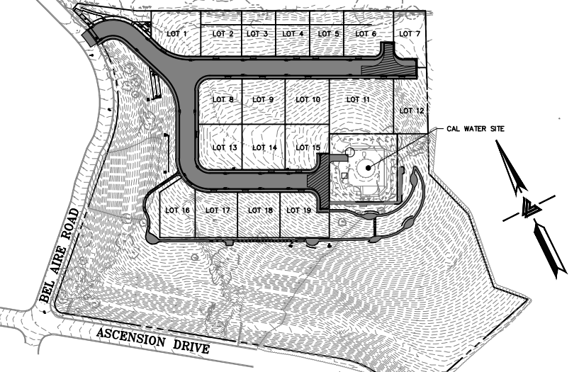
Applicant Presentation
PLANNING AND BUILDING DEPARTMENT
Notes:
9

Slide 10
RECOMMENDATION
Staff recommends approval of the revised grading schedule, including the wet season grading operations, subject to the conditions included in Attachment A.
PLANNING AND BUILDING DEPARTMENT
Notes:
10

Slide 11
PLANNING AND BUILDING DEPARTMENT
Notes:
11

