Slide 1
PLANNING COMMISSION
Board of Supervisors Chambers
400 County Center, Redwood City
ITEM #4
Owner: ………………………….
Applicant: ………………………
File Number: .…………………..
Location: ………………………..
APN: …………………….……….
Keet Nerhan
Greg Ward
PLN2017-00199
9400 Cabrillo Highway, Moss Beach
037-171-860
Project Description:
Coastal Development Permit to install and restore a low-profile landscape planter to an existing gas station.
PLANNING AND BUILDING DEPARTMENT
Notes:
1

Slide 2
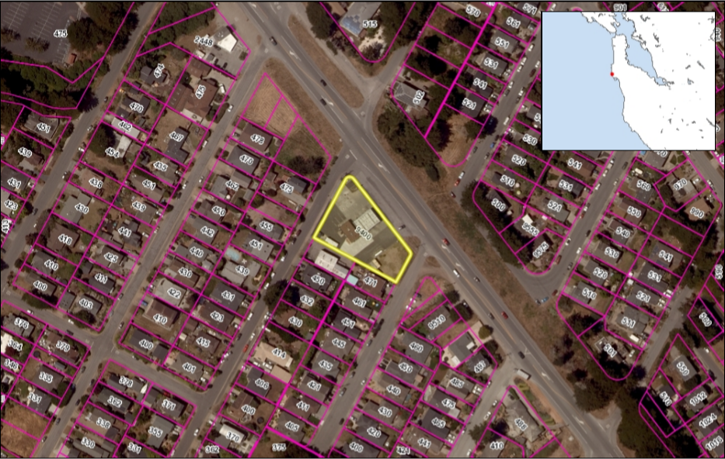
Vicinity Map
Insert photos or plans
Highway 1
Vermont Avenue
Lancaster Avenue

Slide 3
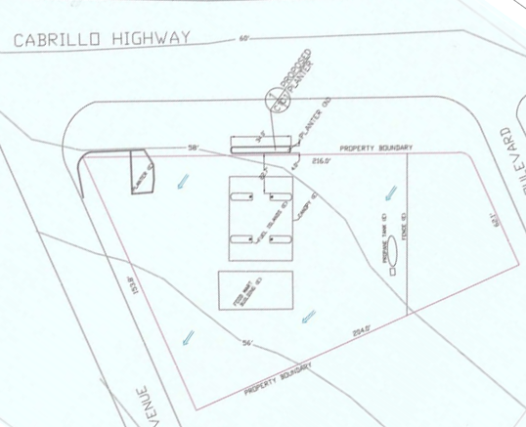

Vicinity Map
PROJECT DESCRIPTION
Chevron Gas Station
To restore a low-profile landscape planter, 136 sq. ft. (34 ft. long, 4 ft. wide, 6 inch high).
10 cubic yards of grading.
No tree removal.
Planter
Gas Station Canopy
Gas Mart
PLANNING AND BUILDING DEPARTMENT
Notes:
3
Green color area if the replacement planter.
The blue color=the canopy over the fuel pumps
Yellow =gas mart

Slide 4
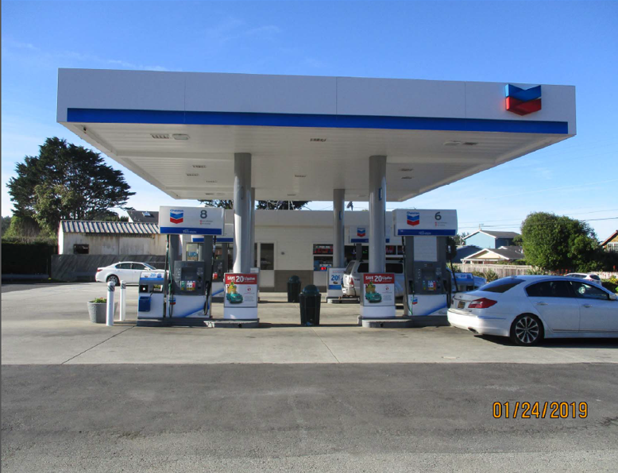
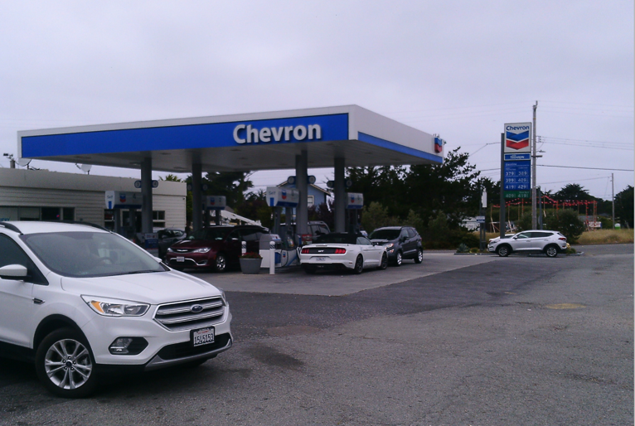
Views from Highway 1
Approximate location of landscape planter

Slide 5
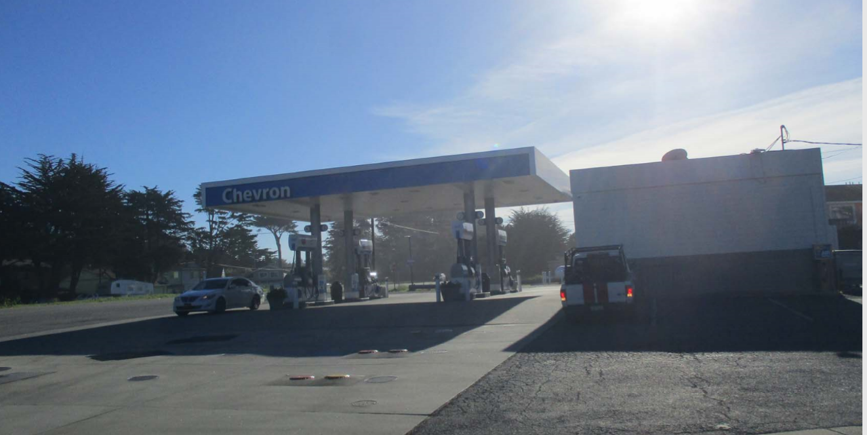
View from Vermont Avenue

Slide 6
REGULATIONS CONFORMANCE
General Plan
Soil Resources, Visual Quality, Urban Land Use and Transportation Policies
Local Coastal Program
General Regulations, Special Design Guidelines for Coastal Communities, Regulation of Scenic Corridors in Urban Areas, Shoreline Access Component
Zoning Regulations for the C-1/S-3/DR/CD District
Standards for Design in Other Areas
PLANNING AND BUILDING DEPARTMENT
Notes:
6

Slide 7
REVIEW BY CALTRANS
Allow the landscape planter to be constructed upon application for and approval of a Caltrans encroachment permit.
Follow the Caltrans Standard Plans and Highway Design Manual Design Guidelines and meet safety and setback requirements per the Highway Design Manual.
Caltrans requires plants to be located to not obscure pedestrian and bicyclists at conflict points.
Review vehicle turnaround within the gas station site which could cause operational conflicts on State Route 1.
PLANNING AND BUILDING DEPARTMENT
Notes:
7

Slide 8

REVIEW BY THE MIDCOAST COMMUNITY COUNCIL
Requests redesign-
Prevent vehicles from unsafely entering/exiting onto Highway 1, into traffic travelling over 50 mph.
The Council submitted letters to the Board of Supervisors and Caltrans.
Requested asphalt curbs to be installed along a two block stretch of the properties that front on Highway 1.
PLANNING AND BUILDING DEPARTMENT
Notes:
8
The current open access area which fronts Highway 1.
The vehicles exiting the gas station are often moving quickly and abruptly into gaps of Highway 1 traffic in unpredictable directions.
requesting the gas station entrance be close off to direct vehicle access to Cabrillo Highway.

Slide 9
REVIEW BY THE MIDCOAST COMMUNITY COUNCIL (continued)
The Council referenced three documents/projects in support of their request:
San Mateo County Highway 1 Safety and Mobility Improvement Study.
Local Coastal Program, Policy 2.51(a), which prohibits new driveway connections to Highway 1.
Caltrans Project Development Procedures Manual, (Chapter 27, Topic 104.2, discusses access openings).
PLANNING AND BUILDING DEPARTMENT
Notes:
9
The implementation plan that will be developed once Connect the Coastside is approved will provide an opportunity to identify and prioritize the resources that will be applied to work out the details of a more comprehensive project..
One of the issues that will need to be addressed in order to implement larger scale improvements at this particular location is maintaining adequate access for fuel refilling trucks.

Slide 10
STAFF RESPONSE
Staff is in general agreement with the MCC’s proposal to restrict direct vehicle access to and from the site along its boundary with Highway One.
However, the intention of the proposed project is to resolve the violation associated with the removal of the prior planter and does not represent the full scope the improvements recommended along this segment of Highway One.
The larger goal of improving adequate access, is part of the project scope for
the San Mateo County Highway 1 Safety and Mobility Improvement Study and Connect the Coastside Plans.
PLANNING AND BUILDING DEPARTMENT
Notes:
10
The current open access area which fronts Highway 1.
The vehicles exiting the gas station are often moving quickly and abruptly into gaps of Highway 1 traffic in unpredictable directions.
requesting the gas station entrance be close off to direct vehicle access to Cabrillo Highway.

Slide 11
ENVIRONMENTAL REVIEW
Categorically exempt pursuant to Section 15301, Class 1 as a minor alteration of existing public or private structures, involving negligible or no expansion of use beyond that existing at the time.
PLANNING AND BUILDING DEPARTMENT
Notes:
11
The current open access area which fronts Highway 1.
The vehicles exiting the gas station are often moving quickly and abruptly into gaps of Highway 1 traffic in unpredictable directions.
requesting the gas station entrance be close off to direct vehicle access to Cabrillo Highway.

Slide 12


Slide 13
RECOMMENDATION
That the Planning Commission approve the Coastal Development Permit, County File No. PLN 2017-00199, by making the required findings and adopting the conditions of approval listed in Attachment A.
PLANNING AND BUILDING DEPARTMENT
Notes:
13

Slide 14
PLANNING COMMISSION
Board of Supervisors Chambers
400 County Center, Redwood City
ITEM #4
Owner: ………………………….
Applicant: ………………………
File Number: .…………………..
Location: ………………………..
APN: …………………….……….
Keet Nerhan
Greg Ward
PLN2017-00199
9400 Cabrillo Highway, Moss Beach
037-171-860
Project Description:
Coastal Development Permit to install and restore a low-profile landscape planter to an existing gas station.
PLANNING AND BUILDING DEPARTMENT
Notes:
14

