Slide 1
PLANNING COMMISSION
Board of Supervisors Chambers
400 County Center, Redwood City
ITEM # 2
Owner: ………………………….
Applicant: ………………………
File Number: .…………………..
Location: ………………………..
APN: …………………….……….
Peninsula Open Space Trust
San Mateo County Real Property Services Division
PLN 2020-00066
San Gregorio area
081-060-020, 081-060-030 and 081-060-130
Project Description:
The County of San Mateo proposes to acquire the subject parcels for the creation of a County park with visitor-serving amenities. Per California Government Code Section 65402, prior to acquisition of property, the County must request an analysis of the proposed acquisition’s conformity with the County General Plan.
PLANNING AND BUILDING DEPARTMENT
Notes:
1

Slide 2
PROJECT DESCRIPTION
The County of San Mateo proposes to acquire the subject parcels for the creation of a County park with visitor-serving amenities. The subject parcels are ocean front and located on the western side of Cabrillo Highway between Half Moon Bay and Pescadero. Any specific developments proposed on the property would require appropriate permits and would be reviewed by the County at the time of project submittal.
Per California Government Code Section 65402, prior to acquisition of property, the County must request an analysis of the proposed acquisition’s conformity with the County General Plan.
PLANNING AND BUILDING DEPARTMENT
Notes:
2

Slide 3
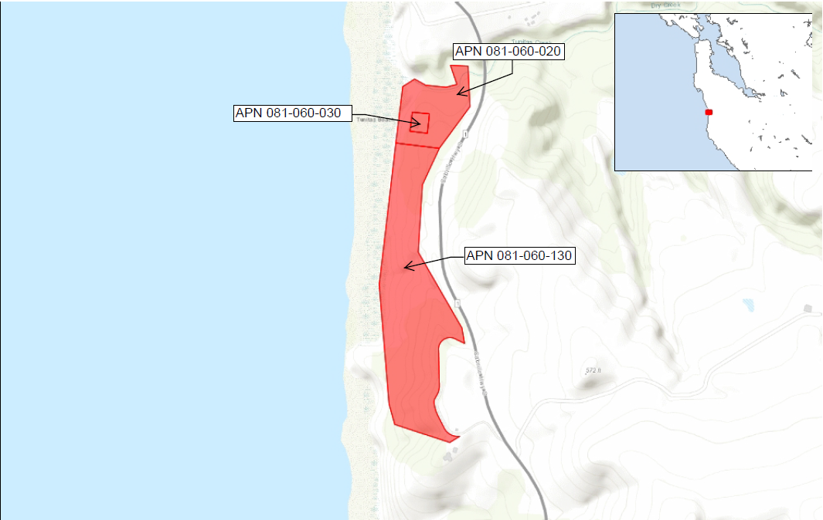

Insert photos or plans

Slide 4
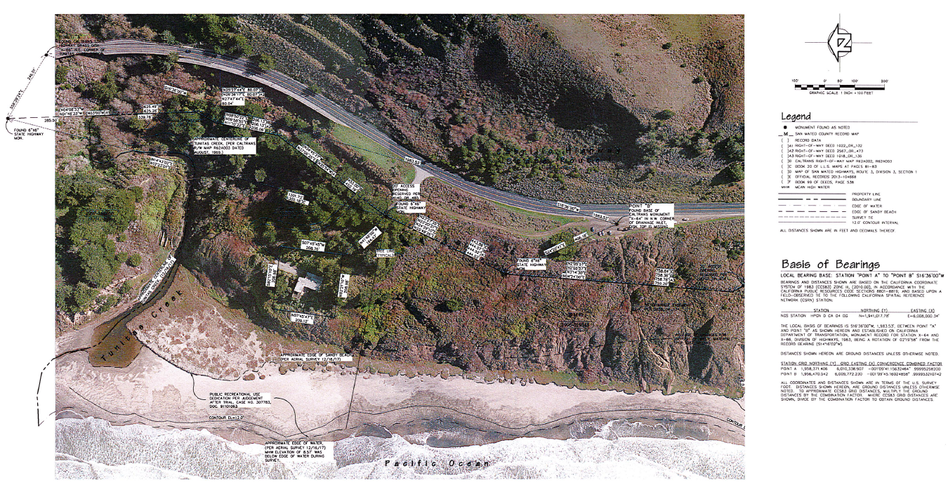
Insert photos or plans

Slide 5
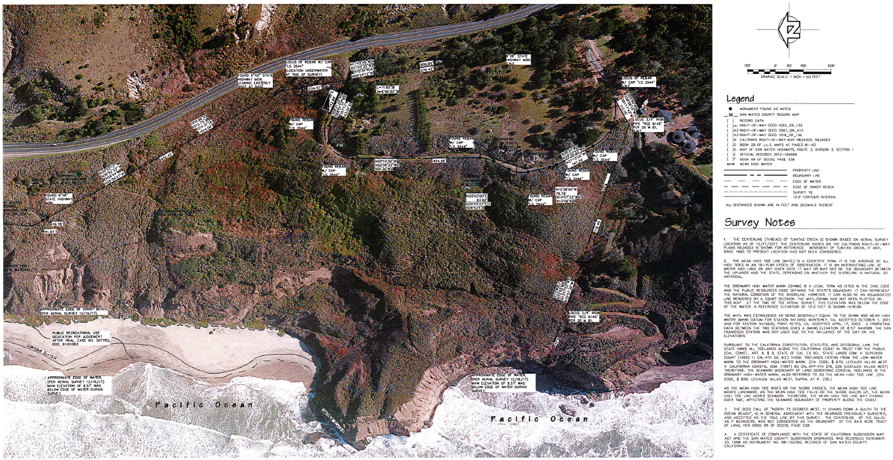
Insert photos or plans

Slide 6
REGULATIONS CONFORMANCE
The proposed acquisition potentially implicates the following categories of General Plan policies:
• Vegetative, Water, Fish and Wildlife Resources Policies
• Park and Recreation Resource Policies
• Rural Land Use Policies
The proposed acquisition does not conflict with any of the relevant General Plan policies. The intended use for the property as a San Mateo County park with visitor serving amenities is generally compatible with the relevant General Plan policies. The County has not proposed any specific developments on the subject property, or any changes to the conditions or uses of the properties at this time. Any future improvements or changes to use would be subject to review by the County at time of application.
PLANNING AND BUILDING DEPARTMENT
Notes:
6

Slide 7
ENVIRONMENTAL REVIEW
A determination that the proposed acquisition of property conforms to the County General Plan is exempt from environmental review under the “common sense exemption” that the California Environmental Quality Act (CEQA) applies only to projects which have the potential for causing a significant effect on the environment (CEQA Guidelines Section 15061(b)(3)). Any future action on the subject property would be subject to applicable CEQA requirements.
PLANNING AND BUILDING DEPARTMENT
Notes:
7

Slide 8
RECOMMENDATION AND FINDINGS
That the Planning Commission find the proposed acquisition by the County of San Mateo of three parcels (APNs 081-060-020, 081-060-030 and 081-060-130) for the purpose of creating a San Mateo County park with visitor-serving amenities conforms to the County General Plan.
PLANNING AND BUILDING DEPARTMENT
Notes:
8

Slide 9
PLANNING COMMISSION
Board of Supervisors Chambers
400 County Center, Redwood City
ITEM #
Owner: ………………………….
Applicant: ………………………
File Number: .…………………..
Location: ………………………..
APN: …………………….……….
Peninsula Open Space Trust
San Mateo County Real Property Services Division
PLN 2020-00066
San Gregorio area
081-060-020, 081-060-030 and 081-060-130
Project Description:
The County of San Mateo proposes to acquire the subject parcels for the creation of a County park with visitor-serving amenities.
PLANNING AND BUILDING DEPARTMENT
Notes:
9

