Slide 1
PLANNING COMMISSION
Board of Supervisors Chambers
400 County Center, Redwood City
ITEM # 1
Owner: ………………………….
Applicant: ………………………
File Number: .…………………..
Location: ………………………..
APN: …………………….……….
Peninsula Open Space Trust
Midpeninsula Regional Open Space District
PLN 2020-00062
San Gregorio area
081-040-010, 081-022-010 and 081-022-020
Project Description:
Consideration of a request by the Midpeninsula Regional Open Space District (MROSD) to determine if acquisition of the 540-acre Gordon Ridge Property in the unincorporated County adjacent to the Tunitas Creek Open Space Preserve conforms to the County General Plan.
PLANNING AND BUILDING DEPARTMENT
Notes:
1

Slide 2
PROJECT DESCRIPTION
The MROSD proposes to acquire the subject parcels for incorporation into the Tunitas Creek Open Space Preserve. The Toto Ranch area of the MROSD’s Tunitas Creek Open Space Preserve is located immediately to the north of the subject property. When purchased, the MROSD intends to manage the property for open space, habitat preservation, conservation grazing, agriculture, watershed protection, and low intensity recreation (trails). A subsequent planning process will analyze opportunities for natural resource management and compatible public trail uses. Any specific development proposed on the property would require appropriate permits and would be reviewed by the County at the time of project submittal.
Per California Government Code Section 65402, prior to acquisition of property, MROSD must request a report on the proposed acquisition’s conformity with the County General Plan.
PLANNING AND BUILDING DEPARTMENT
Notes:
2

Slide 3
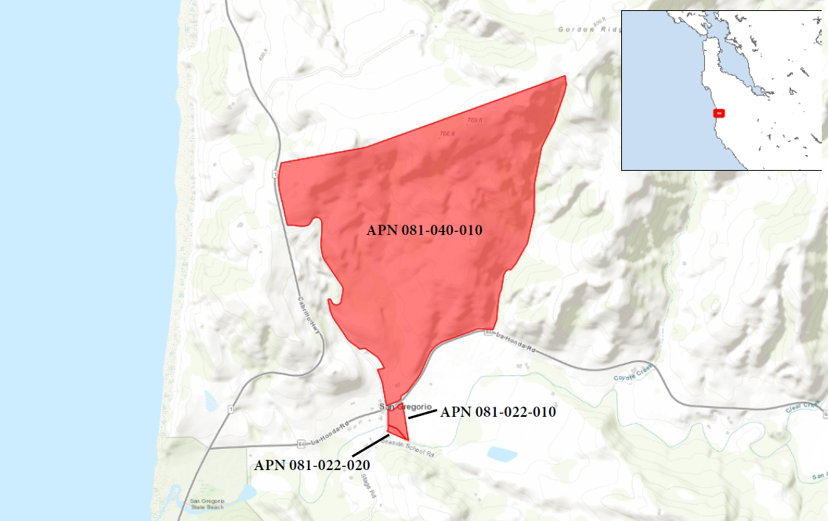

Insert photos or plans

Slide 4
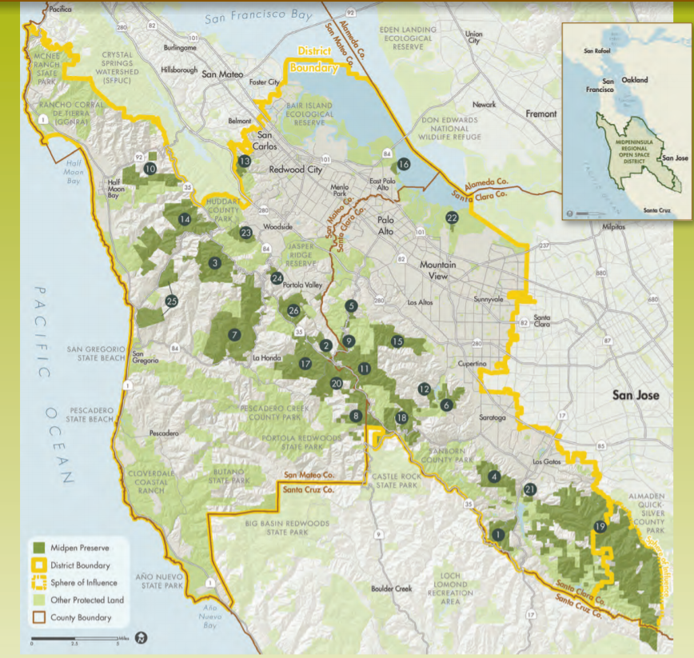

Slide 5
REGULATIONS CONFORMANCE
The proposed acquisition potentially implicates the following categories of General Plan policies:
• Vegetative, Water, Fish and Wildlife Resources Policies
• Soil Resources Policies
• Visual Quality Policies
• Park and Recreation Resource Policies
• Rural Land Use Policies
The proposed acquisition does not conflict with any of the relevant General Plan policies.
PLANNING AND BUILDING DEPARTMENT
Notes:
5

Slide 6
ENVIRONMENTAL REVIEW
A determination that the proposed acquisition of property conforms to the County General Plan is exempt from environmental review under the “common sense exemption” that the California Environmental Quality Act (CEQA) applies only to projects which have the potential for causing a significant effect on the environment (CEQA Guidelines Section 15061(b)(3)). Any future action on the subject property would be subject to applicable CEQA requirements.
PLANNING AND BUILDING DEPARTMENT
Notes:
6

Slide 7
RECOMMENDATION AND FINDINGS
That the Planning Commission find that the proposed acquisition by the Midpeninsula Regional Open Space District of three parcels (APNs 081-040-010, 081-022-010 and 081-022-020) for the purpose expanding the Tunitas Creek Open Space Preserve conforms to the County General Plan.
PLANNING AND BUILDING DEPARTMENT
Notes:
7

Slide 8
PLANNING COMMISSION
Board of Supervisors Chambers
400 County Center, Redwood City
ITEM #
Owner: ………………………….
Applicant: ………………………
File Number: .…………………..
Location: ………………………..
APN: …………………….……….
Peninsula Open Space Trust
Midpeninsula Regional Open Space District
PLN 2020-00062
San Gregorio area
081-040-010, 081-022-010 and 081-022-020
Project Description:
The MROSD proposes to acquire the subject parcels for incorporation into the Tunitas Creek Open Space Preserve.
PLANNING AND BUILDING DEPARTMENT
Notes:
8

