Slide 1
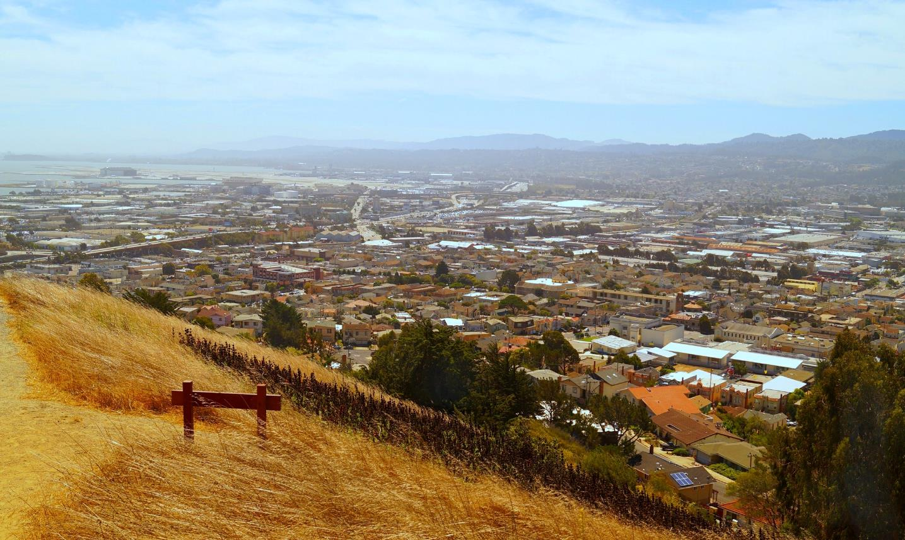
Home for All Learning Network
November 30, 2017

Slide 2
Agenda
Introductions & City Sharing
Frameworks Institute’s Approach to Communicating About Housing
Table Discussions
Mobility Toolkit
Community Engagement Pilot Updates

Slide 3
Learning Network Topics
Top Priorities
Messaging on Housing
Community Engagement
Mobility and Housing
New Sources of Funding
Regional Housing Allocation (RHNA) Sharing
Accessory Dwelling units
Coordination with 21 Elements

Slide 4
Home for All Learning Network
Introductions and City Sharing of
Housing Highlights

Slide 5
Home for All Messaging
Recommendations from the
Frameworks Institute
Peggy Jensen

Slide 6
Frameworks Institute
Nonprofit organization researching the most effective messages to build community support for social and public benefit programs
Ongoing work on housing messaging

Slide 7
Home for All Messages
Task Force Marketing Work Group
  Developed Home for All brand
  Reviewed and approved web page and brochure
Frameworks Institute
  Reviewed and provided feedback on Home for All web and print materials

Slide 8
Recommendations
Relate the need for housing to shared values
Be aware of “backfires”
Data is not the story
Offer next steps
Notes:
Don’t call this a crisis – competes with other crises
Don’t use words that imply the problem can’t be solved: skyrocketing rents, astronomical increases,,,
Don’t use myth /fact sheets
Link causes to solutions
Relate the need to personal values
- what affects one, affects all
- Community relies on people at all income levels for all types of jobs

Slide 9
1. Shared Values
Messaging, not Marketing
  Remind people of what they believe and already know
Focus on the Value of Interdependence
  We are all connected, we rely on each other
  We all have a stake in ensuring the well-being of others
  Moving people from “me” to “we”
Notes:
Remind people of what they believe and know
Messaging, not marketing
Open with why we should all care about the housing crisis
Common values move people from “me” to “we”
The Issue:
There are more jobs available than homes
All of us are affected because:
Rents and home prices have increased
Neighbors, teachers, emergency responders are moving away
Traffic is a daily battle

Slide 10
Framing Interdependence
Because there are more jobs than homes, rents and housing prices have increased. Everyone should be concerned because:
  Family and friends are leaving the area
  The people we rely on - teachers, firefighters, employees and colleagues - are moving away
  Traffic is a daily battle for everyone
Notes:
Remind people of what they believe and know
Messaging, not marketing
Open with why we should all care about the housing crisis
Common values move people from “me” to “we”
The Issue:
There are more jobs available than homes
All of us are affected because:
Rents and home prices have increased
Neighbors, teachers, emergency responders are moving away
Traffic is a daily battle

Slide 11
2. Backfires
Causing the opposite response
  If you can’t afford to live here, move
  If I can afford to live here then housing isn’t my problem
Focus on how the “housed” are affected

Slide 12
3. Data is Not the Story
Make numbers relatable
  19:1 new jobs to new homes
  Inbound commuters = 4 ATT Parks
Relate numbers to solutions
  66% of homes are single family so home sharing and second units are good solutions
Notes:
Data is not the story
Numbers need to be put in context that non-experts can understand
Use social math
Compare sizes:
19:1, new jobs to new housing
Make big numbers easy to envision:
Inbound commuters = 4 ATT Parks
Relating numbers to solutions:
75% of land is open space or agriculture, 66% is single family homes therefore home sharing and second units are ways of adding more affordable housing for seniors, young workers and others

Slide 13
4. Offer Solutions
Solutions should:
  Be concrete, specific and feasible
  Be something we can all work on together
  Show the process
  Provide local options
Notes:
Don’t present just the problem
Present what can be done
Suggest effective solution criteria
Concrete and specific - home sharing, TOD, employer housing
Feasible – second units
Something we can all work on together – downtown specific plans
Show the process – attend Planning Commission or Council meetings
Local options – menu of Home for All solutions, different options for different communities

Slide 14
Telling the Story
Describe the cause
Describe the consequences
Suggest a solution
Add in relevant links
Notes:
Don’t present just the problem
Present what can be done
Suggest effective solution criteria
Concrete and specific - home sharing, TOD, employer housing
Feasible – second units
Something we can all work on together – downtown specific plans
Show the process – attend Planning Commission or Council meetings
Local options – menu of Home for All solutions, different options for different communities

Slide 15
Families Moving - Story Chain
Cause | We are living in a time of great economic growth. Over 70,000 jobs have been added over the last 5 years, but we’ve built fewer than 4,000 new homes for those new workers.
Link 1 | But, adding so many more jobs than homes has caused home prices and apartment rents to rise.
Link 2 | Because we don’t have enough housing that people afford, our colleagues, friends and family members are moving away, taking jobs where they can afford to live.
Consequence | Employers can’t recruit qualified staff and families and friends are moving away from one another.
Solution | But it doesn’t have to be that way. We can build all types of new housing – from small second units to apartments near public transit - so that everyone who wants to live here can. If we do that, our economy will continue to thrive and we can live near our family and friends.

Slide 16
Community - Story Chain
Cause | Adding many more jobs than new homes has caused the price of housing to increase in San Mateo County.
Link 1 | Because we don’t have enough housing that people afford, teachers, emergency responders, our employees and work colleagues moving away, taking jobs where they can afford to live.
Link 2 | And it is hard to fill those vacancies because the people we want to hire can’t afford to live here.
Consequence | Our employers can’t retain or recruit qualified staff, especially for positions such as teachers, nurses, emergency responders and others who contribute to the health, safety and future of our community.
Solution | But it doesn’t have to be that way. We can build all types of new housing – from small second units to apartments near public transit - so that everyone who wants to live here can. If we do that, our economy will continue to thrive and we can continue to all live in a healthy and safe community with high quality schools.

Slide 17
Traffic - Story Chain
Cause | Over the past 7 years, less than 4,000 new homes have been built in San Mateo County, but we added over 70,000 jobs. That’s 19 new jobs for every new home.
Link 1 | So few homes have been added because Adding so many more jobs than homes has caused home prices and apartment rents to rise.
Link 2 | Because we don’t have enough housing that people that work here can afford, lots of people are commuting long distances which clogs our freeways are drags out all our commutes.
Consequence | Bumper to bumper traffic is making life more difficult for everyone
Solution | Here’s the good news: We can build more housing - especially housing close to public transit - so that everyone who works here can live here too. If we do that, we will all enjoy more open roads and shorter commutes

Slide 18
Messaging and Community Engagement
Consistency
Accuracy
Two way street – important to listen
Frameworks approach can provide structure
Remember important factors: messenger, form or interaction, level of understanding
Shared values provide foundation for agreement

Slide 19
Table Discussion
How does the value of interdependence resonate with you?
What are some examples in your community where people do experience interdependence?

Slide 20
Home for All Discussion
Table Discussion Report Out

Slide 21
Mobility Toolkit
Mineta Transportation Institute Study

Slide 22

Housing and Mobility Best Practice Toolkit
Presentation for San Mateo County’s Home for All Initiative
November 30, 2017

Slide 23
Overview
About MTI
Introducing the Research Team
Research Approach

Slide 24
About MTI
Dr. Karen Philbrick, Executive Director
Mission
  Increase mobility for all by improving the safety, efficiency, accessibility, and convenience of our nation’s transportation system
Focus Areas
  Research, education, workforce development, technology transfer
120+ Certified Research Associates

Slide 25

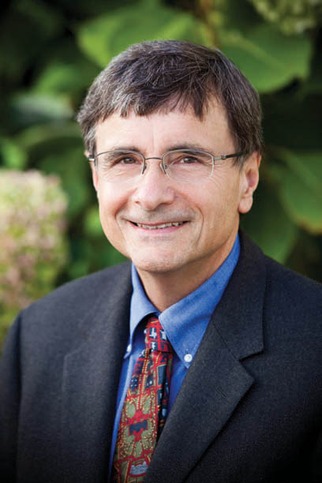

Introducing the Research Team
Local Project Leads
Dr. Serena Alexander
Dr. Joseph Kott
Dr. Hilary Nixon

Slide 26

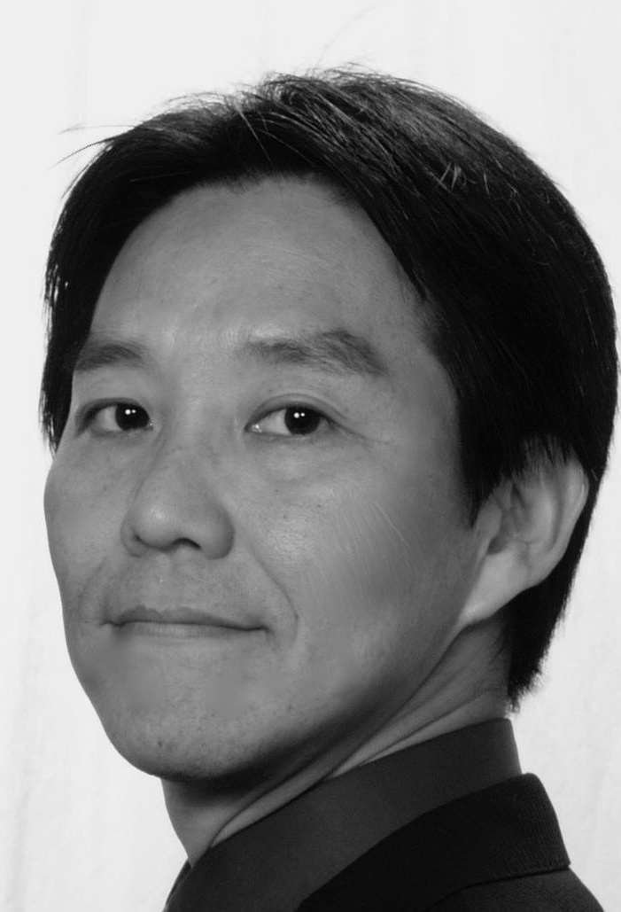
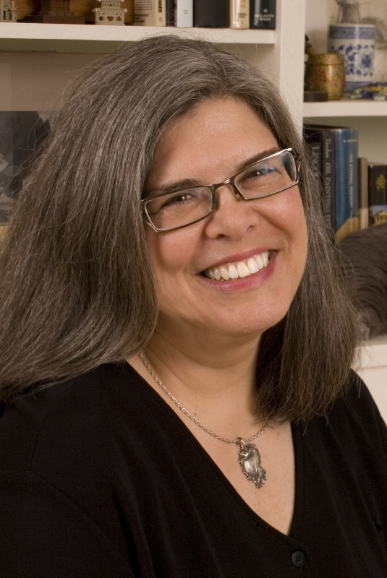
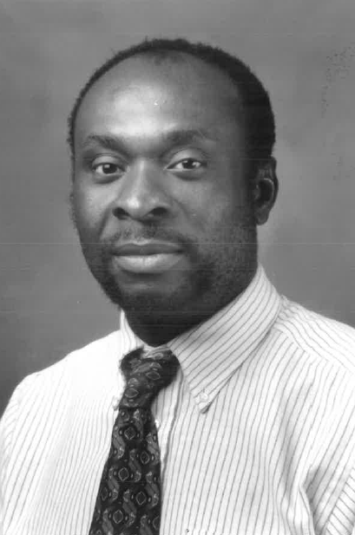
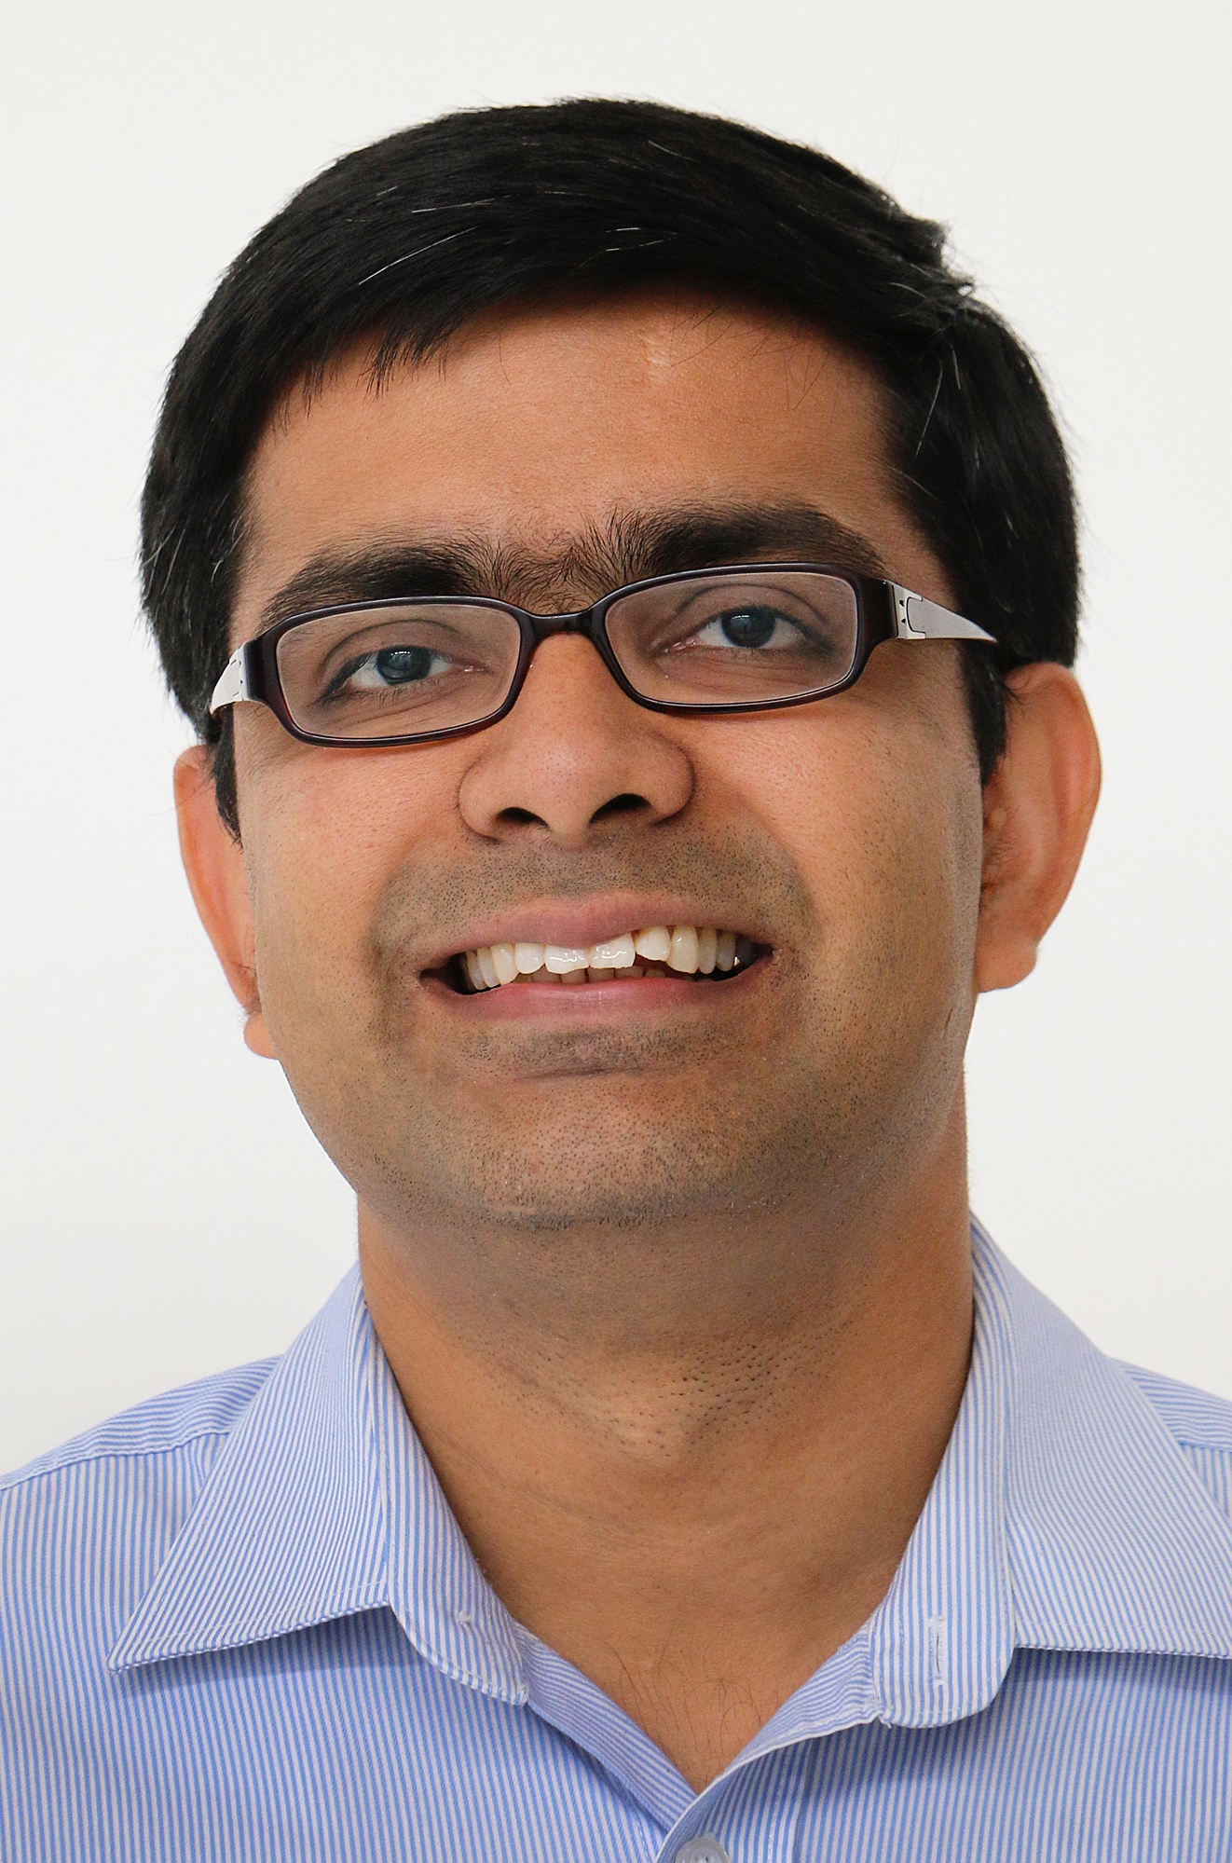
Introducing the Research Team
Parking Subgroup
Dr. Serena Alexander
Dr. Bruce
Appleyard
Dr. Hiroyuki Iseki
Dr. Joseph Kott
Dr. Shannon McDonald
Dr. Udeme Ndon
Dr. Anurag Pande

Slide 27
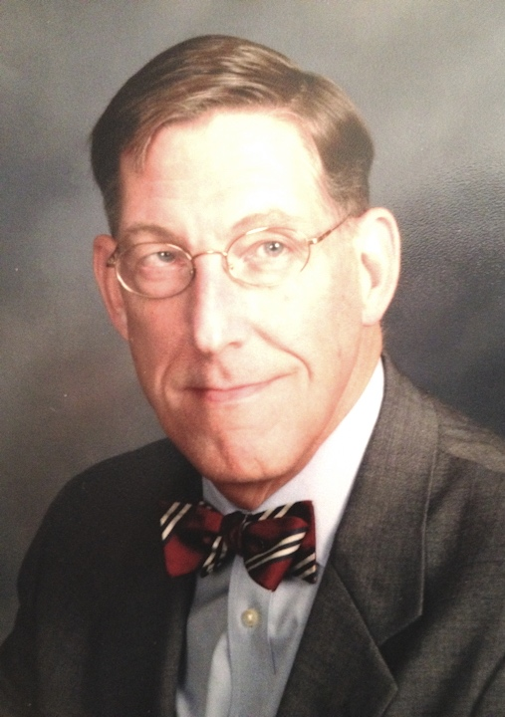


Introducing the Research Team
Commute Alternative Incentives Subgroup
Dr. Maaza Mekuria
Dr. Udeme Ndon
Eric Peterson
Walt Stringer

Slide 28
Introducing the Research Team
Travel Evaluation Metrics Subgroup
Dr. Bruce Appleyard
Dr. Joseph Kott
Dr. Maaza Mekuria
Dr. Anurag Pande

Slide 29

Introducing the Research Team
Community Planning Subgroup
Dr. Bruce Appleyard
Dr. Mark Garrett
Eric Peterson
Walt Stringer

Slide 30
Introducing the Research Team
Development Design Subgroup
Dr. Bruce Appleyard
Dr. Mark Garrett
Dr. Hiroyuki Iseki
Dr. Shannon McDonald
Eric Peterson

Slide 31
Research Approach
Review innovative efforts in the 5 specified categories
  Focus on Bay Area with other national exemplars
  Develop summary paragraphs (5 in each category)
Work with County to identify 15 full cases (3 in each category)
Develop Draft Toolkit for review
Participate in County workshops (Spring 2018)
Value of collaboration with Home For All / County staff

Slide 32
Questions?
Serena Alexander / serena.alexander@sjsu.edu
Joseph Kott / joseph.kott@sjsu.edu
Hilary Nixon / hilary.nixon@sjsu.edu

Slide 33
Home For All Community Engagement Pilot Project
Pilot Projects
  Expanding Housing Opportunities in Burlingame
  Podesta Property PUD in Half Moon Bay
  The Portola Valley Housing Strategic Plan
  Allocation Guidelines for the Redwood City Affordable Housing Fund
Consulting Funds
  Belmont & South San Francisco

Slide 34

Burlingame
Expanding housing opportunities in Burlingame
Reach broad cross-section of residents to explore what mix
of housing options and programs in Burlingame will support a thriving and diverse community
Develop model for engaging community members ahead of proposed housing projects, generating understanding and broad guiding principles

Slide 35
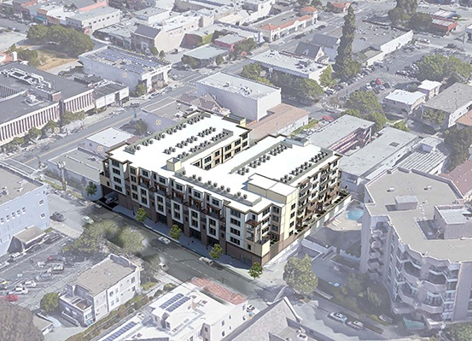
Burlingame
Build capacity for neighborhood-level conversations, e.g., possible Lyon Hoag summit
Proactive outreach and engagement for Village at Burlingame project
Proposed Village at Burlingame

Slide 36
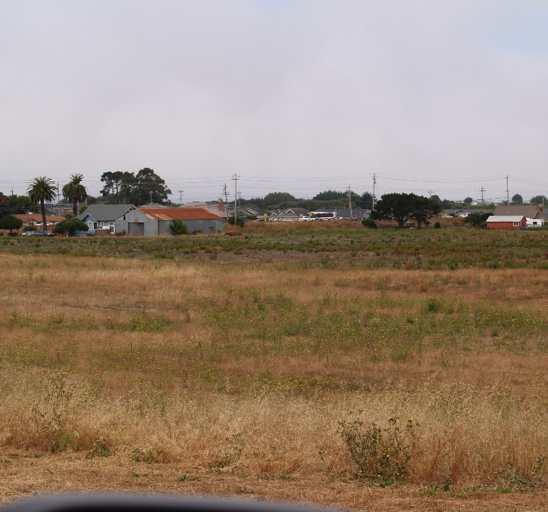
Half Moon Bay
Inviting the community to plan the Podesta Neighborhood
Encourage a wide range of perspectives about housing and the future of Half Moon Bay; expand types of input provided to council
Explore community guidance for a new neighborhood on the Podesta site
Podesta site

Slide 37
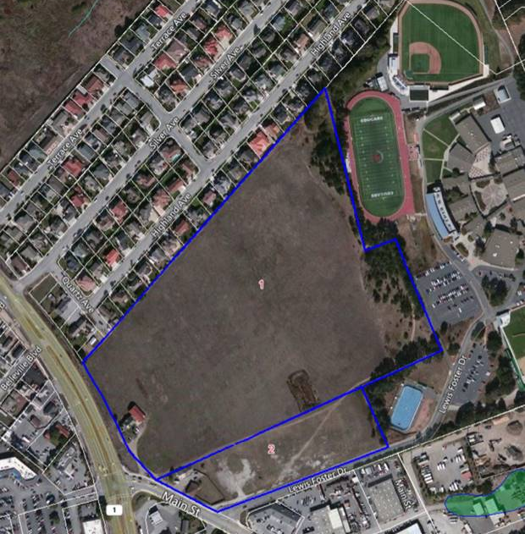
Half Moon Bay
Integrate findings with city's other planning processes
  Local Coastal Program and General Plan
  Parks Master Plan and Bicycle and Pedestrian Master Plan

Slide 38
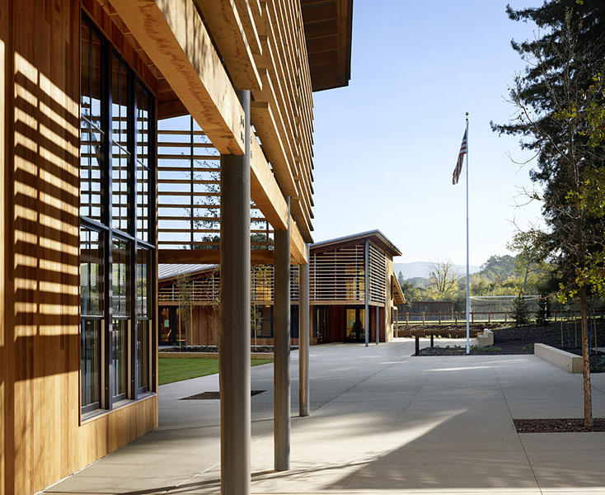
Portola Valley
Updating the housing strategic plan
Increase the capacity of Town and residents to discuss housing issues and consider a "rich mix" of housing options
Lead series of phased conversations exploring needs and considering design options

Slide 39
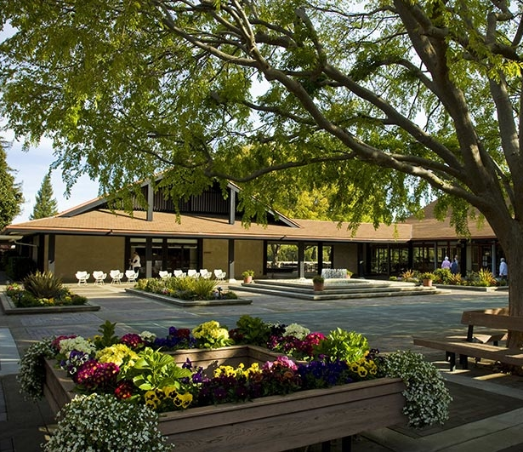
Portola Valley
Conversation #1:
Help residents to explore
how the jobs-housing gap
is impacting Portola Valley
Conversation #2:
Determine what type of
housing designs would add
to the community's character
Coordinate outreach and recruitment with local businesses, schools and community partners
The Sequoias

Slide 40
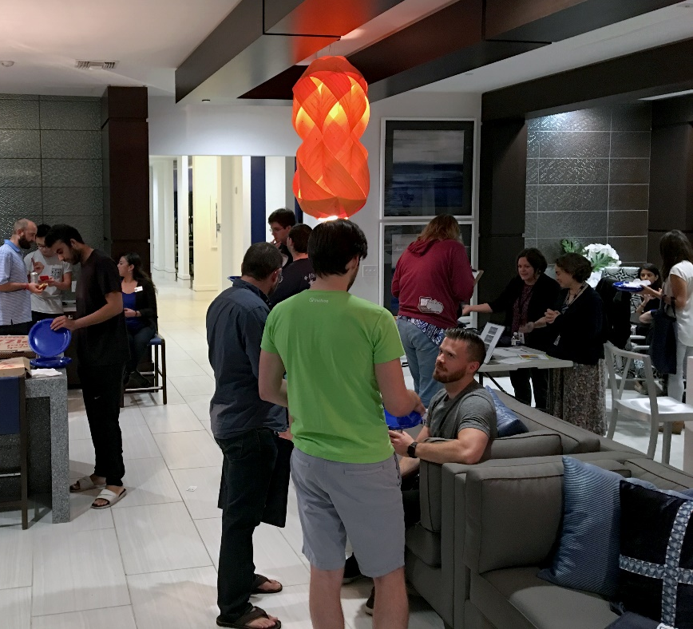
Redwood City
Develop allocation guidelines for city's affordable housing fund
Proactive awareness and education to build understanding of affordable housing
Work with community partners to reach new residents; draw on city's work developing neighborhood leaders

Slide 41
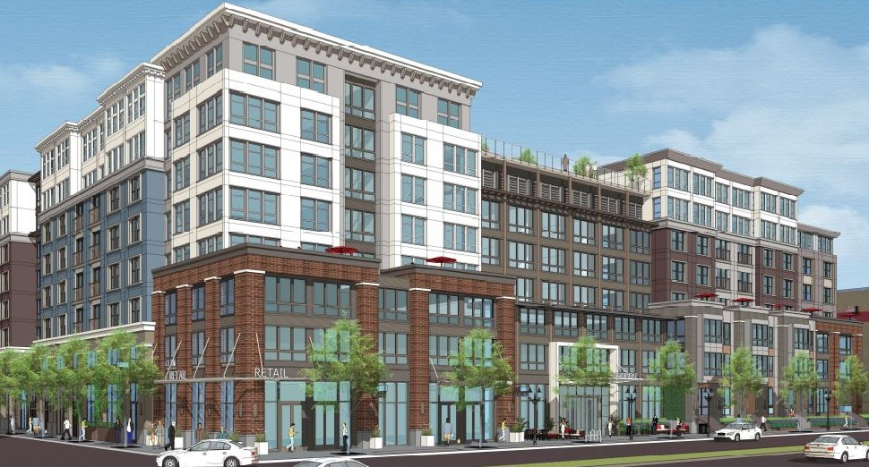
Redwood City
Housing and Human Concerns Committee will host community workshop to be followed by survey
Better understanding of community preferences will shape guidelines presented to Council
Greystar IV Apartments

Slide 42
Home for All
Learning Network
Next Session: February 22nd
Information sharing by cities
Funding for Housing Development
Community Engagement Pilot Updates
Upcoming Events
Convening on Second Units: January 25th, 2018

Slide 43
Next Meeting:
February 22nd from 7:30 – 9:30 AM

