Slide 1



Measure A-Report Back
Heather Forshey, Director
Environmental Health Services Division July 12, 2016
Augmented Housing Inspection Program Pilot
Notes:
Good Morning, President SLOCUM, Members of the Board, Mr. Maltbie, Mr. Byers
HF, Director of E H S
This agenda item is a Report Back on THE AUGMENTED HOUSING INSPECTION PROGRAM PILOT, with a request to accept the report, and
Approve a request to reallocate $81,660 in existing funds to expand the Healthy Homes outreach efforts in FY 16-17. This funding would increase our current staff of ½ time unclassified position to a fulltime position for this FY to perform additional outreach in this program.

Slide 2
County Housing Inspection Program
3,700 buildings
Routine Inspection cycle every 4 years
Inspection Staff – 2
Inspection focuses on Health and Safety of building/living units
Notes:
As you recall, County EH performs routine inspections on all apartment complexes w/ 4 or more units in unincorporated and most cities in SMC.
Using State H & S Code, apartment buildings are inspected EVERY 4 YEARS
Historically, approximately 50% of buildings received additional inspections during the four year cycle. These non-routine inspections were triggered by staff follow-up on identified issues and tenant complaints.

Slide 3
District 1: 59
District 2: 28
District 3: 26
District 4: 167
District 5: 53
Notes:
During the last 4 year inspection cycle:
10% of apartment buildings received at least 4 inspections (including routines, reinspections, and complaint investigations).
In an effort to reduce the ongoing and recurring issues at these properties,
These apartment buildings were selected for this pilot.
They are distributed throughout the County, as you can see in this map.

Slide 4
Measure A Housing Program Pilot
Added 1 Housing Inspector and ½ Outreach Coordinator who are focusing on 348 units
  A more in-depth routine inspection with a second routine inspection one year later;
  Monitoring of violation correction progress;
  Outreach to tenants to provide resources and educate them on their role in maintaining healthy and safe apartment units.
Notes:
Housing Pilot has been providing…
enhanced and more frequent inspections for the 10% (348 total) of apartment buildings that have historically required significantly more inspection oversight.
The funds also enhance compliance through education and outreach, WITH
emphasis on integrated pest management,
a combination of enhanced education and outreach to tenants and landlords, AND
more direct involvement in violation resolution to ensure compliance is reached in a timely manner

Slide 5
Status
January-April 2016: routine inspections of all 348 Measure A properties
244 Complexes (70%) required reinspections
  As of June 30, at least one reinspection has been performed at all of these properties
    All but 24 complexes have returned to compliance
Notes:
I’d like to thank our EH Housing Pilot Team for their hard work and enthusiasm towards this pilot. As you’ll see shortly, in the first 6 months, quite a bit has been accomplished.
[REVIEW SLIDE]

Slide 6
Top 5 Cited Violation Categories
Vermin/Pest Exclusion
Overall Exterior Maintenance
Weather Protection
General Exterior
Fire Safety
Notes:
1 . holes in walls, overgrown vegetation
2. Discarded items and overflowing dumpsters
3. Broken windows
4. Structural integrity, peeling paint, broken gutters
5. Blocked exit routes and nonworking fire extinguishers
Regarding the number of documented violations : While there were 1194 violations observed during these inspections for the pilot group, the number of violations were not significantly higher than those documented in the previous “4 year inspection cycle”.
Historically, our staff identified the violations in inspection reports and allowed the MINOR issues to be incorporated into the building’s routine maintenance schedule. The complexes in the pilot have deadlines for completing all repairs, and reinspections are being performed even for “minor” violations.
What we will be looking for in this pilot is a significant and sustained DECREASE in the violations during subsequent ROUTINE inspections, as well as a DECREASE in the number of complaints and reinspections between routine inspection cycles.
Also tracking time that it takes to complete the inspections and follow up work w/ these buildings.

Slide 7
Outstanding Violations
Most require a contractor, a building permit or time to complete
To date, all complexes with outstanding violations are demonstrating an effort to comply.
Notes:
As of last Thursday, July 7, there are 227 outstanding violations of the original 1194.
Some of them require building permits and/or contractors or multiple visits by pest control companies, which take additional time to complete.
Some of the violations are minor, but are at buildings with more complicated violations, and our staff are waiting to reinspect until after the larger issues have been corrected.
While our staff have had to charge reinspection fees for several buildings that required multiple site visits to check for compliance,
At this time, ALL apartment buildings with outstanding violations are currently working on the issues.
Deadlines are in place, staff have been working with property management and other agencies on each of the violations.

Slide 8
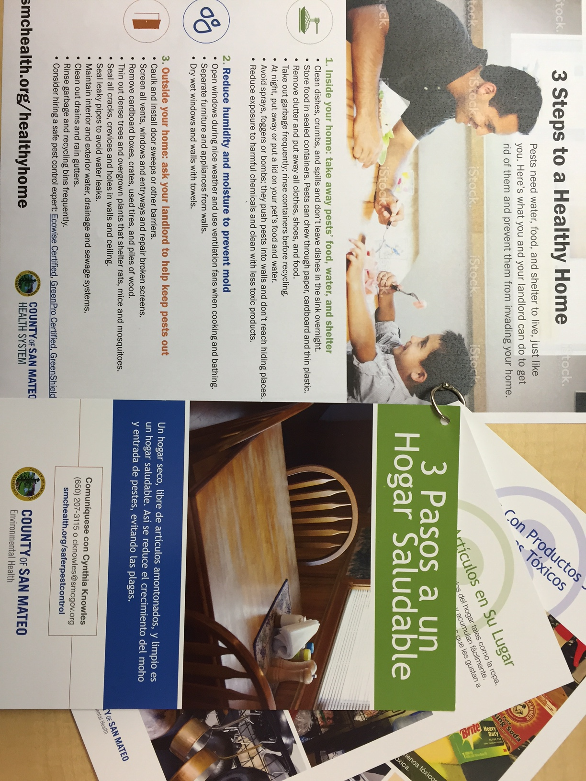
Community Outreach
Measure A buildings with pest problems
Informational flyers for tenants, landlords
Targeted online advertising
Web, social media
Community events
Press
Notes:
Our half –time Community Outreach Coordinator has also been very busy:
has been visiting apartment buildings w/ observed pest issues or as a result of tenant complaints
And is helping tenants prepare for pest control treatment, as well as providing education regarding the contributing factors that attract pests and excessive moisture, and offering solutions.
She’s developed and has been distributing 2 different/similar outreach messages: tenants and landlords
She’s setting up targeted ONLINE “healthy homes” advertising when members in the community search for key words in the Search Engines: “vector control” , “healthy homes”, “telemundo”, and “univision”
She’s distributing our healthy homes materials through the Health System’s Facebook page, NFO Fwd’s Facebook page, and is reaching out to cities to encourage them to include links to our healthy homes flyers
With respect to community events, the NFO Resource fair is being planned for August,
Reaching out to and sharing resources with other gov’t agencies, and non profits, such as the Daly City Partnership, Tri County Apt Assn, and clergy communities, such as those in the City of San Mateo

Slide 9
Pilot Timeline
January-June 2016: Inspections-1st Annual
January 2016-June 2017: Outreach
January-June 2017: Inspections-2nd Annual
Notes:
While our inspection staff work with the remaining apartment buildings on outstanding issues,
More opportunities have presented themselves for our outreach coordinator to spend more time directly with tenants and community stakeholders , and we believe there is much more work to be done this year in this area.
We are requesting permission to reallocate existing funds for an additional ½ FTE Outreach Coordinator
With that, I’m happy to answer any questions you may have.

