Slide 1


Slide 2

Strategic Plan to End Homelessness by 2020
Iliana Rodriguez
Director
Human Services Agency

Slide 3

Overview
Homeless in San Mateo County
Homeless Systems Redesign Process
Strategic Goals to End Homelessness by 2020

Slide 4


Slide 5
Homeless Count
2,281
2,149
1,796
1,772

Slide 6
Fewer Unsheltered People

Slide 7
Locations of Unsheltered People
Encampments 18%
Street 43%
RV's 19%
Cars 20%

Slide 8
Homeless Services Continuum
Emergency Housing
Outreach and Engagement
Transitional Housing
Prevention
Permanent Housing
Rapid Re-Housing
Permanent Supportive Housing

Slide 9

County-Wide Collaboration
Collaborative Committees
  HOPE Inter-Agency Council
  Homeless Continuum of Care
  Community Action Agency
County Leadership
County Departments
Cities
Community Based Organizations (CBOs)

Slide 10
The Road to The New Strategic Plan
Improved Data Integrity
Integrated HMIS into Clarity System
Analyzed HMIS data
Promoted County Collaboration at Department Level
Assessed Programs, Filled Immediate Needs
Completed Homeless Systems Redesign
Developed a Roadmap to End Homelessness

Slide 11

Homeless Systems Redesign Process
Community Learning Circles
(Over 70 participants)
Performance Standards
Shelter Diversion
Coordinated Entry
Interim Housing
Permanent Housing
Community Stakeholder Feedback
HOPE Interagency Council
Continuum of Care Steering Committee
Present New Strategic Plan to the Board of Supervisors
Kick Off with Leadership Team
Key Informant Interviews (20)
County leadership
Safety net service providers
Homeless services providers
Homeless Systems
Data Analysis
Reviewed client and financial data for 2 fiscal years
Technical Assistance to providers
Data Modeling
JUNE
2015
JULY 2015 - JAN 2016
JULY 2015 - MAR 2016
AUG 2015 - JAN-2016
AUG 2015 -MAR 2016
MAR
2016

Slide 12
Entries from Homelessness
35%
of entries are from non-homeless situations

Slide 13
Length of Stay
July 2014 - June 2015
Emergency Shelter
Transitional Housing
Rapid Re-Housing
Adult HHs
Family HHs

Slide 14
Exit to Permanent Housing
July 2014 - June 2015
Emergency Shelter
Transitional Housing
Rapid Re-Housing
Adult HHs
Family HHs

Slide 15
Cost per Permanent Housing Exit
July 2014 - June 2015
Adult HHs
Family HHs

Slide 16
Returns to Homelessness
July 2013 - June 2015
Emergency Shelter
Transitional Housing
Rapid Re-Housing
Adult HHs
Family HHs

Slide 17
Current System Inventory
Housing Type
Inventory
Shelter Providers
Inventory
Emergency Shelter Beds | 325
Transitional Housing Beds | 477
Rapid Re-Housing Beds | 94

Slide 18

Strategic Plan to End Homelessness by 2020

Slide 19

Strategic Plan Goals
Individuals Exiting Institutions will not Discharge to Homelessness
End Family
Homelessness
Create System to End Homelessness
5
4
End All Homelessness by 2020
3
2
1
End Youth
Homelessness
End Veteran
Homelessness

Slide 20
Principles of a Housing Crisis Resolution System
Housing - Focused
Person -Centered
Data - Informed System
Effective Use of
Resources

Slide 21
Housing Crisis Resolution System
CREATE A HOUSING CRISIS RESOLUTION SYSTEM
Vision: No one homeless more than 30 days
Homeless/ Mobile Outreach
Successfully Diverted to Housing
Rapid Re-Housing - Rental Housing
Unsheltered Homeless
Permanent Supportive Housing
Housing Barrier Assessment
Housing Resolution
Shelter Diversion
Prioritization
Housing Crisis
Coordinated Entry
Housing
Affordable/Subsidized Housing
At Risk of Homeless-ness
Market/Rental Housing
Continuous System Performance Monitoring
Interim Housing
Emergency Shelter
Transitional Housing

Slide 22
How We Will Create the System
1
Shift to a Housing First Approach
2
Transform existing set of programs into housing crisis resolution system
3
Develop and Implement Shelter Diversion/Housing Counseling
4
Develop and Implement a Coordinated Entry System for Homeless Services
5
Right Size Interim Housing
6
Expand Rapid Re-Housing Services
7
Maximize Permanent Supportive Housing
8
Use Data for Continuous Quality Improvement

Slide 23

End Veteran Homelessness
Create collaborative and focused effort
  Implement best practices to end veteran homelessness

Slide 24
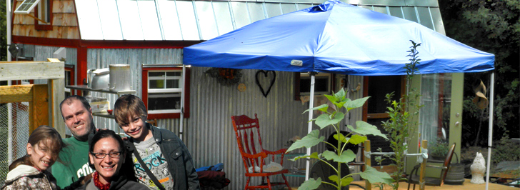
End Family Homelessness
Redesign existing emergency and transitional housing programs for homeless families
Expand housing locator and case management services
Explore micro-housing for families
Prevent entry to shelter through redesigned motel voucher program, linkage with diversion/housing counseling & rapid re-housing

Slide 25

End Youth Homelessness
Gain a better understanding on the rate of youth homelessness
Ensure appropriate supports are available for homeless youth, former foster youth, and transition age youth
Prioritize through coordinated entry
Ensure interim housing capacity
Support efforts to maximize use of existing capacity and housing vouchers

Slide 26

Individuals Exiting from Institutions Will Not Discharge to Homelessness
Coordinate efforts between County departments and institutions for homeless clients to have a permanent or interim housing plan prior to discharge
Prioritize or repurpose shelter capacity for dedicated emergency beds for those leaving institutions for whom a permanent housing option has not yet been identified

Slide 27
Our Goal: End Homelessness by 2020
Functional Zero
System Performance and Accountability
Continuous Quality Improvement
Housing Stability

Slide 28

THANK
YOU
?
Questions

