Slide 1
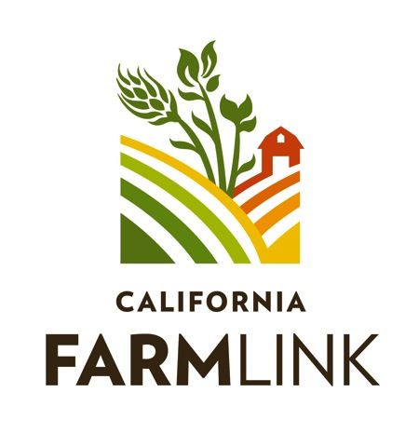
www.californiafarmlink.org Brett Melone, brett@cafarmlink.org
FarmLink Loans
For Farmers

Slide 2
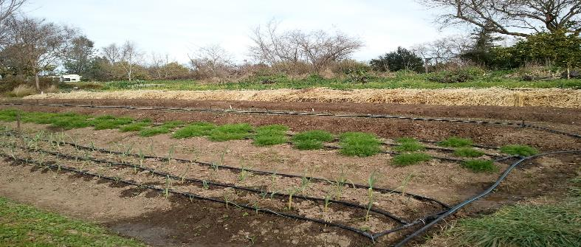
California FarmLink
Access to Land: coaching on finding land, negotiating leases, farm succession, etc.
Access to Capital: operating & equipment loans from $1,000 to $250,000 AND help with understanding financing options, how to qualify for a loan, etc.

Slide 3
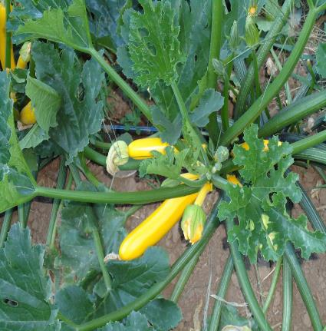
Loan Client Story: Roberto Gonzalez
Diversified organic vegetable grower in Hollister that started farming in 2007 on 5 acres. Grew to 18 acres, selling through stable wholesale and farmers markets. Depended upon “blue valve” water from Central Valley Project. Access began to be restricted in 2012, and was completely cutoff by 2014. An existing well on the property needed a new pump. No credit history, limited English, immigration status, no financial projections - made it difficult for him to qualify with a conventional lender.
FarmLink made him a $25,000 equipment loan to purchase a new pump. Why?
10+ years farming experience
Well thought out crop & sales plan
3-year track record with main customer
Responsive, diligent in follow up

Slide 4
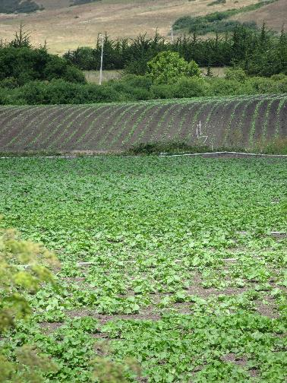
Loan Client Story: Yellow Wall Farm
Well-established direct market grower in Santa Cruz with an NRCS EQIP contract, including a rainwater catchment system. Needed bridge financing to cover construction costs.
FarmLink made them a $25,000 bridge loan. Why?
NRCS EQIP contract as collateral
Water security and conservation important to FarmLink’s mission
10 yr track record

Slide 5
What makes FarmLink different?
Focused on organic/sustainable farms
Able to work with conservation partners to provide bridge and long-term financing for both hard and soft practices
Understands direct market channels
Can work with newer farmers, people with no credit
Non-profit, Community Development Financial Institution
Bilingual staff

Slide 6
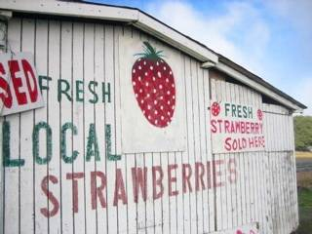
FarmLink Loans: Details
Loan amount: $1,000 to $250,000
Loan uses & terms:
Operating loan for production expenses: pay it back based on your seasonal income / cash flow; due by end of the season
Equipment/infrastructure loan: fixed monthly payments that you can afford, up to 7 years
Interest rate: 7% fixed
Loan fee (one-time): 2%
Application fee: none
Prepayment penalty: none
Land loans available in 2015!
(terms TBD)

Slide 7
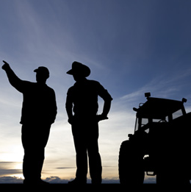
FarmLink Loans: How To Qualify
Demonstrate that you can repay the loan
Farm management experience
Well thought out crop plan and where you will sell
Any previous farming experience that you have helps show you can succeed and repay the loan (historical production records, tax returns or financial stmts, etc.)
Demonstrate that you are willing to repay
Credit history – Paid back previous loans (no credit okay)
References – customers, suppliers, landlord
Character – follow through, organized, etc.

Slide 8
FarmLink Loans: Application Process
Total loan processing time = 2-6 weeks
Be prepared: how much do you want, for what
Call FarmLink Loan Officer & find out if you might qualify
Fill out a loan application and turn in key paperwork
(i.e. tax returns, lease, etc.)
Be available for a farm site visit and answer questions
Wait for response on loan approval/decline
FarmLink Loan Officer will gather and analyze all the information, and make the case to approve your loan request.

Slide 9
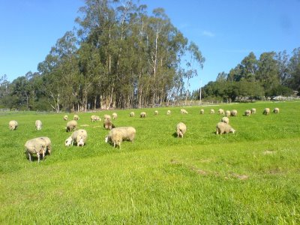
FarmLink Staff Contacts
Ali Peman-Dupier
Loan Officer
ali@cafarmlink.org
831.216.8023
Deborah Nares
Farm Water Advisor
760.583.2555
Brett Melone
Director of Lending
brett@cafarmlink.org
831.869.8400

