Slide 1
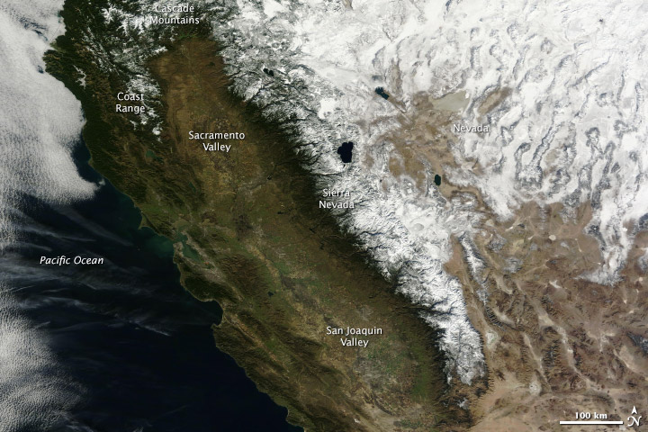
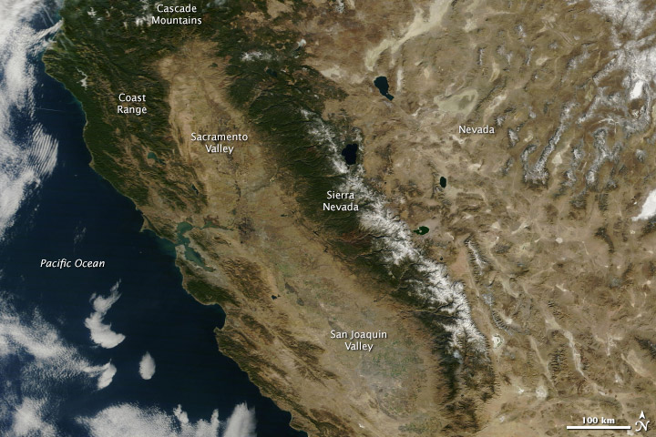
UC Cooperative Extension San Mateo County Resources and Partnership Opportunities
January 2013 January 2014
NASA images courtesy LANCE/EOSDIS MODIS Rapid Response Team at NASA GSFC
Virginia Bolshakova
Director, UCCE SM/SF Counties
vbolshakova@ucanr.edu

Slide 2
We are
Problem Solvers
Researchers
Coordinators
Advisors
Collaborative Leaders
Educators
Stewards
Community Builders

Slide 3
ANR envisions a thriving California in 2025 where healthy people and communities, healthy food systems, and healthy environments are strengthened by a close partnership between the University of California and its research and extension programs and the people of the state.

Slide 4
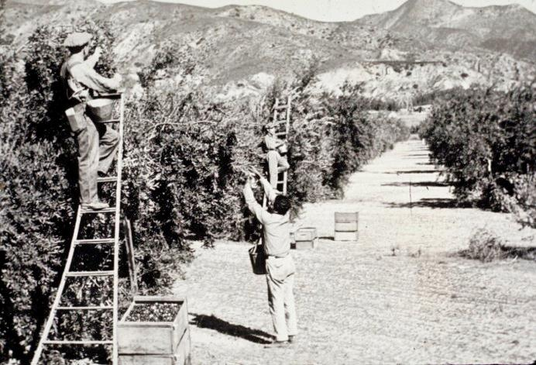
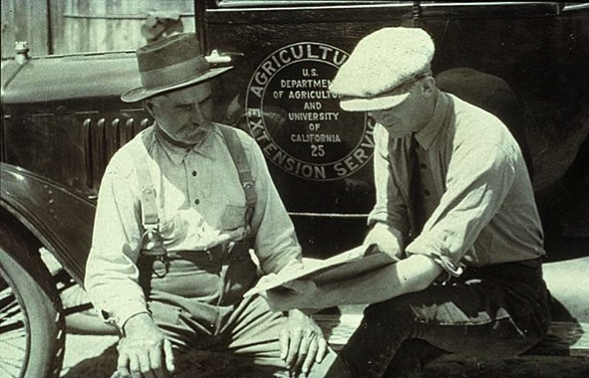
UC ANR is a network connecting the people of California and their University.
Our more than 300 campus-based specialists and county-based advisors work as teams to bring practical, unbiased, science-based answers to Californians
California opened its first county Cooperative Extension office in Humboldt county in 1913.

Slide 5
"What we really tried to do," Forero said, "is make it so it wasn't so overwhelming that people said, 'I don't have time to do this.’ From a Cooperative Extension perspective, we don't buy, sell or regulate. We try to provide ideas for folks, and what they do with them is up to them.” –Capital Press, Published 16November2014

Slide 6
Agricultural Experiment Station
Campus-based researchers
UC Cooperative Extension
Local advisors who live and work in the communities they serve and our campus-based specialists
Research and Extension Centers
9 locations statewide
Statewide Programs
Specific focus on high-priority concerns

Slide 7
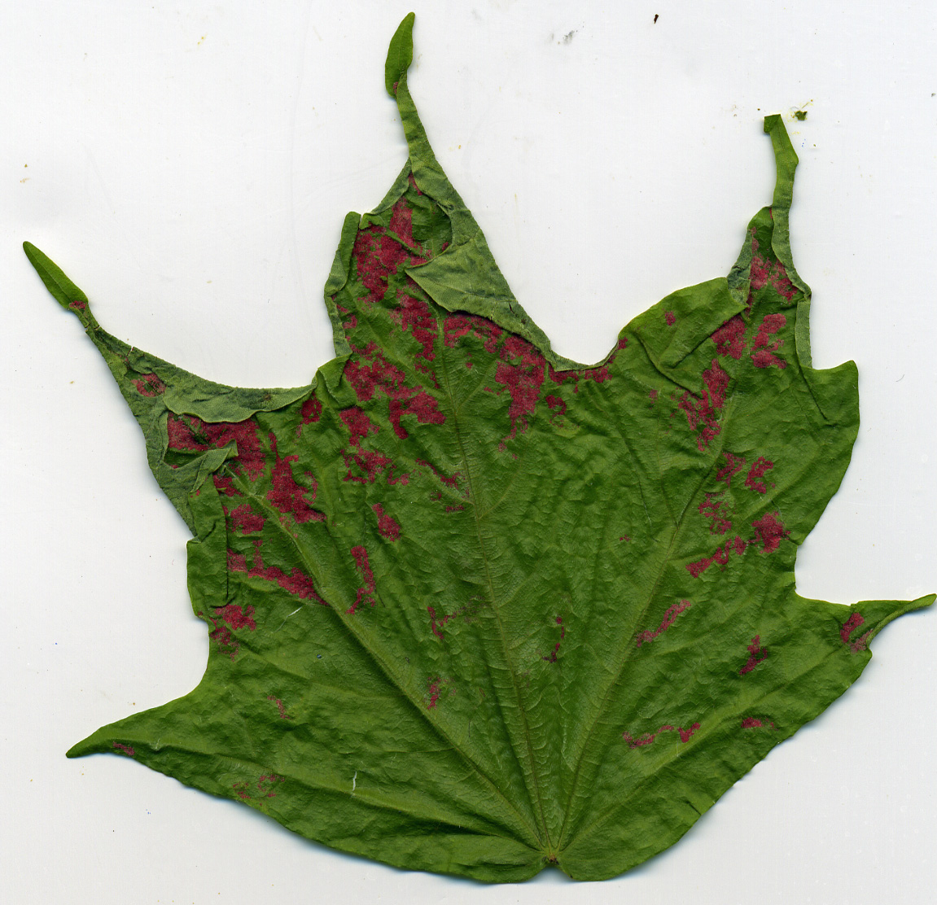
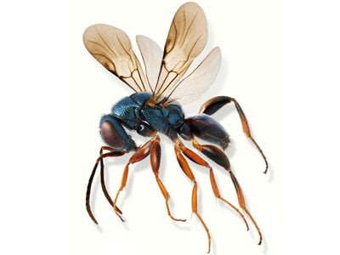

Slide 8
Improving water quality, quantity, and security
STRATEGIC INITIATIVE
Water is the lifeblood of California's economy. Increased competition for water and effects of drought and climate change all impact our water supply. ANR research improves water management practices and policies by
Partnering with agricultural, environmental and government groups to address water issues
Developing crops and irrigation methods that use less water
Establishing practices to protect watersheds from agrochemicals, salinity, animal waste and other pollutants
Establishing methods to use degraded water
Developing efficient water-use policies

Slide 9
UCCE Irrigation and Water Resources Advisor Michael Cahn: From Drip Tips to Crop Manage
Drip provides more management options for growers
Crop Manage is a web-based tool that helps growers manage water and nitrogen needs in vegetables. https://ucanr.edu/cropmanage

Slide 10
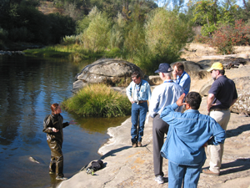
UCCE Livestock & Natural Resources Advisor Larry Forero: Irrigation School
UCCE Shasta & Trinity Counties livestock and natural resources advisor since 1988, Larry Forero has recently been helping ranchers maximize their irrigation efficiency as state regulators are taking a hard look at water use. He plans an ‘irrigation school’ this spring.

Slide 11
UC Response to Drought: Short-term
http://ciwr.ucanr.edu/

Slide 12
Current Drought Resources
Drought-related events, information, experts list, media coverage, and stories.

Slide 13
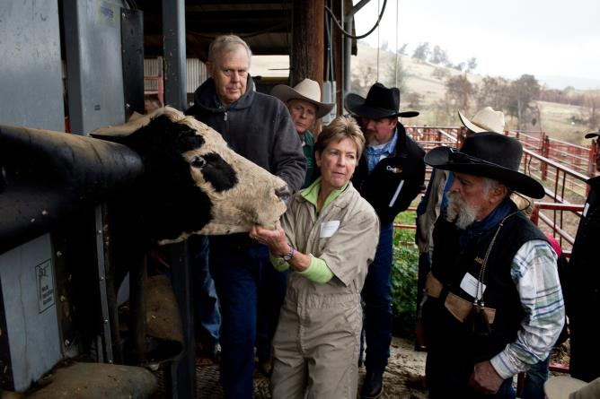
UC Drought Education and Events
Almost 150 events this year. About 10,000 attendees.
Many events with video capture now on the web.
Over 15 more events planned with more to come
Veterinarian Dr. Nancy Martin talks with ranchers about how to help their herds survive drought at a UC ANR workshop in Browns Valley in January.

Slide 14
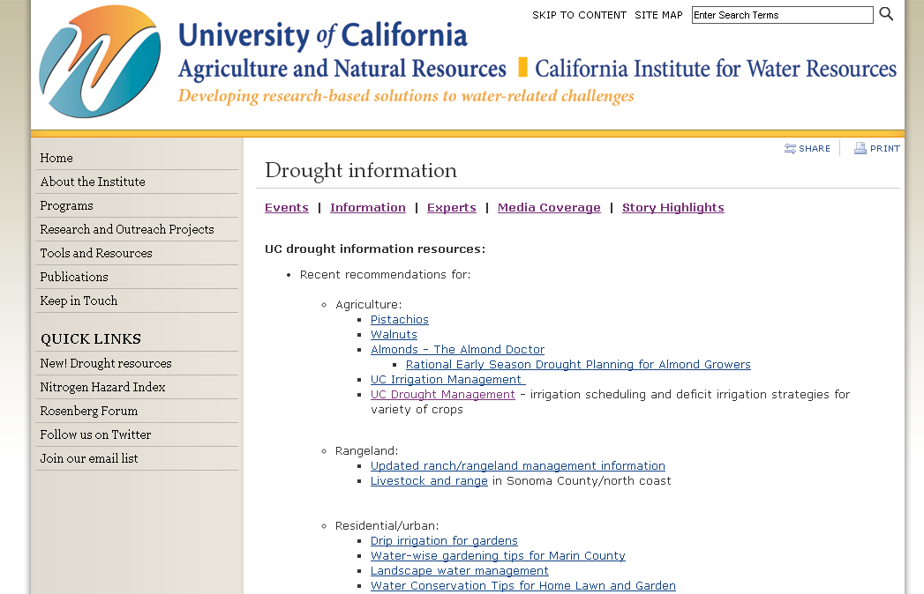
UC Drought Information

Slide 15
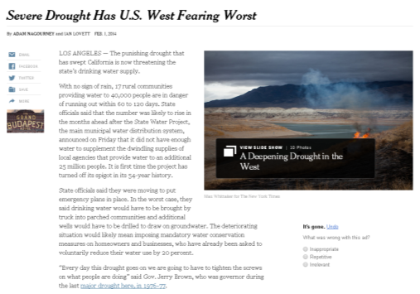
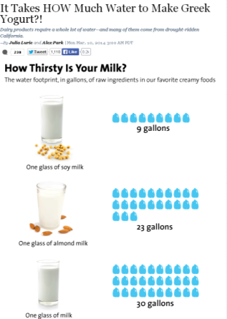
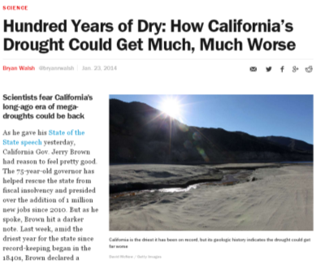
UC Drought Media Coverage
Over 300 articles in a variety of media outlets including the New York Times, Washington Post, Los Angeles Times, Time, Businessweek and Mother Jones.
Media Experts from UC ANR and each UC Campus.

Slide 16
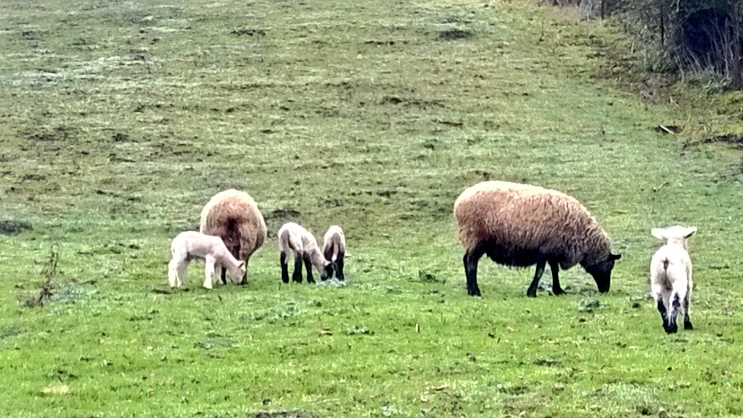
THANK YOU!

