Slide 1
Community Meeting
May 9th, 2016
Joe Lo Coco – County of San Mateo
Adam Dankberg – Kimley-Horn
Eileen Goodwin – Apex Strategies

Slide 2
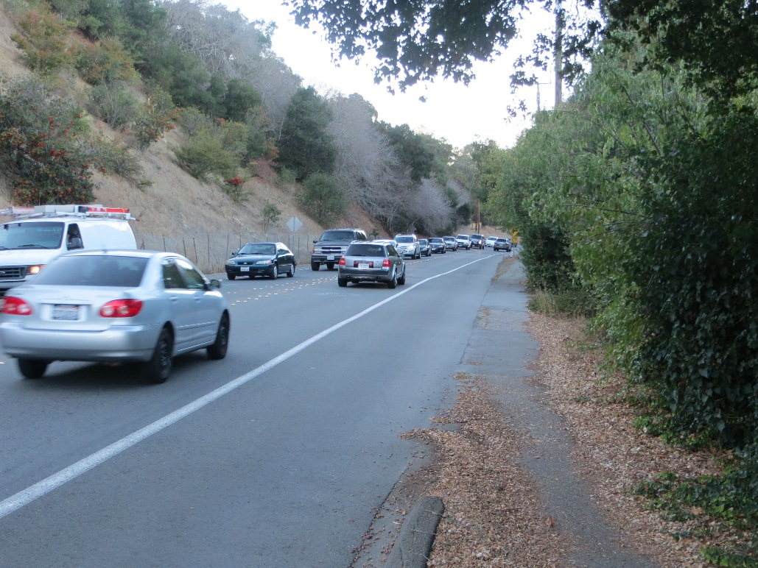
Agenda
Presentation
  Project Overview
  Analysis Findings
  Improvement Alternatives
Open House

Slide 3

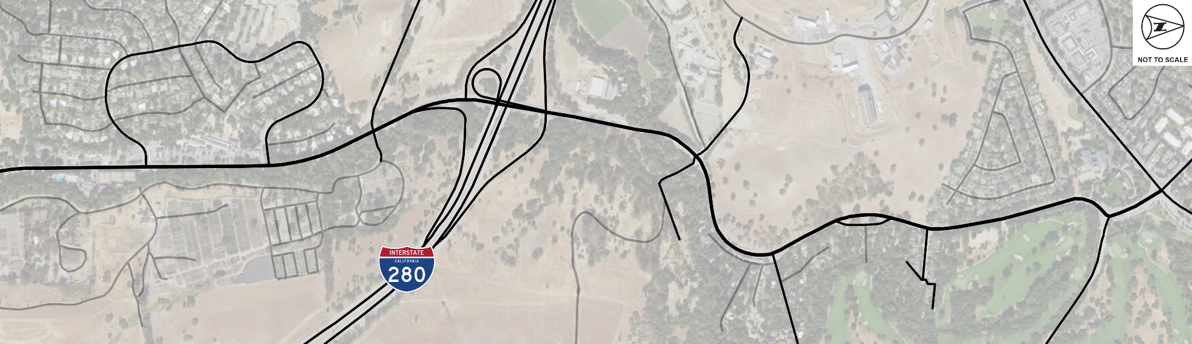



Project Corridor
Alpine Access Rd
La Cuesta Dr
Alpine Road
La Mesa Dr
Sand Hill Road
Piers Ln
Wildwood Ln
Junipero Serra Blvd
Bishop Ln
Stowe Ln
Study Area
Study Intersection
(Signalized)
Study Intersection
(Unsignalized)

Slide 4
Background
Approximately 25,000 vehicles/day on north side of I-280
Lengthy queues approaching I-280 in southbound direction in afternoon/evening
Difficult to access corridor due to heavy volumes and limited sight distance
Heavily utilized bicycle corridor
Corridor is greatly constrained by steep slopes, limited ROW and Los Trancos/San Francisquito Creek

Slide 5
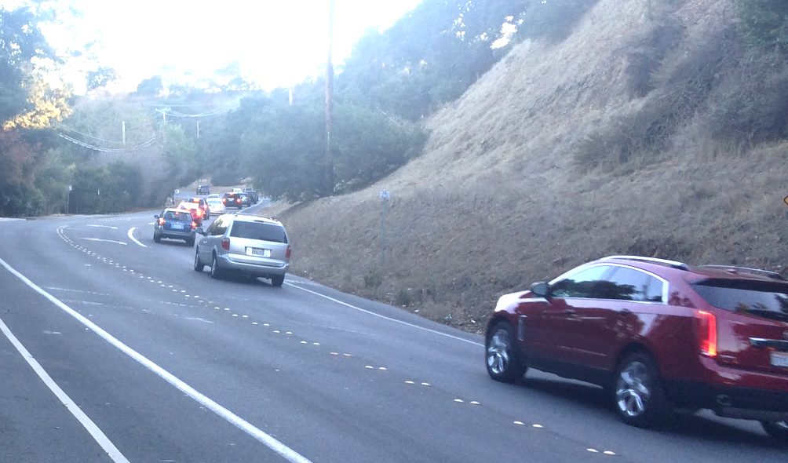
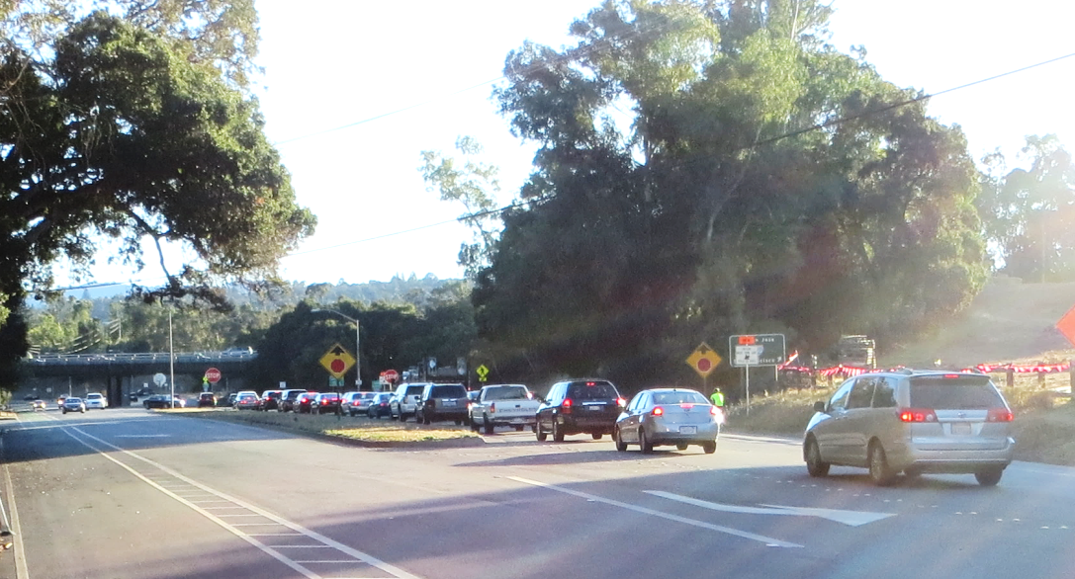
Corridor Congestion
Queues from I-280 northbound ramps extend north to Stowe Lane
Travel time from Junipero Serra Boulevard to I-280 increases from 4 to 13 minutes in afternoon peak hour due to congestion

Slide 6
Historical Traffic Volume Growth
North of I-280
  35% increase in daily traffic volumes between Winter 2012/13 and Fall 2015
  72% increase in daily traffic volumes between Winter 2008/09 and Fall 2015
South of I-280
  40% increase in daily traffic volumes between Winter 2008/09 and Fall 2015
Throughout corridor
  Peak hour traffic volumes essentially flat (within 1.0%) between Fall 2011/Spring 2012 and Fall 2015

Slide 7
Historical Speed Data
Near Piers Lane/Alpine Access Road
  2015 – 41 MPH
  2012 – 43 MPH
  2010 – 44 MPH
  2008 – 44 MPH
Near La Mesa
  2015 – 38 MPH
  2011 – 40 MPH

Slide 8
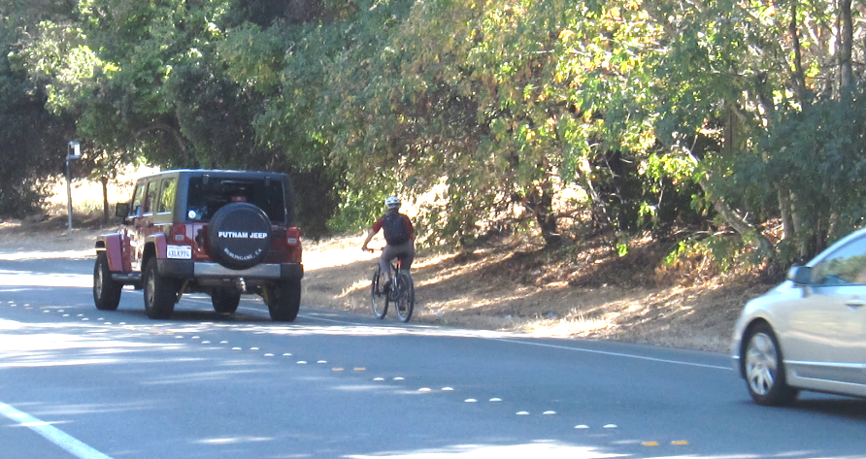
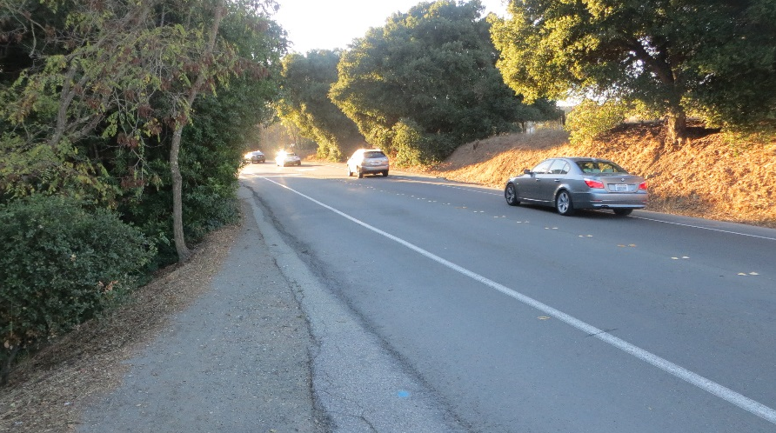
Bike Circulation Challenges
Lack of separation between bike lanes and vehicle lanes
Limited access points to bike lanes
Path is narrow in places, not continuous and has limited to no separation from roadway

Slide 9
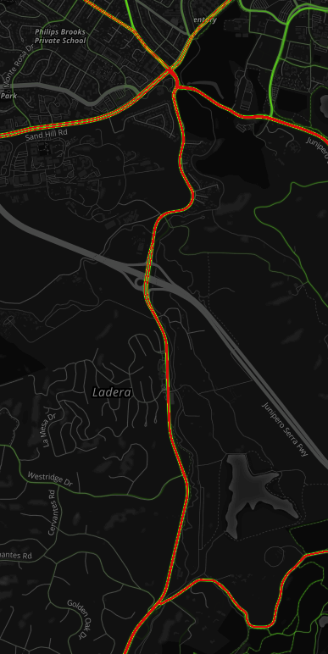
Existing Bike Volumes
Weekday
  Afternoon (2 PM – 6 PM): 196
  Peak Hour: 53
Saturday
  Daily (8 AM – 6 PM): 894
  Peak Hour: 195
Sunday
  Daily (8 AM – 6 PM): 830
  Peak Hour: 177
Data collected October 2015 and April 2016

Slide 10
Reported Collision History
(2011 to 2015)
72 total reported incidents along Alpine Road within Study Area
  Nearly half (34 incidents) at I-280 interchange
11 involving cyclists
3 involving severe injuries
Broadside collision was most common type of collision (53%) followed by rear-end collision (18%)
Number of reported incidents at I-280 dropped in 2015
  11 in 2012, 13 in 2013, 12 in 2014, 6 in 2015

Slide 11
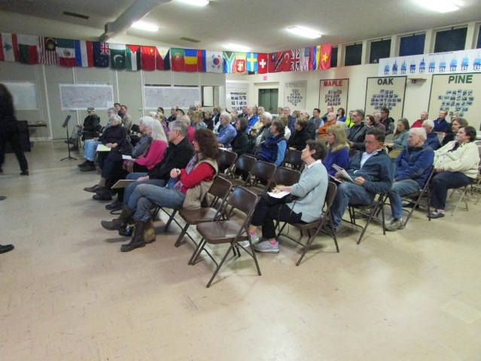
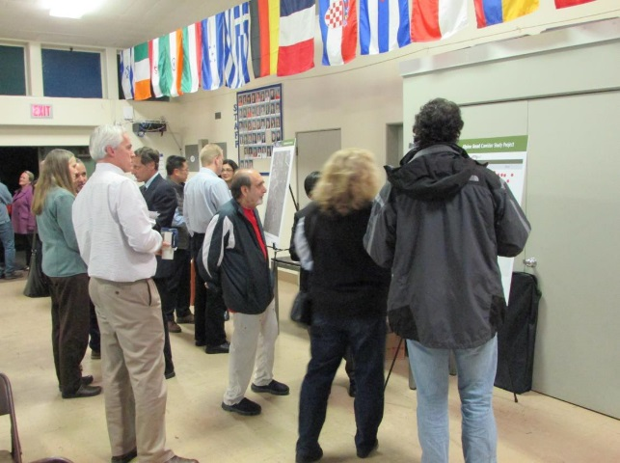
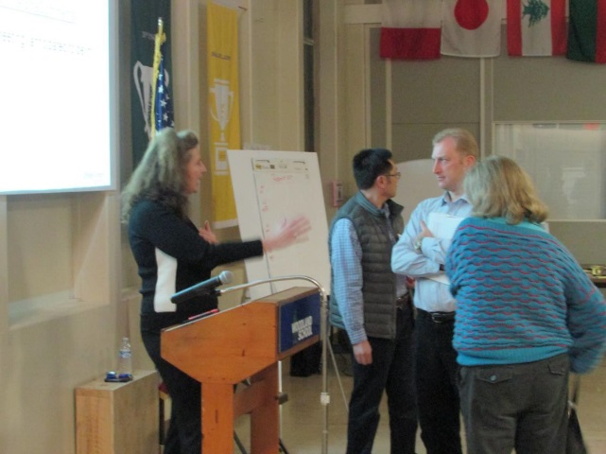
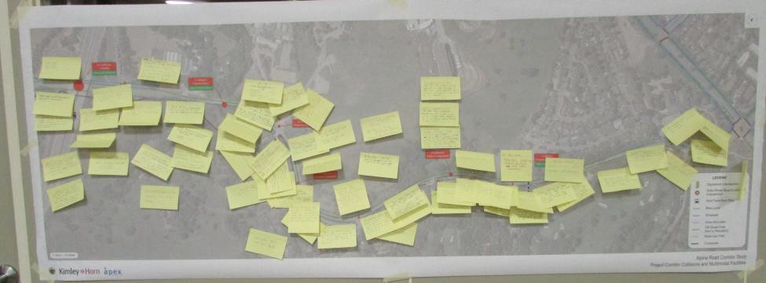
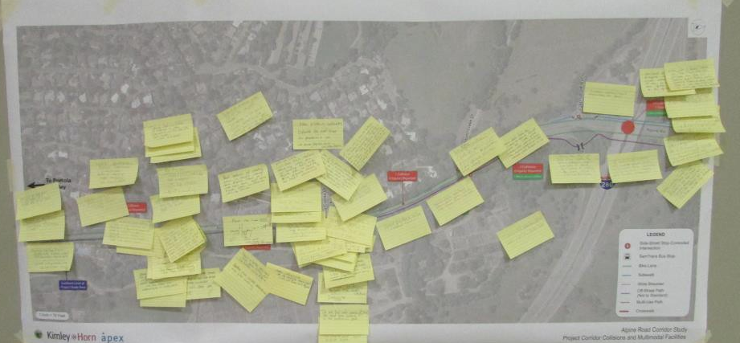
Community Meeting #1
Meeting held January 21, 2016 with approximately 100 attendees

Slide 12
Identified Areas in Need of Improvement
Access to Alpine Road from La Mesa, La Cuesta
Reduce Speeding
Parking for Dish Trail near Piers Lane
Access to Alpine Road from Bishop, Stowe, and Wildwood
Lighting for crosswalks
Pedestrian safety
Bicyclist safety
Emergency vehicle access

Slide 13
Meeting Follow-Up Survey
146 responses received
Better access to Alpine Trail and better maintenance
Eliminate “free” movements at interchange
Difficult to turn onto Alpine Road
Congestion at Junipero Serra Boulevard and Sand Hill Road
Need for crosswalk to west side of Alpine Road near Stanford Weekend Acres to access bus stop
Consider needs of emergency vehicles

Slide 14
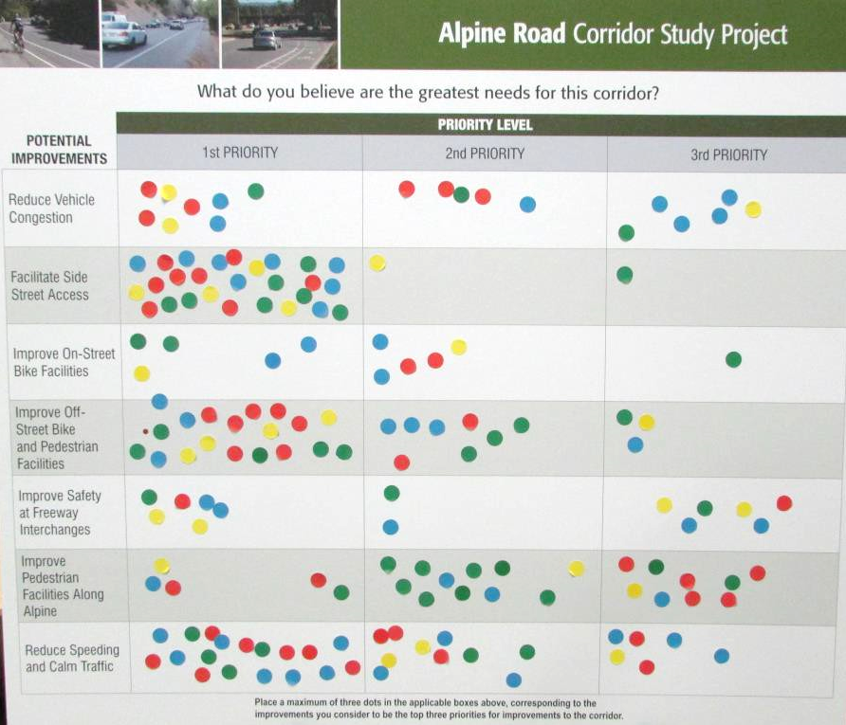
Community Priorities
Facilitate Side-Street Access
Reduce Speeding and Calm Traffic
Improve Off-Street Path

Slide 15
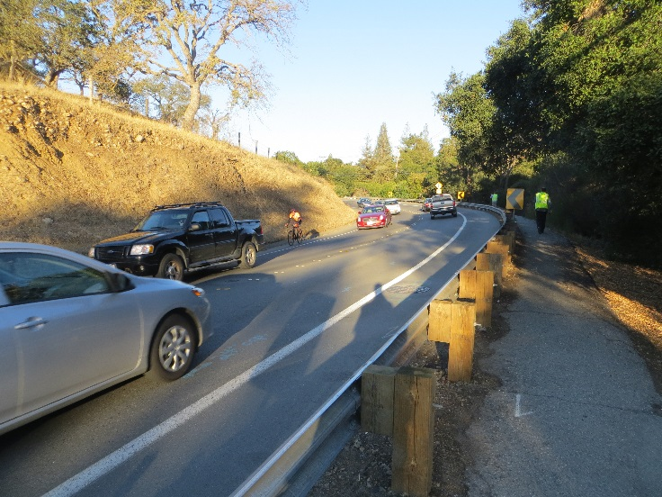
Improvement Objectives
Reduce congestion and improve traffic operations and safety
Support safe and efficient bicycle, pedestrian, and transit facilities
Street aesthetic
Identify cost-effective solutions

Slide 16
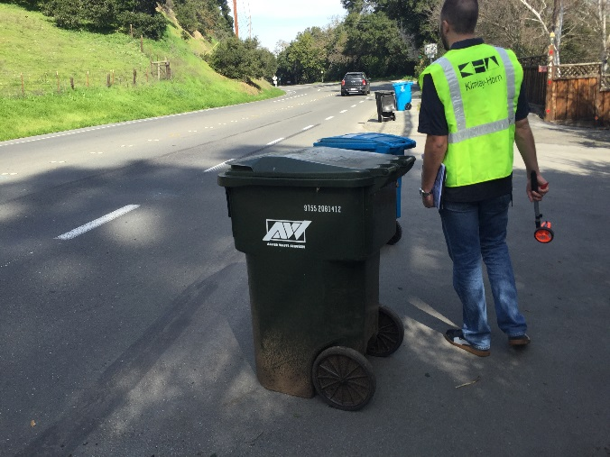
Development of Improvements
Meet project objectives
Implementable within a reasonably expected project budget
Consistent with requirements of MUTCD, AASHTO, County standards
Minimize or avoid potential environmental impacts
Methodology
  Site Visits
  Traffic Analysis
  Conceptual design
  Community Feedback

Slide 17

Improvement Alternatives
 | Signing, Striping, other Minor Improvements | Signalization | Roundabouts | Some Widening within ROW | Widening Outside ROW
Alternative 1
Alternative 2
Alternative 3
Alternative 4
Alternative 5

Slide 18
Reduce Speed Limit
Speed survey taken as part of this project reflects reduction in speeds along corridor
California Manual on Uniform Traffic Control Devices
  The posted speed may be reduced by 5 mph from the nearest 5 mph increment of the 85th-percentile speed, in compliance with CVC Sections 627 and 22358.5.
  Requires an Engineering & Traffic Study to justify reduction
Complete an Engineering & Traffic Study in order to implement and sign a consistent 35 MPH speed limit throughout corridor

Slide 19
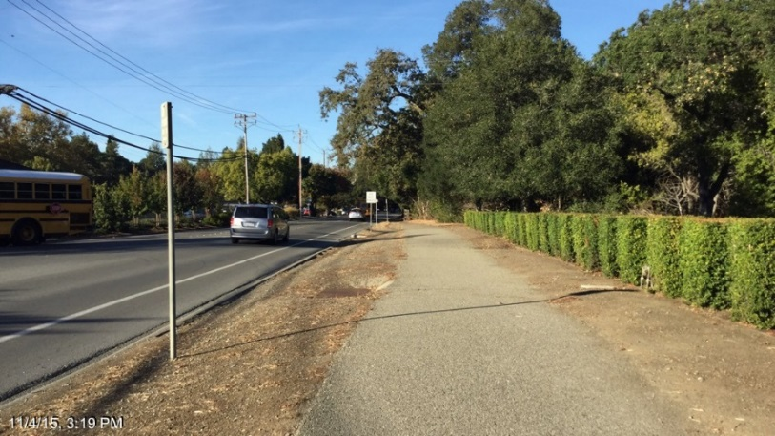
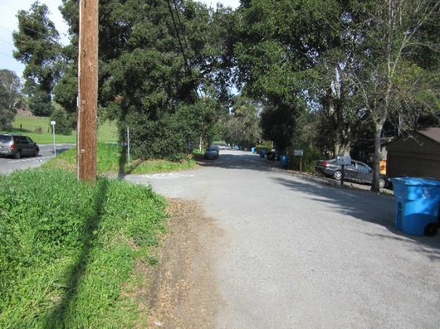
Path Improvements
Provide barrier to separate pathway from roadway
  Asphalt curb
  Landscape strip
Widen path to minimum 8’ where feasible and supported by community
  Will be pinch-points where widening not feasible due to Los Trancos Creek, lack of right-of-way, or mature trees
Provide marked path along Bishop and Wildwood

Slide 20
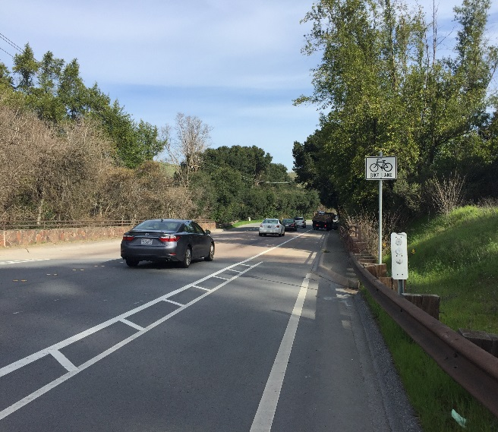
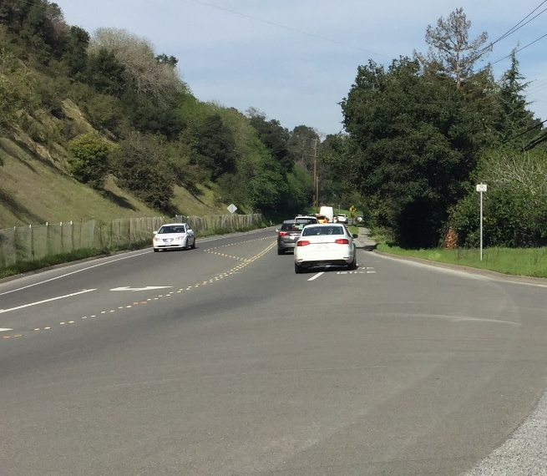
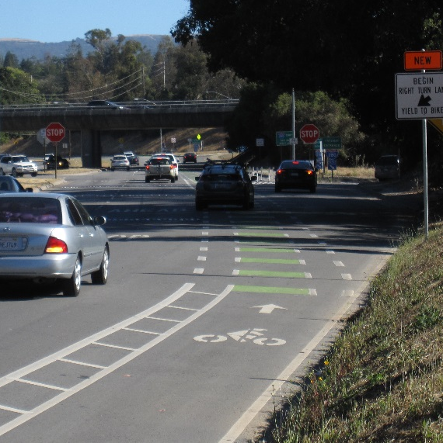
Bike Lane Improvements
Widen bike lanes where feasible
Provide buffered bike lanes where feasible
Re-align travel lanes to reduce bike lane intrusion
Dashed green striping in conflict areas
Bike slots next to right-turn pockets

Slide 21
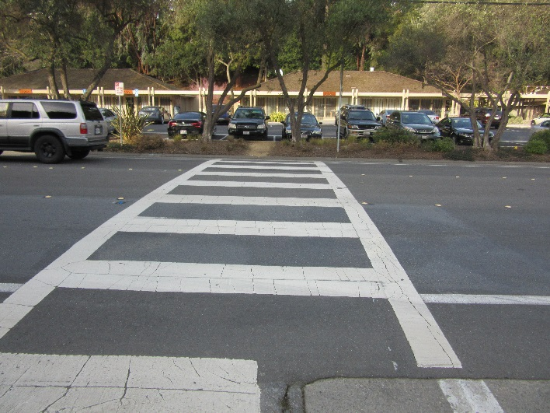
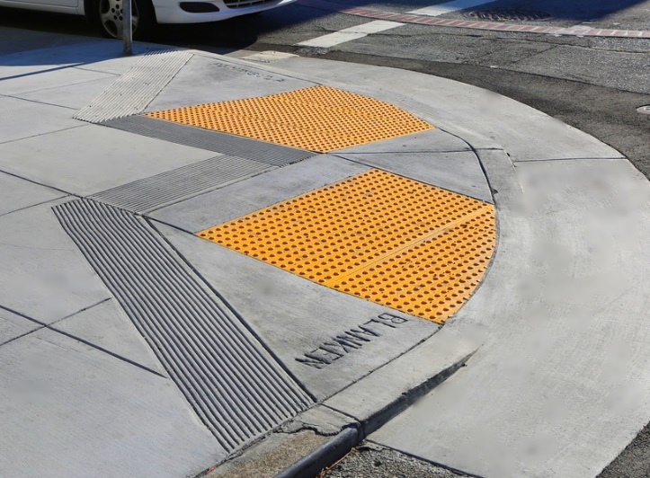
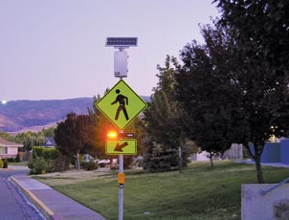
Crosswalk Improvements
Curb ramps to meet ADA requirements
Rapid rectangular flashing beacons (RRFBs)
Pedestrian lighting
Improved visibility

Slide 22
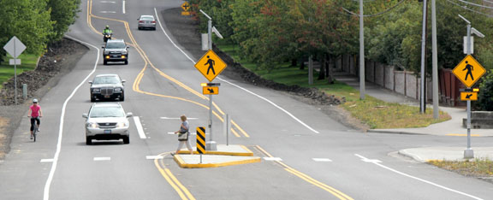
Benefits of RRFBs
Increases frequency of yielding to pedestrians
  Increased yielding from less than 5% to over 80% in multiple studies
  Particularly effective at night (yielding rates in excess of 90%)
Lights only flash with pedestrian activation

Slide 23
Traffic Signals
Allows for safe side-street access to corridor
Intersections must meet traffic signal warrants for signal installation
  Warrants met at La Mesa, La Cuesta, Alpine Access Road/Piers Lane, I-280 northbound ramps, I-280 southbound ramps
Allows for safe pedestrian crossing

Slide 24
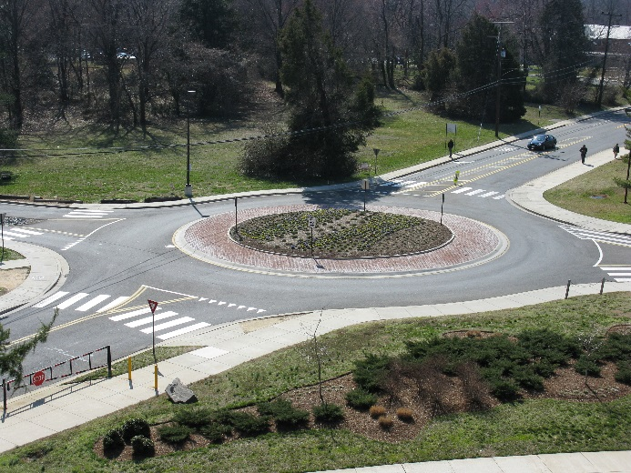
Roundabouts
Benefits
  Improves side-street access to corridor
  Proven to calm traffic speeds
    Vehicles must slow to 25 MPH or less to enter/circulate roundabout
  Proven to reduce crash frequency compared to traffic signals
    Single-lane roundabouts by approximately 50%
    Multi-lane roundabouts by approximately 30%
  Provides for safer pedestrian crossing
  Allows for landscaping in center island
Drawbacks
  Requires more right-of-way
  Does not create vehicle platoons
  Cost
Proposed where signal warrants met

Slide 25
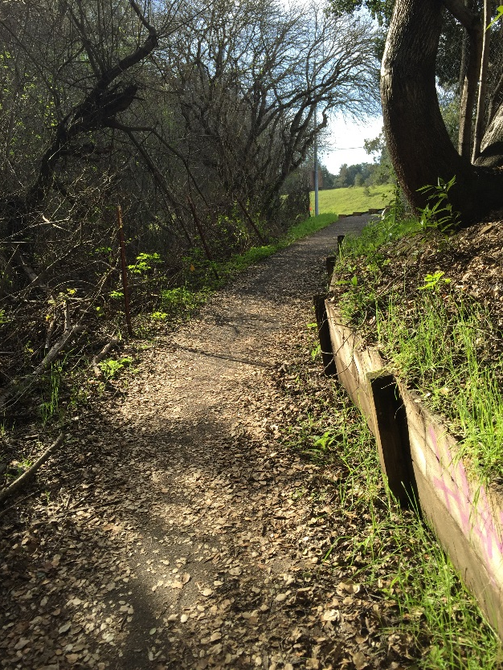
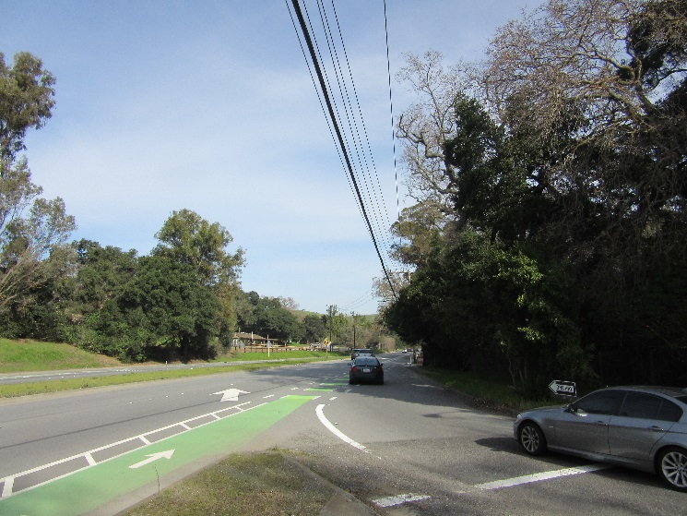
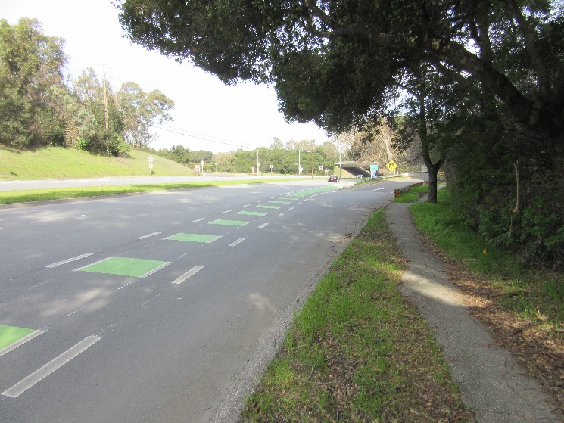
Other Interchange Improvements
Eliminate free-right turns to improve crossings of ramps for bicycles and pedestrians
Eliminate MP-bound Alpine to SB I-280 free on-ramp
Improve trail crossings of ramps
Eliminate PV-bound Alpine lane merge

Slide 26
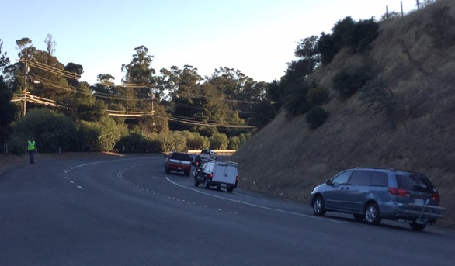
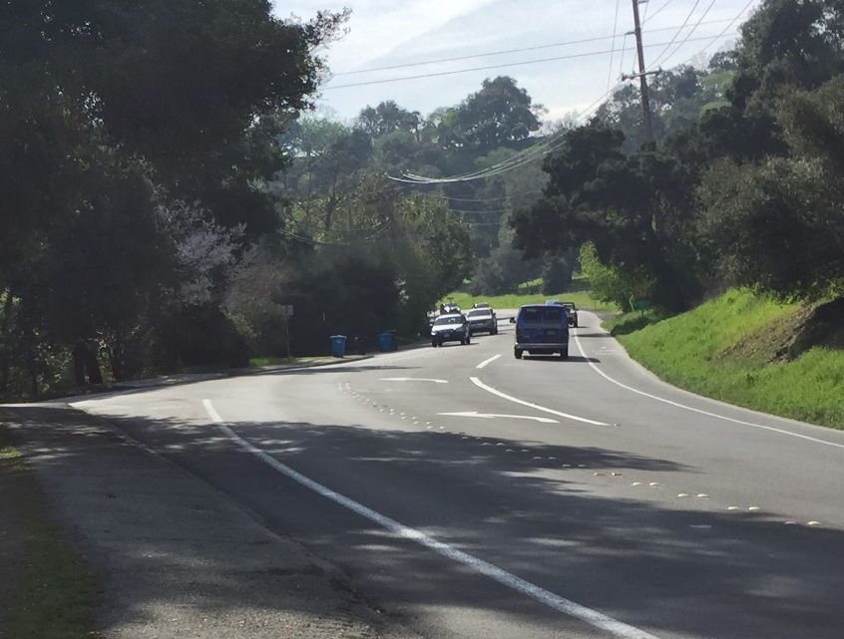
Improve Roadway Access/Egress
Lengthen turn pockets
Lengthen acceleration lanes

Slide 27
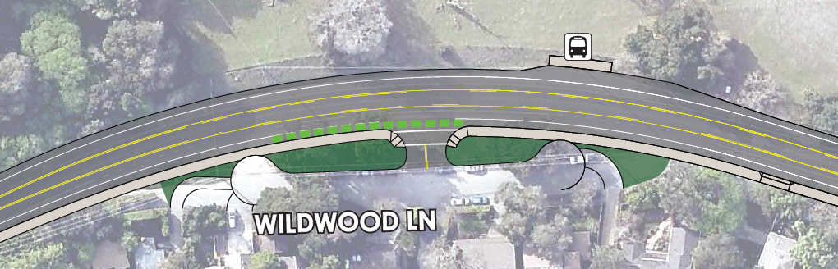
Wildwood Access Consolidation
Consolidate the two driveways into one
Provide a center turn lane
Existing
Proposed

Slide 28
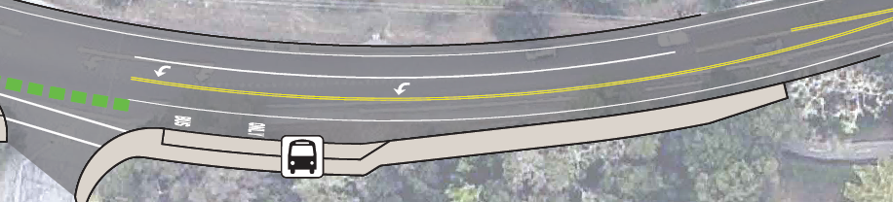
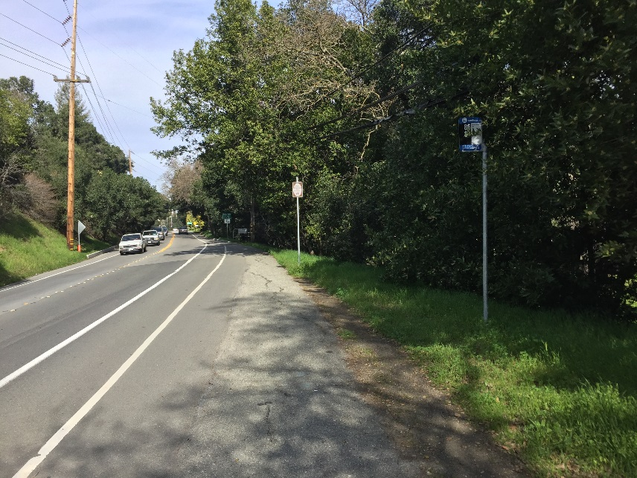
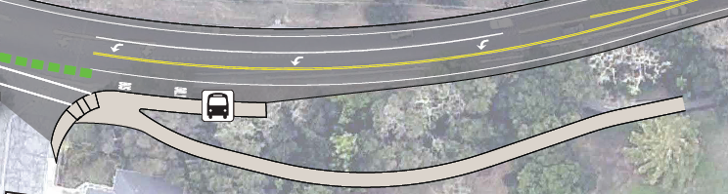
Trail Extension to Stowe
Options:
  Provide two-way facility at-grade adjacent to roadway with barrier
  Extend off-street path to Stowe Lane
Coordinate with SamTrans to improve bus stop pullout and waiting area

Slide 29
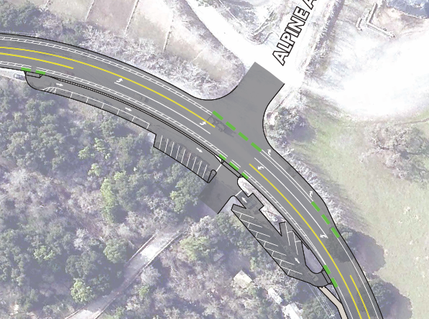
Dish Trail Parking
Provide marked, paved stalls separated from roadway
Access via right-in/right-out driveways on Alpine Road
May require some right-of-way

Slide 30
Traffic Analysis
Performed traffic analysis of each improvement alternative
Used the VISSIM micro-simulation tool, which allows for simulation of autos, bicycles, pedestrians, and transit vehicles
Included the Sand Hill Road/Santa Cruz Avenue and Junipero Serra Boulevard/Santa Cruz Avenue signals in the model
Analyzed travel time, delay, and queuing

Slide 31
Future Analysis Scenarios
Examined improvements with Year 2020 and Year 2040 projected volumes
Used regional model to project future growth
  Year 2020: Projected growth of up to 50 more vehicles in peak direction in peak hour
  Year 2040: Projected growth of up to 300 more vehicles in peak direction in peak hour

Slide 32
Baseline Traffic Analysis Findings
Existing intersections operating deficiently in terms of delay:
  Wildwood
  Bishop
  Alpine Access
  I-280 Northbound Ramps
Additional intersections operating deficiently in terms of delay by Year 2020:
  Stowe
Additional intersections operating deficiently in terms of delay by Year 2040:
  I-280 Southbound Ramps

Slide 33
Traffic Analysis Key Findings
Provision of improvements (signal or roundabout) at I-280 ramps eliminates delay deficiency at all side-streets in near-term
  In long-term, Alpine Access has delay deficiency
Roundabouts at I-280 northbound ramps operate near capacity by Year 2040
Roundabouts or signals at La Mesa and La Cuesta would both operate effectively

Slide 34
Change in Travel Times with Improvements
Existing Conditions Travel Times
Direction | AM Peak | Afternoon Peak | PM Peak
Northbound (I-280 to JSB) | 3.9 mins | 3.4 mins | 3.4 mins
Southbound (JSB to I-280) | 3.9 mins | 12.8 mins | 9.5 mins
Year 2020 Corridor Travel Times
Direction | No Improvements |  |  | Alternative 2 Signals, Minor Improvements |  |  | Alternative 3 Roundabouts, Minor Improvements |  |  | Alternative 4 Signals, Major Improvements |  |  | Alternative 5 Roundabouts, Major Improvements
 | AM Peak | Afternoon Peak | PM Peak | AM Peak | Afternoon Peak | PM Peak | AM Peak | Afternoon Peak | PM Peak | AM Peak | Afternoon Peak | PM Peak | AM Peak | Afternoon Peak | PM Peak
Northbound (I-280 to JSB) | 4.1 | 3.4 | 3.4 | -0.1 | +0.2 | +0.1 | -0.5 | +0.3 | +0.2 | - | +0.2 | +0.1 | -0.4 | +0.4 | +0.3
Southbound (JSB to I-280) | 4.0 | 13.1 | 9.6 | +0.9 | -8.7 | -5.2 | +0.1 | -8.8 | -5.6 | +0.1 | -9.5 | -6.1 | -0.3 | -9.3 | -5.9
AM Peak: 7:30-8:30 AM
Afternoon Peak: 3:00-4:00 PM
PM Peak: 5:00-6:00 PM

Slide 35
Benefits of Improvements
Bicycle & Pedestrian Safety
  Green paint, separated and widened pathway, reduced speeds, RRFBs and lighting at crosswalks, buffered bike lanes/slots
Corridor Access
  Lengthened turn pockets and acceleration lanes, improved visibility, reduced queuing on Alpine
Vehicle Safety & Traffic Calming
  Wildwood driveway consolidation, reduced speed limits, roundabouts, lengthened turn pockets and acceleration lanes, speed feedback signs

Slide 36
Evaluation Criteria
Multimodal Circulation and Safety
Corridor Access
Traffic Calming and Vehicle Safety
Traffic Throughput and Congestion Reduction
Community Feedback
Cost
Notes:
Mention VISSIM modeling

Slide 37
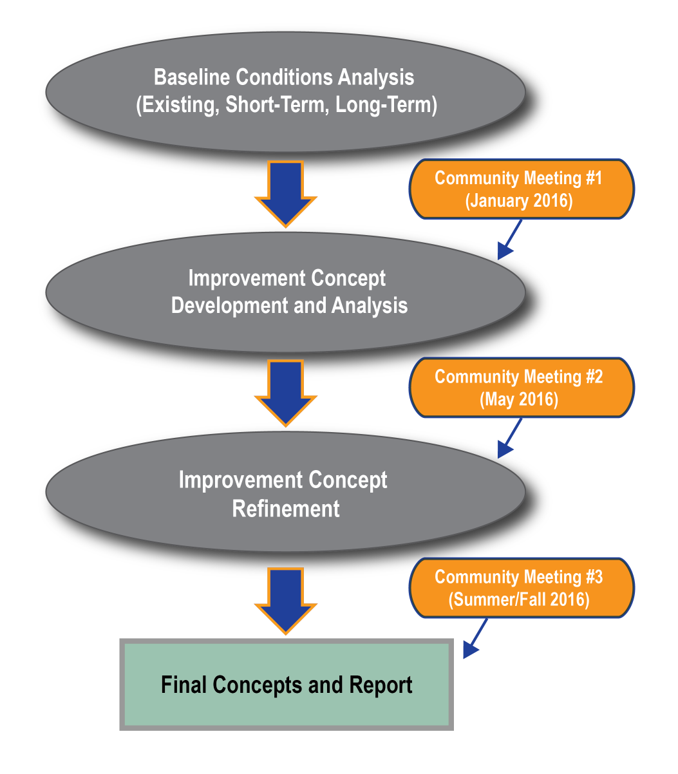
Project
Process
We are
here

Slide 38
Next Steps
Refinement of Improvement Options
Develop Cost Estimates
Presentation of Refined Improvements at Public Outreach Meeting #3 (Summer/Fall)

Slide 39
Meeting Objectives
What do you think of each improvement alternative?
What changes should be made to the proposed improvements?
What other types of improvements are we missing?

Slide 40
Improvement Feedback
Please place red, yellow, and green dots next to the improvements proposed
  Green = Support
  Yellow = Unsure
  Red = Oppose
Please write any additional feedback in the space provided for each improvement alternative
Provide any additional feedback on the comment cards

Slide 41
Traffic Simulation
Simulation of corridor operations during the worst part of the day (afternoon peak hour)
Shows how each of the improvements would operate compared to the no-build in Year 2020
Separate stations for each of Ladera area, I-280 area, Stanford Weekend Acres area
Each station plays videos of no-build, Alternatives 2/4, and Alternatives 3/5

Slide 42
Other Opportunities to Provide Feedback
Fill out a comment card here at the meeting
Provide any additional comments online at: https://www.surveymonkey.com/r/AlpineComments2
Attend our next community meeting (anticipated to be in 2-3 months)

