Slide 1
Jamie Draper
San Mateo County District Attorney’s Office
Inspector

Slide 2
Overview
STEP Act Prosecution Basics
Significant Case Law Overview
Sources of Gang Intel & Importance of Documentation
Initial Response & Follow-up Investigations
End Goal
Training Opportunities

Slide 3
Definition of a Criminal Street Gang
(PC 186.22(f))
A criminal street gang is any ongoing organization, association, or group of three or more persons, whether formal or informal:
1. Common name or common identifying sign or symbol;
2. Primary Activity: Committing crimes listed in PC 186.22(e);
3. Pattern of Criminal Activity: Crimes listed in PC 186.22(e).

Slide 4
STEP Act IMPACT
Increased punishment (186.22(b)/12022.53(e))
Increased bail (+$50k)
Misdemeanors increased to Felonies (186.22(d))
Felonies become strikes (1192.7(C)(28))
Death Penalty/LWOP (190.2(a)(22))
Probation/Parole Conditions
Gang Member Registration (186.30)
Prison/Jail Classification & Housing
Probable Cause for Search Warrants
Prosecution of Juveniles in Adult Court *
Jury Hears Gang Evidence

Slide 5
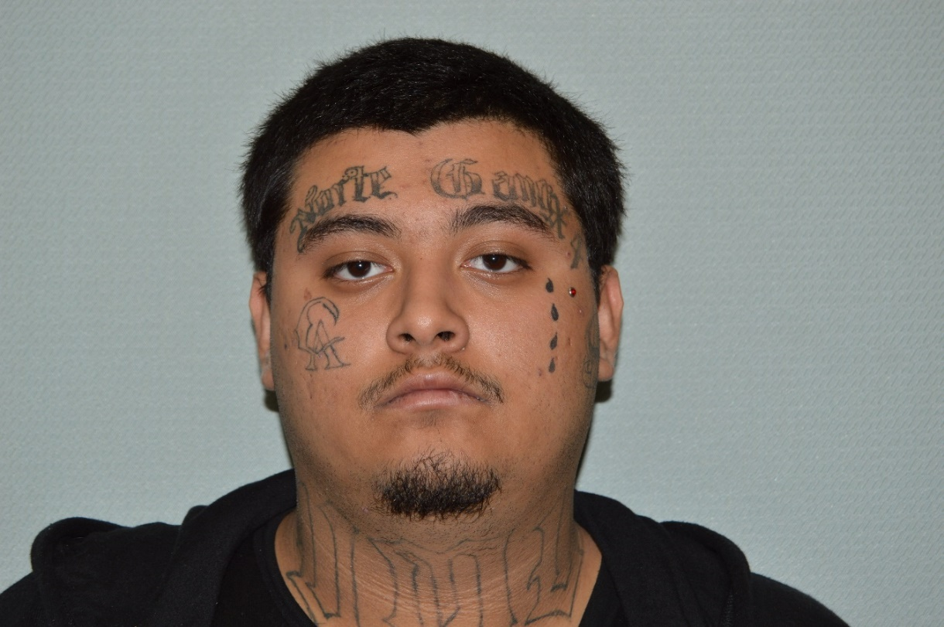
People’s Exhibit #1: Jury Hears Gang Evidence
Gang evidence is admissible when it is relevant to prove the STEP Act. (P v. Valdez)

Slide 6
STEP Act
Important Sections
PC 186.22(f): Definition of a Criminal Street Gang
186.22(b)(1) PC: felony enhancement
(felony committed for or with the gang)
186.22(a) PC: substantive charge (fel/misd)
(active participation in the gang)
186.22(d) PC: enhances misd to felony
(misdemeanor to benefit gang)

Slide 7
Criminal Street Gang Defined
(PC 186.22(f))
Primary Activity (Crimes listed in 186.22(e))
  Gang Expert Testimony
  Prior Crimes Committed by the Gang
  Current Crime
  Documents Produced by the Gang

Slide 8
Criminal Street Gang Defined
(PC 186.22(f))
Pattern Offenses: Members must have engaged in a pattern of criminal activity.
  2 or More Offenses (Listed in 186.22(e)
  After 1988 (Enactment of STEP Act)
  Within 3 Years of Most Recent offense
    Should be within 3 years of your crime

Slide 9
Pattern Offenses/Primary Activity
PC 186.22(e)
Murder/Manslaughter
Assault w/DW (Misd/Fel)
211/Carjacking/Burg./Grand Theft
Vandalism (Felony)
Narcotics Sales
Illegal Firearms Possn. (Misd/Fel)
PC 422
PC 136.1
VC 10851
PC 246

Slide 10
Gang Enhancement: 186.22(b)
1. The defendant committed the crime for the benefit of, at the direction of, or in association with a criminal street gang;
AND
2. The defendant intended to assist, further, or promote criminal conduct by gang members.

Slide 11
Gang Enhancement: 186.22(b)
How does the crime benefit the gang?
Was the crime done with other gang members?
Where did the crime occur?
Is the victim a rival?
Was the Defendant directed to commit the crime by another gang member?
Have you found kites containing standing orders by the gang to commit attacks on rivals in the jail.

Slide 12
Benefit/Direction/Association
Elimination of Rivals
Enhances Reputation/Strength of the Gang
Establish Control: Territory/Drugs
Red on Red/Blue on Blue—Enforcing Gang’s Rules

Slide 13
Gang Enhancement: Life Sentences
Wit. Threats: 16-2-3
Extortion: 2-3-4
PC 246: 3-5-7
PC 215: 3-5-9
Home Inv. 213: 3-6-9
664/187
7-Life
7-Life
15-Life
15-Life
15-life
15-Life

Slide 14
Gun Use Allegation
PC 12022.53(E)
Use: 10 Years
Discharge: 20 Years
GBI: 25-Life
Example: Driver in a Shooting that results in Death.
When Gang Related
-Applies to Shooter and Aider/Abettor
2nd Degree Murder: 15-Life
Gang/12022.53(e): +25-Life

Slide 15
Albillar
P v. Albillar 51 Cal 4th 47
  “In sum if substantial evidence establishes that the defendant intended to and did commit the charged felony with known members of a gang, the jury may fairly infer that the defendant had the specific intent to promote, further or assist criminal conduct by those gang members.” (People v. Albillar, 51 Cal 4th 47, 68)
3 Gang Members Commit Forcible Rape of a minor Victim
Victim is NOT a Rival
No Gang Slurs
No Overt Gang Threats
Sexual Assault

Slide 16
Albillar
California Supreme Court found that there was sufficient evidence to support that:
The sexual assault was committed in association with a Criminal Street Gang AND
The sexual assault was committed for the benefit of a Criminal Street Gang.

Slide 17
Albillar: Association Theory
Status
Respect
Increases their chances of success in completing the crime and evading apprehension (no snitching)
Serves as training for younger gang members
Reinforces gang loyalties
Corroborates their participation in gang activity
Allows them to rely on intimidation

Slide 18
People v. rodriguez
PC 186.22(A)

Slide 19
PC 186.22(A)
1. The defendant actively participated in a criminal street gang;
2. When the defendant participated in the gang, he knew that members of the gang engage in or have engaged in a pattern of criminal gang activity;
AND
3. The defendant willfully assisted, furthered, or promoted felonious criminal conduct by members of the gang either by:
a. directly and actively committing a felony offense;
OR
b. aiding and abetting a felony offense.

Slide 20
PC 186.22(A)
Before Rodriguez
After Rodriguez
Active Participant +
Knowledge +
Any Felony
= PC 186.22(A)
Felony Must be Committed with another gang member.
Similar to Association under Albillar
Renders PC 186.22(A) Almost Useless except in Co-Defendant Cases.

Slide 21
People v. Prunty
Supreme Court of California
August 27, 2015
Organizational Nexus

Slide 22
People v. Prunty: Facts
Prunty identified himself as a Norteño;
Prunty claimed membership in a particular Norteño subset, the Detroit Boulevard Norteños;
Prunty uttered gang slurs and invoked “Norte” when shooting a perceived rival gang member at a mall.
Issue: Predicates Used to Establish the Gang

Slide 23
People v. Prunty: Expert Testimony
Sacramento-area Norteño gang’s general existence and origins, its use of shared signs, symbols, colors, and names, its primary activities, and the predicate activities of two local neighborhood subsets.
The expert did not, however, offer any specific testimony contending that these subsets’ activities connected them to one another or to the Sacramento Norteño gang in general.

Slide 24
People v. Prunty: Issue & Ruling
“This case asks us to decide what type of showing the prosecution must make when its theory of why a criminal street gang exists turns on the conduct of one or more gang subsets.”
“We conclude that the STEP Act requires the prosecution to introduce evidence showing an associational or organizational connection that unites members of a putative criminal street gang.”

Slide 25
People v. Prunty: Issue & Ruling
Common name or identifying symbol is not enough.
Common enemy is not enough.
Common ideology is not enough.

Slide 26
Organizational Nexus
Court Suggests
Shared bylaws or organizational arrangements.
Each subset has a “shot caller” who answers to a the same higher authority.
Subsets that share a cut of drug sale proceeds with the same members of the Nuestra Familia prison gang.

Slide 27
Organizational Nexus
Norteño subsets that routinely act to protect the same territory or “turf.”
Proof that several gang subsets conduct independent, but harmonious, criminal operations within a discrete geographical area.
Subsets working in concert to commit a crime.
Subsets that “hang out together” and “back up each other”

Slide 28
People v. Sanchez
California Supreme Court, June 30, 2016
Case Specific Hearsay

Slide 29
Prior to Sanchez
Expert could reveal to the jury the specifics of hearsay information upon which the expert relied.
It was not admitted for the “truth of the matter asserted” but only as a basis to evaluate the expert’s opinion.
Sanchez held that an expert’s testimony regarding the basis (hearsay) for an opinion must be considered for its truth by the jury.

Slide 30
People v. Sanchez
Case Specific Hearsay
  Anything dealing directly with Defendant
  Contacts
  Admissions
  Predicate Offenses?
    Yes because an element of the offense.
    No because it relates to the history of the gang.
General Background Hearsay
  Background information on the gang-colors, signs, rivals
  Territory controlled
  Crimes committed by the gang (Does this encompass Predicates?)

Slide 31
Field Identification Cards & Sanchez
Reason for the encounter
  What is the PC
  How was it consensual
Miranda Compliant
  Under arrest?
  Detained?
  Mirandized?

Slide 32
Sources of Gang Intel/Documentation
Field ID cards: one of the single most important pieces of evidence
- shows prior admissions
- prior associates
- wearing gang clothing
- areas frequented
You will testify about your FI.
Description:
Wearing red sweatshirt and shorts.
Black hat with red trim
Black, white and red shoes.

Slide 33
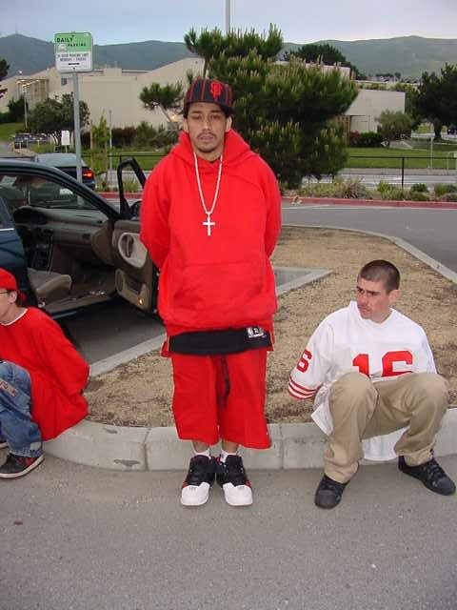
DOCUMENTATION
Field ID cards: one of the single most important pieces of evidence
- shows prior admissions
- prior associates
- wearing gang clothing
- areas frequented
Gang Expert will rely on these in court-Only if:
Properly Documented
You Testify to the FI

Slide 34
INVESTIGATION
As with any case, get good witness and victim statements:
  What gang members say during crimes can be key
  Record everything – Victims and witnesses will backtrack later or become uncooperative out of fear
Try and get them past fear of retaliation:
  Their personal info will be redacted from reports
  Witness relocation is an option (*Budget issues*)
Look for video of the crime
If victim/Witness is also a gang member:
  Get them to admit it if you can
  Document your suspicion of membership if they don’t admit
  The info is going to come out anyway, so better to deal with it up front

Slide 35
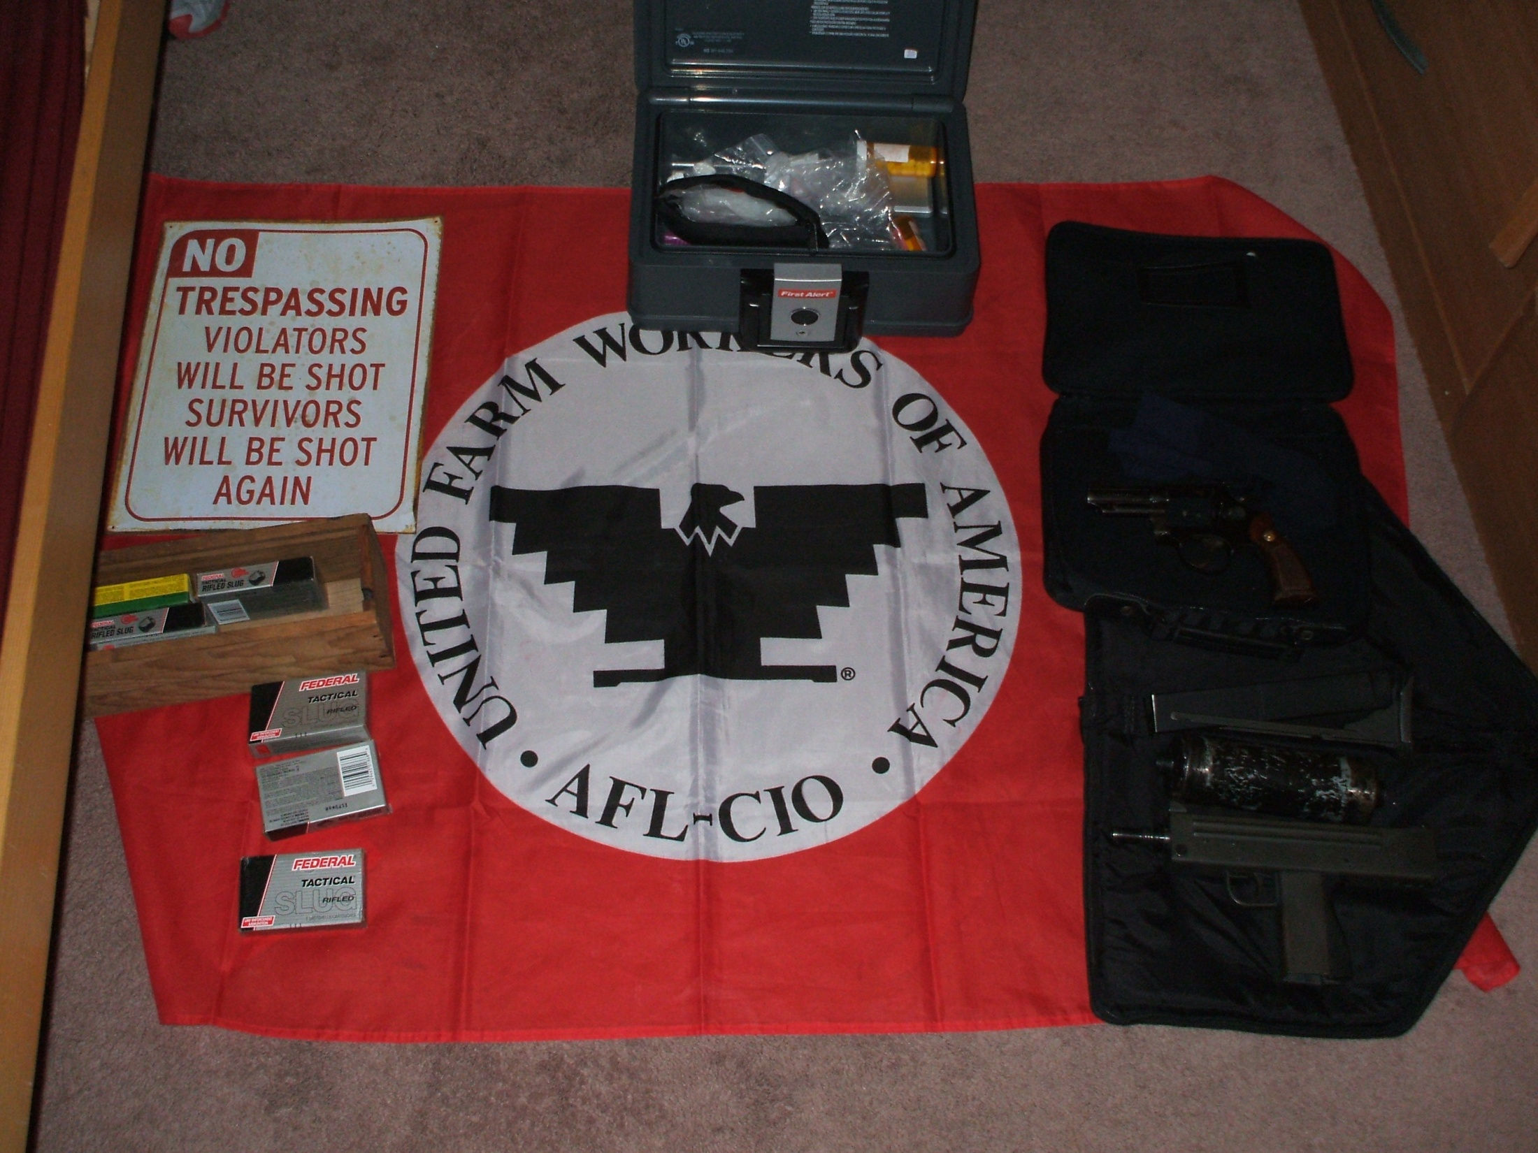
Follow-UP
Probation/Parole Searches:
Clothing
Gang Photos
Rosters
Newspaper Article/Police Reports
Graffiti
Flags/Posters
CDs, Rap Lyrics

Slide 36
Follow-up
SEARCH WARRANTS:
If not on probation or parole, get a search warrant for their residence.
Your case isn’t over once the on-view crime is
solved, a search warrant will help you:
1. Identify other suspects
2. Solidify suspect’s gang membership (Be Mindful of Sanchez)
3. Provide evidence of other crimes
4. Provide you with intel for future cases
5. Get guns off the streets

Slide 37
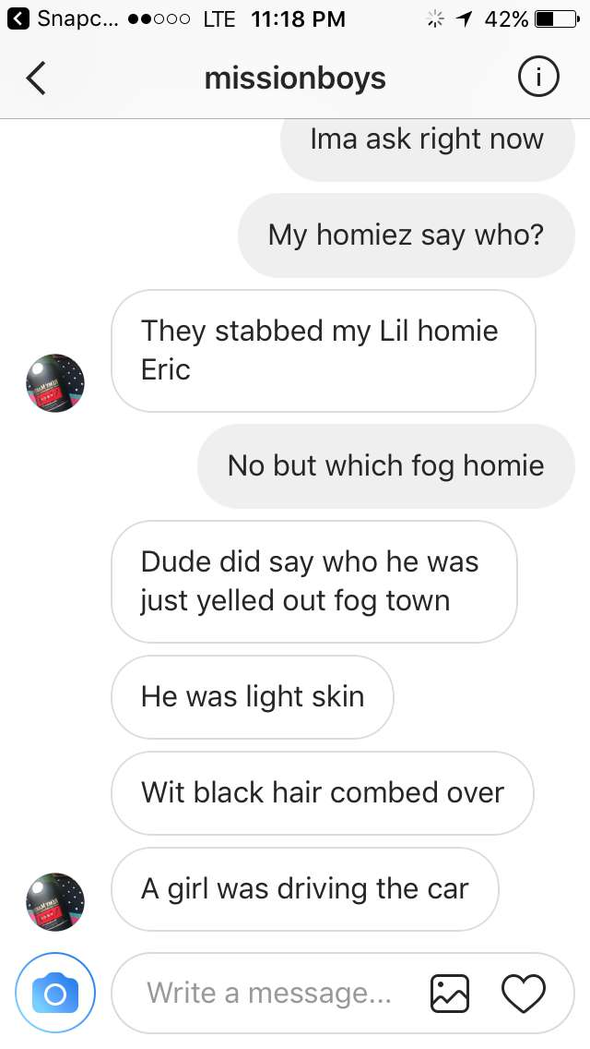
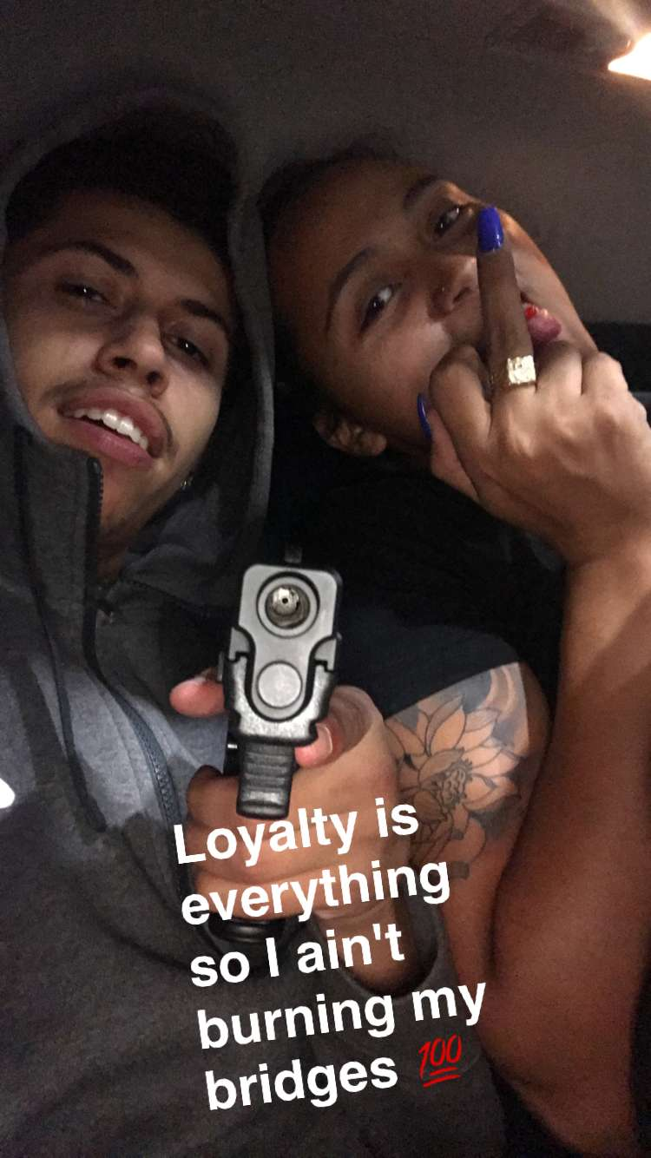
Follow-up
Social Media
  ID accounts and preserve with providers
  SW to get records

Slide 38
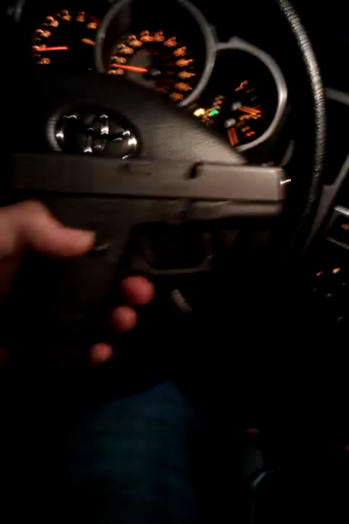
Follow-up
Cell Phones
  Seize them and preserve them for download
    Many locked devices can be unlocked if preserved accordingly
  SW to download and examine

Slide 39

Follow-up
Jail Calls
  Great source of information and can lead to additional crimes
    Cases like Sunny Day on other major gang cases in the last 10 years were made by jail calls

Slide 40
Jamie Draper
San Mateo County District Attorney’s Office
Inspector
650-363-4073
jdraper@smcgov.org

