Slide 1


Slide 2

Supplemental Nutrition Assistance Program

Slide 3
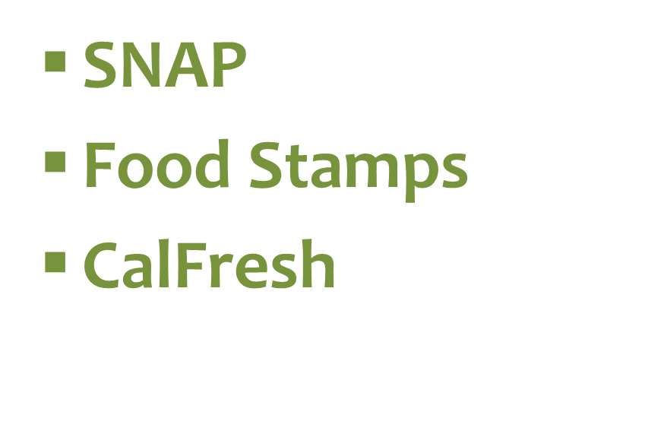
What’s our Name?

Slide 4
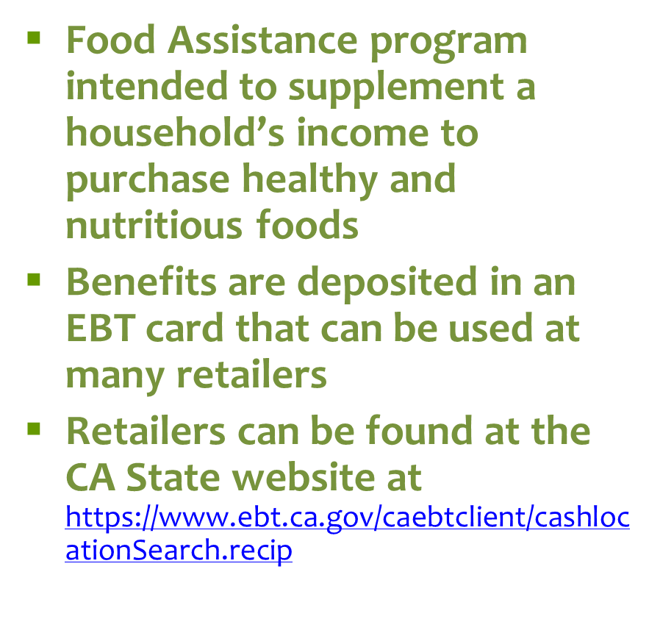
What is CalFresh?

Slide 5
CalFresh Income Limits eff. 10/15
Household Size* | Maximum Gross Monthly Income (130 % of Poverty Level)
1 | $1,276
2 | $1,726
3 | $2,177
4 | $2,628
5 | $3,078
6 | $3,529
7 | $3,980
* Add $451 for each additional member

Slide 6























Application Process

Slide 7
On Line Applications
Online applications can be completed on the Benefits CalWIN website
www.mybenefitscalwin.org
Applications are completed online and interfaced into the CalWIN computer system and processed at the Human Services office

Slide 8
Eligibility Factors
Social Security Numbers
Alien/Citizenship status
Residence
Resources/Property (for Expedited Services only)
Income
Students
Household Composition

Slide 9
Interview Options
In Person
  Completed with regional Benefits Analysts
Telephone
  Completed with Phone Benefits Analysts

Slide 10
Elimination of Fingerprinting for CalFresh Customers
As of January 2012, the CalFresh program eliminated the Fingerprinting requirement for all applicants.

Slide 11
Application Processing Standards
The County has 30 days to process a CalFresh application, unless:
  The applicant is determined eligible for Expedited Service (ES), where benefits must be granted/ denied within 3 days

Slide 12
Reporting Requirements
Semi-Annual Reporting (SAR) Households
Change Reporting Households
Annual Recertification
Income Reporting Threshold

Slide 13
Benefits of CalFresh
Better access to nutritious food
Increase ability to afford basic necessities
Provides household a means to meet nutritional needs
Stimulates state and local economy
Households do not need to pay back CalFresh benefits
Allows working individuals and/or families to remain potentially eligible

Slide 14
CalFresh Outreach in
San Mateo County

Slide 15
CalFresh Outreach Partners in
San Mateo County
San Mateo County contracts with the following for application & outreach assistance:
Second Harvest Food Bank
Single Stop/JobTrain, Inc.
Coastside Hope
Puente de la Costa Sur
SparkPoint at Skyline
SparkPoint at Canada

Slide 16
Partnership ties with
Human Services Agency
San Mateo County provides the following services to contracted partners:
Identified point of contact
Case updates/reporting
CalFresh 101 training
CalFresh partner meeting
Site visits

Slide 17
Outreach Outcomes
    On average CalFresh receives 225 applications monthly from our contracted partners
    Average total of monthly benefits is approximately $19,705.00

Slide 18
Upcoming Outreach Activities
CalFresh in a Day with Cañada College
South San Francisco Senior Service Health and Fitness Fair

Slide 19
CalFresh Questions?
Customers can call our toll free line
1(800) 223-8383
Representatives are available
Mon- Fri. from 8-5 p.m.
Automated Case information is available 24 hours/day,
7 days a week

Slide 20
San Mateo County Contacts
Carolina Salinas
CalFresh Outreach Coordinator
(650) 802-5163

