Slide 1

Elder and Dependent Abuse
Investigation & Prosecution
Nicole Sato, Deputy District Attorney

Slide 2
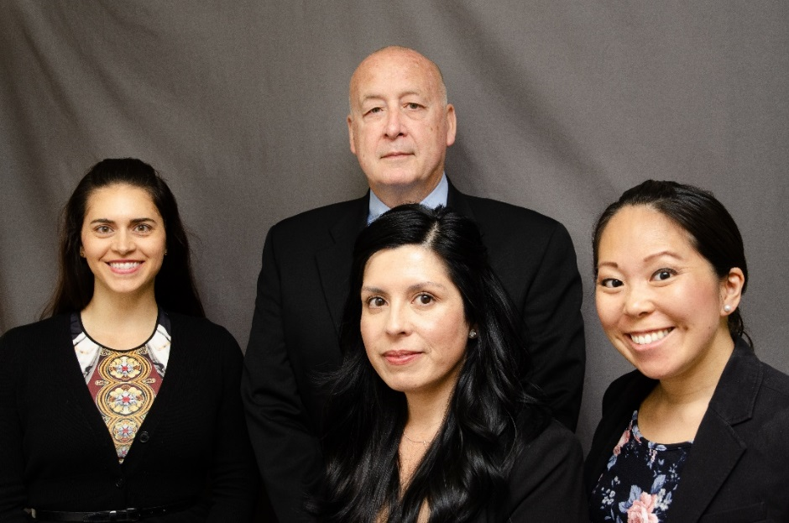
The Elder and Dependent Abuse Unit
Nicole Sato, Deputy District Attorney
Kristin Nimau, Deputy District Attorney
Inspector Greg Giguiere
Sonia Anaya, Paralegal and Victim Advocate

Slide 3
What types of cases does the Elder and Dependent Abuse Unit handle?
Any case where a victim is either an elder or dependent adult
    Financial Abuse
    Neglect Cases
    Physical Abuse, Robberies, Residential Burglaries, Three Strikes
    Domestic Violence
    Sexual Assault

Slide 4



Who qualifies as an elder adult?
Elder adult: Must be 65 years of age or older

Slide 5
Knew or reasonably should have known that the victim was an elder or dependent adult
Elders!
Age 64 – Not an elder

Slide 6
Who qualifies as a dependent adult?
Age: 18 to 64 years old
Has physical or mental limitations that restrict his or her ability to carry out normal activities or to protect his or her rights
Includes those with physical or developmental disabilities, as well as those whose mental or physical abilities have decreased because of age
Can be an inpatient in a health or psychiatric facility

Slide 7
Recognizing & Responding to Elder Financial Abuse

Slide 8
Elder Financial Abuse
Most commonly reported form of elder abuse, 37% of seniors are estimated to have been victims.
Most abusers are family members or trusted caregivers/friends.
Co-Occurrence of Abuse
  75% of seniors who are financially abused are also being physically abused or neglected.
For us, having our identity compromised is a hassle, but for elders it can set off a chain reaction and shorten their lives

Slide 9
Elder Financial Abuse
Elders don’t want to report for fear of losing their independence or can’t report because they don’t realize they have been victimized
Don’t dismiss a case as “civil” simply because you’re not sure what to do with it.
  DA’s Office can assist with complex cases. Call or e-mail us and we can help you determine whether a case is civil. We can also give you some tips for your investigation.
  Take a case, gather the documents & information while you can, and forward to your bureau.

Slide 10
Common Charging Sections
Penal Code section 368(d)
Penal Code section 368(e)
Penal Code section 530.5(a)
Penal Code section 460(a) w/ PC 667.5(c)(21)
Enhancement: Penal Code section 667.9
Enhancement: Penal Code section 186.11
    Must have 2 or more related felonies
    State prison
    More than $500,000 → 2 – 3 – 5 years in state prison

Slide 11
Statute of Limitations
    For financial cases, we have four years to file charges, either from the date of discovery of the crime, or from the date when a victim or law enforcement agency could or should reasonably have discovered the crime.

Slide 12
Different theories of elder theft
Theft by false pretense | knowingly deceiving someone of his property in reliance on a material lie or omission; defendant never intended to perform | Victim’s capacity is irrelevant | Challenge – proving the falsity or intention not to perform from the start
Theft by larceny | Defendant steals from the victim without permission (victim had capacity at the time) | Victim needs to be able to testify that no permission was given | Challenge – victim’s health declines after the theft
Theft by larceny | Defendant steals from the victim with apparent permission | Victim must lack capacity and the defendant knew or should have known | Challenge – need an expert assessment; undue influence is not enough for a criminal case

Slide 13
Dementia/Lack of Capacity
    What is dementia?
    Financial capacity is the first to diminish
    Seniors with impaired financial capacity may “seem fine,” mild cognitive impairment. Just because someone has dementia does not mean that they lack capacity necessarily.
    Typically affects the senior’s ability to save new memories; old memories likely to be intact.
    Seniors with dementia are three times more likely to be the victims of abuse and neglect.
    Mild Cognitive Impairment – the “Gray Area” of greatest risk.

Slide 14
Someone lacks capacity when they are incapable of consent
Legal test for consent:
must act freely and voluntarily and not under the influence of threats, force or duress;
must have knowledge of the true nature of the act or transaction involved; and
must possess the mental capacity to make an intelligent choice whether or not to do something proposed by another person.

Slide 15
When did victim lose capacity?
Can we drop a pin where the elder lost capacity?
Has someone diagnosed MCI/dementia? Who? When? Get the medical records. If the elder might lack capacity, he can’t sign a medical release. Ask a child who has POA to sign a release or write a search warrant.
EDAPT team has a neuropsychologist to assess capacity. If no one has made a diagnosis and you think the elder may lack capacity, let the DA’s Office know ASAP. The closer the assessment to the date of the crime the better.

Slide 16
Victim lacks capacity to consent. Now what?
We also must prove that the suspect knew or reasonably should have known that the victim lacked the ability to consent.

Slide 17
Challenges:
The Right to Folly
    Harriet says she decided all on her own to sign over her house to her caregiver.
    Stanley says he married his 40 year old caregiver because they love each other.
    Margaret invested the bulk of her stocks in a “start up” run by someone who attends her church.
    If these elders still had the legal right to consent to these financial and lifestyle decisions, there’s not likely to be a criminal case. Refer to APS.
Notes:
Andrea

Slide 18
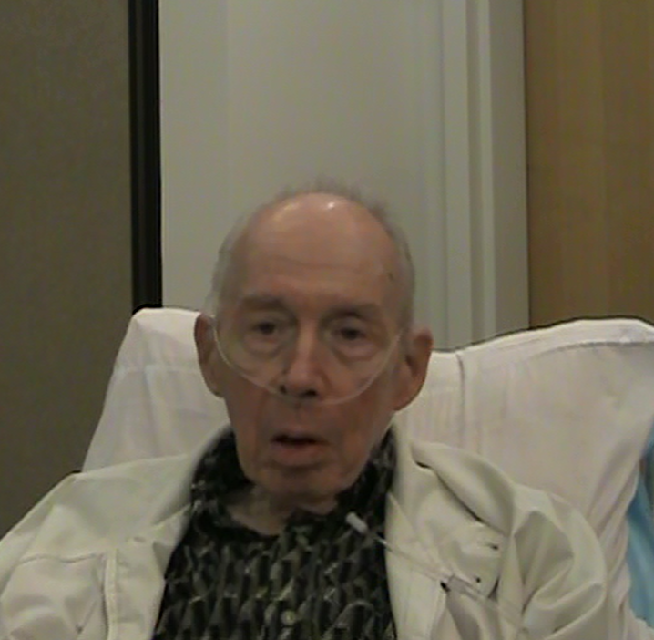
Case study:
People v. Muath Zghoul
The victim, Donald Kennedy, was 80 years old, autistic and diagnosed with stage 3 lymphoma cancer. He was admitted to the hospital after a nurse had checked in on him at his home and found him weak and laying in his own feces and urine. The victim lived alone in a home that he had inherited from his parents – his only asset. He had no family or friends.

Slide 19
Defendant worked for a board and care placement agency and was introduced to the victim in order to assist him in placement at a board and care facility. Within two days of meeting the victim at the hospital for the first time, the defendant had the victim sign the deed to his home over to a limited liability company owned by the Defendant. Defendant also had the victim sign a durable power of attorney for finances and power of attorney for control over all of his finances at the victim’s banking institution.
The victim thought he was signing paperwork to consolidate his assets. The Defendant recorded the deed and power of attorney at the county recorder’s office the next day.

Slide 20
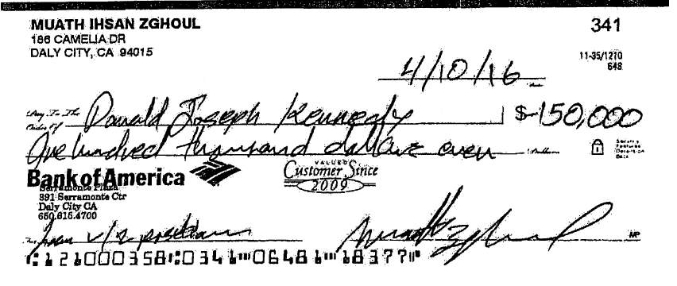
Although the defendant claimed to have left a $150,000 check with the victim, the victim never received any money for his home. The victim also had a reverse mortgage on his home that was never paid off.

Slide 21
During an interview with police and a representative from Aging and Adult Services, the defendant denied any affiliation with the Limited Liability Company and denied living at the address that was associated with the LLC. Defendant was listed as the owner of the LLC with the Secretary of State.
Officers executed a search warrant at the Defendant’s home, which was the same address that was listed as the address for the LLC with the Secretary of State. Officers seized a computer that showed the defendant was forging and manufacturing documents after his arrest.

Slide 22
Issues along the way
The victim filed a civil lawsuit against the defendant to get his home back
While the criminal case was still pending, the victim signed a declaration under penalty of perjury attesting to several damaging facts set forth by the defendant.
The notary public - the only other person present when the victim signed the grant deed and power of attorney documents - testified at a civil deposition that the victim appeared to understand that he was signing over the deed to his home.

Slide 23
The Trial
The victim passed away before the trial - exactly two years to the day that he had signed the deed to his home
The jury trial lasted three weeks
Several witnesses testified: investigators, nurses, representatives from Aging and Adult Services, a neuropsychologist, the notary public and an expert geriatrician

Slide 24
The result
After a little less than a day of deliberations, the jury found the defendant guilty of both felony counts:
Theft from an Elder
Filing of a False Document

Slide 25
The result
After the verdicts, the Defendant filed a motion for new trial, which was denied.
He was sentenced to serve two years in county jail, followed by one year of mandatory supervision, which included elder abuse conditions and restitution to Mr. Kennedy’s estate in the amount of $50,000.

Slide 26
Case study:
People v. Milton LeClaire
San Bruno Investigation
Victim: Harriet Cook, age 89
Loss: $26,500
FACTS:
  After seeing victim gardening outside her home, D shows up at the victim’s home and sells her $3,000 in meat products. After loading meat into her freezer, D asks if she would be interested in investing in his business. He said he needed $ for a down payment and that she would make her money back with interest. Victim wrote gave D $26,500 via checks and wiring money over the course of 1 ½ months. D went to the bank with the victim to withdraw $.

Slide 27
Case study:
People v. Milton LeClaire
Foster City Investigation
Victim: Roger Hartelius, age 77
Loss: $208,010
FACTS:
  After selling victim frozen meat, D approached the victim with a business proposition. D then told victim if he purchased $208,010 in frozen food for a church, he would be repaid with a profit. D went to the bank with the victim and cashed several checks totaling $208,010 in less than a month.

Slide 28
So what did Defendant get?
Defendant pled to FOUR violent felonies – residential burglary while someone was home (PC 460(a)/PC 667.5(c)(21)) and two felony counts of PC 368(d).

Slide 29
So what did Defendant get?
He is currently serving a 9 year state prison sentence at 85%

Slide 30
Lessons to be learned from these cases
Working with each other is imperative.
Think outside the box.
Make elder abuse cases a priority – the victims may die.
Working elder abuse cases is incredibly rewarding.

Slide 31
What types of evidence should you collect?
Bank Records
    Make sure to include the victim’s banking institution and account numbers in your report!
Video surveillance of withdrawals or deposits
Signed medical release form / Medical Records
    Look for capacity evaluation conducted by neuropsychologist
Power of Attorney documents

Slide 32
What types of evidence should you collect?
Copies of trust or wills
Civil depositions
Adult Protective Services records
Documents relating to a real estate transaction (ex. Grant deed, loan docs)
Copies of contracts
Conservatorship documents

Slide 33
Interviewing your elderly victim
Try to interview the elder or dependent adult alone – you never know who the suspect is.
Always record – preferably video – interviews with elderly victim
Try to gauge the victim’s capacity on your own
Consider having a social worker from Adult Protective Services assist you during interview of the victim to help you assess capacity
Review all transactions in bank records with the victim

Slide 34
Additional tips for your elder fraud investigations
Photograph your victim
Always refer cases to Adult Protective Services
Obtain medical records and bank records early on.
    If the victim has capacity, obtain signed release forms for medical and banking records.
Do NOT rush to arrest. Contact the elder abuse DA before proceeding with elder financial cases – these cases are complicated!

Slide 35
Recognizing Elder Neglect, Neglect Deaths, and GBI

Slide 36
Common Charging Sections
Penal Code section 368(b)(1)
Penal Code section 368(b)(2)
Penal Code section 368(b)(3)
Penal Code section 368(c)
Penal Code section 368(f)
Enhancement: Penal Code section 12022.7(c)
- GBI on person 70 years or older = + 5 years

Slide 37
Penalties
PC 368(b)(1) – 1 year county jail or 2-3-4 years in state prison
PC 368(b)(2) – Victims actually suffers GBI
  + 3 years if victim is under 70 years old
  + 5 years if victim is 70 years of age or older
PC 368(b)(3) – Proximately causes death of victim
  + 5 years if victim is under 70 years old
  + 7 years if victim is 70 years of age or older

Slide 38
PC 368(b)(1): Neglect
Having care or custody, willfully caused or permitted the elder to be injured or placed the elder in a situation which endangers the elder under circumstances or conditions likely to cause GBI or death.
  If the suspect is not the caregiver, can still be prosecuted if there is a legal duty to supervise and control the person who inflicted pain or mental suffering
  Suspect was “criminally negligent” when he/she caused or permitted the injury.

Slide 39
How do we if know it’s criminal?
Criminal negligence involves more than ordinary carelessness, inattention, or mistake in judgment.
A person acts with criminal negligence when:
  He or she acts in a reckless way that creates a high risk of death or great bodily harm;
  AND
  A reasonable person would have known that acting in that way would create such a risk.

Slide 40
Signs of Neglect
  Pressure sores (aka bed sores)
  Poor hygiene
  Disheveled appearance
    Toenails / Fingernails
  Malnutrition
  Dehydration
  Delay or failure to seek care

Slide 41
Evidence for a Neglect Case
  Witness Statements
    First Responders
    Family
    Neighbors
    Suspect
    APS
  Expert Testimony
    Physician
    Wound Care Nurse
    Neuropsychologist
    Coroner
    Geriatrician

Slide 42
Evidence for a Neglect Case
  Photographs
    Victim’s wounds
    Victim’s living conditions / environment
    Medications
  Medical Records
    Make sure to pull ALL records, not just hospital records
  AMR / Fire reports
    Include names and contact information of all first responders
  APS Records
  Bank records – financial motive?
  Past employment records if professional caregiver

Slide 43
What to look for: Environmental
    Living Conditions –
      What does the elder’s space look like compared to caregivers’?
      Food – is there food the elder could eat and that is consistent with dietary needs (teeth, diabetes)?
      Medications – check the labels to determine if it looks like elder is being under- or over-medicated.
      Adequate environmental controls – air conditioning/heating.
      Mobility accommodations.

Slide 44
What to look for: Environmental
    Access to toileting
      No access to appropriate toileting options = increased dependence and potential for abuse.
    Forced isolation – Access to phones?
    Caregiver is disengaged
      Missed appointments, dismissive about seriousness of the situation, mental health issues, clearly incapable of providing adequate care.
    Evidence of financial exploitation

Slide 45
What to look for: Environmental
    “Simple” falls can be catastrophic for seniors
      Subdural hematomas – brain bleeds, may take as long as 24 hours to manifest.
      Fractures can start a cascade effect leading to infection, decreased mobility, pneumonia, and death
      Is the environment appropriate to the senior’s needs?
    Restraints
      Be aware of injuries consistent with restraints even if no restraints are present.

Slide 46
What to ask
How old do you think the victim is? How old does the victim look to you?
Who is responsible? Who is the primary caregiver?
  Let the suspects place themselves in that role.
  What kind/amount/frequency of medications did decedent take?
  Who was his doctor? When was he last seen?
  When did she stop being able to toilet herself?
  Once someone assumes care, they must continue to provide care until other arrangements are made.

Slide 47
What to ask
If the victim dies at a different facility/location than where they were neglected:
Find out –
  How long were they at the current facility/location?
  Where were they before that?
  Get medical records from all of the facilities – primary care provider, hospitals, skilled nursing facilities and assisted living facilities.
  APS history?
  You may have to trace the neglect/abuse back to its source.

Slide 48
Case Study
  Police respond to an apartment when coroner calls with concern of criminal neglect.
  Police find 73 year old decedent naked and in deplorable physical condition.
      Victim’s back was completely covered in dead, rotting skin
      There was fecal matter and rotting flesh stuck to the mattress where she had been laying.
      The victim’s foot was rotting with gangrene
  Victim had been bedridden for 2 ½ years
  4/29/08 – Victim weighed 238 pounds
  3/10/13 – Victim weighed 129 pounds

Slide 49
Defendants say…
  Both defendants admitted to being their mother’s caregivers
  Both defendants acknowledged that the victim suffered from Type II diabetes
  One caregiver admitted that the last time she cleaned the victim’s buttocks was 1-2 months prior and that she “got lazy” because she was too tired
  The other caregiver worked for an agency that provided care to the elderly. When shown pictures of the victim’s injuries, she agreed that her mother would have been in a lot of pain.

Slide 50
Case Study
  Pathology report: Victim died of natural causes – respiratory failure due to bilateral bronchopneumonia
  Geriatrician: Victim’s lack of good nutrition and poor hygiene contributed to victim’s decline in health and death.

Slide 51
Tips
  A picture says a thousand words: photograph everything
  Collect the victim’s medical records and records from care facilities where the victim had stayed. Do you see any patterns in the victim’s health or well-being?
  Expert geriatrician opinion may be required. Please contact Elder Abuse DA if you have questions in a neglect case.
  Make sure to document all names and contact information of first responders and medical personnel (Fire personnel, AMR, nurses and doctors)

Slide 52
Recognizing & Responding to Elder Physical Abuse

Slide 53
Common Charging Sections
Penal Code section 368(b)(1)
Penal Code section 368(c)
Penal Code section 243.25
Penal Code section 368(f)
Enhancement: Penal Code section 12022.7(c)
- GBI on person 70 years or older = + 5 years

Slide 54
Treat your elder cases like a
DV/Sex Assault
Uncooperative victims who may lack capacity.
Co-dependent relationship with abuser.
Vulnerable, embarrassed victims.
Record all of your victim, witness and suspect interviews.
  If it’s a physical abuse or neglect case, interview your medical witnesses ASAP and obtain a medical release when possible.

Slide 55
Domestic Violence
Family Code section 6211 defines “domestic violence” and includes any other person related by consanguinity or affinity within the second degree.
  Mothers
  Fathers
  Grandmothers
  Grandfathers

Slide 56
Tips
Assume your victim will be uncooperative later and build your case accordingly.
Video record your interviews with elder victims. If you cannot video record your interviews, audio record!
Build rapport with these victims – they need your support
Get jail calls – this could be the difference between a dismissal and prison time.

Slide 57
Responding to Elder or Dependent Adult Sexual Abuse

Slide 58
Common Charging Sections
  PC 288A(g) – Oral Copulation of a Disabled Person
    Victim had a mental disorder or developmental or physical disability that prevented him or her from legally consenting (unable to understand the act, its nature and possible consequences)
  PC 261(a)(1) – Rape of Disabled Person
  PC 286(g) – Sodomy of a Disabled Person
  PC 289(b) – Sexual Penetration of a Disabled Person
  PC 288(b)(2) and (c)(2) – Lewd Act on Dependent Adult
    Applies if D is a caretaker and victim is a dependent person

Slide 59
Sexual Abuse
  Many seniors need help with toileting, bathing, other ADLs – increasing risk of sexual assault.
  Reduced cognitive function & lack of mobility increase risk.
Sex offenders are attracted to vulnerability
  Easy to overpower, manipulate, unlikely to report, and unlikely to be believed if they report.
  The stigma, embarrassment, and humiliation are magnified with seniors.

Slide 60
Tips
  Follow the sexual assault protocol, even if your senior or dependent adult victim lacks capacity.
  When we disbelieve our disabled or demented victims, the bad guys win.
  Pre-text Phone Calls
    Consider utilizing the victim’s adult daughter or son if he or she has contact with the suspect.
    Let the suspect speak!

Slide 61
In closing…
THANK YOU.
The work you do every day makes a difference in the lives of those you serve.
Thank you for being part of our elder and dependent protection team.

Slide 62
NICOLE SATO, DDA
(650) 599-7415
(408) 316-6374 (Cell)
nsato@smcgov.org
(Will be out on maternity leave beginning in mid-May)
KRISTIN NIMAU, DDA
(650) 363-4089
(805) 218-7650 (Cell)
knimau@smcgov.org
INSPECTOR GREG GIGUIERE
(650) 363-7428
ggiguiere@smcgov.org

