Slide 1

Domestic Violence
Report Writing Tips
Helping Victims C.O.P.E

Slide 2
With Each Report – Assume The Worst
  DV does not get better – violence turns into more violence
    The more cases we can prosecute, the more opportunities we have to curb this behavior
  We will lose witnesses during the life of the case
    Victims who are initially cooperative tend to recant
    Other witnesses – tend to become uncooperative as well

Slide 3
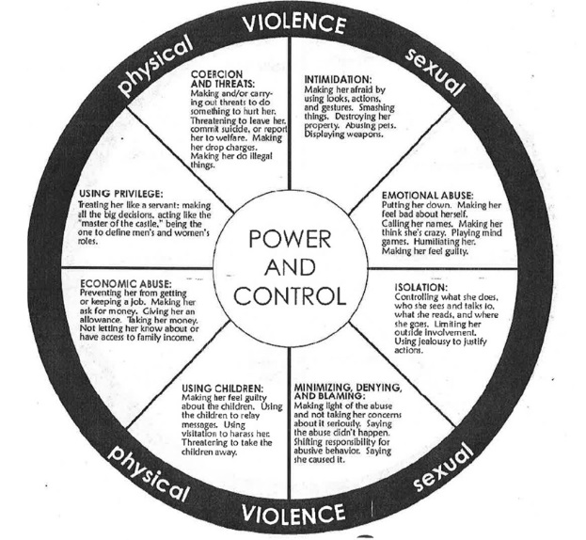
Why is that?

Slide 4
What Can We Do?
Investigate DV cases and prepare reports that enable the DA move forward without the victim
  Think about helping the victim C.O.P.E. with domestic violence
    Chronology
    Observations
    Prior Violence
    Evidence to corroborate

Slide 5
Chronology
Who is the Reporting Party? (check CAD)
Who did you contact first? (Victim or Suspect)
  *Get alternative means of contact for vic
If Victim was contacted before Suspect – what was said in that initial statement
At what point was suspect detained

Slide 6
Chronology
Why is this important?
  Without the witness - we have to over come 2 hurdles to get statements into court:
    #1 = Hearsay exception
    #2 = Defendant’s right to confront the witnesses against him

Slide 7
Chronology
Hurdle #1 – Hearsay exception
  Can usually be overcome by a “Spontaneous Statement” (EC 1240) – i.e. vic made statement while under the influence of the traumatic event (crying, distraught, etc.)
    Other common exceptions:
      Forfeiture by wrong doing – i.e. when a victim is recanting because of threats from defendant
      Statements made to Medical providers

Slide 8
Chronology
Hurdle #2: Confrontation Clause (AKA Crawford)
  What is it? → Constitutional guarantee: D gets to confront (i.e. cross) the witnesses against him
  Rule = If a witness makes a “testimonial” statement, defendant has a right to cross them. (Therefore, we cannot get the statement in without the witness)

Slide 9
Chronology
What is not testimonial? → Informal statements taken under an “ongoing emergency”
  How can we tell? → Gray area, but generally:
    Statements made to first responders in an informal manner
    And statements made when there is still a danger to the victim (i.e. suspect not yet detained)
*Think – initial statements

Slide 10
Observations
Demeanor of both Vic and Suspect
  Crying, shaking, distraught?
  Calm?
  Combative?

Slide 11
Observations
Visible Injuries
Non-Visible Injuries
  Complaints of pain
  Strangulation cases
    Difficulty swallowing, sore throat
    Changes in voice
    Light headedness
    Memory loss (“I don’t remember”)

Slide 12
Observations
Objective indicators of credibility/lack of credibility
Signs/symptoms of intoxication
  Alcohol
  Drugs
  How impaired do they seem?

Slide 13
Prior Violence
Get a picture of the relationship dynamics
Detail any prior violence mentioned by the victim
  If reported – attempt to get police report numbers
  If unreported – ask the victim if they have pics, or any other corroboration
  Run suspect in RIMS for DV contacts
  Ask about possible sex assault incidents
    Violence often transfers to sexual encounters
    We don’t want surprises when it comes to sex assault claims
  The more information about prior violence, the better!

Slide 14
Prior Violence
How is this helpful?
  Evidence Code 1109 – allows us to get in prior violence (within 10yrs) to prove propensity (i.e. because D did it then, he likely did it again now)
    Prior violence under EC 1109 = requires lower burden of proof (preponderance)
      *And, on a practical level, gives us a better picture of the relationship and potential dangers

Slide 15
Evidence to Corroborate
Pictures, pictures, pictures!
  Of the Victim (including face + hands)
  Of the Suspect (including face + hands)
  Of the Scene
    Review pics on scene (may be bad lighting/angle)
AND – follow up pictures
  Injuries develop over time

Slide 16
Evidence to Corroborate
Other witnesses (get alt. phone #’s, etc.)
  Even if they just heard something
  Ask if the Victim talked to anyone before officers arrived (those statements have a good chance of coming into a trial)
  Neighbors that have heard or seen prior fights

Slide 17
Evidence to Corroborate
Children present in the home:
  Document all children in the home
  Statements
  Note physical conditions and emotional states
  Always consider cross reports to CPS
    Exposing children to DV is a form of child abuse
    PC 136.2(a)(2) – allows for children to be included in NCOs if they were just present during time of DV

Slide 18
Evidence to Corroborate
AMR/Fire Personnel – Note personnel and engine/medic # that responded
  Get Med. Release forms
  Why is this important?
    Evidence Code 1370 – Victim’s statement is admissible if:
      Narrates/describes how physical injury was inflicted upon them
      Is at or near the time of the physical injury

Slide 19
Evidence to Corroborate
If suspect is not located
  Document your efforts to locate defendant (this will protect you later during cross examination)
  Ask Vic to ID suspect through a Photo ID / personal picture

Slide 20
Evidence to Corroborate
Recordings!
  Surveillance
  Dash Cams / Body Cams
  PUMA recorders
Phone dumps or Screen shots of phone data
  If you get consent – download the phone right away
  If you don’t get consent – write a SW
Follow up/Golden Rods – need attention ASAP

Slide 21
Evidence to Corroborate
Emergency Protective Orders
  Always ask the Vic if they want an EPO granted
  If Vic refuses – decide, if due to the severity of the facts, you should attempt to get one granted
    If so, make the request
EPO issued? – think about jail calls

Slide 22
Recap
When writing your reports – think of helping victims C.O.P.E.
  Chronology
  Observations
  Prior violence
  Evidence to corroborate

Slide 23
Contacts
Myself: Paula Vielman-Reeves / pvielman@smcgov.org / (650) 363-4774
Current Felony DV Team:
  Ryan McLaughlin: rxmclaughlin@smcgov.org
  Joe Goethals: jgoethals@smcgov.org
Current Misdo. DV Team:
  Amanda Alcantara: aalcantera@smcgov.org
  Jamal Anderson: janderson@smcgov.org
  Josh Martin: jmartin@smcgov.org

