Slide 1
Swatting Investigations
Sergeant Samy Tarazi
REACT Task Force
Santa Clara County Sheriff’s Office
408-210-6369

Slide 2

What is Swatting?
Swatting is the reporting of or threat of significant violence in order to cause a significant response from law enforcement, usually with the intent to harass or annoy the victim.

Slide 3
Penal Code
148.3.
(a) Any individual who reports, or causes any report to be made, to any city, county, city and county, or state department, district, agency, division, commission, or board, that an “emergency” exists, knowing that the report is false, is guilty of a misdemeanor and upon conviction thereof shall be punishable by imprisonment in a county jail for a period not exceeding one year, or by a fine not exceeding one thousand dollars ($1,000), or by both that imprisonment and fine.
(b) Any individual who reports, or causes any report to be made, to any city, county, city and county, or state department, district, agency, division, commission, or board, that an “emergency” exists, who knows that the report is false, and who knows or should know that the response to the report is likely to cause death or great bodily injury, and great bodily injury or death is sustained by any person as a result of the false report, is guilty of a felony and upon conviction thereof shall be punishable by imprisonment pursuant to subdivision (h) of Section 1170, or by a fine of not more than ten thousand dollars ($10,000), or by both that imprisonment and fine.

Slide 4
Initial evidence collection
1. Obtain the phone records of the incoming call.
Most likely, the suspect is calling from a VoIP line into the non-emergency line of the dispatch center.
If VoIP line, look up service provider.
If not VoIP line, figure out what company services the number.
Be aware of spoofed numbers.
2. Obtain recording of the call, will be important for voice analysis.

Slide 5






Determine Motive

Slide 6
Interview the victims
If there are teenage boys that live at the house- interview them!
Get a list of all video games they play on-line, what console (PS4, Xbox, PC ext).
Ask what their usernames are on that platform.
Ask for their friends list. Have them log on and show you list.
Ask them who they think did it and why they think so. Ask about recent threats and or on-line feuds.

Slide 7
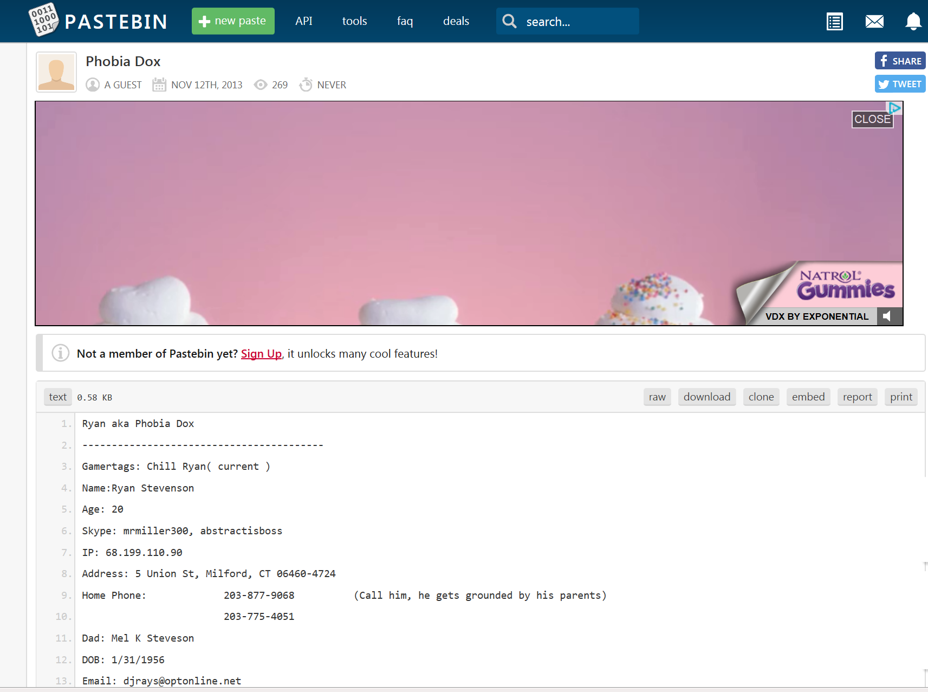
DOX
Search for and publish private or identifying information about (a particular individual) on the Internet, typically with malicious intent.

Slide 8
Twitch and YouTube
https://www.twitch.tv/
https://www.youtube.com
If victim points to suspects videos, pull the videos and compare voice to 9-1-1 call.

Slide 9
Furthering Investigation: VoIP lines
Use phone lookup tools to determine provider of phone. I personally use ZetX (paid service). What do you use?
If it is Bandwidth: e-mail uslawenforcement@bandwidth.com with the phone number and date and they will tell you who the number was subleased to.
If Google, write search warrant to Google for IP logs and associated Google accounts.
Follow-up on ISP of IP address for subscriber information.

Slide 10
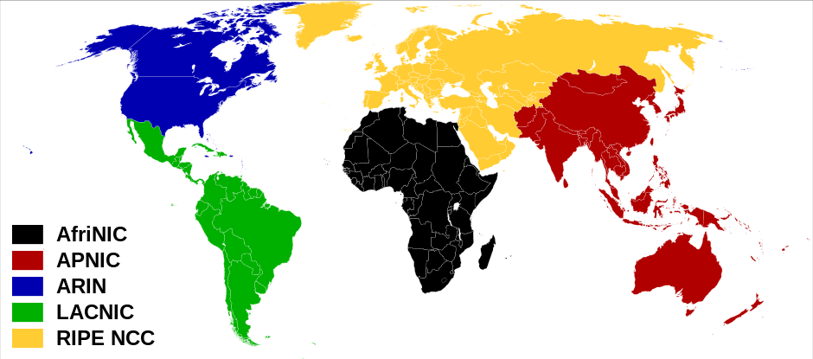
How are IP address assigned?
Internet Assigned Numbers Authority (IANA) manages 5 regional Internet registries.

Slide 11
ARIN
ARIN assigns all IP address in North America.
They assign them in blocks to Internet Service Providers (ISP).
The ISP then assigns a unique IP address to the user.
The ARIN database will tell you what ISP a particular IP address was assigned too.

Slide 12
ARIN Services
who.is: Directory service for accessing current registration data of a domain name (website) or an IP address
Whowas: provides historical registration information for a given IP address. To get access to this, you must register at www.arin.net. It can take up to two days to get approval. Results are returned to the user via e-mail in a zip file.

Slide 13
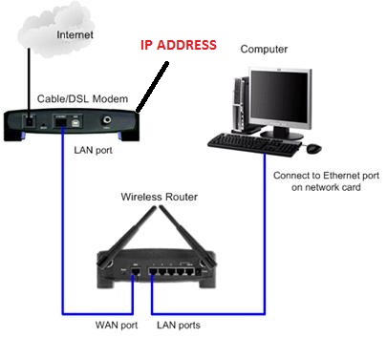
What can IP address tell you?
An IP address will always tell you the Internet Service Provider that owns that IP address.
It will not directly tell you the specific user, computer, cell phone or other device that was used.

Slide 14
Practice Exercise #1
Take out your phones and go to Google.com and search:
“What is my IP address?”
Copy the result.
Type the following web address into your browser: “who.is”
Paste the IP address into the search bar and hit search.
Do you see who your internet provider is? Who is it? Where can you send legal request forms?

Slide 15
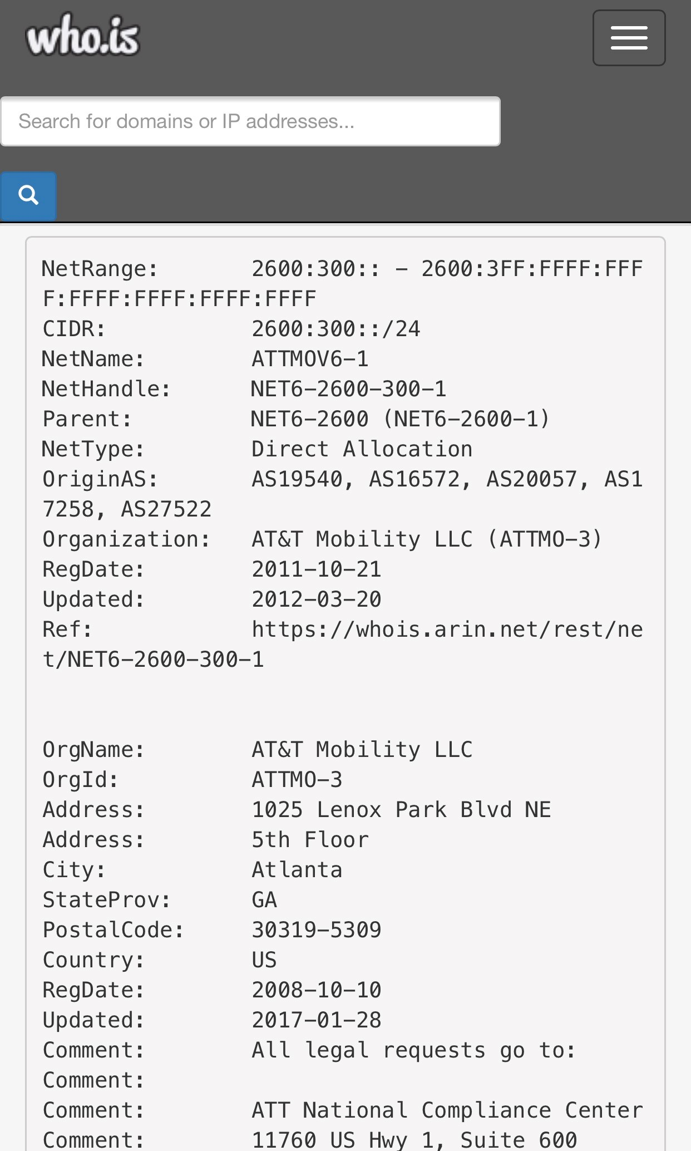
Example of who.is printout

Slide 16
Linking IP to a Geographical location
IP addresses are assigned in blocks to Internet Service Providers. There are databases that store this information and often times will give you a clue to the geographical region that IP address belongs to.
There are several free websites that will search this database for you. I like freegeoip.net, but there are different sites that do the same thing..
DO NOT take this information as a fact. Only the business record from the Internet Service Provider should be used as fact.

Slide 17
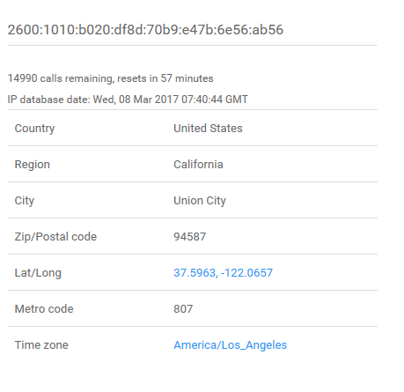
Practice Exercise #2
Go to http://freegeoip.net
The IP address assigned to your device/computer will be inserted by default. You can type in any IP address into the box and get results for that IP.
Remember, this isn’t always accurate. Do not depend on this as an official record.

Slide 18
Mobile Internet: IPv4 vs IPv6
IPv4- example: “67.43.144.198” This allows the entire planet to have approximately 4.2 billion IP addresses.
IPv6: example: “2602:0445:0000:0000:a93e:5ca7:81e2:5f9d” This allows for 340 undecillion (that is 38 0’s) addresses for the entire planet.
US Mobile carries will not typically have any useful records on IPv4 without a port number, which usually isn’t obtained.

Slide 19

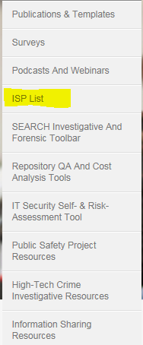
Where do you send a search warrant to figure out who was using the IP address?
The first step is to go to www.Search.org
Top right area, highlight “Resources” and click ISP List

Slide 20
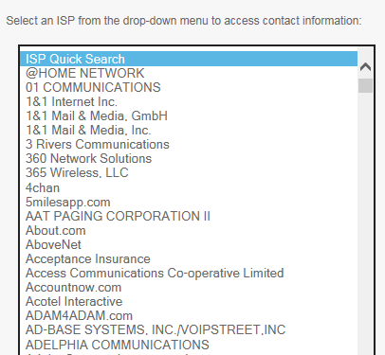
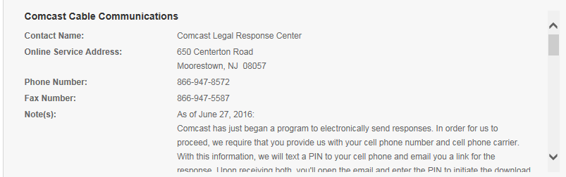
Search.org
You will be provided with contact information for this company.
Select the appropriate company

Slide 21
What to do with foreign IP addresses
Don’t be discouraged by foreign IP addresses. The local law enforcement in those countries will help!
If Canada, Australia or United Kingdom IP addresses often times an e-mail to the local police department will pay huge dividends.
M-Lat process can be a pain, but sometimes it is required.
Be aware of proxy servers.

Slide 22
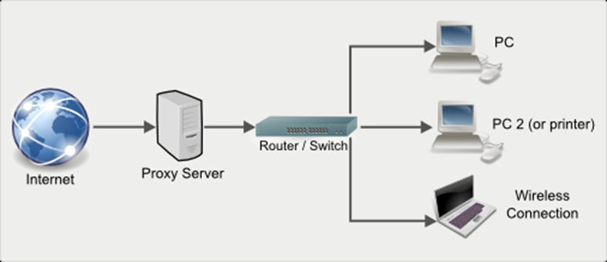
Proxy Servers
Proxy server owners will not always cooperate with law enforcement or the owner is unknown.

Slide 23
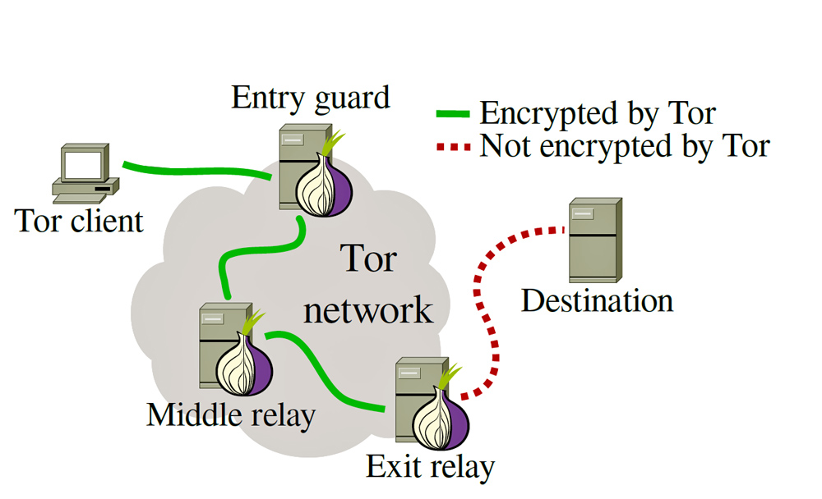
Tor Client (Dark Web)
The Dark Web is basically a deregulated proxy server with 3 levels.
Depending at what point you intercept records, you will most likely received IP information for the exit relay

Slide 24
NCRIC And other sources of information sharing
Share your case with everyone. Make a TRAK Flyer with the details.
Call NCRIC and let them know and ask for assistance.
Call JTTF (FBI Counter Terrorism Task Force) and run the case by them, you’d be surprised out how much information is collected and shared about Swatters.

Slide 25
Penalty
You’ve been working on getting records for weeks to months… stay calm when the suspect is put on probation.
Don’t be discouraged. The laws are getting stronger every year to combat this potentially deadly prank.
Do your best to follow every lead. Most of the Swatters do it over and over and they need to be arrested!
GOOD LUCK

Slide 26
REACT INFORMATION
The Five Bay Area Counties (SF, San Mateo, Alameda, Santa Clara and Santa Cruz)
Starazi@rtf.sccgov.org
408-282-2426

