Slide 1
San Mateo County Agricultural Advisory Committee
Survey Results
Prepared for the October 20, 2025 AAC Meeting

Slide 2
Overall Themes from Survey Responses
Desire to promote and support agriculture in the County and serve stakeholders; desire to be useful
Need for role clarification overall and regarding specific projects (some feel the Commission is overreaching in its role, others feel that the Commission has been limited in its role)
Need for improved meeting processes and training/knowledge for both County staff and Commission members
Need for collaboration and respect among the County, the AAC and stakeholders

Slide 3
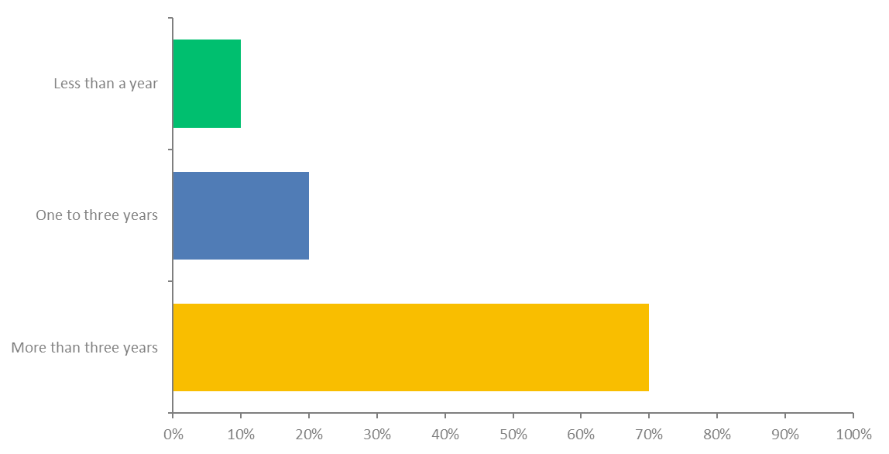
Q1: How long have you been on the AAC?

Slide 4
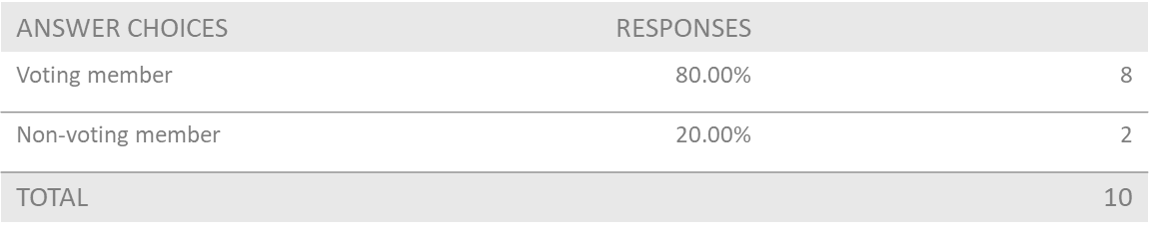
Q2: Are you a voting member or a non-voting member?

Slide 5
Q3: Why did you join the AAC?
To promote, support and protect agriculture in the County and on the coast
Gain knowledge and understand development rules
To provide my perspective and expertise to shape policies: long-term farming family, non-farmer, younger generation of farmers
Legacy of family farm in the County

Slide 6
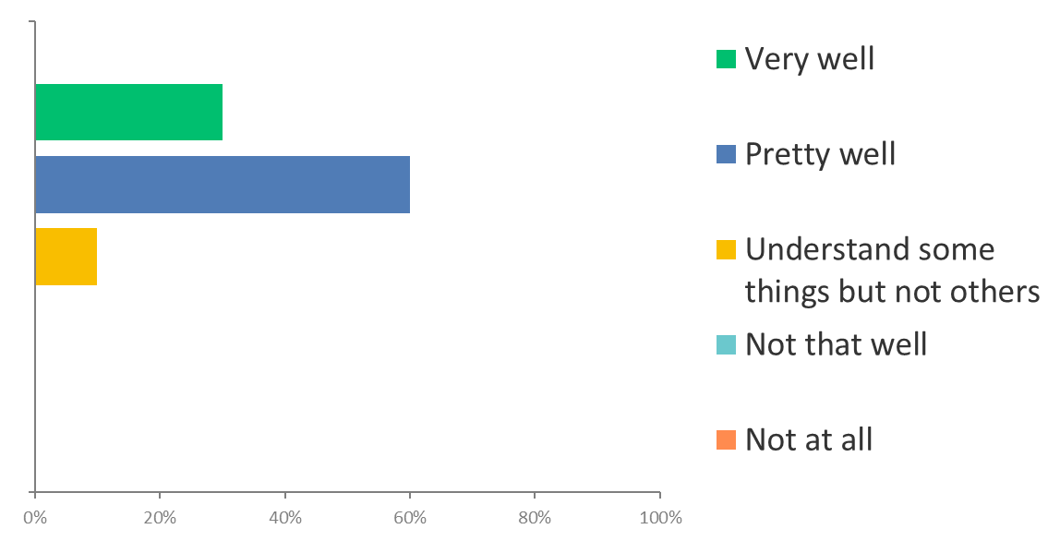
Q4: How well do you understand your role as a member of the AAC?

Slide 7
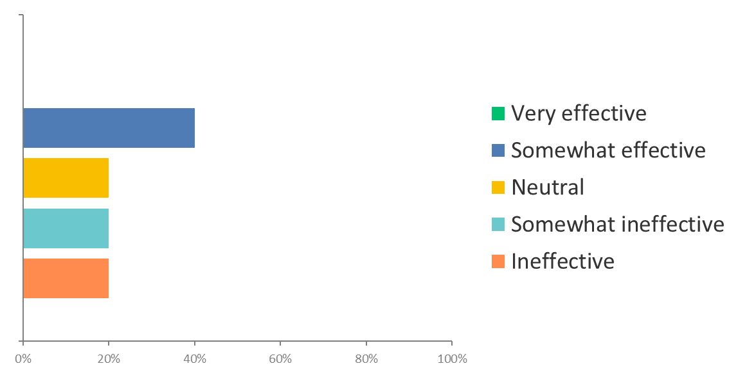
Q5: In your opinion, how effective is the AAC in the following areas:
- Achieving its role and purpose

Slide 8
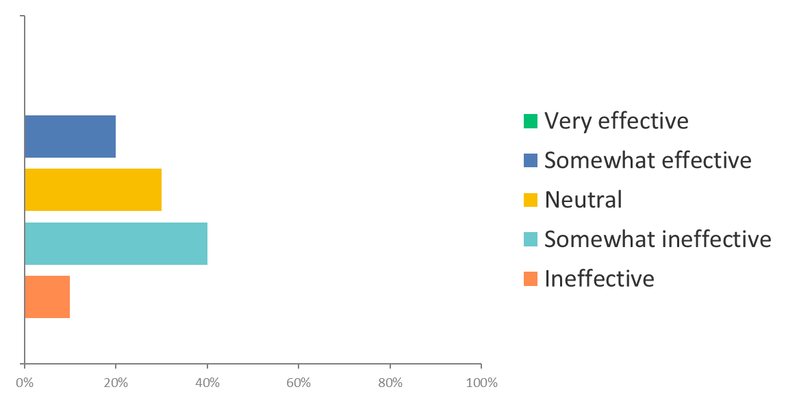
Q5: In your opinion, how effective is the AAC in the following areas:
- Holding productive meetings

Slide 9
Q6: What do you feel are the strengths and challenges of the AAC?
Strengths
Passionate, hopeful and supportive of agriculture in the County
Can share our opinions based on agriculture experience, history and knowledge
Can seek input from and represent the local agriculture community, have a deep connection to local farmers
Diverse group of individuals and perspectives representing many aspects of the agriculture community, place for diverse viewpoints to be voiced
Proactively advise the County on ways to preserve agriculture (workshop)
Members take meetings seriously and want the committee to be effective

Slide 10
Q6: What do you feel are the strengths and challenges of the AAC?
Challenges
AAC’s role is not clear: Concern about overreach of authority and projects not brought to AAC
Meetings are not as effective as they could be: off track and unfocused, incomplete information for recommendations
County/Committee relationship needs improvement: how AAC recommendations are used, how to align AAC work with County priorities
Collaboration with others can be enhanced: other orgs involved in ag issues including farmworkers and open space orgs

Slide 11
Q7: What can be done to improve the effectiveness of the AAC?
Clarify AAC Role: how it relates to County policy development and project approval, what the County is looking for from the AAC
Provide training for AAC members on meeting rules and effectiveness, relevant laws
County, AAC and other stakeholders should collaborate, listen to and respect each other
Provide relevant information and responses to AAC about agendized projects

Slide 12
Q8: What can be done to improve the AAC meetings?
Have a clear, focused meeting structure and agendas that are followed
Provide training for members on how to conduct effective meetings
Have a standard for how AAC meetings are held (e.g., hybrid, recorded and posted online, secretarial duties, minutes, how Zoom attendees participate, etc.)
Ask AAC for input on policy issues that affect agriculture, e.g., input on housing task force

Slide 13
Q9: How can the AAC and County staff best work together to accomplish the AAC’s purpose?
Improve communication and respect among staff, chair and AAC members
Clarify the AAC’s role and impact:
  Provide trainings and reminders of AAC’s purpose and jurisdiction
  Expand the role of the AAC beyond processing PAD permits to support shared goals and use Committee expertise
  Summarize the impact of the AAC’s work
Improve effectiveness of AAC input:
  Improve meeting management and effectiveness
  Highlight areas for which the County is seeking a recommendation
  Make sure County staff and planners are knowledgeable and can respond to questions

Slide 14
Q10: What are your top two priorities for the AAC to accomplish in the next two to three years?
Keep agriculture thriving on the coast for future generations; help shape the future of agriculture in the County; recommend revisions to policies and regulations to promote agriculture
Work more effectively with the County: “Be a committee that the County wants to work with and is respectful of our input.”
Improve connections to the community, be responsive to local needs. Serve as a resource to farmers, etc. in dealing with the Planning Department.

