Slide 1

Transgender Day of Remembrance
  2025
San Mateo County

Slide 2

  Who is Transgender?
  Individuals whose gender identity, expression, and/or lived experiences differ from the sex assigned to them at birth
  “Trans” is often used as shorthand for transgender
  Some transgender individuals identify as:
    Within the gender binary, male or female
    Outside of the gender binary, as neither male/female, a combination of genders, or an exclusion of genders (agender)
  Trans people may use terms such as non-binary, gender non-conforming, or gender expansive to describe their identity

Slide 3
Respectful Language &
  Identity
  Terminology and identities within the trans community vary widely, maintain cultural humility
  Always use the pronouns and name provided by the person you are referring to, and make an effort to update your language as people share new names/pronouns with you
  Using correct identifiers shows respect, dignity, and inclusion for all

Slide 4

  The Transgender Flag
The Transgender Pride Flag represents transgender identity, diversity, and the journey toward authenticity and equality. Monica Helms, a transgender woman, created it in 1999.

Slide 5
  Importance of Transgender Day of Remembrance
  Founded in 1999 by Gwendolyn Ann Smith to honor Rita Hester, a transgender woman murdered in Massachusetts
  Observed annually on November 20 & recognized worldwide
  Anti-transgender violence has more than doubled since 1999
  Transgender women of color are disproportionately affected

Slide 6
Content Warning
This presentation includes material about violence against transgender people, which may be activating or painful. We invite you to take breaks, seek support, or step out at any time.

Slide 7
  IN MEMORY OF...

Slide 8
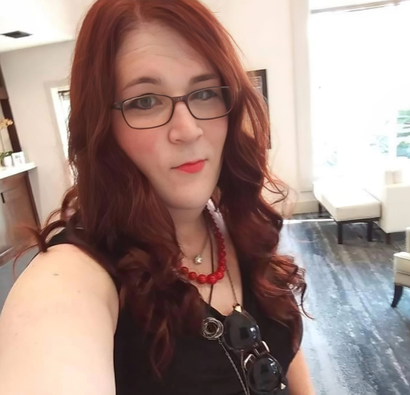
  Kayla Jane Walker
Kayla was a 39-year-old transgender woman from Austin, TX, remembered by her sister as a “fierce advocate for the weird and wonderful.” A talented guitar player, she found strength and love within her chosen family after being ostracized by her birth family. Some of her final words shared on Facebook were, “Resist Despair.”
On November 10, 2024, Kayla was murdered in a hit-and-run. One week later, Aldair Albiter-Casas was arrested and charged with the collision.

Slide 9
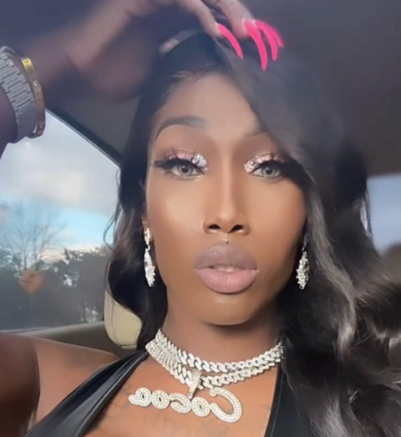
  Quanesha Shantel ("Cocoa")
Cocoa, a 26-year-old transgender woman, lived in Greensboro, NC. With her mother’s support, she began her transition at a young age. A member of the House of Mizrahi, she was known in the ballroom community for her vibrant presence. Friends described her as “stunning” and “radiant.”
On November 10, 2024, Cocoa was murdered by her ex-boyfriend, Jeremy Reynolds, who was arrested and charged with first-degree murder. The case is being investigated as a domestic violence incident.

Slide 10
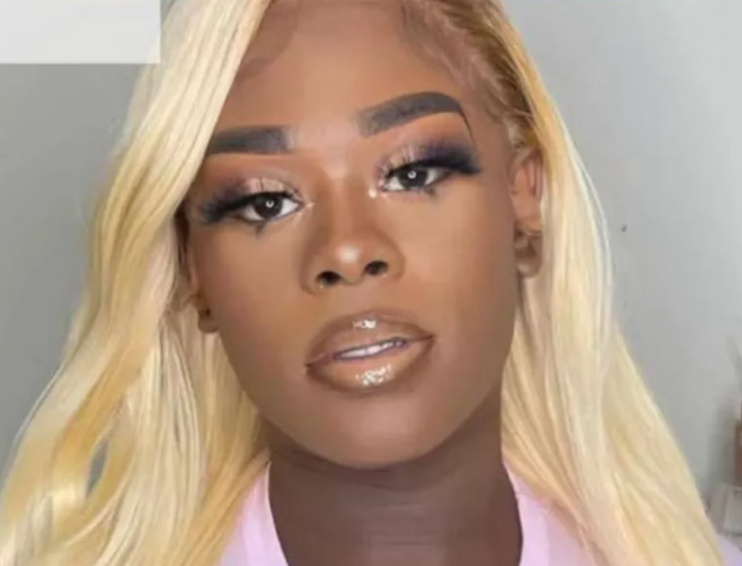
  Ra’lasia Wright
Ra’lasia, a 25-year-old transgender woman from Minneapolis, was a loyal friend who “just wanted to make sure everyone was good.” She built a strong chosen family within the trans community and was remembered as someone who “paved the way” for others.
On December 1, 2024, Ra’alasia was found murdered near Powderhorn Park after friends tracked her phone following an iPhone SOS alert. No arrests have been made.

Slide 11
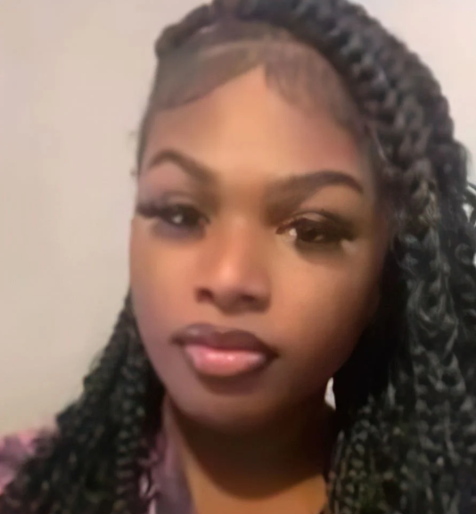
  Cam Thompson
Cam was an 18-year-old transgender woman from Tuscaloosa, AL, remembered by her aunt for her beautiful, contagious smile. A recent Job Corps graduate, she was preparing to begin college and looking forward to her future.
On December 16, 2024, Cam was murdered. A minor has been arrested & charged as an adult in her murder. Her family believes it was a hate crime, but Alabama’s hate crime law does not include protections for gender identity.

Slide 12
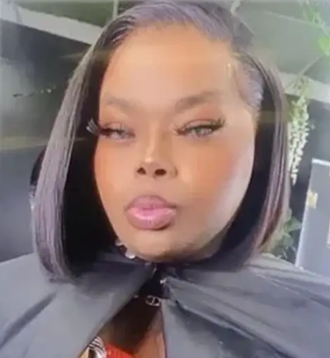
  Tahiry Broom
Tahiry, a 29-year-old transgender woman from Southfield, MI, was beloved in the LGBTQ+ community. Vibrant, confident, and kindhearted, she loved her friends and family deeply and was known for her generosity and zest for life.
On February 9, Tahiry was murdered after an argument with Robert Ridges III. He has been charged with second-degree murder in connection with her death

Slide 13
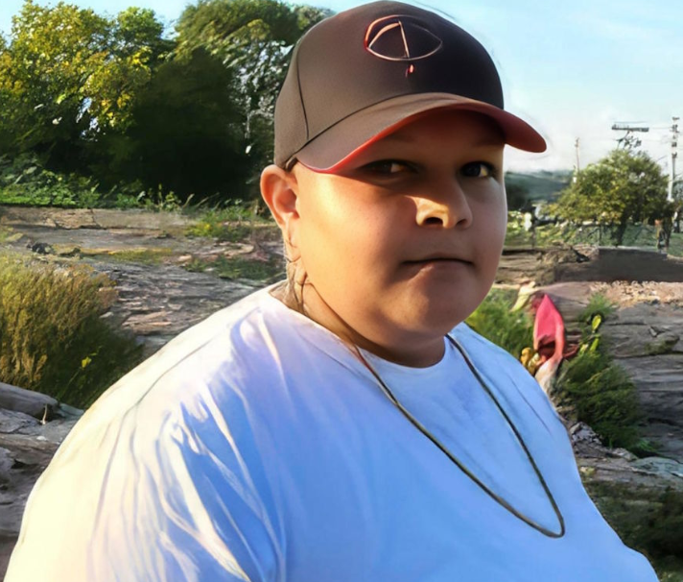
  Sam Nordquist
Sam was a 24-year-old transgender man from Oakdale, MI. His mother described him as an “amazing person who was always on the go.” He cared for vulnerable adults and dedicated his time to helping others.
After leaving Michigan, Sam was murdered on February 14, 2024, in New York State. Seven individuals have since pleaded guilty in connection with his death.

Slide 14
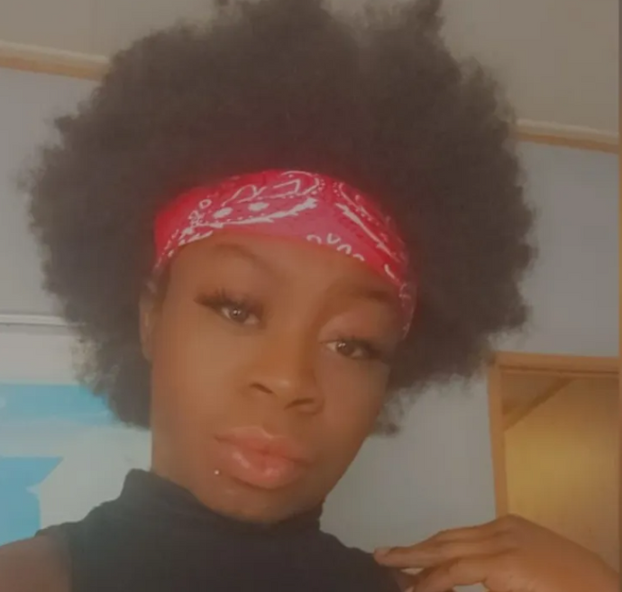
  Ervianna “Baydee” Johnson
Ervianna was a 25-year-old transgender woman from Tabor, North Carolina. Friends said her presence always brought joy. Known for her hip-hop majorette competitions, epic drop split, and vibrant personality, she was also deeply family-centered.
On February 19, 2025, Ervianna was found murdered near her home. Her death is currently under investigation by the Columbus County Sheriff’s Office.

Slide 15
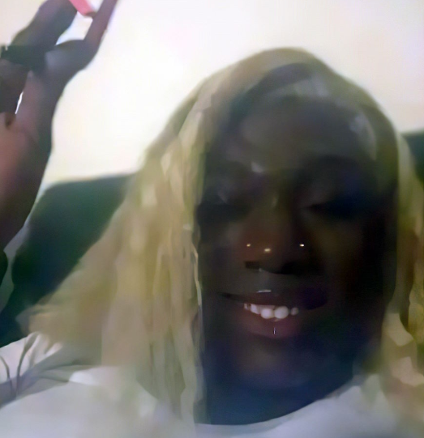
Amyri
  Dior
Amyri was a 23-year-old transgender woman from Milwaukee, WI. Remembered as a “good soul,” she loved to sing, dance, and simply be herself. Her kindness, joy, and vibrant energy are cherished by her family, friends, and community members.
On February 21, Amyri was murdered, and her family believes it was motivated by her gender identity. David Steed has been arrested and charged with first-degree murder.

Slide 16

  Linda Becerra Moran
Linda was a 30-year-old transgender woman from Ecuador. While limited information is available, service providers report that she had relocated to Los Angeles and was devoutly Catholic.
On February 27, 2025, Linda reported experiencing a mental health crisis, prompting a 911 call for assistance. When she did not follow police commands, she was shot and killed. Her family has filed a civil lawsuit against the LAPD officers involved.

Slide 17
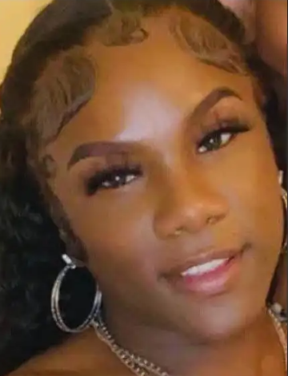
  Kaitoria Le’Cynthia Bankz ("Kai")
Kai was a 31-year-old transgender woman from Autaugaville, AL, and a valued Knights and Orchids Society member. She worked in LGBTQ+ health and advocacy, loved Beyoncé, doing hair and nails, and was preparing to study psychology in college
On March 31, 2025, she was killed by an acquaintance who also injured her brother on Trans Day of Visibility. Kelman Merrel King turned himself in and was charged with murder and attempted murder.

Slide 18
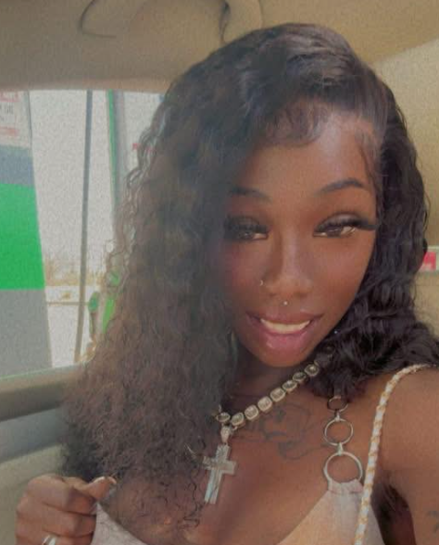
  Kelsey Elem
Kelsey was a 25-year-old transgender woman from St. Louis, MI, remembered as a passionate advocate for the trans community and a kind friend to all. A dedicated student at Duke University, she was admired for her strong work ethic.
Kelsey was murdered on April 24 by her ex-boyfriend, Martino Lewis, who has since been charged with her murder.

Slide 19
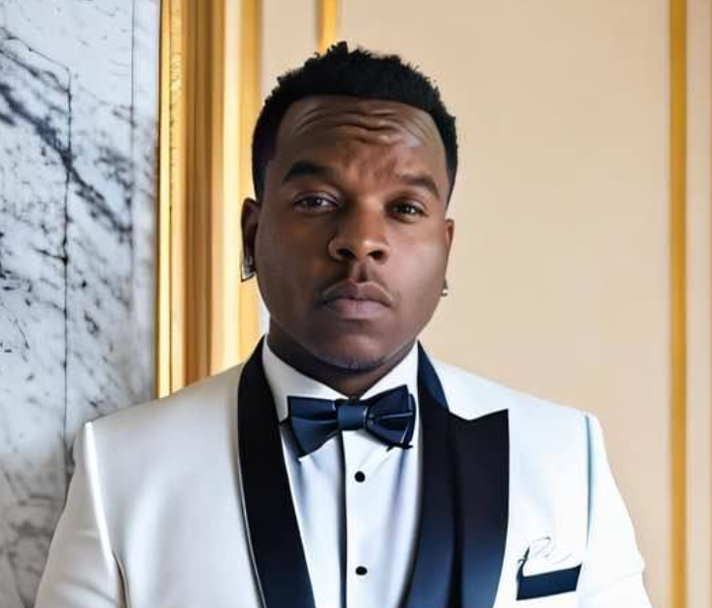
  Shy'Parius Dupree
Shy’Parius was a 32-year-old transgender man from Memphis, TN. A devoted husband and father, he worked as a youth counselor, co-owned a small business with his wife, and advocated for the well-being of children.
On May 17, 2025, Shy’Parius was found murdered. Details surrounding his death remain limited as the investigation continues.

Slide 20
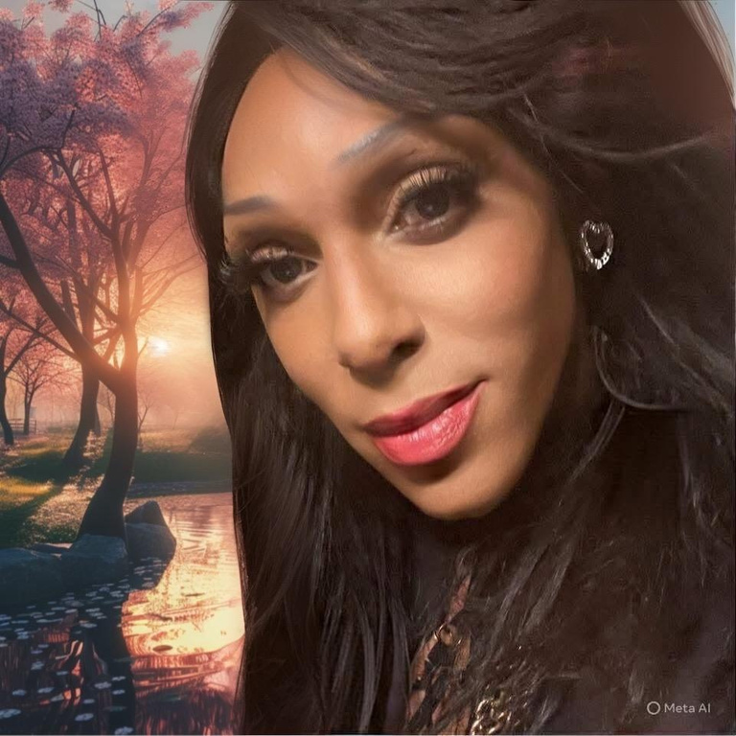
  Karmin Wells
Karmin was a 25-year-old transgender woman from Detroit, MI, known for her caring personality. A talented ballroom performer, she was dubbed “the walking wonder” and won the status of Legend in the Iconic International House of Revlon in 2018.
On May 25, 2025 she was found fatally shot in her home. Detroit Police suspect the perpetrator, who is yet to be identified, pretended to visit for a date with the intention to murder Karmin.

Slide 21
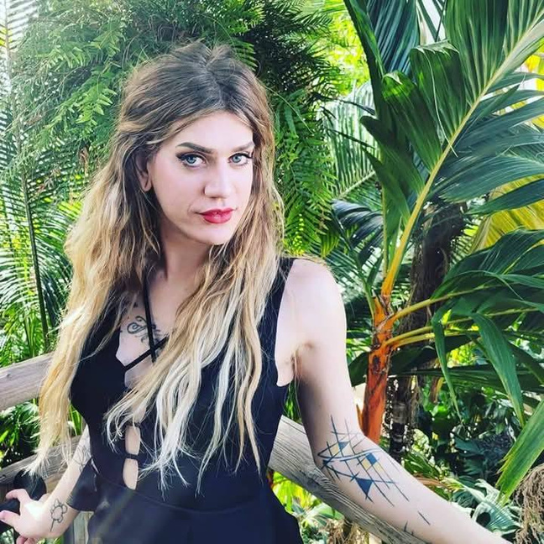
  Jax Gratton
Jax was a 34-year-old transgender woman from Denver, CO. She worked as a hair stylist, and was beloved by her community for the joy and love she brought to others.
Jax went missing in April, and her remains were discovered in Lakewood, CO on June 6, 2025. Unfortunately, the cause of death was unable to be determined and the investigation is ongoing.

Slide 22
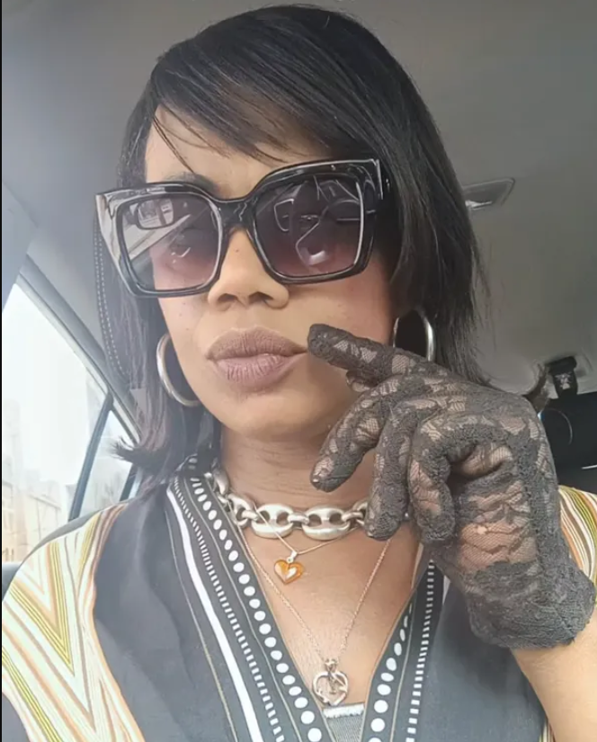
  Laura Schueler
Laura was a 47-year-old transgender woman from Cincinnati, OH. She was known for her strong fashion sense, being an animal lover, and being the first to check in on friends and family in need of support.
On June 7, 2025, Laura was shot near her home around 6:50 A.M. Police have yet to release details and are still investigating the incident.

Slide 23
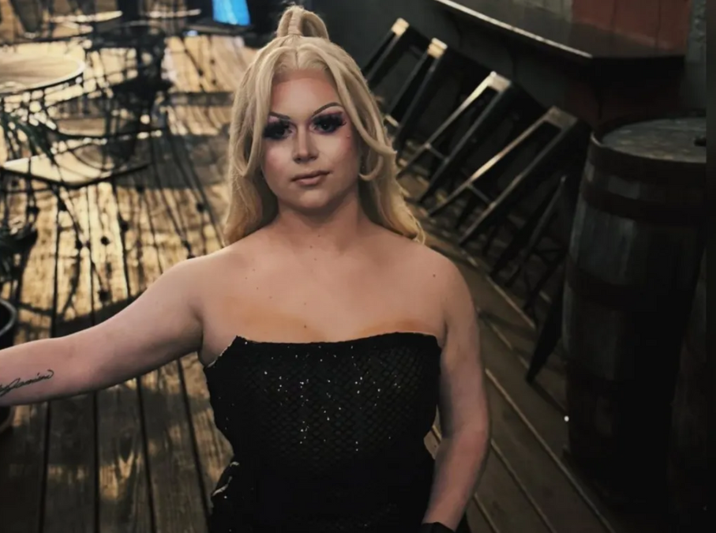
  JJ Godbey
JJ was a 26-year-old trans drag artist from Canton, OH. They were well-known in their local LGBTQ+ community as a performer and outspoken activist. They loved pop music, the Pittsburgh Steelers, and movies.
On June 19, 2025, JJ was reported missing. Several weeks later, police arrested & charged their former boyfriend, Daniel Mattay, with homicide. JJ has yet to be located.

Slide 24
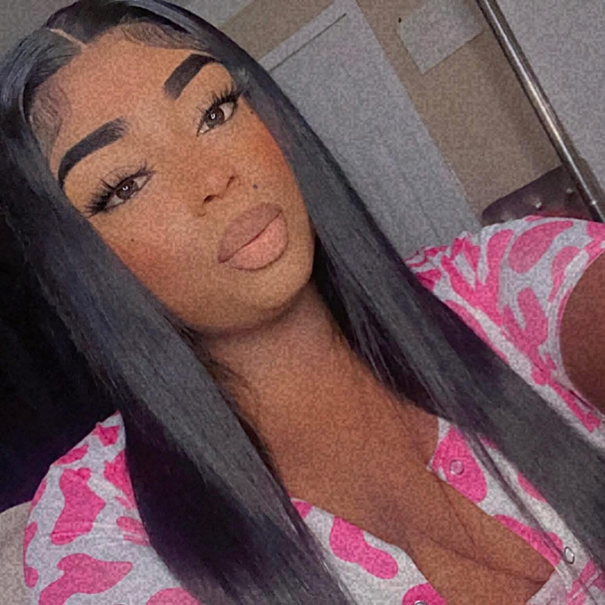
  Christina Hayes
Christina was a 28-year-old transgender woman from Detroit, MI. While few details are available about her life, her loss is deeply felt and remembered by the community.
On June 21, 2025, Christina was murdered by a client after he learned of her transgender identity. The suspect, Malique Javon Fails, was arrested by Detroit Police and is currently awaiting trial

Slide 25
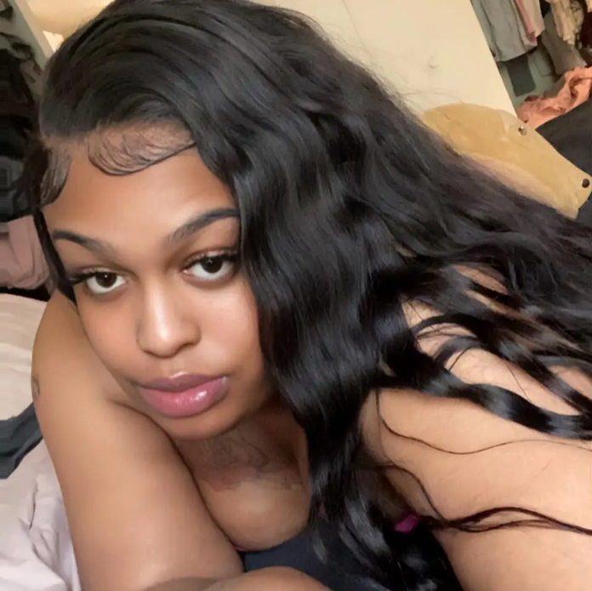
  Kamora Woods
Kamora was a 27-year-old transgender woman from Indianapolis, IN. She is remembered as an animal lover who could make anyone laugh, and was very loved by her friends and family.
On June 26, 2025, Kamora was found by her mother, Danielle, in her bedroom. Police determined she died from a gunshot on June 25 and have arrested suspect James Wallace, who is awaiting trial.

Slide 26
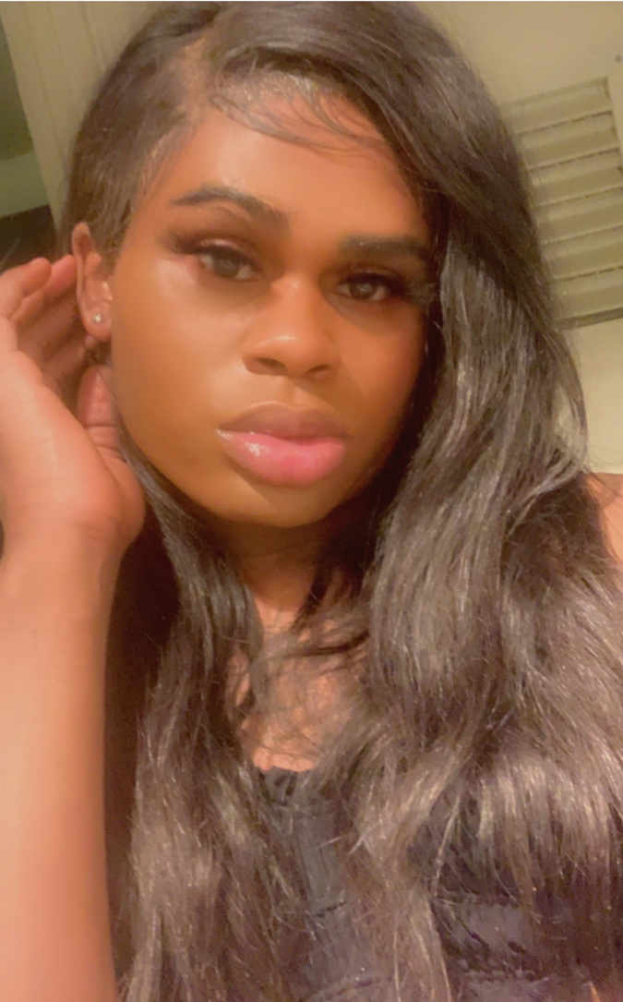
  Dream Johnson
Dream was a 28-year-old transgender woman from Washington, D.C. She was loved by her friends and family, and was known as a radiant spirit filled with love, laughter, and the courage to live authentically.
On July 5, 2025, Dream was found unconscious by D.C. EMS, suffering from gunshot wounds, and was pronounced dead at a local hospital. Witnesses claim the assailants used hateful speech; however, D.C. Police have not yet identified any suspects.

Slide 27
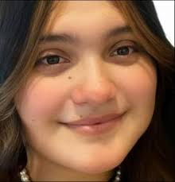
  Rosa Machuca
Rosa was a 24-year-old transgender woman from Austin, TX. She was loved by her fiancée Kim Dang, who had been with Rosa for 11 years, and is remembered as being kind, caring and loving.
On August 11, 2025, Rosa was one of three people killed in a shooting in the parking lot of her workplace, along with an elderly man and a 4-year-old child. Police have arrested and charged Ethan Neineker for the three murders.

Slide 28
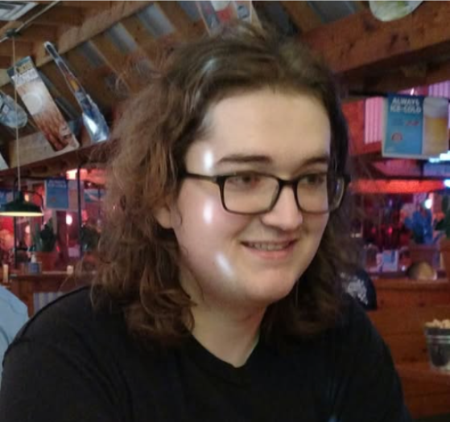
  Blair A. Sawyer
Blair was a 27-year-old transgender woman from Louisville, KY. She loved dragons and playing instruments, including the piano. She had a large community of friends and family due to her online gaming and artistic presence.
On August 11, 2025, Blair was the victim of a hit-and-run incident while riding her bicycle. Police and media misgendered & deadnamed her, and have not yet apprehended any suspect.

Slide 29
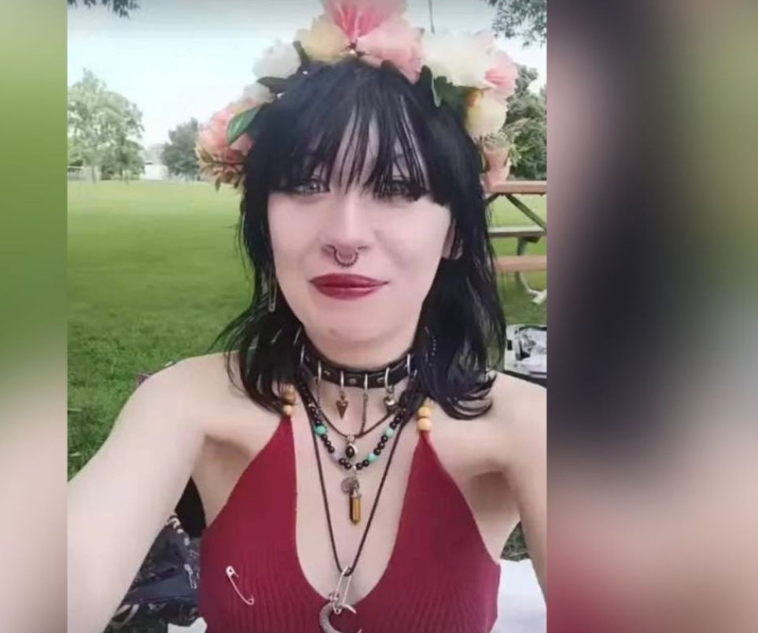
  Onyx Cornish
Onyx was a queer and trans 18-year-old from Caldwell, Idaho, who used he/they/she pronouns. They loved heavy metal, alt fashion & makeup, and their cat, Sami. They were outspoken on LGBTQ+ and political issues and were loved by many friends.
On August 18, 2025, Onyx was shot and killed by their adoptive father, along with Sami. Delbert Cornish was arrested, confessed, and is awaiting trial.

Slide 30
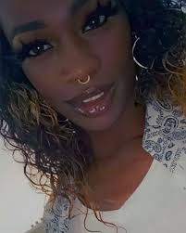
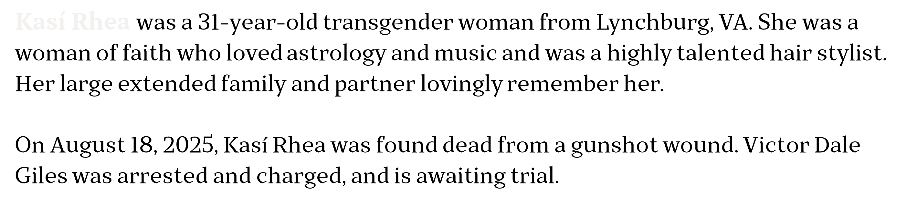
  Kasí Rhea ("Kaeyy Holmes")
Kasí Rhea was a 31-year-old transgender woman from Lynchburg, VA. She was a woman of faith who loved astrology and music and was a highly talented hair stylist. Her large extended family and partner lovingly remember her.
On August 18, 2025, Kas$í$ Rhea was found dead from a gunshot wound. Victor Dale Giles was arrested and charged, and is awaiting trial.

Slide 31
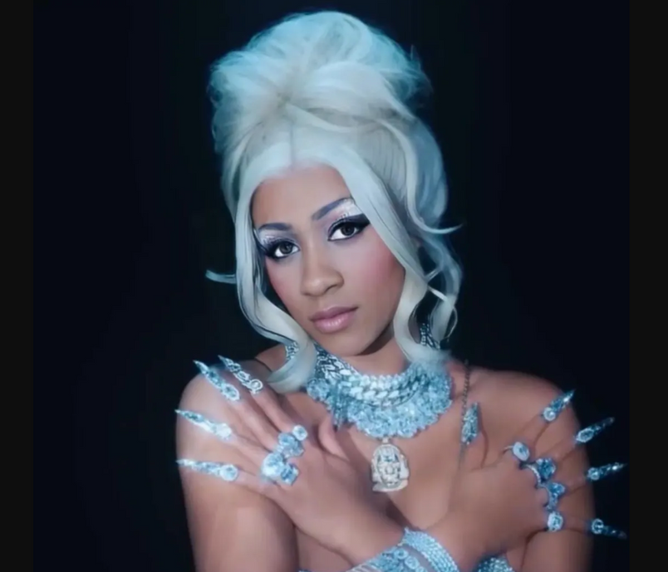
  Tiara Love Tori Jackson
Tiara Love was a 37-year-old transgender woman from Saginaw, MI, who had recently moved to Charlotte, NC. She worked in the healthcare industry, helping others, and loved music, dancing, and humor. She was known for participating in KiKi balls, winning trophies, and finding ballroom family in both states.
On September 26, 2025, Tiara died from gunshot wounds. Darris Dee Marshall was found on the scene of a second shooting, arrested, and charged.

Slide 32
  Individuals Who Died by Suicide
  Sydney Leigh Phillips ("Syd"): 22 Years Old; East Islip, NY, Nov. 4, 2024
  Roy Mora: 15 Years Old; Fort Bragg, CA, Dec. 7, 2024
  Aziza Barnes (“Z”): 31 Years Old; Oxford, MI, Dec. 15, 2024
  Meka Shabazz: 46 Years Old; Columbus, OH, Dec. 23, 2024
  Parker Savarese: 15 Years Old; Setauket, NY, Jan. 8, 2025
  Eliza Rae Shupe: Age unknown; Syracuse, NY, Jan. 27, 2025
  Katelyn Rinetta Benoit: 15 Years Old; Rochester, NY, Mar. 24, 2025
  Norah Horowitz: 38 Years Old; Virginia Beach, VA, Apr. 7, 2025
  Charlotte Fosgate: 17 Years Old; Portland, OR, May 25, 20205
  Tessa June: 21 Years Old; North Carolina, June 4, 2025
  Emma Slabach: 24 Years Old; Fort Wayne, IN, June 9, 2025

Slide 33
  Individuals Who Died by Suicide
  Lily-Dawn Harkins: Age unknown; Colorado; June 22, 2025
  Gabrielle Nguyen (“Cam”): Age unknown; Colorado, June 22, 2025
  Arty Cassidy Beowulf Gibson: 23 Years Old; Portland, OR, June 29, 2025

Slide 34
  2024 DATA
  78%
  42%
Victims were people of color
Victims with a known killer were killed by a romantic/sexual partner, friend, or family member
  56%
Black transgender women
  38%
  63%
Misgendered or deadnamed by authorities or the press
Killed with a gun
(Human Rights Campaign Foundation. (2024). The epidemic of violence against the transgender & gender-expansive community in the United States: Fatal violence report 2024.)

Slide 35
  CALL TO ACTION
  Partnering with the Pride Initiative , LGBTQIA+ Commission, SMC Pride Center, CoastPride, and/or Gender Justice LA (now in Pacifica) to strengthen LGBTQ+ data sharing, highlight inequities, and improve SOGI data collection.
  Launching Transgender, Gender Diverse, and Intersex (TGI) Cultural Competency Training for BHRS staff and contractors
  Collaborating with the San Mateo County Pride Center to expand the TGI training with local data and resources.
  Supporting the dissemination of pronoun badge toppers across Health to increase visibility and belonging.
  Supporting the San Mateo County Transgender Day of Remembrance (TDoR) event. Each November, TDoR honors lives lost to anti-trans violence and calls us to action: to affirm dignity, confront inequities, and build safer communities.
We invite staff, clients, and community members to join us for San Mateo County’s Transgender Day of Remembrance on November 20th, 5:30–7:30 PM at the South San Francisco Parks and Recreation Center. Together, we can remember lives lost, stand with our transgender community, and continue building a county where all can thrive.

Slide 36
  Sources
GLAAD
Doubly Victimized, Reporting on Transgender Victims of Crime. https://www.glaad.org/publications/transgendervictimsofcrime
Advocates for Trans Equality (formally the National Center for Transgender Equality)
Human Rights Campaign The epidemic of violence against the transgender & gender-expansive community in the United States: Fatal violence report 2024.)
Trans Lives Matter
Remembering Our Dead

Slide 37

  Say Their Names

