Slide 1

Behavioral Health and Recovery Services
Office of Diversity and Equity (ODE)
May 15th, 2025
Dr. Tia Bell
Frances Lobos

Slide 2
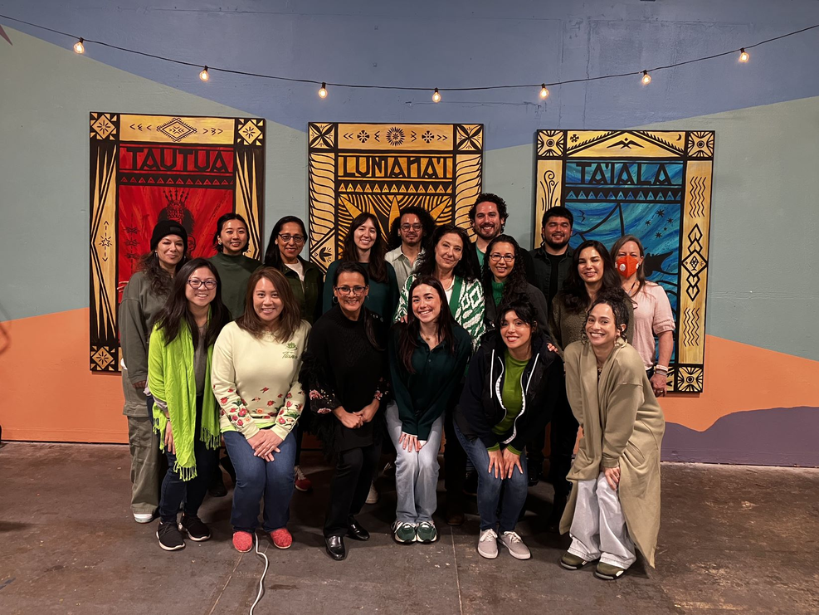
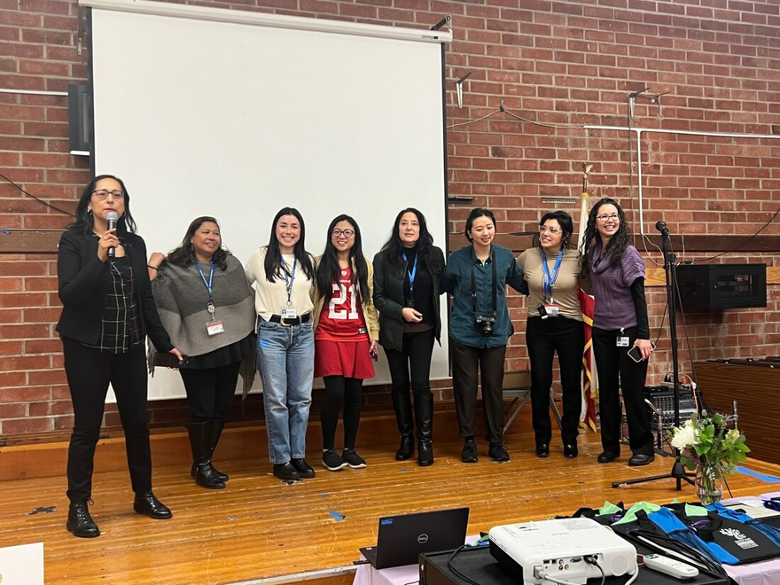
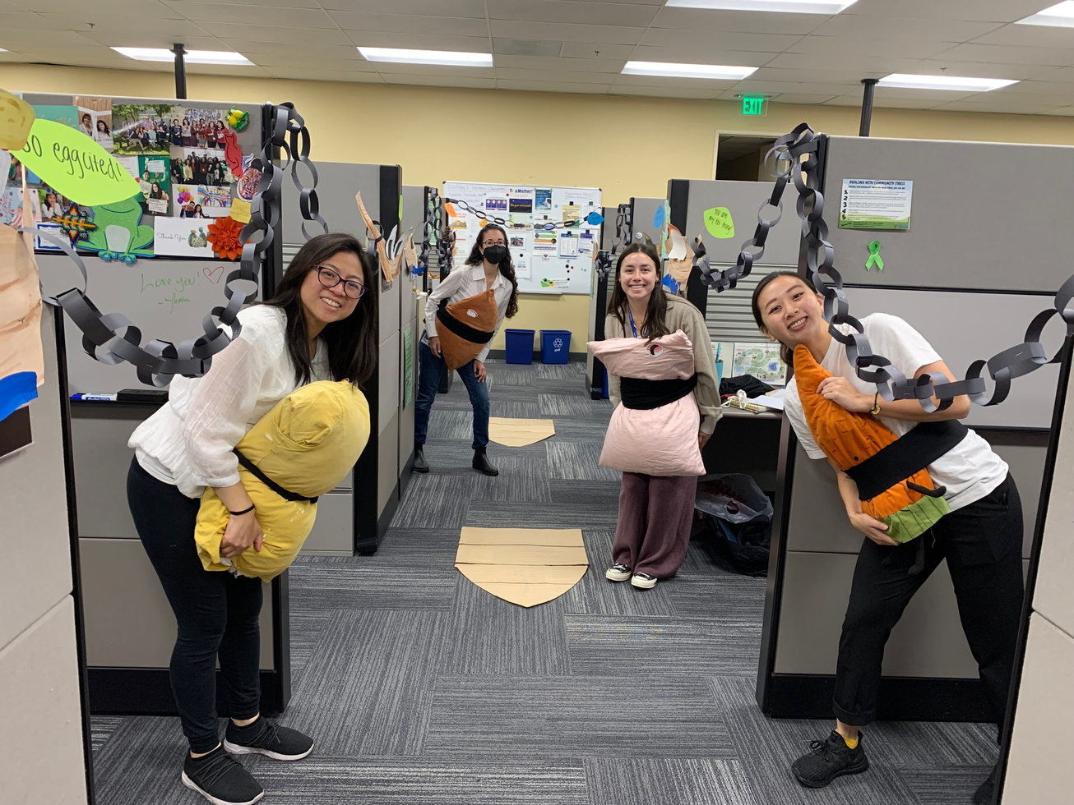


Who we are...
At BHRS ODE, we strive to make behavioral health services culturally appropriate while ensuring substance use services and mental wellness are accessible to all San Mateo County residents.

Slide 3
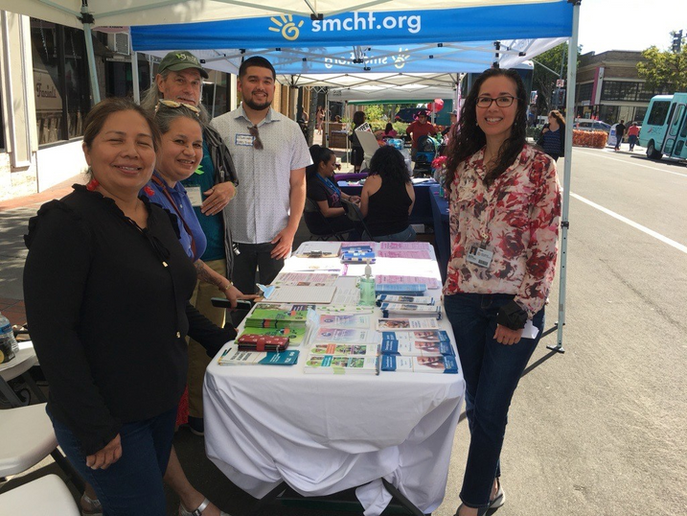
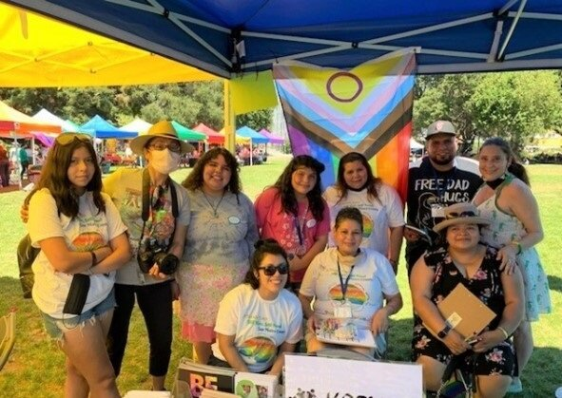
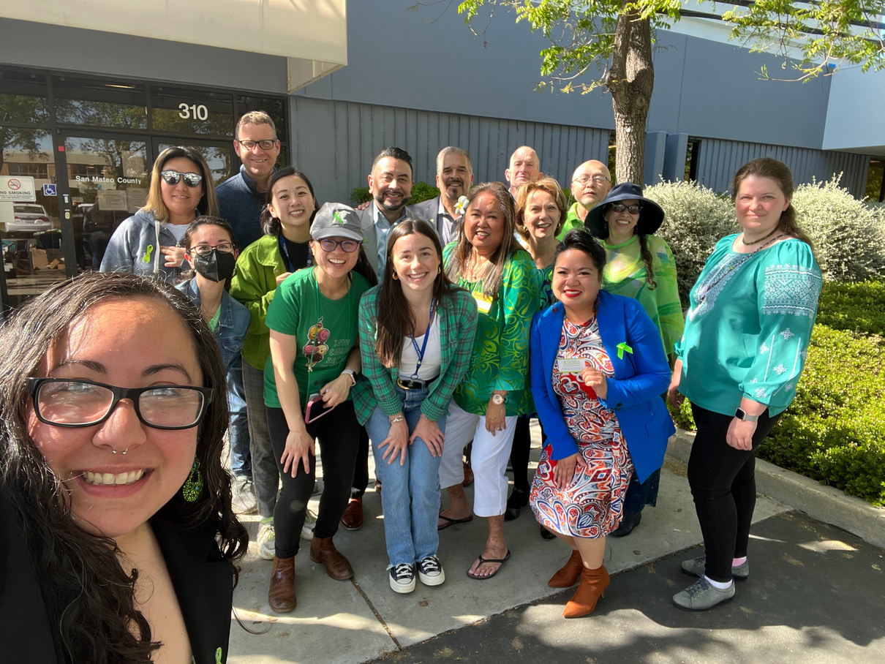
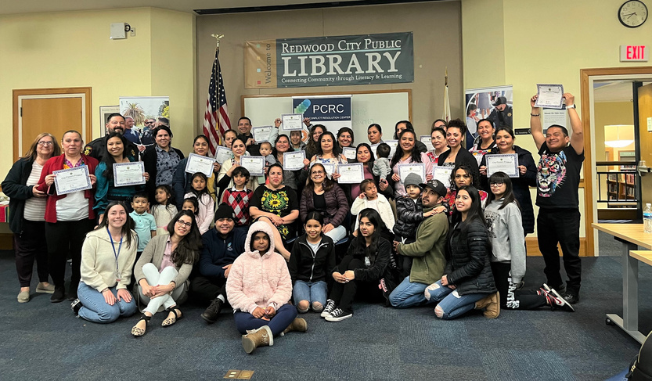

ODE’s Mission:
We work with our partners to advance health equity in behavioral health outcomes for our community members.

Slide 4

Health Equity Initiatives
  Focus on reducing disparities in access & quality of care
  Work towards reducing stigma related to behavioral health
  Improve workforce development efforts
Notes:
-Collaborative effort between Behavioral Health and Recovery Services (BHRS), local partners, community members, BHRS clients and their families to improve behavioral health & health disparities in marginalized communities
-Do that through:
---focusing on reducing disparities in access/quality of care
---working towards dismantling stigma related to BH
---improving work force development efforts (by prioritizing cultural humility, inclusion, and equitable quality care)
-the HEI's also contribute to
--Educating and empowering community members
--Supporting wellness and recovery
--Building culturally responsive services
-Beginning in 2006, some of first initiatives were formed after a community ax identified service needs in PI and Filipino communities
-by 2007, HEIs began working towards decreasing stigma, educating and empowering community members, supporting wellness and recovery, and building culturally responsive services
-programming such as HEIs, address systemic and community biases & prioritize social supports

Slide 5
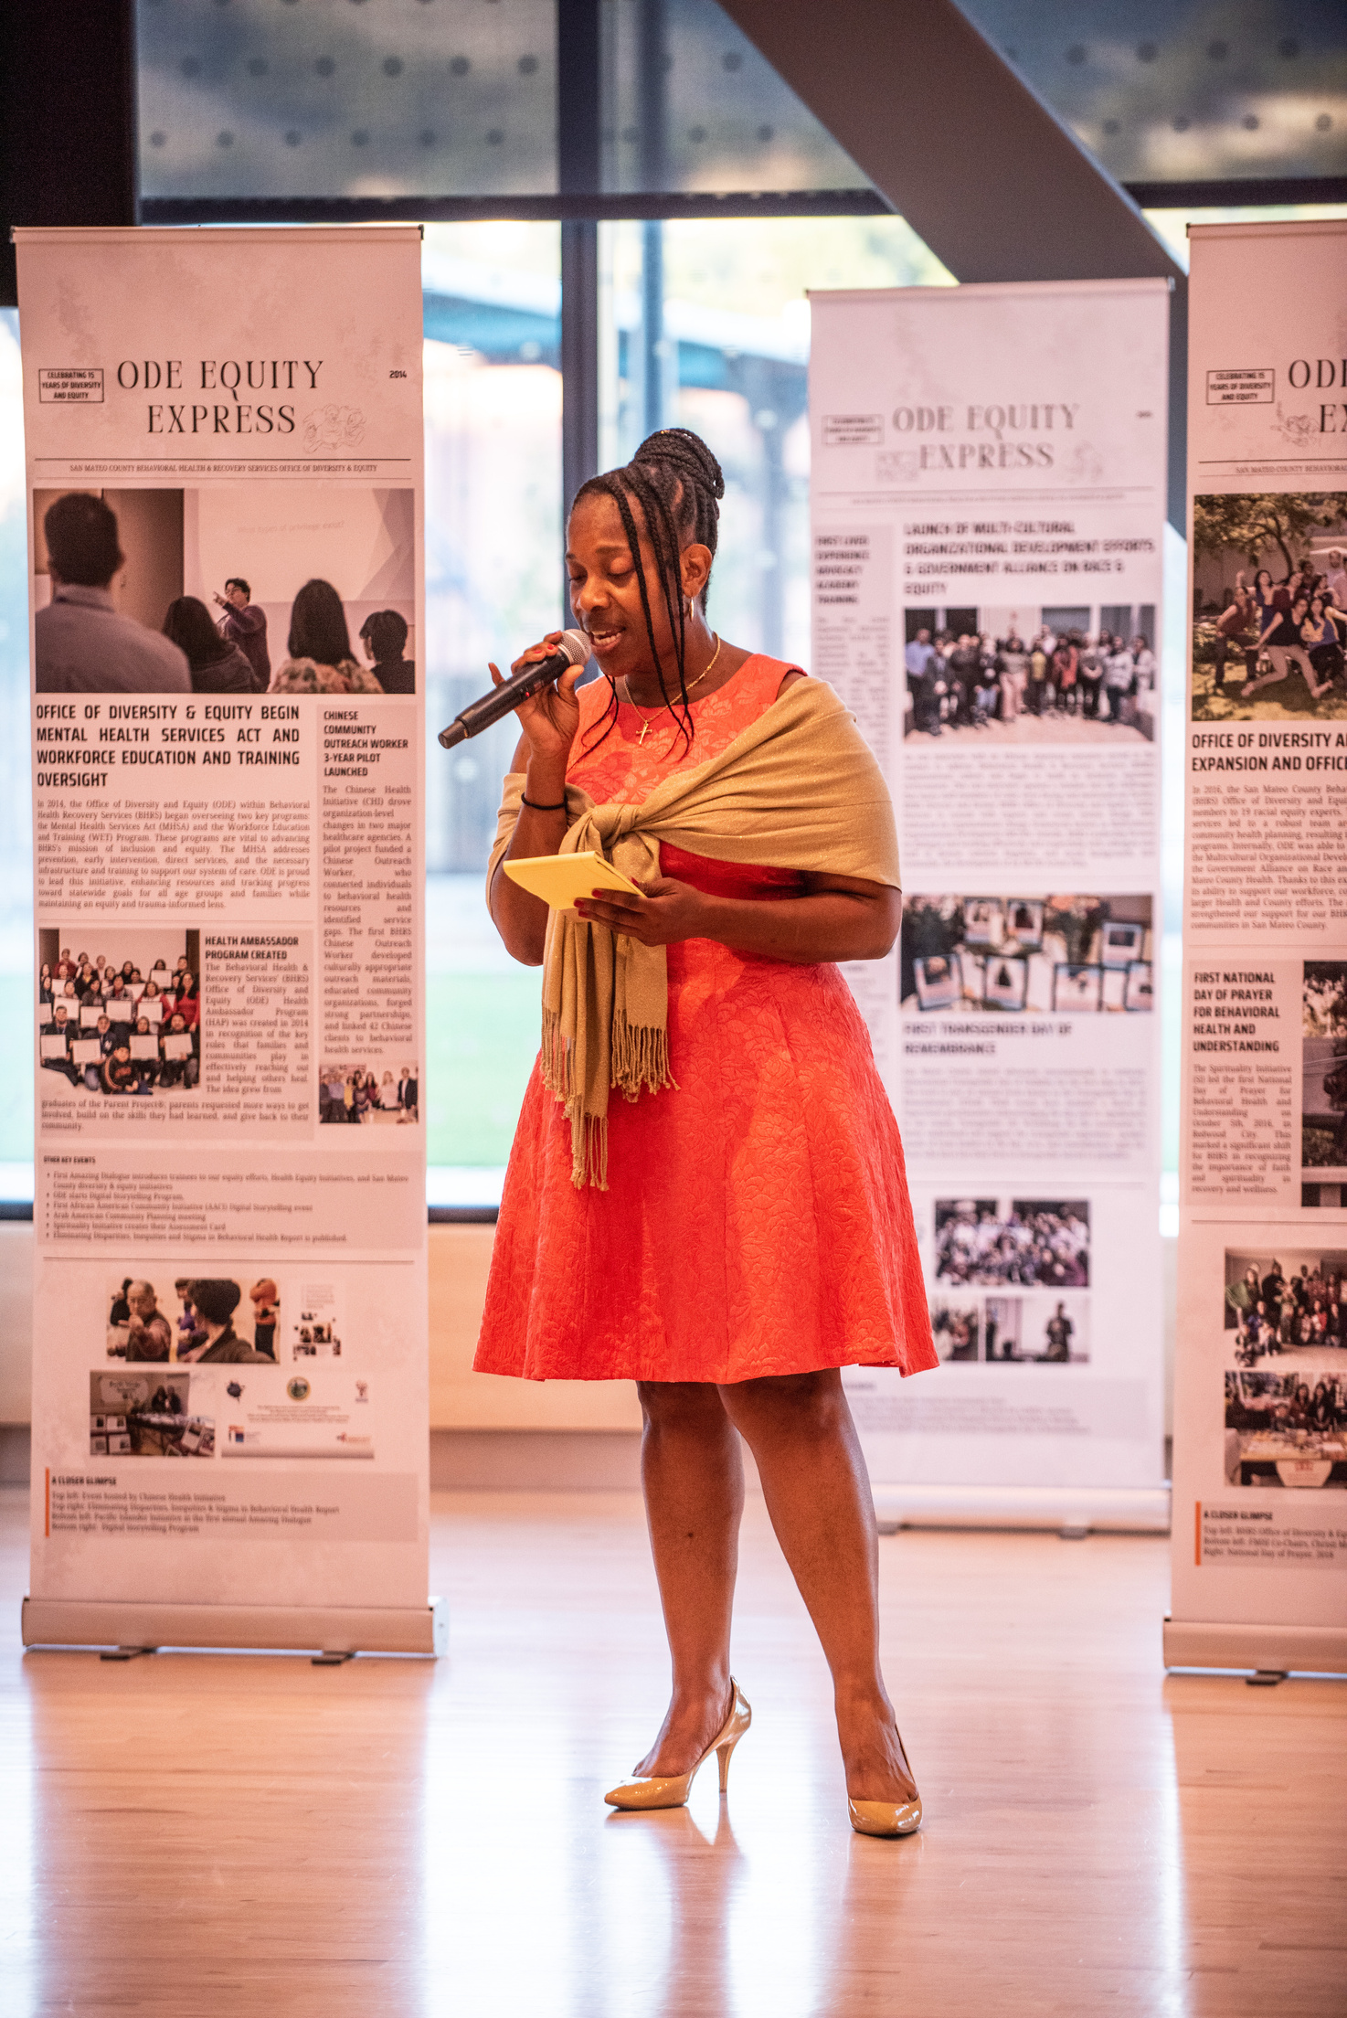
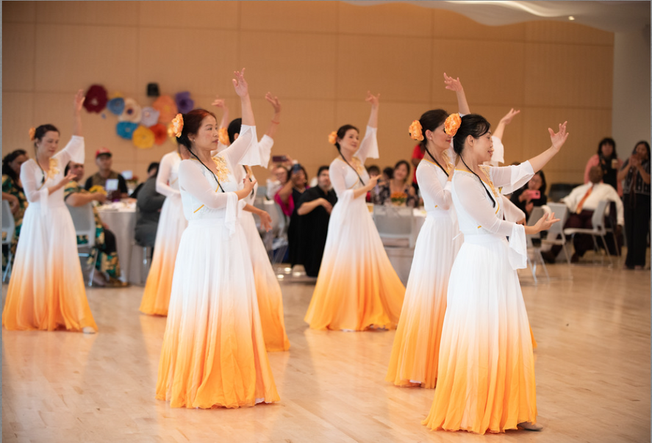
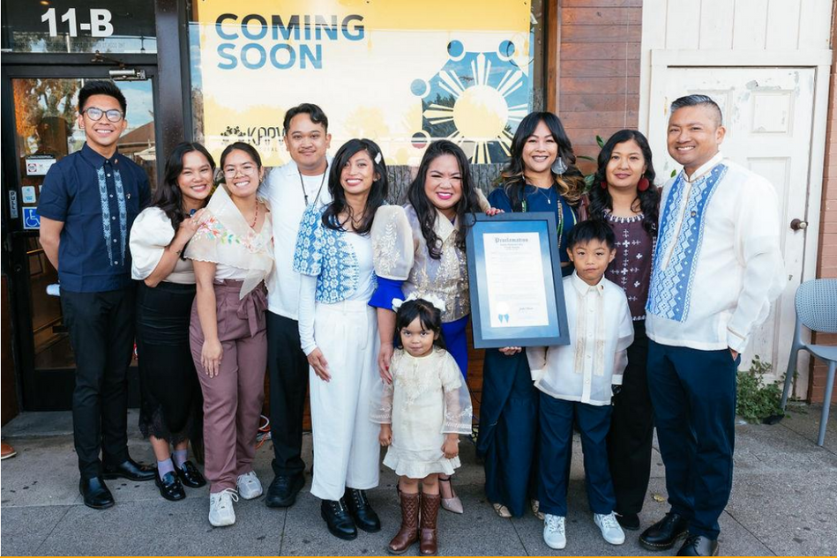
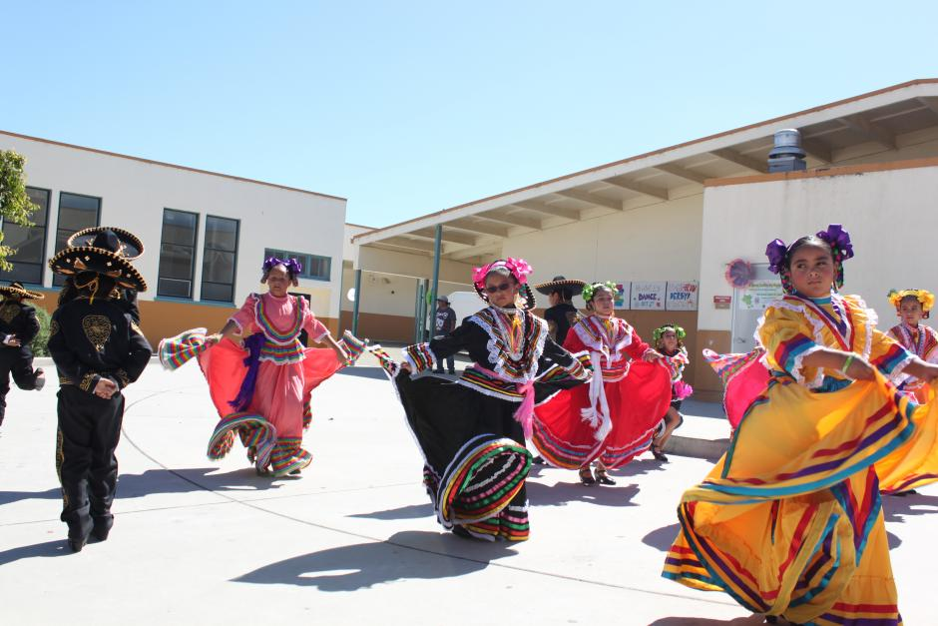
Building Wellness in Your Community

Slide 6
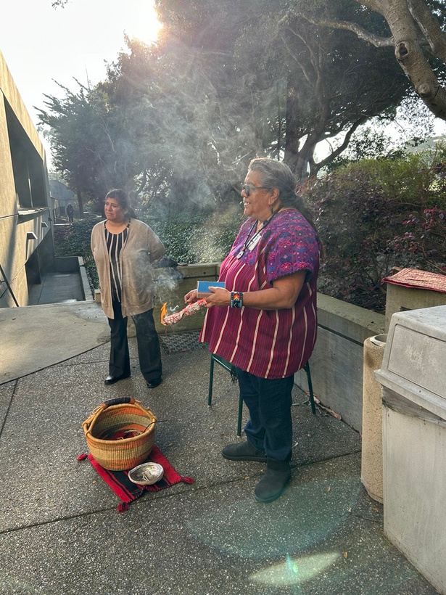
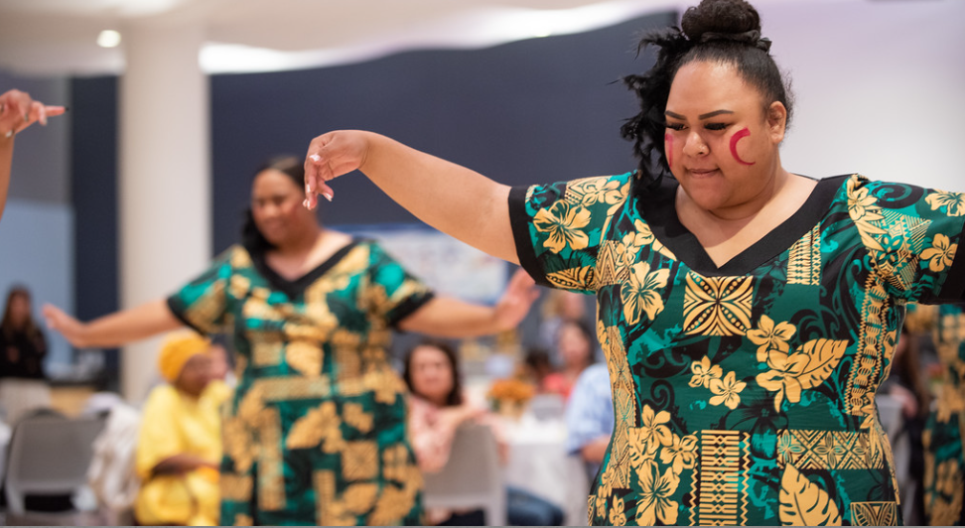
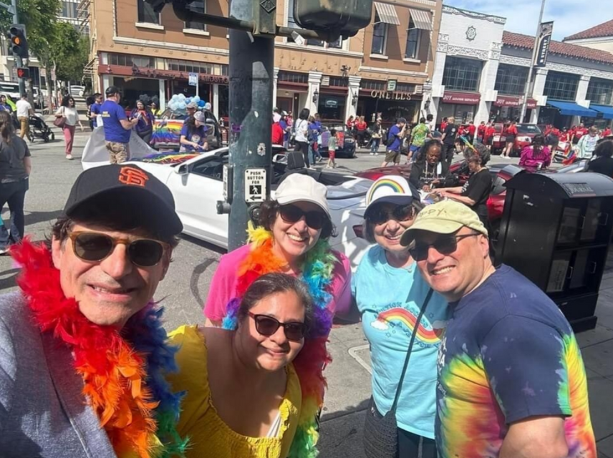
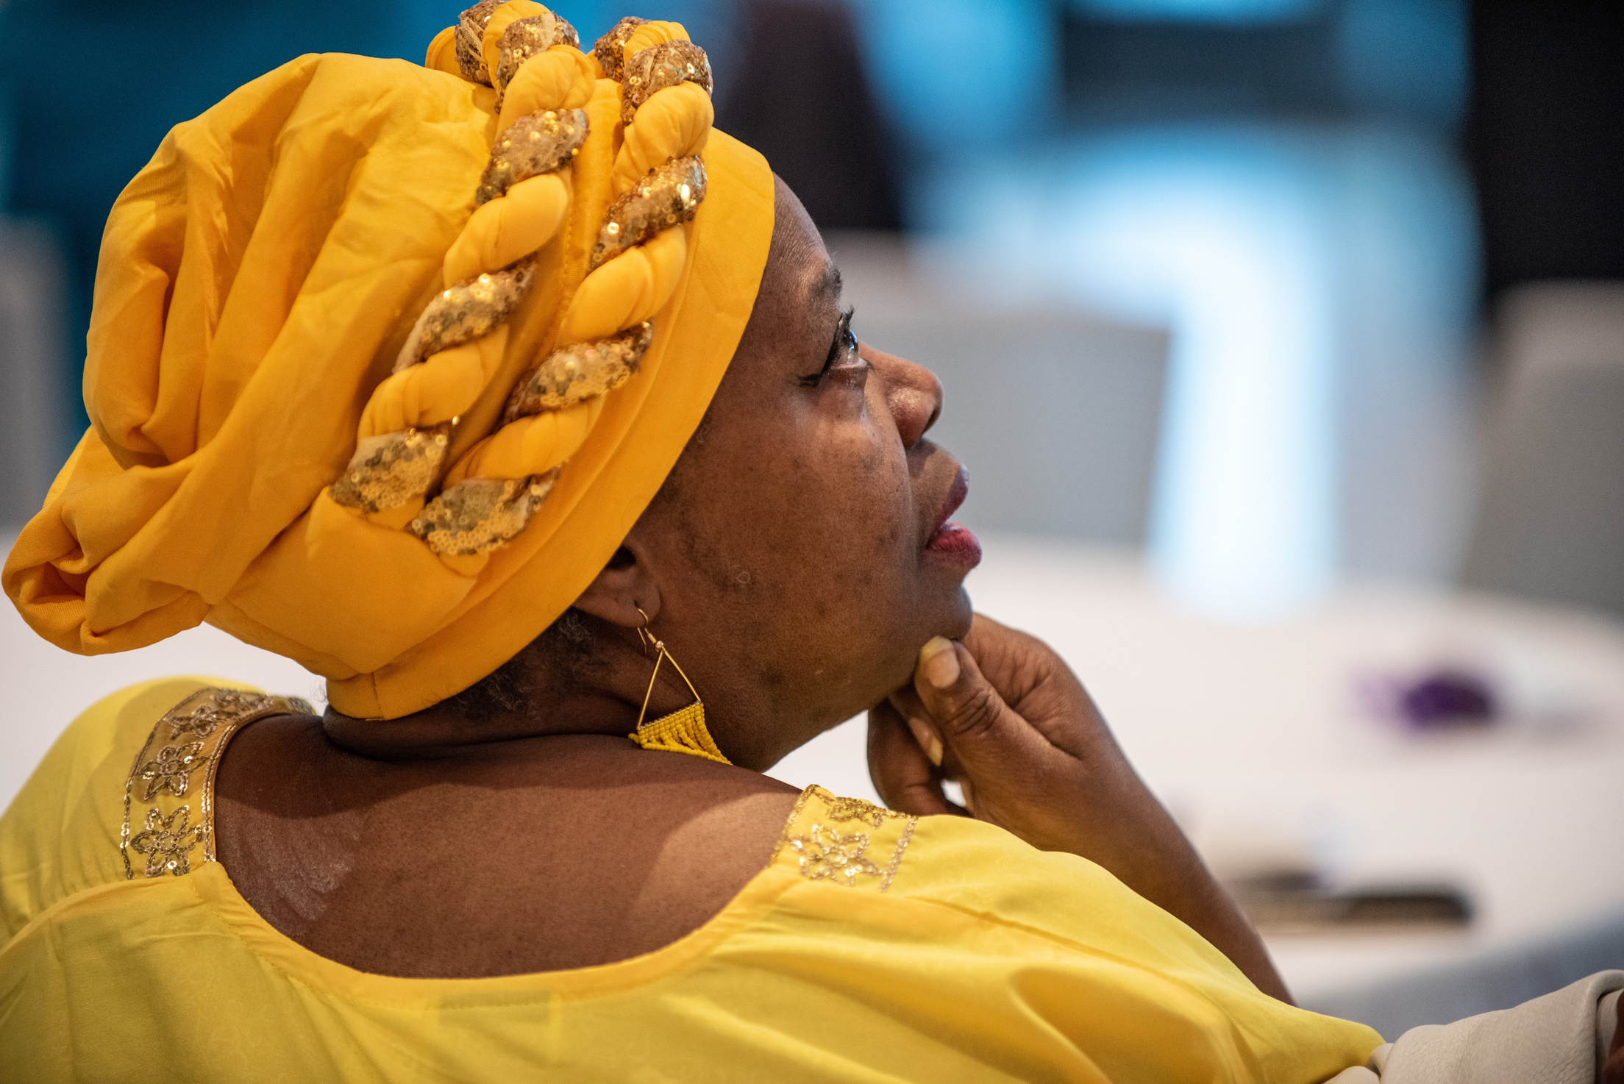
Building Wellness in Your Community

Slide 7
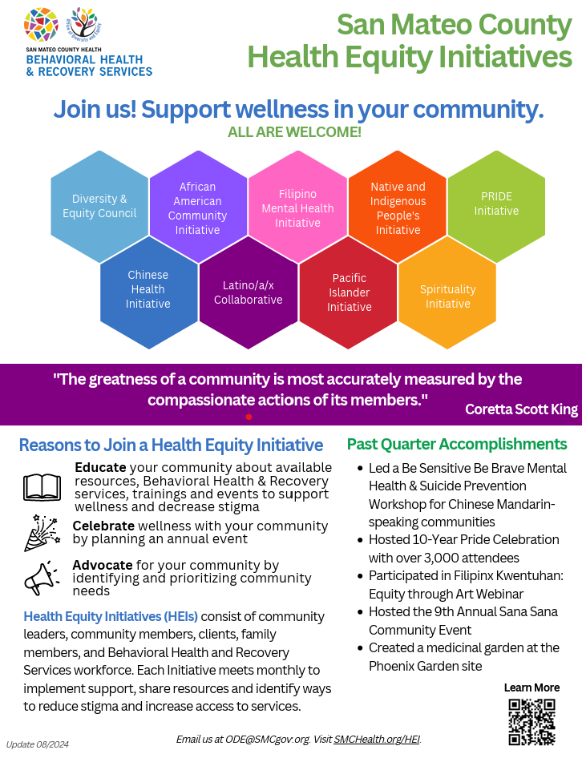
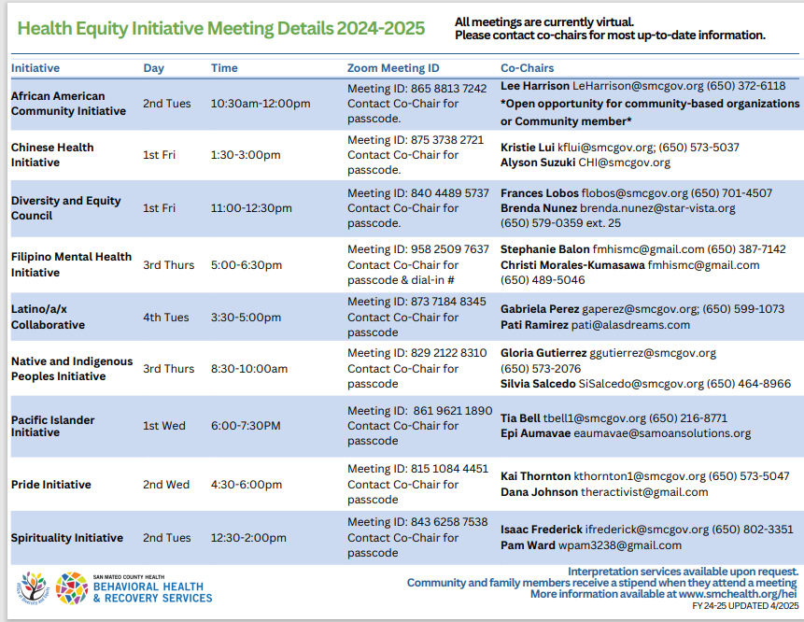

Slide 8
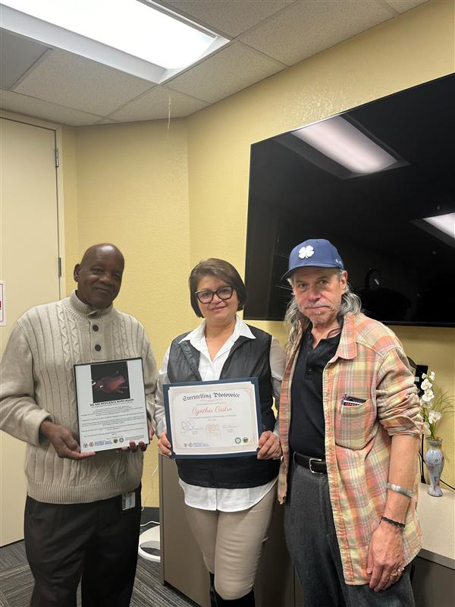

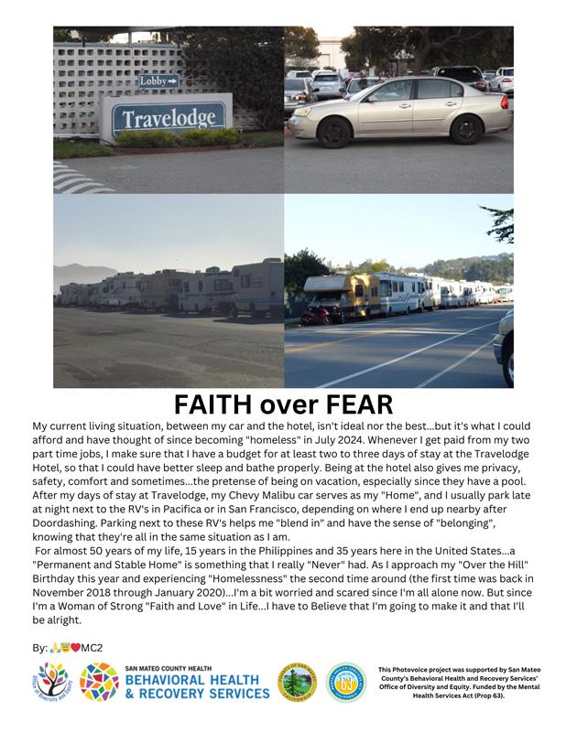
The Photovoice Storytelling Program
The Photovoice Program amplifies lived experience & enhance self-expression in an effort to target inequities and create more equitable behavioral health outcomes. Taking photos and sharing stories advocates for improved services not only in BHRS, but systemwide in San Mateo County. In doing so, Photovoices broaden the definition of wellness and recovery in a trauma-informed, culturally informed, and linguistically informed manner.

Slide 9

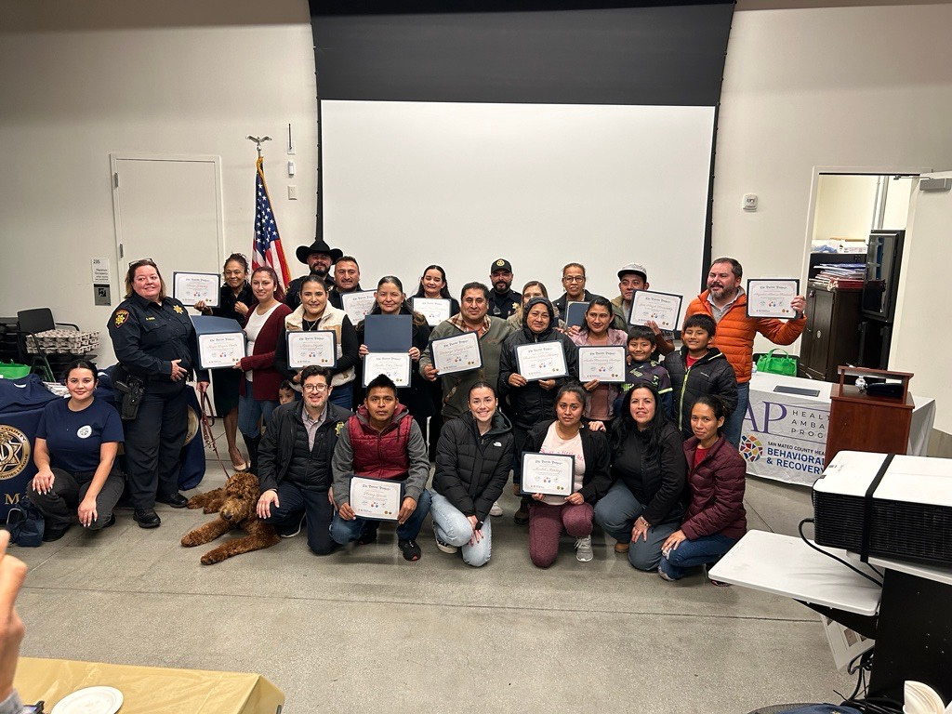
The Parent Project Program
The Parent Project is a 12-week parenting course offered in English and Spanish and is dedicated to improving family relationships while addressing unwanted behaviors in adolescents. Classes are offered via Zoom and in person. In-person classes include childcare and free dinner.

Slide 10
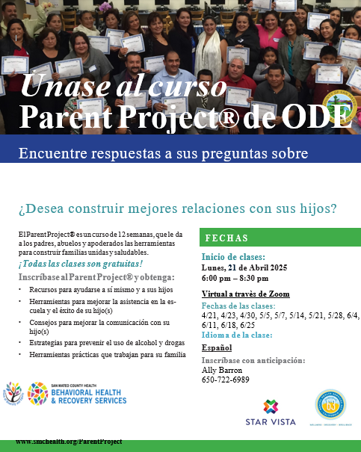

Virtual Parent Project Spanish class beginning on April 22nd!

Slide 11
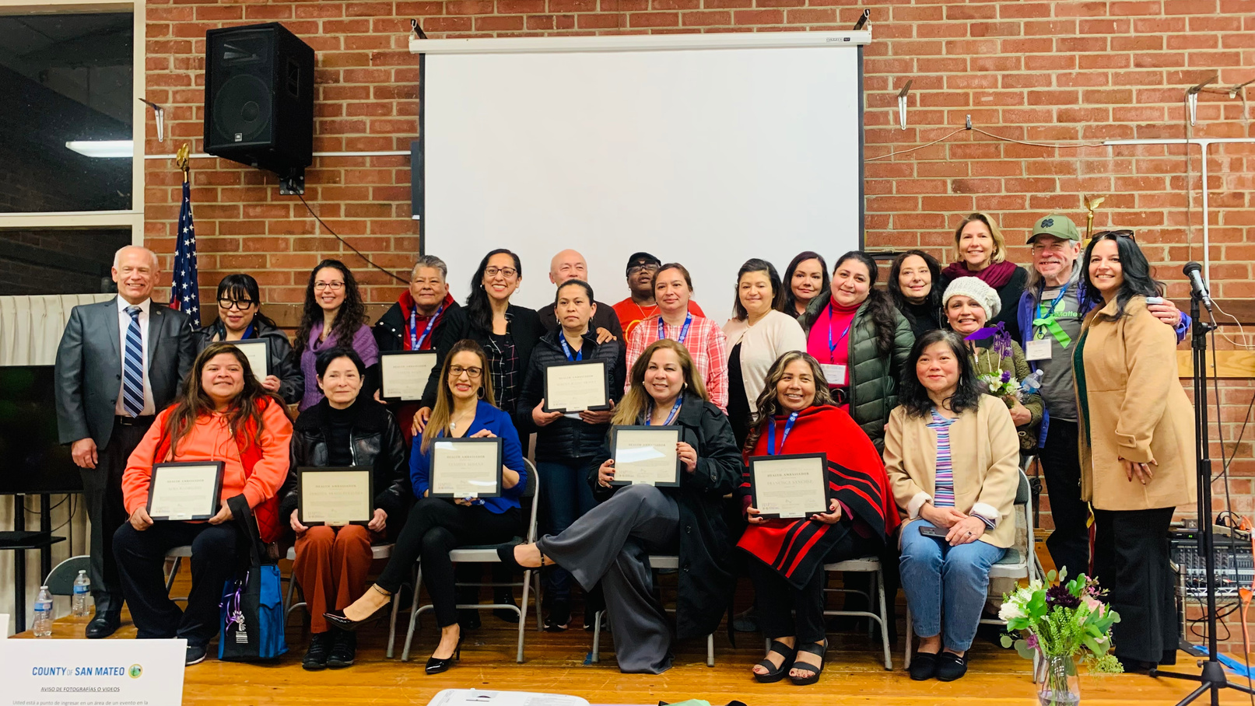
Health Ambassador Program
San Mateo County’s Behavioral Health and Recovery Services (BHRS) Health Ambassador Program was created in recognition of the important role that community members serve in effectively reaching out to others in the community

Slide 12

How do Health Ambassadors help the Community?
  Increase community awareness of services available in San Mateo County and help connect individuals to appropriate care and support.
  Reduce the stigma around mental health and substance use issues so individuals are more willing to get help.
  Improve your community’s ability to recognize the signs and symptoms of mental health and/or substance use issues and implement social change.
  Foster community support and involvement in BHRS’ vision to improve services.
  Assist communities in practicing prevention and early intervention, leading to healthier and stronger families.

Slide 13
How do I Become a Health Ambassador?
COMPLETE 5 out of 11 Trainings or Workshops
NAMI Family to Family A 12-week educational program for family/caregivers of individuals with severe mental illness. Learn current information about psychiatric diagnosis, treatment & strategies to help a loved one
NAMI Basics A 6-week educational program designed for parents & other family caregivers of children & adolescents with emotional & behavioral difficulties. Helps caregivers understand the illnesses that are causing difficulties and the critical role of family in treatment.
Applied Suicide Intervention Skills Training (ASIST) Helps people effectively recognize & intervene to prevent suicide. This training helps individuals respond to crisis situations & provides tools to help prevent the immediate risk of suicide.

Slide 14
How do I Become a Health Ambassador?
COMPLETE 5 out of 11 Trainings or Workshops
Photo Voice Project: Enables community residents of all ages & languages to share information about their experiences through photos. A unique way to heal, educate our community & voice your local health issues.
Stigma Free San Mateo: Become active in advocating for the full inclusion & wellbeing of all persons in our community with mental health & substance use challenges. In this work, individuals engage in outreach, education & dialogue with members of our communities to help create a stigma free county.

Slide 15

How do I Become a Health Ambassador?
COMPLETE 5 out of 11 Trainings or Workshops
Lived Experience Academy: An 10-hour training offered to consumers & family members who want to learn how to share their stories of recovery in a way that empower themselves, inspires others and help improve the County’s behavioral health services. Graduates will be considered to present their stories at various BHRS programs/events.

Slide 16
To get in contact with San Mateo County Behavioral Health and Recovery Services Call Access Center, visit www.smchealth.org/bhrs-contacts or call
1-800-686-0101

Slide 17
Upcoming Office of Diversity Equity Events....

Slide 18


May Health Month

Slide 19
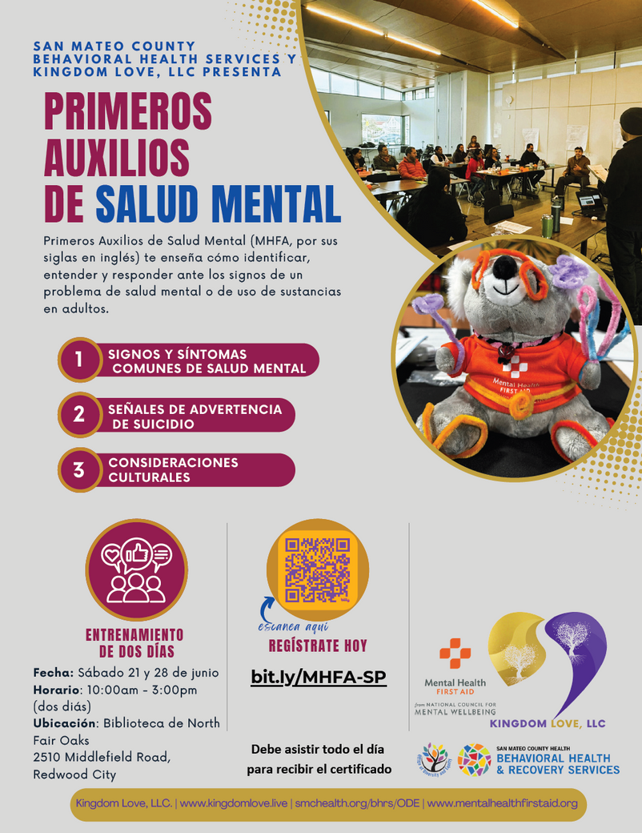
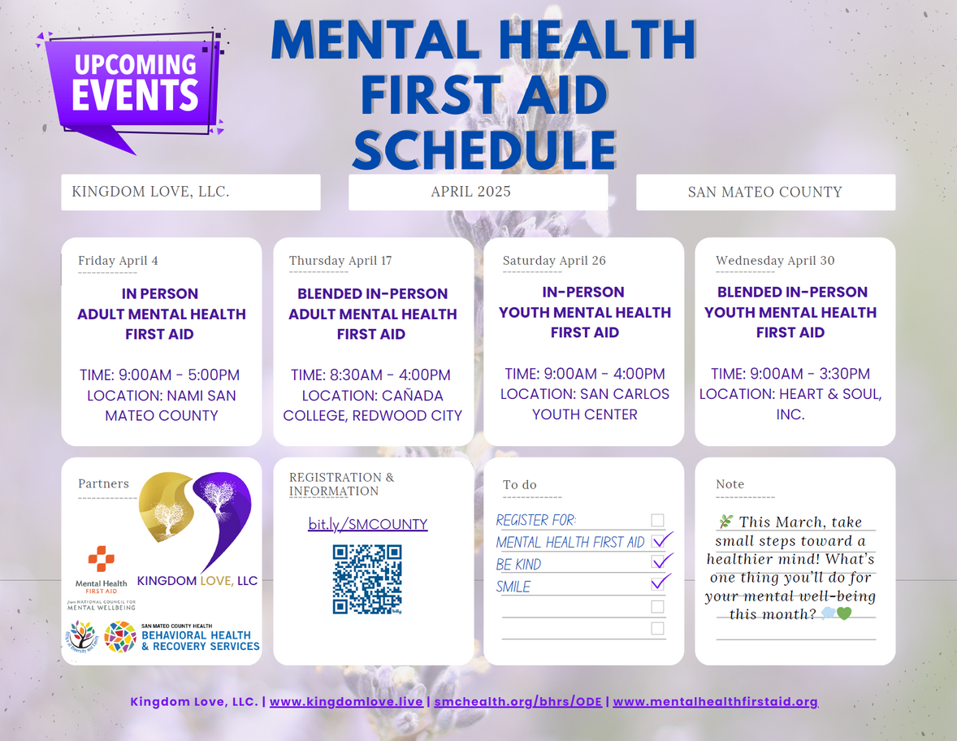
Mental Health First Aid Trainings

Slide 20

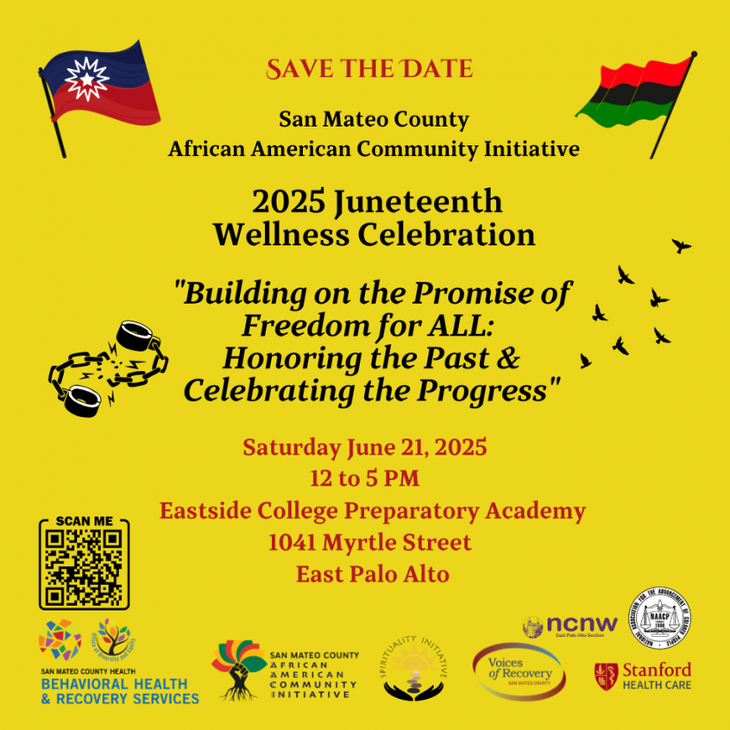
Health Equity Initiative Events

Slide 21
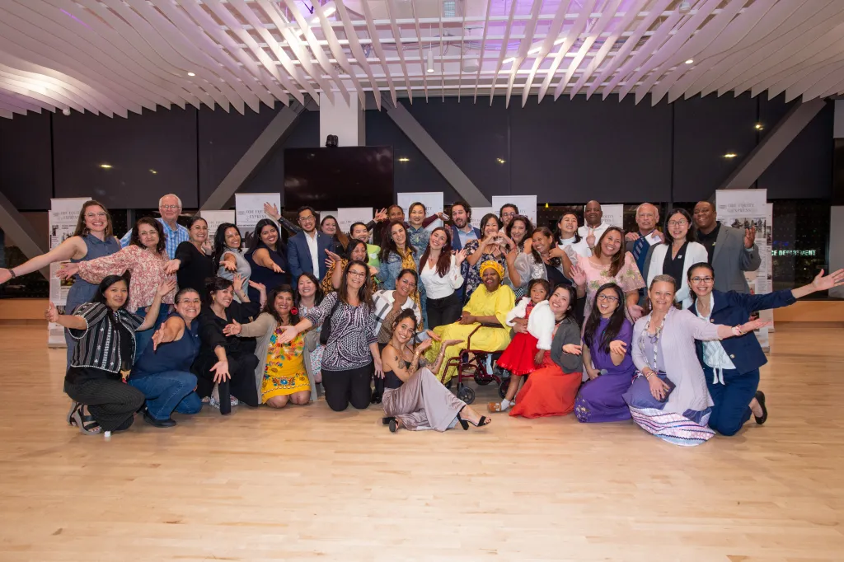
Check out our ODE blog and webpage to learn more...

Slide 22
Thank you!
Tia Bell (tbell1@smcgov.org)
Frances Lobos (flobos@smcgov.org)

