Slide 1

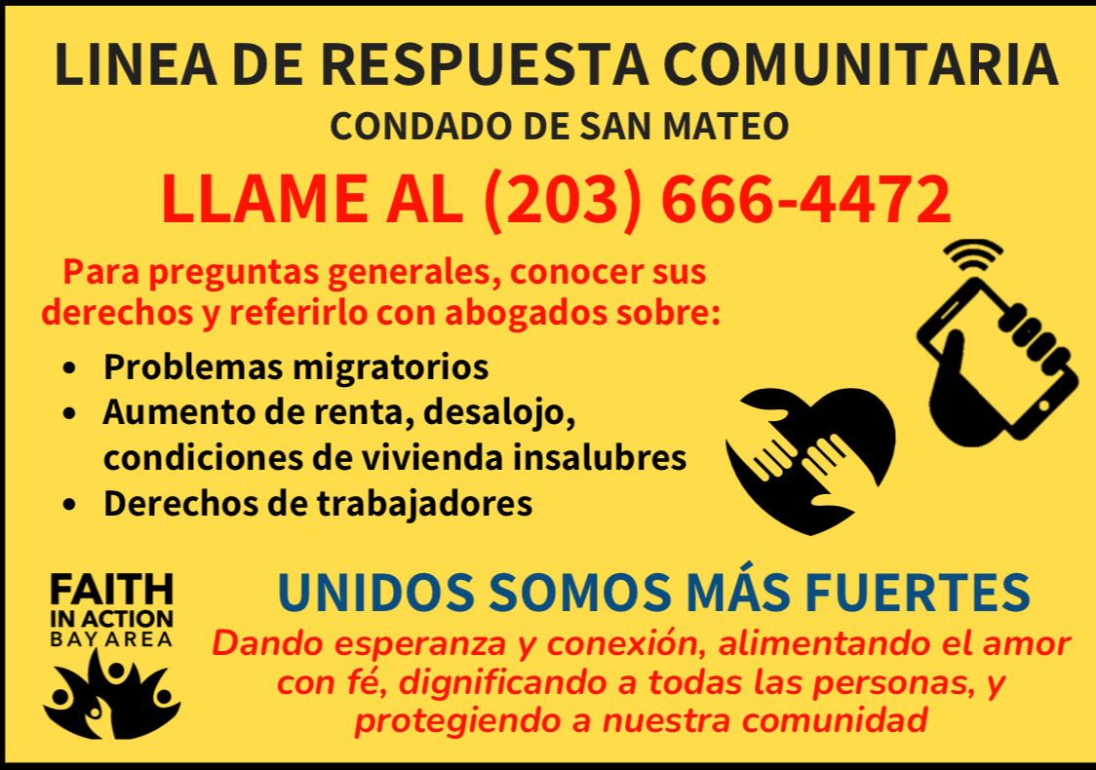
Power over
Panic
SMC Rapid Response Network: Protecting Immigrant Communities since 2017

Slide 2
What is the SMC Rapid Response Network
Hotline to receive calls about enforcement actions,
And
A coordinated legal response (intervention on the day of immigration arrest or short thereafter)
Community support:
Verification of ICE Activity
Advocacy
Accompaniment
Mutual Aid
Visibility
County, Community and Legal response for immigration enforcement actions in our county

Slide 3




Key Components
Community
Hotline
Attorney Responders
Witness enforcement, receive a call from a just-detained loved one, or otherwise first-hand knowledge of an immigration arrest, or enforcement operation
Dispatchers answer calls, gather initial information (intake) to equip attorneys to efficiently respond, and to record potential rights violations
Lead of the day-of response, including direct advocacy with ICE and/or pro se filings in courts.
Leads the communication with the detained community member

Slide 4
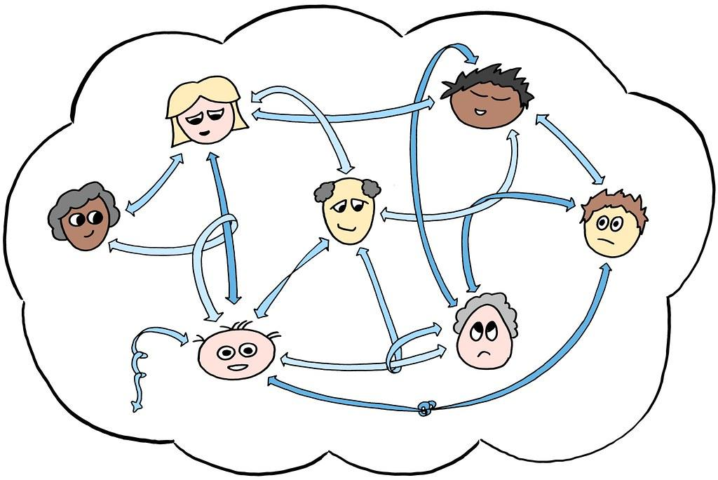


Key Components
Verification (ICE or Rumors?)
Mutual Aid
Organizers
Support as needed for the family of the detainee with essential needs– it could be connecting to resources for mental health, rent support, food, etc
Accompaniment to court, etc
Coordinate solidarity across the community and the impacted family to advocate, when needed (this could look like press events, letters, etc)
Community Volunteers across the county, able to verify rumors about ICE enforcement in our neighborhoods. If ICE is present, they are able to document activity.

Slide 5
Steps in a Rapid Response Activation for a detention in SMC
Community member calls the Hotline
Dispatcher supports the caller with what they may need. IF the call is about an ICE detention, then the dispatcher does an intake and submits it to the attorneys
If there is enough time (before 3PM), the Attorney Responder attempts to offer intake, consultation, and advocacy and /or limited scope representation with the goal of stopping imminent deportation, and other goals like bond/release or at least being sent to a facility in CA

Slide 6
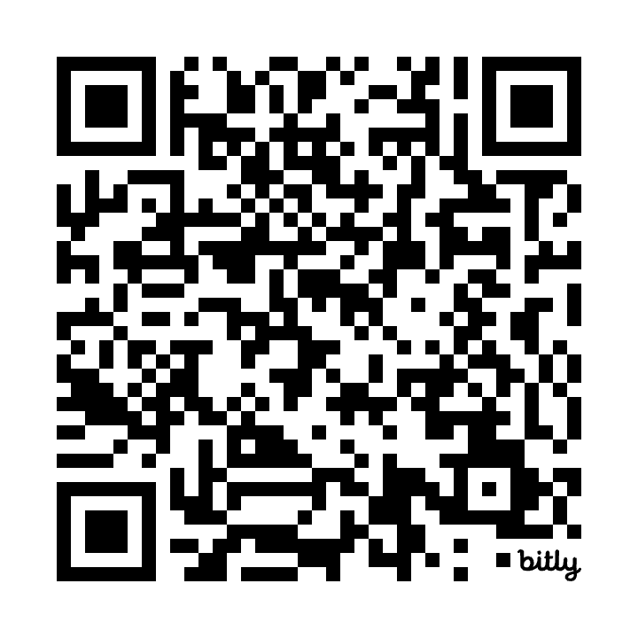
How can I support?
Donate to direct support for victims’ families
Verifiers
Visibility
Become part of the Verification Team for the SMC Hotline
Verify rumors of ICE presence in your city
If ICE is present, document and observe
Become part of the Visibility Team for the SMC Hotline
Make sure that businesses, orgs, libraries, etc in your city have posters on their windows (throughout the year)
Yellow cards, Red cards, Posters
100% of donations go directly to families impacted by ICE detention or deportation
bit.ly/SMC-immigration-fund
Email fiabayarea@faithinactionba.org to learn how to get involved

Slide 7
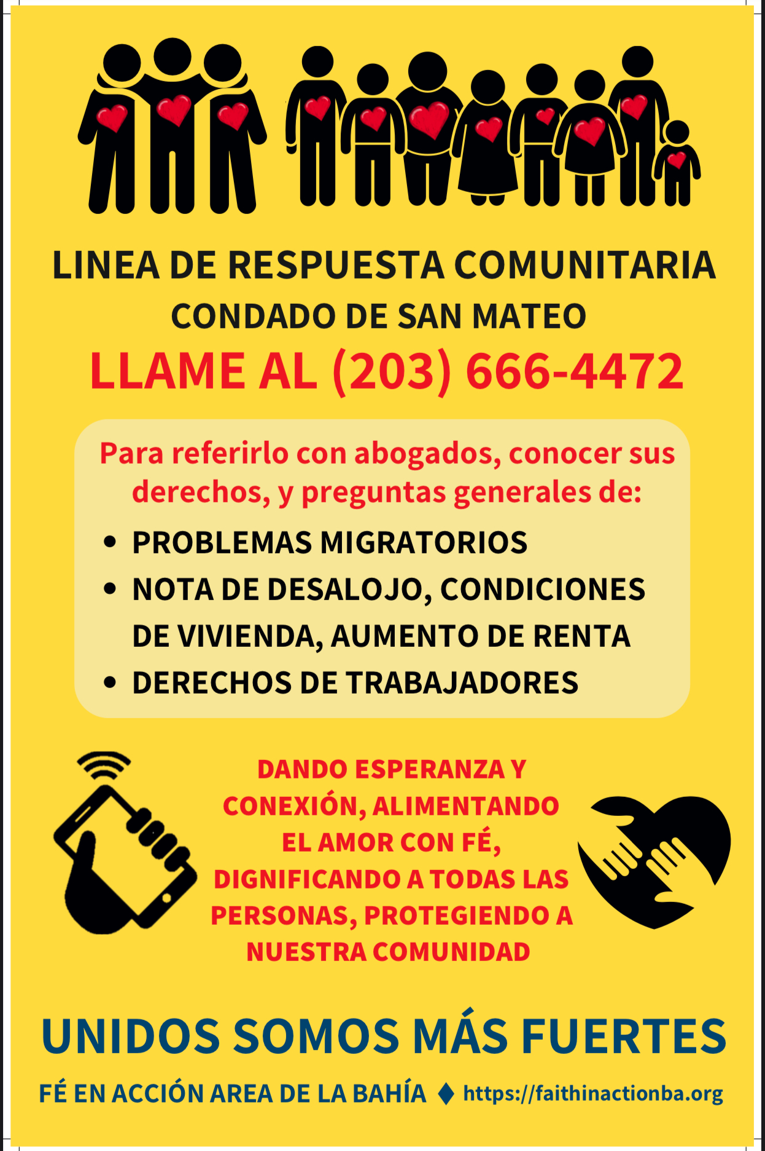
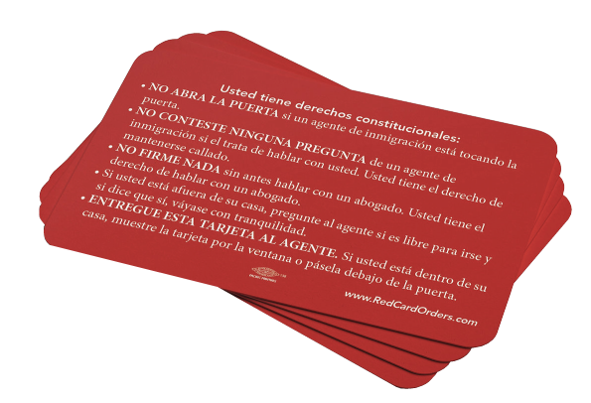

Slide 8

In this challenging time we are more aware of than ever of the strength and solidarity in our community, and we THANK YOU for joining us in strengthening the SMC Rapid Response Network.
When we protect the most vulnerable people in our community, all of us are more protected.
When we are connected and aware of our interconnectedness, we find the path forward together.

