Slide 1

IMMIGRATION OVERVIEW
January 2025
Immigration Institute of the Bay Area

Slide 2
Immigration Institute of the Bay Area
IIBA OFFICES
Immigration Institute of the Bay Area
Brentwood: 925-237-8581 ext. 11
Fremont: 510-894-3639
Napa: 707-266-1568 ext. 401
Oakland: 510-451-2846 x 301
Redwood City: 650-780-7530
San Francisco: 415-538-8100 x 206
Petaluma: 707-932-7000
iibayarea.org
Call to make an appointment!
Notes:
https://www.youtube.com/watch?v=b3qs1_WbI64
Intro
https://www.youtube.com/watch?v=2_kP8CHydSg
Why this works matters
https://www.youtube.com/watch?v=cdwtTU1v4FM
Citizenship
https://www.youtube.com/watch?v=VfW-Lun7CR4&list=UU3B0zol1iI6mEgbaGBDHRHg&index=1
DACA

Slide 3

PRESENTATION OUTLINE
What’s New?
Common Immigration Remedies
Know Your Rights
Resources in your community: OUR SERVICES

Slide 4
WHAT’S NEW?
DACA: The 5th Circuit Court of Appeals may rule against the DACA program very soon so we advise DACA recipients to renew as soon as possible.
New President: As of January 20th, we will have a new president and we fear that immigration cases may become more difficult but we don’t know in what way yet.

Slide 5
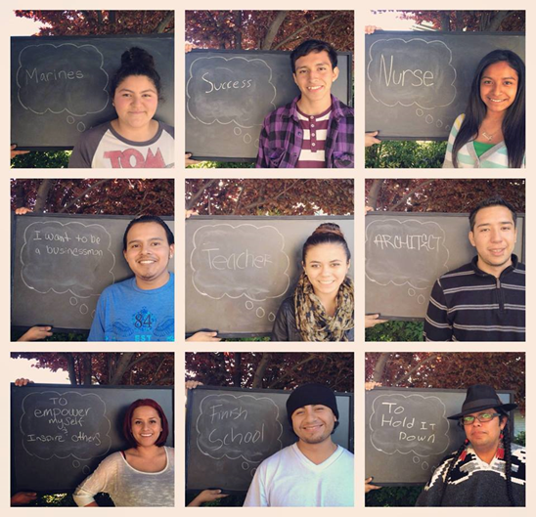
DACA

Slide 6
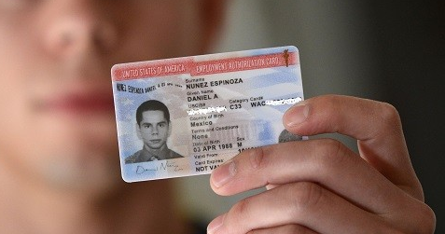
COMMON IMMIGRATION REMEDIES Immigration Institute of the Bay Area
DEFERRED ACTION FOR CHILDHOOD ARRIVALS (DACA)
Eligibility:
Under age of 31 as of June 15, 2012
Came to the U.S. before reaching age 16
Continuously resided in U.S. since June 15 2007
Physically present in U.S. on June 15, 2012
Entered without inspection before June 15 2012; or had lawful immigration status that expired by June 15, 2012
Meet educational requirement; or was an honorably discharged veteran of the U.S. armed forces or Coast Guard
Not convicted of a felony, significant misdemeanor, three or more other misdemeanors, and do not otherwise pose a threat to national security or public safety.
Benefits:
Work permit
Social Security number
Driver license/identification
Deferred action on immigration proceedings
DACA is a program created as an executive order – it is not law and can be changed by the president

Slide 7
Instituto de Inmigracion del Area de la Bahia
REMEDIOS COMUNES DE INMIGRACION
DEFERRED ACTION FOR CHILDHOOD ARRIVALS (DACA)
Now those who are eligible can apply for DACA for the first time, but because of a court case USCIS cannot yet approve those cases so they will just remain pending for now. This is still true even though there are new DACA regulations.
You have to show that you qualify (in the U.S. since 2007).
We can help you with your application and your documentation
You can renew every 2 years once they are able to approve your initial application.
If you have DACA, you can renew and apply for Advance Parole travel permit if you have a reason to travel.

Slide 8

Immigration Institute of the Bay Area
COMMON IMMIGRATION REMEDIES
CITIZENSHIP THROUGH NATURALIZATION
Benefits:
Vote
Travel and live outside the U.S.
Assist family members immigrate to the U.S. faster
Petition parents, siblings, and married children
Deportation protection for you and children
Public benefits
Government Jobs
Dual Citizenship (ex. Mexico, Peru)

Slide 9

Immigration Institute of the Bay Area
COMMON IMMIGRATION REMEDIES
CITIZENSHIP THROUGH NATURALIZATION
Eligibility:
18 years of age or older
Lawful Permanent Resident for 5 years (3 if married to citizen)
Physically present in the U.S. for 30 months in the last 5 years (if married to citizen: 18 months in the last 3 years)
Not abandoned residence in the U.S. *
Good moral character
Speak, read and write basic English, and pass the U.S. History and Civics exam
Language Exemption – To take exam in native language: 50/20, 55/15, 65/20
Age 50 + Permanent Resident 20 year = 100 questions
Age 55 and Permanent Resident 15+ yrs = 100 questions
Age 65 and Permanent Resident 20+ yrs = 20 questions
Other Exception: Disability – will need USCIS Form N648
Take Oath of Allegience

Slide 10

Immigration Institute of the Bay Area
COMMON IMMIGRATION REMEDIES
FAMILY PETITIONS
Citizens may petition for:
Immediate Relatives (no wait list): Spouse, Children who are unmarried and under age 21, and Parents (if the citizen is over age 21)
Other Relatives: Married or unmarried sons and daughters of any age, Siblings
Lawful Permanent Residents may petition for:
Spouse
Children under age 21 (unmarried)
Son/Daughter over age 21 (unmarried)

Slide 11
Immigration Institute of the Bay Area
COMMON IMMIGRATION REMEDIES
FAMILY PETITIONS
Two Ways of Applying and Completing the Application Process
Inside the U.S. (One or Two Steps)
Family Petition (I-130)
Adjustment of Status to become a permanent resident (I-485)
Must be 245(a) or 245(i) eligible
Outside the U.S. (Two Steps)
Step 1 – Family Petition (I-130), can be done inside the U.S. I-601A also before leaving the U.S.
Step 2 – Consular Processing, must be done in country of origin
Common Problems with Family Applications:
  Long waitlist
  If travel to complete the second step, might face bars to re-entry
      EX: Live in the U.S. more than 1 year without lawful status = 10 year bar
  Waivers to some bars for re-entry, but not everyone will qualify

Slide 12
Immigration Institute of the Bay Area
COMMON INMIGRATION REMEDIES
TPS
You can apply for TPS for the first time now if you are from these countries:
NAME OF COUNTRY: | MUST HAVE ENTERED U.S. BY: | APPLICATION DEADLINE:
Afghanistan | 09/20/2023 | 05/20/2025
Myanmar (Burma) | 03/21/2024 | 11/25/2025
Cameroon | 10/05/2023 | 06/07/2025
Sudan | 08/16/2023 | 04/19/2025
Syria | 01/25/2024 | 09/30/2025
South Sudan | 09/04/2023 | 05/03/2025
Ukraine | 08/16/2023 | 04/19/2025
Haiti | 06/03/2024 | 02/03/2026
Ethiopia | 04/11/2024 | 12/12/2025
Somalia | 07/12/2024 | 03/17/2026
Venezuela | 07/31/2023 | 04/02/2025
Yemen | 07/02/2024 | 03/03/2026
Lebanon | 10/16/2024 | 05/27/2026

Slide 13
Immigration Institute of the Bay Area
COMMON INMIGRATION REMEDIES
You can renew your TPS now if you already have TPS
and are from one of these countries:
NAME OF COUNTRY: | APPLICATION DEADLINE:
El Salvador | 03/18/2025
Sudan | More information coming soon
Ukraine | More information coming soon
Venezuela | More information coming soon
Honduras | 07/05/2025
Nepal | 06/24/2025
Nicaragua | 07/05/2025

Slide 14
Immigration Institute of the Bay Area
COMMON INMIGRATION REMEDIES
TPS
TPS and DACA recipients may be able to be considered to have a lawful parole entry that could help them adjust their status and obtain permanent residency if they are the spouse, parent, or child (under 21) of a U.S. Citizen and travel on advance parole. If they are a parent of a U.S. Citizen, that child has to be over 21 in order to petition for them.
If you have TPS or DACA and think this might help you, please come to a consultation to analyze your options and see if it is time for you to renew.

Slide 15


Immigration Institute of the Bay Area
COMMON IMMIGRATION REMEDIES
PROTECTION FOR VICTIMS OF CRIME
VAWA:
Self-petition done by spouse, child, or parent of Abusive Permanent Resident or Citizen. Eligible for Lawful Permanent Residency.
U-Visa:
4 year humanitarian visa for survivors of a qualifying crime. Must demonstrate that they assisted with investigation. Eligible for Lawful Permanent Residency in the future.
T-Visa:
4 year humanitarian visa for survivors of human trafficking. Eligible for Lawful Permanent Residency in the future.
http://www.thehotline.org/
1-800-799-7233 | 1-800-787-3224
https://polarisproject.org

Slide 16
Immigration Institute of the Bay Area
COMMON IMMIGRATION REMEDIES
IF YOU HAVE BEEN A VICTIM OF A CRIME…
REPORT IT TO THE POLICE:
Everyone has the right to make a police report and everyone is entitled to the same protection by the police regardless of immigration status.
COOPERATE WITH LAW ENFORCEMENT:
A U visa is an option for crime victims if they cooperate with the pólice in the investigation (and the district attorney if there is a prosecution).
GET HELP:
Help is available from the Victim Witness Office of the District Attorney and from nonprofit domestic violence agencies (including therapy, housing, and support).
http://www.thehotline.org/
1-800-799-7233 | 1-800-787-3224
https://polarisproject.org

Slide 17
Immigration Institute of the Bay Area
COMMON IMMIGRATION REMEDIES
OTHER OPTIONS
CANCELLATION OF REMOVAL:
Relief for individuals who are in removal proceedings (deportation).
Must have lived continuously in the U.S. for 10 years
Show good moral character
Prove “exceptional and extremely unusual hardship” to spouse, child, or parent who is USC or LPR
ASYLUM:
Protection for those who fear return to their home country and are already in the U.S. or are seeking admission at a port of entry. Generally must submit the application within a year after entry even if still waiting for your court date. Have to show fear of return to the home country on account of race, religion, nationality, political opinion, or membership in a particular social group. Every case is different and it is important to consult with an attorney or accredited representative. Can apply for permanent residence a year after asylum is granted.
SPECIAL IMMIGRANT JUVENILE STATUS (SIJS)
For unmarried children under age 21who have been declared dependent on a juvenile court or placed in custody of individual or entity appointed by court
Must show that reunification with one or both parents is not viable due to abuse, neglect or abandonment

Slide 18

Immigration Institute of the Bay Area
KNOW YOUR RIGHTS
https://www.youtube.com/watch?v=lX_XOnesuvI
Notes:
https://www.aclu.org/know-your-rights/what-do-if-immigration-agents-ice-are-your-door
https://www.youtube.com/watch?v=DSIX4GBP5es
THE KNOW YOUR RIGHTS
https://www.youtube.com/watch?v=lX_XOnesuvI
CAR

Slide 19


Slide 20
Immigration Institute of the Bay Area
KNOW YOUR RIGHTS
EVERYONE HAS RIGHTS UNDER THE CONSTITUTION
Not to disclose – do not need to give information about where you were born or how you entered the U.S.
Not to open the door – to enter your home by force, ICE must have a warrant signed by a judge. They almost never have a warrant signed by a judge. Your best protection is to not open the door.
Do not sign documents – Do not sign any documents without first speaking with an attorney. Ask for a hearing with an immigration judge.

Slide 21
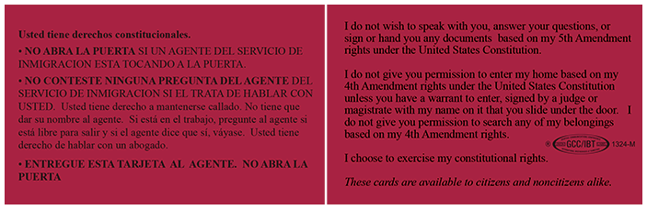
Instituto de Inmigracion del Area de la Bahia
CONOZCA SUS DERECHOS
Red Card for ICE

Slide 22
Immigration Institute of the Bay Area
KNOW YOUR RIGHTS
WHAT CAN PEOPLE DO TO PROTECT THEMSELVES?
Prepare an immigration file:
Store important documents in a folder, let a family member or close friend know where it is and memorize that person’s phone number
Gather records relating to any arrests or convictions.
Talk to an immigration lawyer or accredited representative to find out whether you are eligible for any immigration remedies
Make a plan:
Decide who will take care of your children if you are not able to. Talk to that person and make sure he or she is willing to help you
Without worrying them, assure your children they will be taken care of if you are not available to care for them
Make sure they know who will take care of them. Have your children memorize that person’s phone number
Save money for a bond

Slide 23
Immigration Institute of the Bay Area
KNOW YOUR RIGHTS
Avoid Being a Victim of Fraud
Only get legal advice from attorneys and accredited representatives, NOT NOTARIES. An attorney will not be offended if you ask for their license number. To look up if a person is an attorney licensed to practice law in CA, visit calbar.org.
If something is too good to be true, it probably is.
Be careful about traveling outside of the U.S. Depending on your circumstances, it could affect your immigration case and you may not be able to return.

Slide 24
Immigration Institute of the Bay Area
COMMUNITY RESOURCES
Immigration Institute of the Bay Area Services
Confidential immigration consults
Representation in deportation matters (limited)
Legal assistance for naturalization, U-visa, family petitions, DACA, TPS, Green card renewal/replacement, etc.
Citizenship workshops
Classes to study for your citizenship interview

Slide 25
Immigration Institute of the Bay Area
IIBA OFFICES
QUESTIONS?
THANK YOU!
Brentwood: 925-237-8581 ext. 11
Fremont: 510-894-3639
Napa: 707-266-1568 ext. 401
Oakland: 510-451-2846 x 301
Redwood City: 650-780-7530
San Francisco: 415-538-8100 x 206
Petaluma: 707-932-7000
iibayarea.org
Call to make an appointment!

