Slide 1
Operation Copy & Paste
Replicating San Francisco’s BMR Prioritization for Veterans to the San Mateo BMR Program
By Trevor Dungan & Nicholas Rusanoff

Slide 2
Introduction
Historical Context
San Mateo BMR existing
San Francisco BMR update
Implementation Process for applying the BMR Prioritization to San Mateo

Slide 3
Historical Context
Veteran Homelessness
“From the time of the Vietnam War, and continuing as veterans returned from wars in Iraq and Afghanistan, data show that veterans have experienced homelessness at rates exceeding their representation in the general population.”
Congressional Research Service REPORT Veterans and Homelessness
Updated April 12, 2023 (https://crsreports.congress.gov/product/pdf/RL/RL34024)

Slide 4
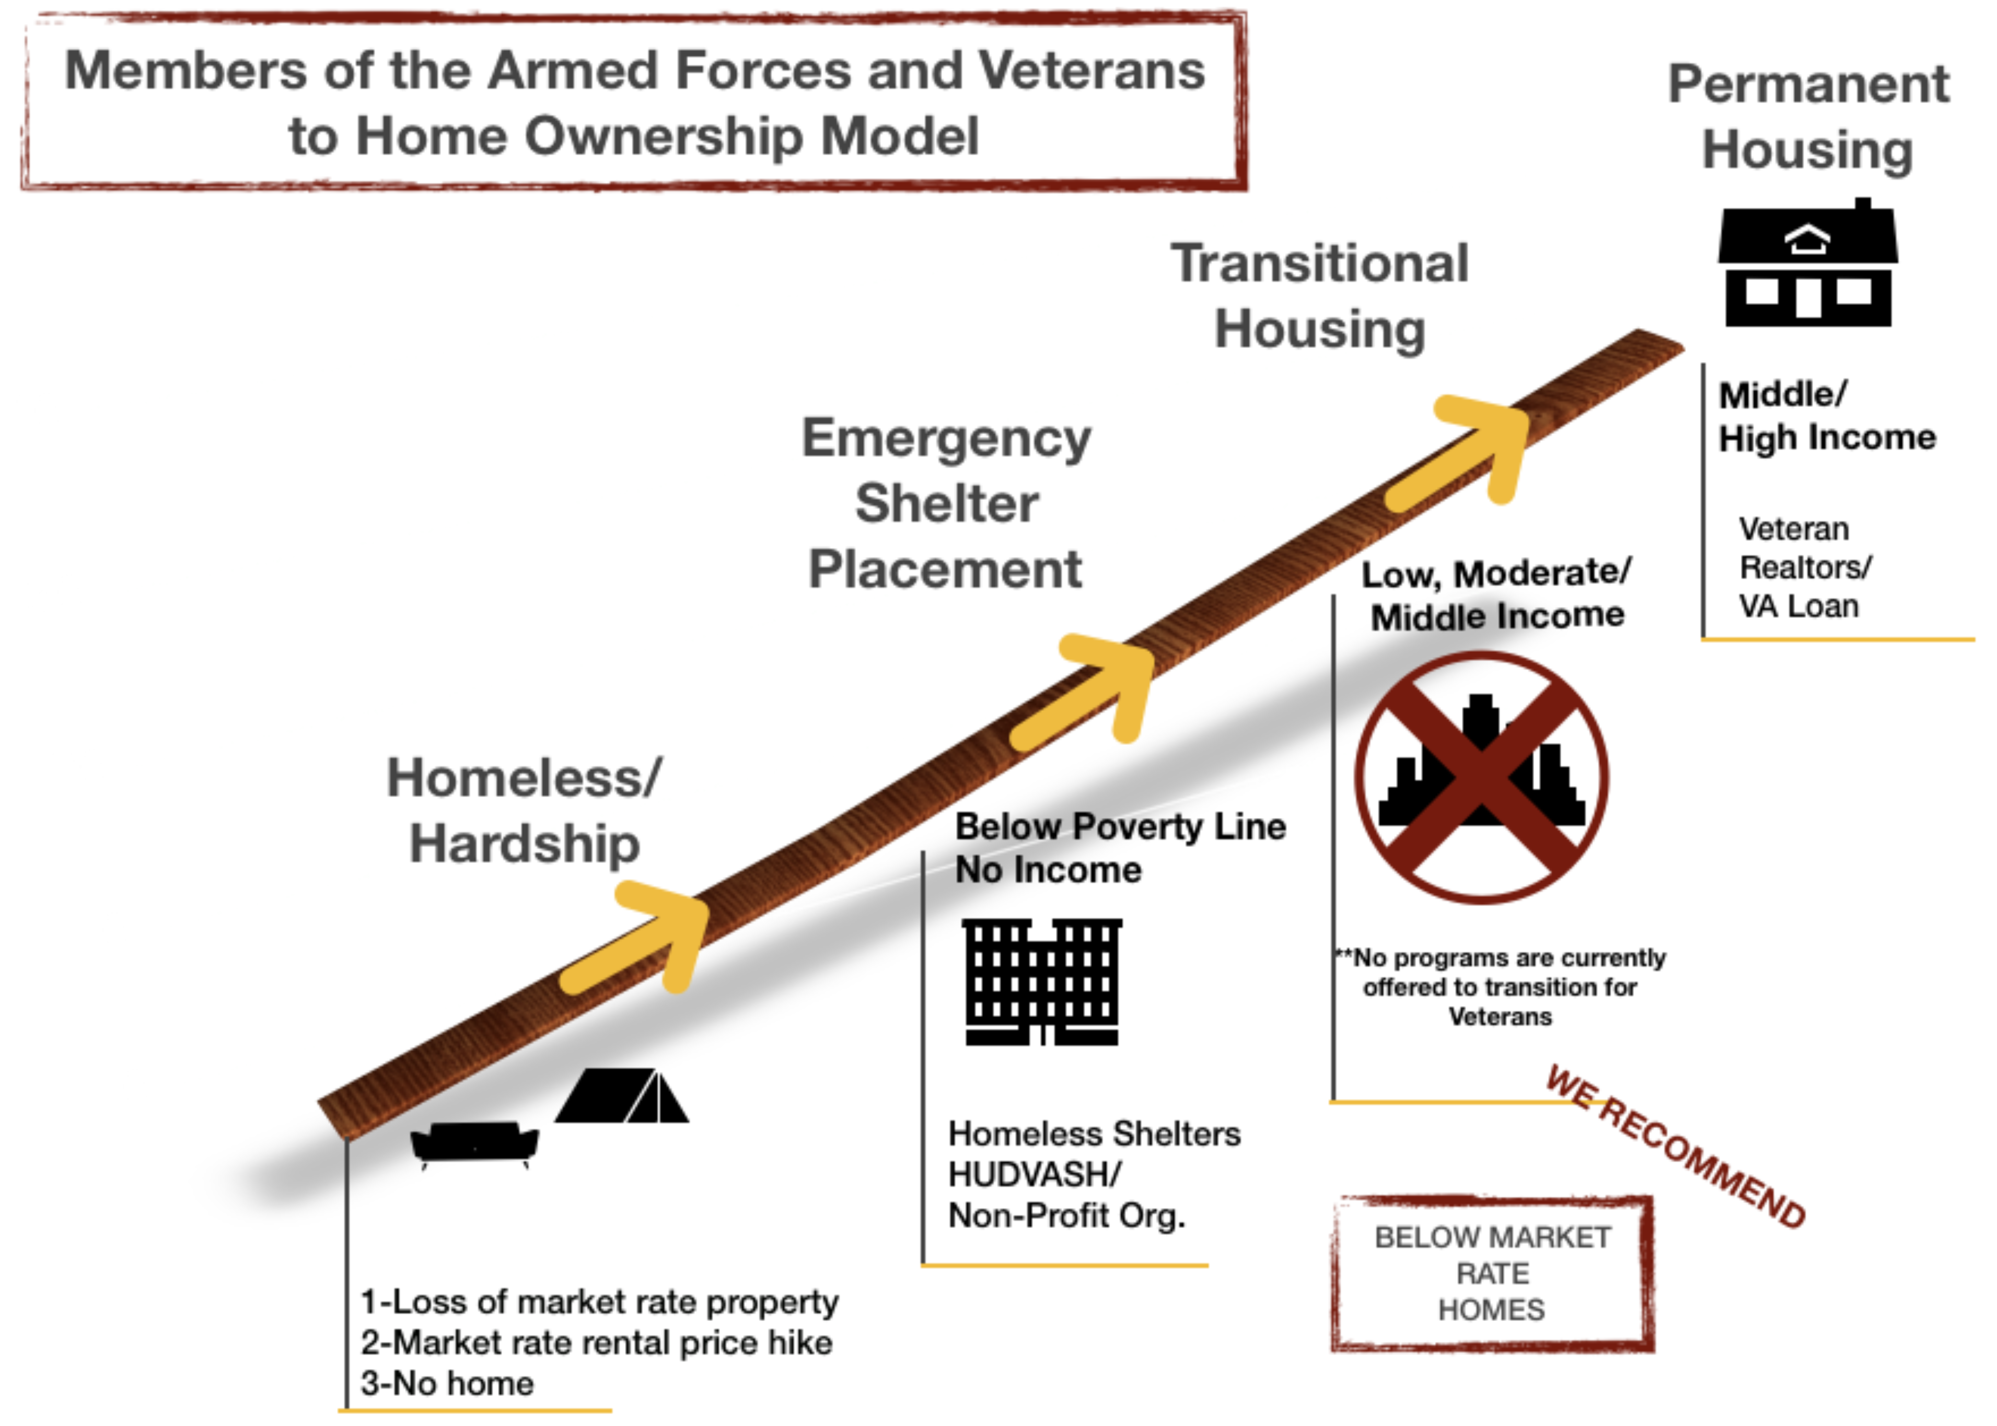
What is the Point?

Slide 5
San Mateo BMR existing
Eligibility:
AMI & Household Size
All applicants must include Pre-Approval Letter from a lender
All applicants must either live and/or work in San Mateo County
  Primary residence in San Mateo County continuously for a minimum of one year.
  Work in San Mateo County a minimum of one year over the last two years. A minimum average of 20 hours per week, over the course of the qualifying year.
Income Eligibility
  To qualify to purchase a BMR home, the buyer must meet the following income requirement. San Mateo County Income limits for 2022 (80 percent Area Median Income):
    1 person household: $104,400
    2 person household: $119,300
    3 person household: $149,100
Applicant must NOT have owned any real property in the last three calendar years.
Applicant’s household composition must not exceed state limits: 3 persons for 2-bedroom unit, 4 persons for 3-bedroom unit.
Applicant must be able to show mortgage readiness, including having a minimum of three (3) percent down-payment.
Applicant Priority:
Anyone who meets the income criteria and qualifies for financing may purchase a BMR home, however, priority will be given to:
Residents living in unincorporated San Mateo County
First-time homebuyers;
Section 8 Homebuyer Program participants
Applicant requirements
Other San Mateo BMR projects
Quotes
Objective to overcome homelessness
How to improve
What to copy
ENHANCEMENT not a PIVOT
There was an issue allocating BMR or housing units exclusively for the veteran population, this will use the existing system to just allow veterans who served their country to get to the front of the line for low income housing within the current framework without derailing the entire system as it was originally intended

Slide 6
Current BMR Lending and Residency Requirements
Eligibility:
AMI & Household Size
All applicants must include Pre-Approval Letter from a lender
All applicants must either live and/or work in San Mateo County
  Primary residence in San Mateo County continuously for a minimum of one year.
  Work in San Mateo County a minimum of one year over the last two years. A minimum average of 20 hours per week, over the course of the qualifying year.

Slide 7
Current BMR Income Eligibility
Income Eligibility
  To qualify to purchase a BMR home, the buyer must meet the following income requirement. San Mateo County Income limits for 2022 (80 percent Area Median Income):
    1 person household: $104,400
    2 person household: $119,300
    3 person household: $149,100

Slide 8
Current BMR Applicant Requirements:
Applicant must NOT have owned any real property in the last three calendar years.
Applicant’s household composition must not exceed state limits: 3 persons for 2-bedroom unit, 4 persons for 3-bedroom unit.
Applicant must be able to show mortgage readiness, including having a minimum of three (3) percent down-payment

Slide 9
Current BMR Applicant Priority:
Anyone who meets the income criteria and qualifies for financing may purchase a BMR home, however, priority will be given to:
Residents living in unincorporated San Mateo County
First-time homebuyers;
Section 8 Homebuyer Program participants

Slide 10
San Francisco BMR Program & Update
-New developments must include BMR units, addressing housing scarcity.
-Eligibility Criteria: Based on AMI & family size, subdivided into priority groups:
You or your family were forced to move by the SF Redevelopment Agency
You were forced to move due to fire, eviction, or rising rent
You live in the same neighborhood as a new building
You live or work in San Francisco
Everyone Else
  Veterans Priority:
A minimal alteration to the system added priority for veterans without disrupting the framework.

Slide 11
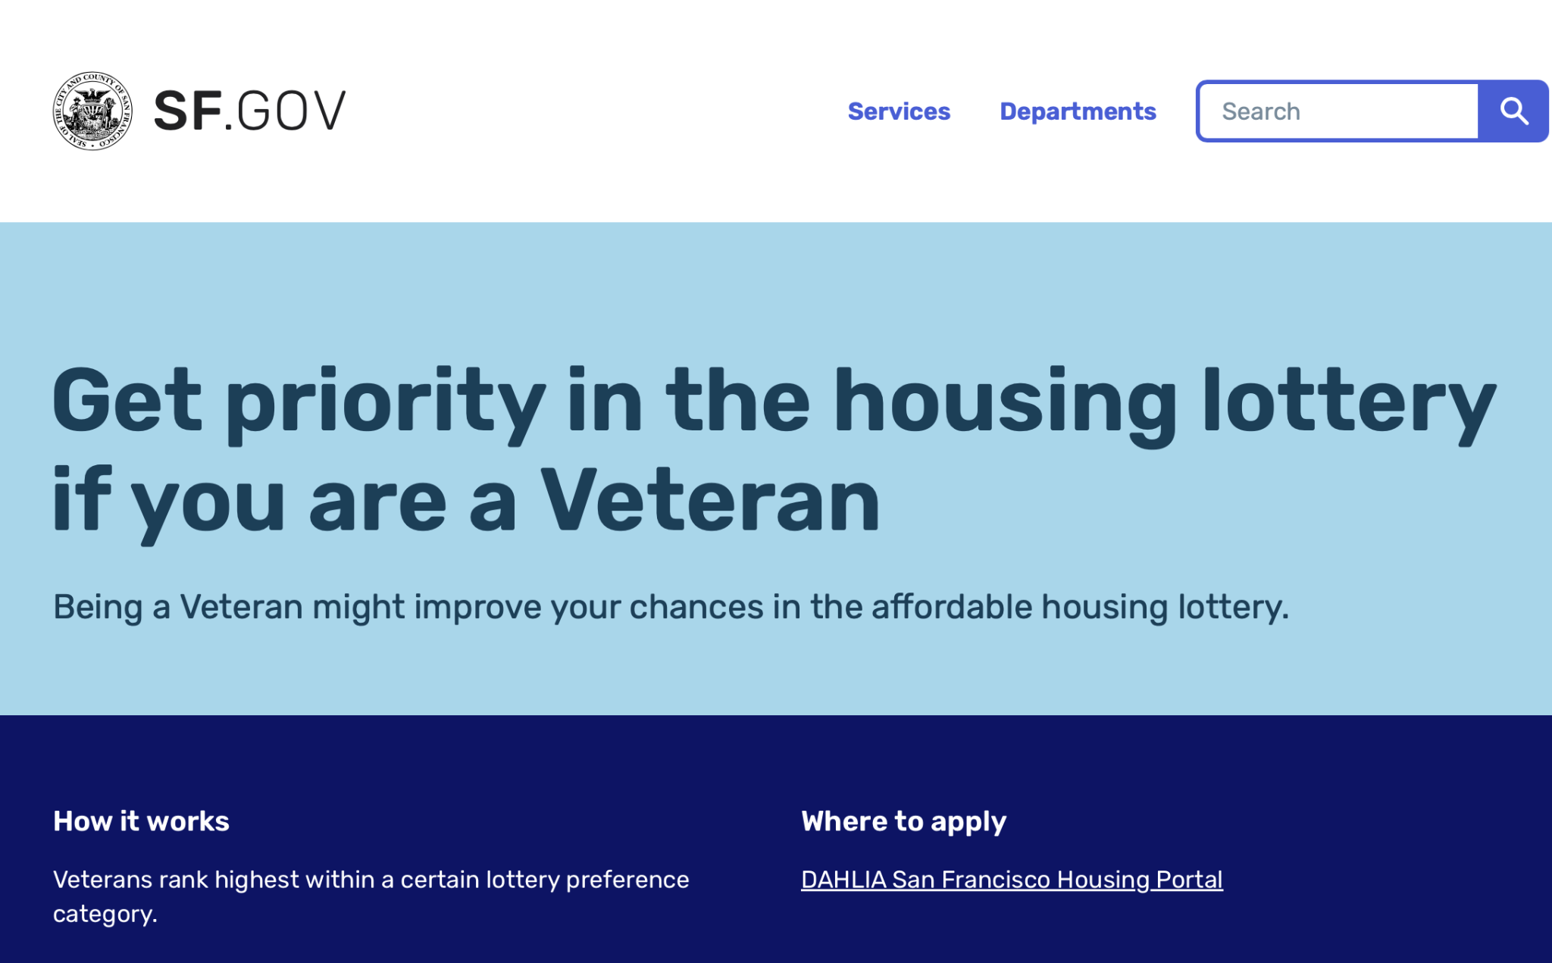
San Francisco BMR update (cont.)

Slide 12
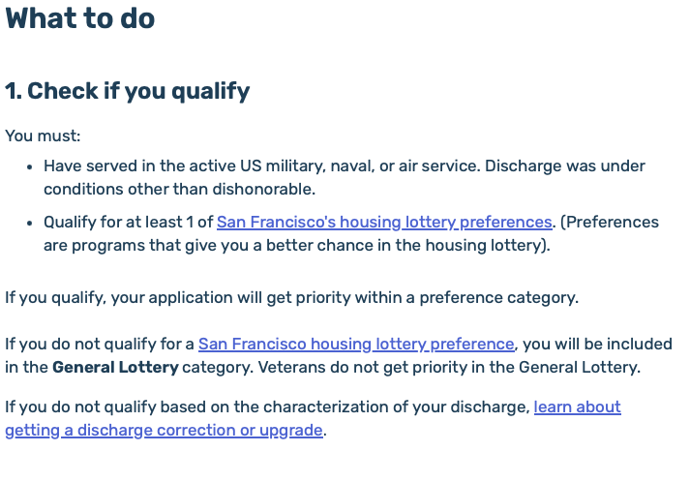
San Francisco BMR update (cont.)

Slide 13
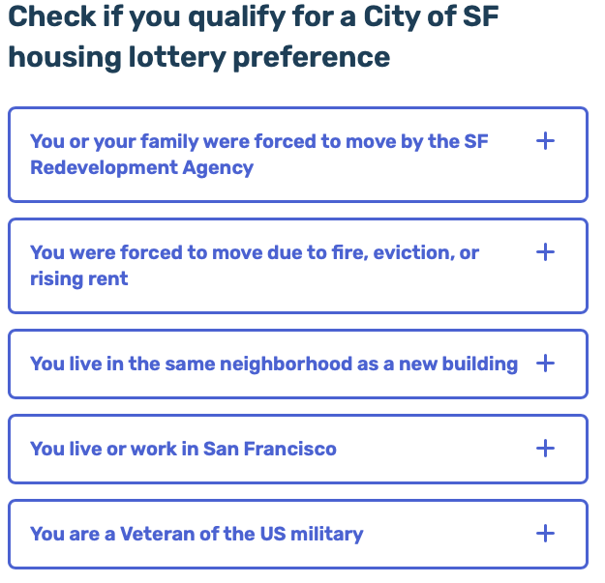
San Francisco BMR update (cont.)

Slide 14
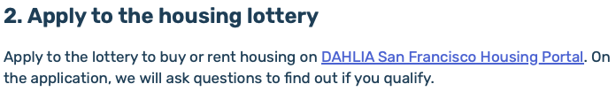
San Francisco BMR update (cont.)

Slide 15
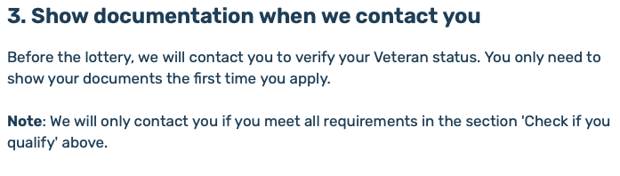
San Francisco BMR update (cont.)

Slide 16
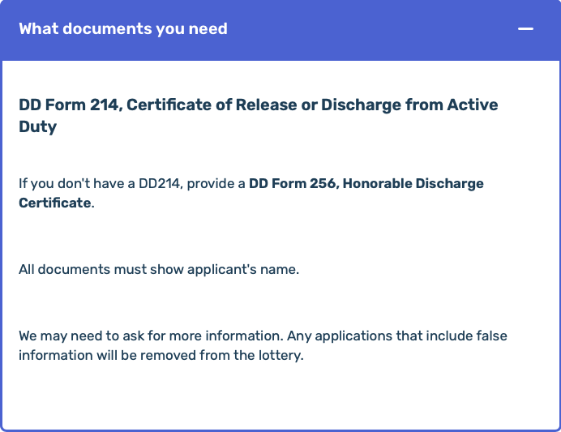
San Francisco BMR update (cont.)

Slide 17
Implementation Process for applying the BMR Prioritization to San Mateo
Legislative Steps:
Formation of a working group to create a proposal for the Veterans Affairs Commission.
Creation of an ad hoc committee to draft the proposal for the Board of Supervisors.
Securing a sponsor on the Board of Supervisors.

Slide 18
Implementation Process for applying the BMR Prioritization to San Mateo
San Francisco Legislative Process
Introduction to the Board of Supervisors:
  Collaboration with Alan Wong, the only elected veteran in San Francisco, to draft the ordinance.
  Sponsored by District 4 Supervisor Gordon Mar.
  Referred to the Land Use and Transportation Committee.
Public Advocacy:
  Grassroots veterans provided public comment in support of the legislation.
Approval Process:
  Land Use Committee recommended approval to the full Board of Supervisors.
  Board of Supervisors unanimously passed the legislation.
Implementation:
  The Mayor’s Office of Housing and Community Development enacted the ordinance.

Slide 19
Implementation Process for applying the BMR Prioritization to San Mateo
San Mateo County BMR Program – Path Forward
Why This Matters:
Veterans in San Mateo County face similar housing challenges as those in San Francisco.
Leveraging the same Salesforce software used by both counties makes the implementation feasible.
Proposed Steps:
Form a working group to draft a proposal for the San Mateo Veterans Affairs Commission.
Use San Francisco’s model to advocate for prioritizing veterans in the San Mateo BMR lottery.
Engage stakeholders, including grassroots veterans and county supervisors, to champion the proposal.

Slide 20
Implementation Process for applying the BMR Prioritization to San Mateo
Conclusion
By replicating San Francisco’s model, San Mateo County can enhance its existing BMR program to better serve veterans without disrupting the framework.
A collaborative approach ensures a successful prioritization process, from grassroots advocacy to legislative implementation.
Let’s discuss this further at the next San Mateo County Veterans Affairs Commission meeting.

Slide 21
Implementation Process for applying the BMR Prioritization to San Mateo
San Francisco Legislative Process
Introduction to the Board of Supervisors:
  Sponsored by District 4 Supervisor Gordon Mar.
  Referred to the Land Use and Transportation Committee.
Public Advocacy:
  Grassroots veterans provided public comment in support of the legislation.

Slide 22
Implementation Process for applying the BMR Prioritization to San Mateo
-Formation of a working group to create a proposal for the Veterans Affairs Commission.
-Creation of an ad hoc committee to draft the proposal for the Board of Supervisors.
-Securing a sponsor on the Board of Supervisors.

Slide 23
Implementation Process for applying the BMR Prioritization to San Mateo
-San Francisco City College Board President Alan Wong, who serves as the only elected veteran in San Francisco, worked on drafting the ordinance to be presented to The Board of Supervisors
-The legislation was brought before The Board of Supervisors by District 4 Supervisor Gordon Mar
- The Board of Supervisors forwarded the proposition for evaluation before The Land Use and Transportation Committee
-Grassroots veterans provided public comment, unanimously supporting the proposal at the Land Use Committee hearing.

Slide 24
Implementation Process for applying the BMR Prioritization to San Mateo
-The Land Use Committee forwarded the legislation with a recommendation for approval to the full Board of Supervisors
-The Board of Supervisors unanimously passed the legislation.
-The Mayor's Office of Housing and Community Development implemented the ordinance
-A collaborative approach, from grassroots support to legislative advocacy, successfully prioritized veterans in San Francisco's BMR housing lottery.

Slide 25
Useful Links
https://www.nbcbayarea.com/news/local/sf-supes-pass-affordable-housing-measures-increase-access-for-veterans/2949459/
https://crsreports.congress.gov/product/pdf/RL/RL34024
https://leginfo.legislature.ca.gov/faces/billCompareClient.xhtml?bill_id=201920200SB222&showamends=false

