Slide 1
Transgender Day of Remembrance 2023
San Mateo County

Slide 2
Who is Transgender?
Transgender is a broad term that can be used to describe people whose gender identities, expression and/or lived experiences differs from the sex they were assigned at birth.
“Trans” is often used as shorthand for transgender.
Some transgender people identify as neither a man nor a woman, or as a combination of male and female, and may use terms like non-binary, gender non-conforming, or gender expansive to describe their gender identity.

Slide 3
Who is Transgender?
As with any language that attempts to succinctly capture the human experience, the usage of these terms and sense of identity among the transgender community vary widely.
It is important to use respectful terminology, and treat transgender people as you would treat any other person. This includes using the name the person has asked you to call them as well as the pronouns they want you to use. Using correct identifiers and pronouns isn’t just about accuracy – it’s about affording all individuals the respect and dignity that everyone deserves.

Slide 4
What is Transgender Day of Remembrance?
Transgender Day of Remembrance was founded in 1999 by Gwendolyn Ann Smith, a transgender woman, to memorialize the murder of transgender woman Rita Hestor in Allston, MA. Since its inception, TDoR has been held annually on November 20, and has slowly evolved from the web-based project started by Smith into an international day of action.
The number of reported cases of anti-transgender hate crimes has more than doubled since 1999. In the past decade, more than one person per month has died as a result of transgender-based hate or prejudice. It is clear that fatal violence disproportionately affects transgender women of color, and that the intersections of racism, sexism, homophobia and transphobia conspire to deprive them of employment, housing, healthcare and other necessities, barriers that make them vulnerable.

Slide 5
Transgender Flag
The flag represents the transgender community. The blue represents men, the pink represents women, and the white is for those who are transitioning, gender queer, or non-binary.

Slide 6
In Memory Of…

Slide 7
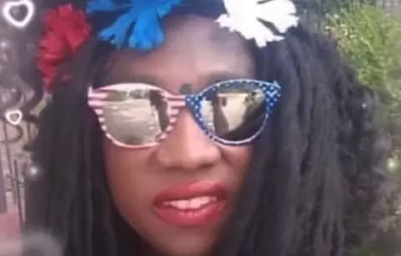
Jasmine “Star” Mack, 36
Jasmine “Star” Mack’s sister, Pamela Witherspoon, said that Jasmine was “a sweet person.” She also said that her sister “loved to sing gospel songs and was an excellent actor.”
This 36-year-old Black transgender woman was killed in Washington, D.C. on January 7th, 2023

Slide 8
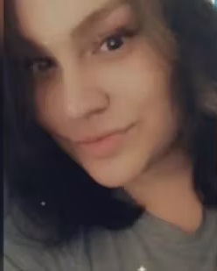
KC Johnson, 27
According to local news, KC Johnson's partner Bulla Brodzinski remembered her as being “kind and caring."
The 27-year-old white transgender woman was killed in Wilmington, North Carolina on January 14th, 2023, after being declared missing on January 13th.

Slide 9
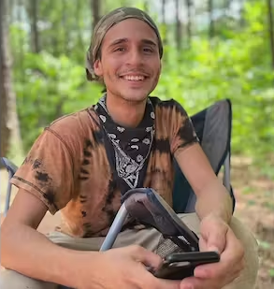
Manuel Teran, 26
Manuel Teran “Tortuguita”, a 26-year-old Indigenous queer and non-binary environmental activist and community organizer, is remembered as a “radiant, joyful, beloved community member” who “brought an indescribable jubilance to each and every moment of their life,” and “fought tirelessly to honor and protect the sacred land of the Weelaunee Forest. They took great joy in caring for each and every person that they came across."
Tortuguita was shot and killed by Georgia state troopers in Atlanta, Georgia on January 18th, 2023 during an ongoing protest alongside other self-described “forest defender” protestors against a proposed $90 million, 85-acre police training facility deemed “Cop City” by activists, slated to be built in the Weelaunee Forest in Atlanta.

Slide 10
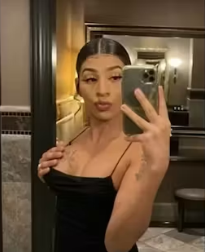
Maria Jose Rivera, 22
Maria Jose Rivera Rivera, a 22-year-old Latina transgender woman, was described by her immigration lawyer as “lively, funny, and dynamic” and “a joy to work with.”
On January 21th, 2023, Maria Jose was found fatally shot in Houston, one of two people found dead at an apartment complex in an apparent murder-suicide.

Slide 11
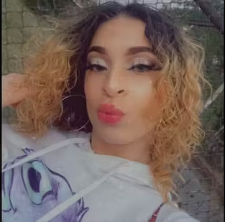
Unique Banks, 21
Unique Banks, a 21-year-old Latina trans woman, was killed in a mass shooting along with her mother, Alexsandra Olmo, on January 23rd, 2023, in Chicago. Unique’s father Omar Burgos said that his “heart is torn apart” and that he had hoped for her to live with him in Florida. Three other people, including two other trans women, were also attacked during the shooting, leaving them in critical condition.

Slide 12
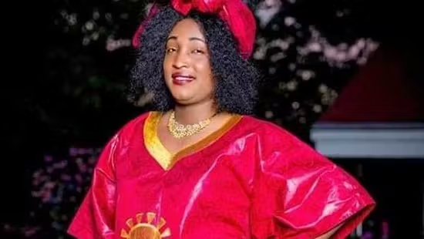
Zachee Imanitwitho
On a GoFundMe page for Zachee Imanitwitaho’s funeral expenses, the Black transgender woman was described as someone who was “well-loved by family, friends, and coworkers, and that she lived her life bravely and authentically.”
She immigrated to the U.S. from Rwanda and was killed on February 3rd, 2023, in Louisville, Kentucky in the parking lot of her workplace.

Slide 13
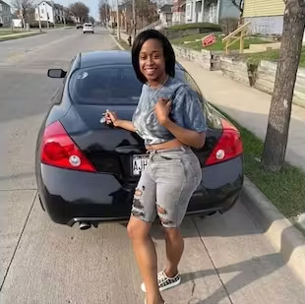
Cashay Henderson, 31
In a GoFundMe started to help cover funeral costs for Cashay Henderson, the 31-year-old Black transgender woman is described as “a bubbly spirit with a down to earth, tell it like it is personality,” who was “as beautiful as can be, inside and out.” The GoFundMe also notes that Cashay is survived by her father, mother, sister, and niece, as well as other family and “many, many friends.”
Cashay was shot in Milwaukee on February 26th, 2023.

Slide 14
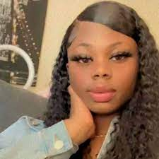
Tasiyah Woodland, 18
Tasiyah Woodland was a Black "high-spirited” transgender woman who was “protective of those she loved." On a GoFundMe page, Tasiyah's aunt, Lizzy Woodland, said "she made everyone around her know that they were loved."
Tasiyah was tragically killed in St. Mary’s County, Maryland on March 24th, 2023.

Slide 15
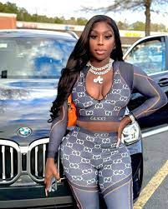
Ashley Burton, 37
Ashley Burton was a 37-year-old Black transgender woman who was described as “a courageous fighter” by her cousin. Her brother Patrick praised her authenticity as a trans woman saying, “The way my sibling moved in life, it was…take it or leave it. ‘This is how I am.’ You can respect it or neglect it, but Ashley put it out there and let that person know. It’s not going to be a secret."
Ashley was killed in Atlanta Georgia on April 11th, 2023.

Slide 16
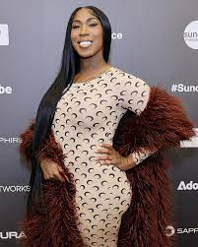
Koko Da Doll, 35
Koko Da Doll was a 35-year-old Black transgender woman, a successful rapper who was working on new music, and starred in the barrier-breaking, award-winning Sundance Film Festival documentary, “Kokomo City.”
Tragically, Koko was found shot to death near an Atlanta shopping plaza on April 18th.

Slide 17
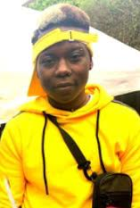
Banko Brown, 24
Banko Brown was a 24-year-old Black trans man who is remembered as being “brilliant” and as someone who made “everybody laugh.” Julia Arroyo, the co-executive director of the Young Women’s Freedom Center where Brown was working as a community organizing intern, said Banko “made friends easily and connected deeply with others.”
On April 27th, 2023, he was killed by an armed security guard in San Francisco after an altercation with an armed security guard at a local Walgreens store.

Slide 18
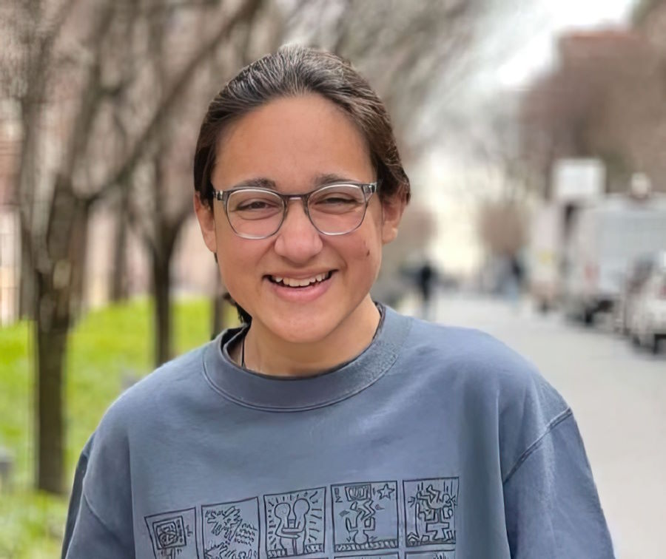
Ome Gandhi, 16
Ome was murdered by her father on May 16th, 2023 in Salt Lake City, Utah

Slide 19
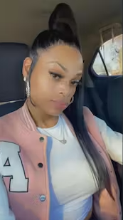
Ashia Davis, 34
Ashia Davis was a 34-year-old Black transgender woman from Detroit who was full of joy, devoted to her faith, and a loving dog owner to a Yorkie named Clyde. Allona Anderson, Ashia’s good friend who is also transgender, spoke to FOX2 News and said they had known each other since they were children. “And we loved each other. That was a good friend of mine."
On June 2nd, 2023, the second day of Pride Month, Ashia was found dead in a Highland Park hotel room.

Slide 20
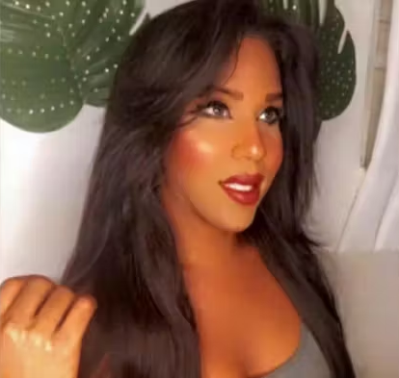
Chanell Perez Ortiz, 29
Chanell Perez Ortiz, a 29-year-old Puerto Rican transgender woman, was a cosmetologist. She was interested in fashion, makeup and hair styles. She shared quotes from French designer Coco Chanel. According to PGH Lesbian, Channell “shared a lot of playful, fun content, and clearly had strong friendships with people who are grieving her deeply.”
Channell was killed in Carolina, Puerto Rico, on June 25th, 2023.

Slide 21
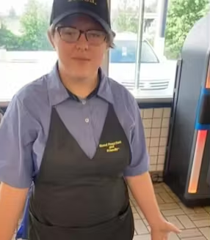
Jacob Williamson, 18
Jacob Williamson, an 18-year-old transgender man, worked at a local Waffle House and was beloved by coworkers and even had moved in with one of them about a month prior to his death, according to his coworker’s TikTok account. Jacob loved to sing and draw.
Jacob was killed in Monroe, South Carolina, on June 30th, 2023.

Slide 22
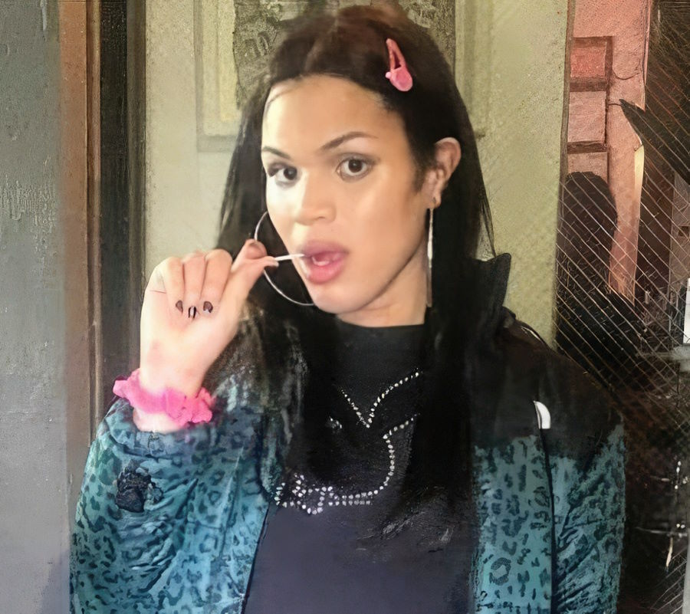
Fernielle Mary Mora, 26
Fernielle Mary Mora, a beloved trans woman of color in the Bronx, was killed on July 6th, 2023.
Fernielle was found dead in suspicious circumstances in her apartment in the Bronx.

Slide 23
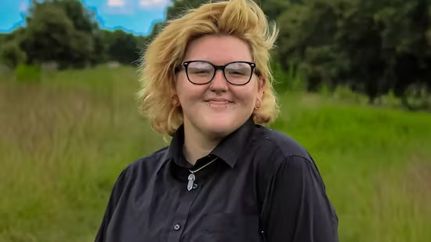
Camdyn Rider, 21
Camdyn Rider, a 21-year-old white transgender man, was eight months pregnant at the time of his murder which occurred on July 21st, 2023, outside his home in Winter Park, Florida. Camdyn had recently posted on Facebook about how excited he was to welcome a child into the world.
According to news reports, Camdyn was killed by his partner, Riley Groover, during an argument. Groover then died by suicide. Sheriff's deputies investigating the murder revealed that Groover had a “history of violence,” and that prior domestic violence incidents had not been reported.

Slide 24
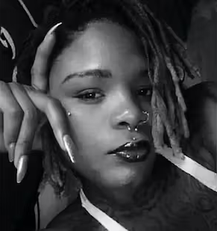
DéVonnie J’Rae Johnson, 28
According to reports, DéVonnie J’Rae Johnson - a 28-year-old Black transgender woman - was a vibrant artist who was born in Tulsa, Oklahoma. She had moved to Los Angeles in order to transition. Those who knew her called her “a well-loved and cherished friend and member of the community.”
DéVonnie was shot and killed on August 7th, 2023, during an altercation with a security guard just one day after her birthday, according to news reports and social media.

Slide 25
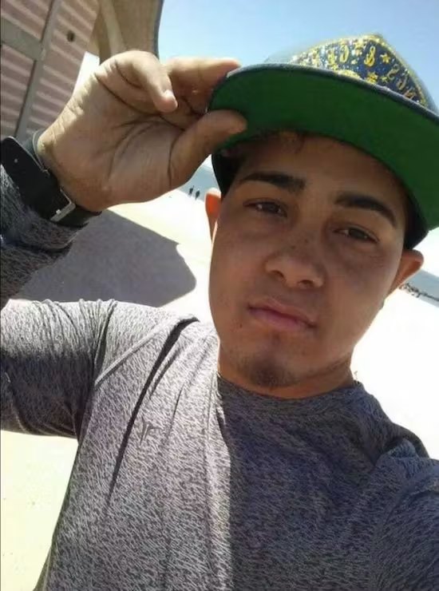
Luis Ángel Díaz Castro, 22
Luis Ángel Díaz Castro, a trans man from Puerto Rico, studied at The Universidad de Puerto Rico en Arecibo and worked at the Department of Education. He also loved Latin music. His family noted Hector Maysonet and Chema y JohnD as his favorite music artists.
At just 22 years old, Luis Ángel was tragically murdered on August 12th, 2023, in San Juan, Puerto Rico. The person accused of killing Luis Ángel is in police custody.

Slide 26
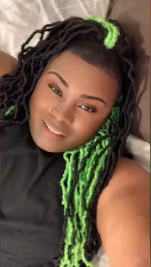
Thomas Robertson, 28
Thomas ‘Tom-Tom’ Robertson, a 28-year-old Black gender non-conforming person, was working as a cook at a local IHOP restaurant in East Chicago, Indiana, having relocated there from Chicago, Illinois, where he was born and raised. Thomas frequently changed the color and style of his hair, posting photos online showcasing his creativity.
On August 17th, 2023, Thomas was a victim of a fatal shooting in Calumet City, Indiana.

Slide 27
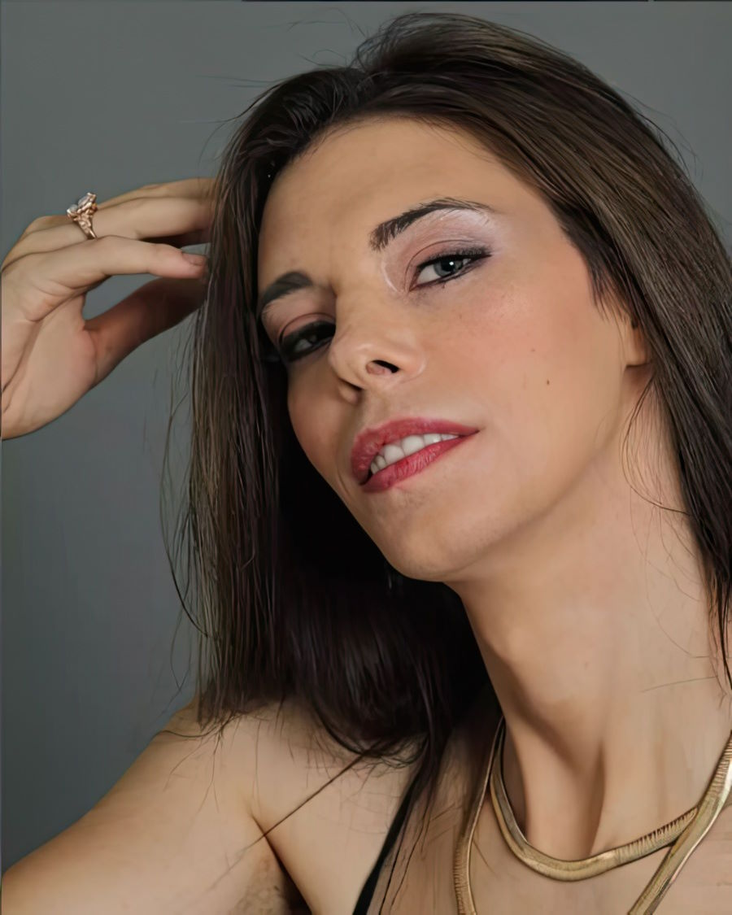
Alexa Alex Andreevna Sokova, 34
Alexa Alex Andreevna Sokova was a 34 year old Russian born model living in Florida. Alexa was a former Miss Palm Bay petite. She worked as an androgynous model and described herself as “the new kate moss or twiggy.” Alexa worked for Viera Models. Her social media feeds are filled with fashion, jewelry, and modeling images.
Alexa's body was found in an undeveloped area of Palm Bay known as "The Compound" on August 30th, 2023. One report suggests that Alexa may have detransitioned before they were killed. We have not been able to confirm this.

Slide 28
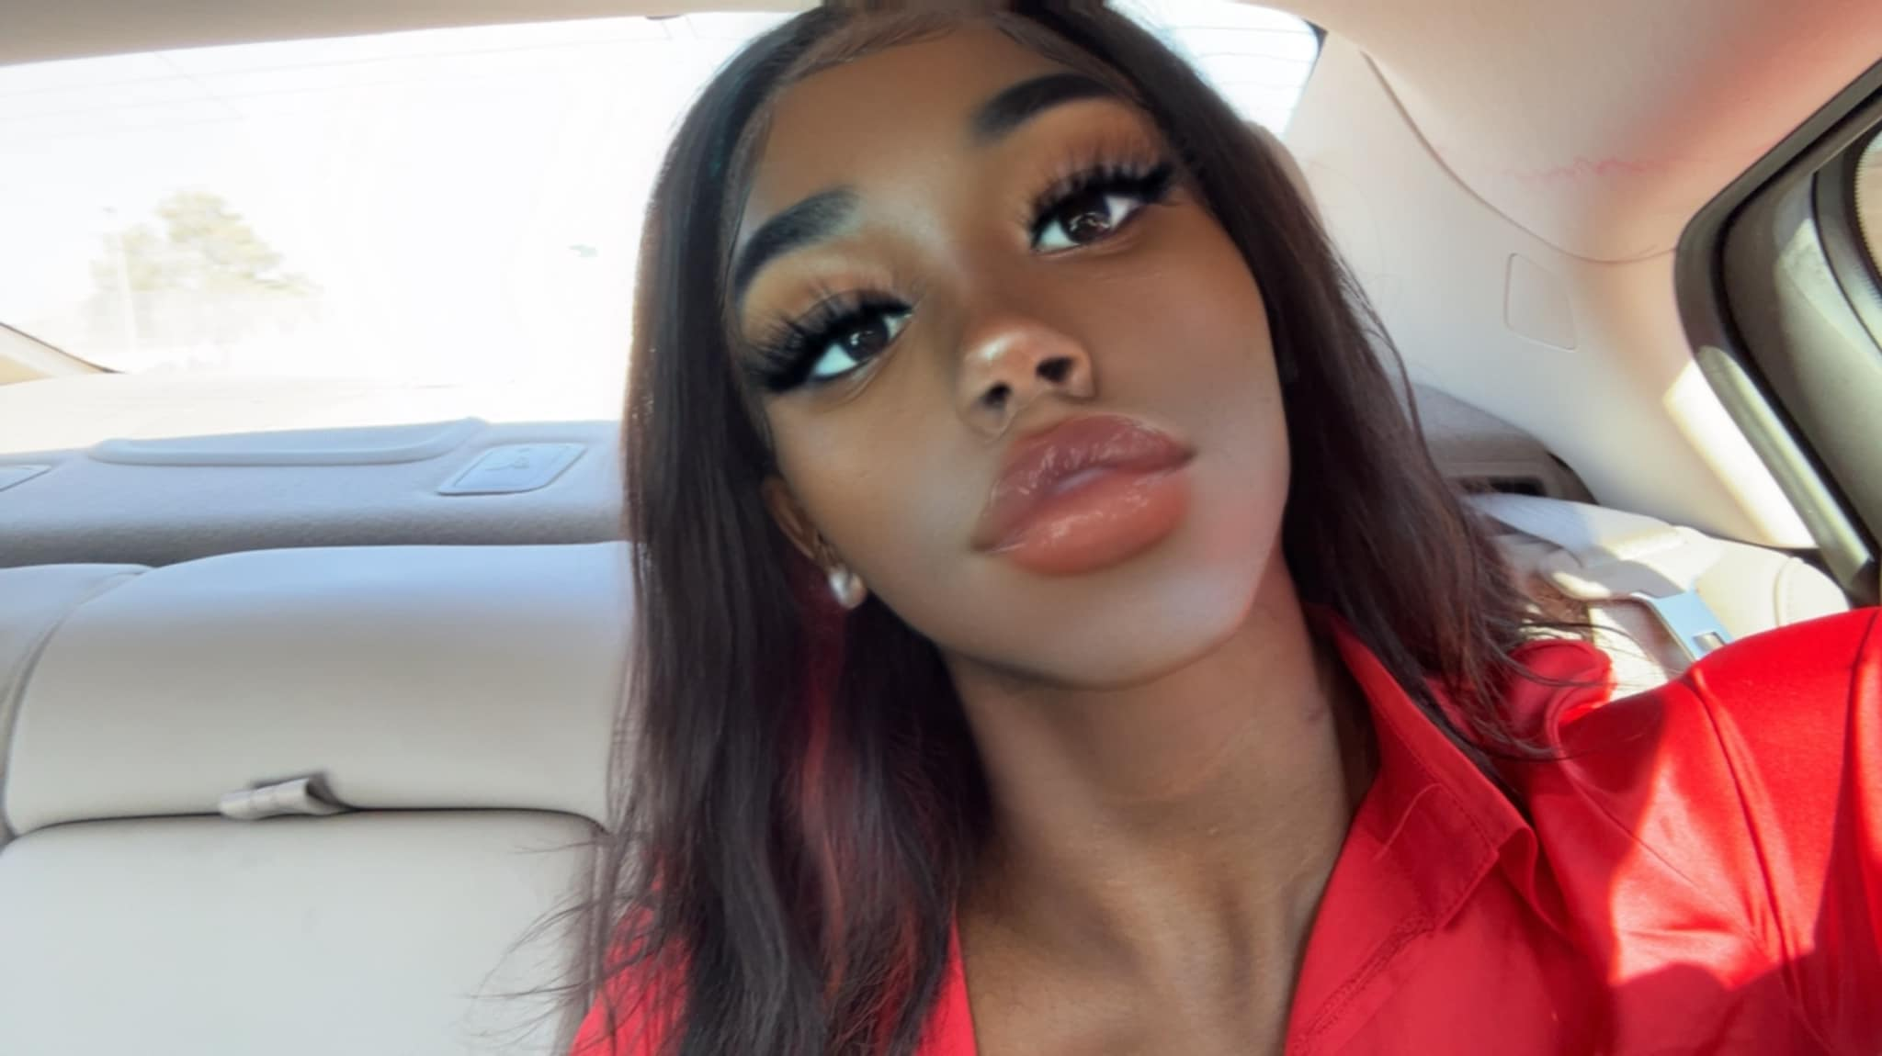
Bre'Asia Bankz
Bre’Asia identified as nonbinary and used she/her pronouns. She loved to dance, spend time with her siblings and cousins, and filled her social media with fashion, hair, makeup and celebrity posts. She singled out the movies ‘To Kill a Mockingbird’ and ‘Love & Basketball’ as her favorites.
On September 5th at 1:35 am Bre’Asia Banks was murdered in cold blood by the man that she loved, her boyfriend.

Slide 29
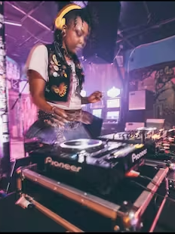
YOKO
YOKO was a talented nonbinary artist and DJ. YOKO loved their family and their friends, who remember YOKO as “an exceptional, joyful, absurdly talented, and extremely loving and gentle human.” YOKO’s work included modeling, tattooing, murals, publications, solo showings, curating art shows, and doing live works for different shows and events.
YOKO was struck and killed by a driver of an SUV on September 19th, 2023. The driver fled the scene.

Slide 30
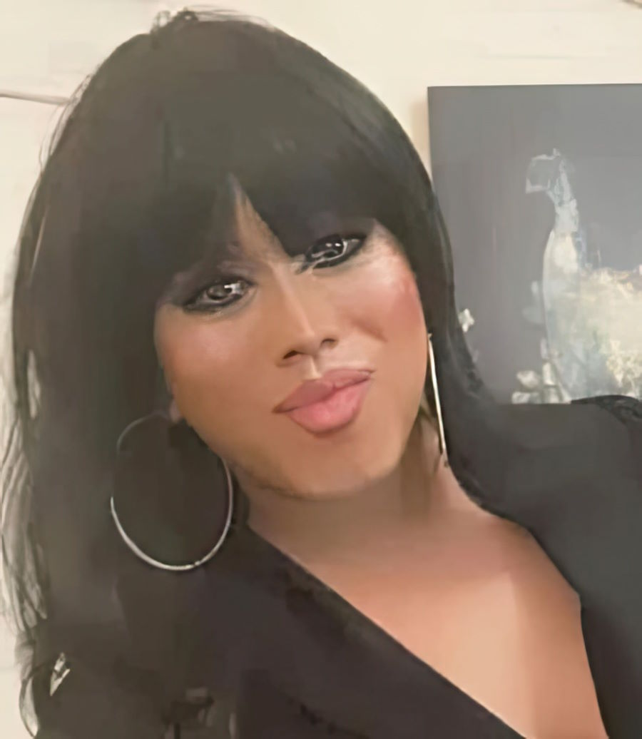
Sherlyn Marjorie, 35
Sherlyn was a drag performer. Her last performance was in Rio Rancho the night she disappeared. According to her social media profiles, she has lived in Tijuana, California, as well as Mexico City. Most recently, she lived in Albuquerque. Her social media featured the quote “El beso es el regalo del niño, la bendición de los padres y la mascara del hipócrita” that translates to “The kiss is the gift of the child, the blessing of the parents and the mask of the hypocrite.”
She was a Latina trans woman, just 35 years old when she was found dead alongside a road in Albuquerque, New Mexico on September 26th, 2023. She had been missing since September 16th, 2023.

Slide 31
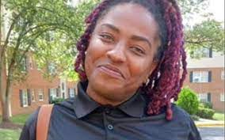
Skylar Harrison Reeves, 30
Skylar Harrison Reeves was found dead in Marvin Gaye Park in Washington DC on October 2nd, 2023. Her death is still under investigation.

Slide 32
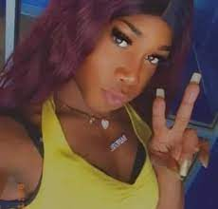
Chyna Long, 30
Chyna Long was a dance choreographer and Black transgender woman. Chyna’s father Jonathan Long said that his child was many things, but chief among her passions was dance. “She is a choreographer,” he said. “Since 18 years old, kids came to the house, girls by droves, and she would teach them dancing.”
Chyna Long was shot to death in Milwaukee, Wisconsin on October 8th.

Slide 33
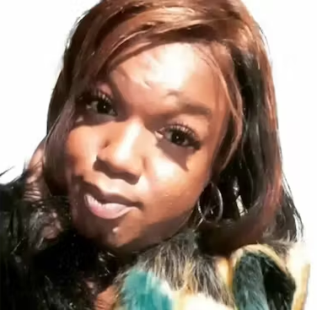
A’nee Johnson, 30
A’nee Johnson, who was also known as A’nee Roberson, was a 30-year-old Black transgender woman from Washington D.C. A’nee was well loved by many friends.
Tragically, on October 14th, 2023, A’nee was killed during an assault when she was pushed into a roadway and hit by a car.

Slide 34
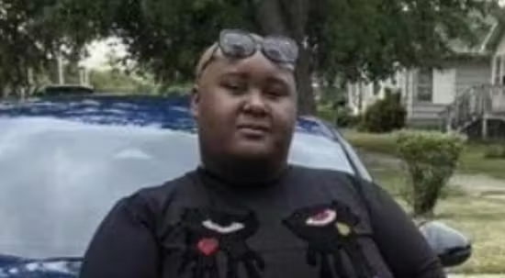
Dominic Dupree, 25
Dominic Dupree, who was also known as Dominic Palace, was a 25-year-old Black gender non-conforming person from Gary, Indiana, who operated companies including Private Protection Division LLC and Hondo IV Lawncare and Snow Removal LLC.
Tragically, Dominic was fatally shot in Chicago on October 13, 2023.

Slide 35
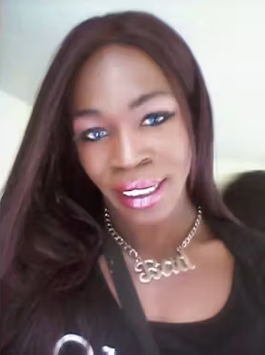
Lisa Love, 35
Lisa Love, a 35-year-old Black transgender woman, was described as a friend as “funny, smart, beautiful and a breath of fresh air to this world.” Lisa’s cousin remembered her as “an all-around good person who did not deserve this. A loving, caring, free-spirited person. Always smiling and laughing.”
Lisa was fatally shot on Oct. 17, 2023, while walking home from a friend’s house. An investigation of the shooting is ongoing. Lisa’s family members believe it was a targeted shooting.

Slide 36
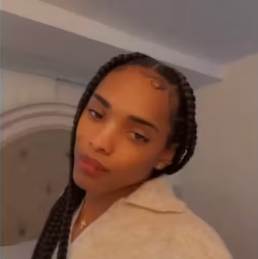
London Price, 26
London Price, a 26-year-old Black transgender woman, was described by her aunt as being “always beautiful and pretty,” saying, “She’ll give you the shirt off her back, and I think that’s kind of what put her in this situation to get her hurt.”
London was fatally shot in Miami-Dade County on October 23, 2023.

Slide 37
We remember the lives lost
At least 30 individuals were killed in the United States in 2023
At least 32 individuals were killed in the United States in 2022
At least 49 individuals were killed in the United States in 2021
At least 34 individuals were killed in the United States in 2020
At least 25 individuals were killed in the United States in 2019
We say “at least” because the numbers are very likely an underrepresentation of the number of transgender people who have been killed.

Slide 38
We honor the lives lived
Even in the face of physical danger, hatred and discrimination – sometimes ruthlessly endorsed and enforced by those at the highest level of our government – transgender Americans live courageously and overcome unjust barriers in all corners of our country.

Slide 39


Slide 40
Sources
GLAAD
Doubly Victimized, Reporting on Transgender Victims of Crime. https://www.glaad.org/publications/transgendervictimsofcrime
Human Rights Campaign
Fatal Violence Against the Transgender and Gender Non-Conforming Community in 2023.
Fatal Violence Against the Transgender and Gender Non-Conforming Community in 2022.
Fatal Violence Against the Transgender and Gender Non-Conforming Community in 2021.
National Center for Transgender Equality.
Trans Lives Matter
Remembering Our Dead

