Slide 1
PLANNING COMMISSION
Board of Supervisors Chambers
400 County Center, Redwood City
ITEM # 2
Applicant/Owner : MidPen Housing Corporation
File Number: PLN 2022-00220
Location: Corner of Carlos and Sierra Streets, Moss Beach
APN: 037-022-070
Project Description: Introduction of a Draft Environmental Impact Report (DEIR), prepared pursuant to the California Environmental Quality Act (CEQA), for the proposed Cypress Point Planned Unit Development Coastal Development Permit and General Plan Land Use Map Amendment.
PLANNING AND BUILDING DEPARTMENT
Notes:
1

Slide 2
PRESENTATION OUTLINE
Project Location
Project Chronology
Project Description
EIR Schedule
PLANNING AND BUILDING DEPARTMENT
Notes:
2

Slide 3
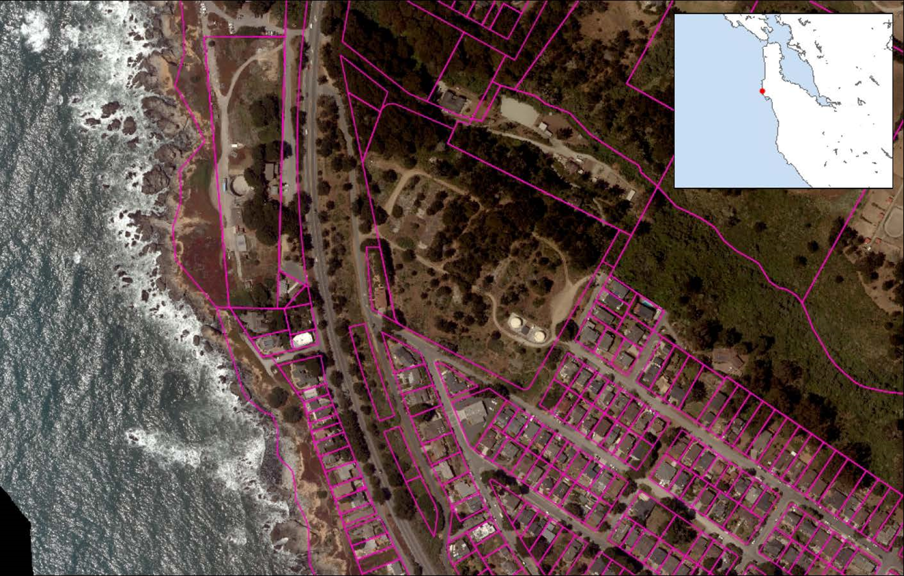

Slide 4
PRESENTATION OUTLINE
Project Location
Project Chronology
Project Description
EIR Schedule
PLANNING AND BUILDING DEPARTMENT
Notes:
4

Slide 5
PROJECT CHRONOLOGY
June 10, 2020 – Planning Commission (PC) recommended to the Board of Supervisors (BOS) to approve the proposed Zoning and LCP Amendments.
July 21, 2020 – BOS approved the proposed amendments which are transmitted to the California Coastal Commission (CCC) for certification.
PLANNING AND BUILDING DEPARTMENT
Notes:
5

Slide 6
PROJECT CHRONOLOGY
March 22, 2021 – CCC certified the Amendments.
July 6, 2022 – CDP application submitted.
December 14, 2022 – PC holds public Scoping Meeting for project EIR.
PLANNING AND BUILDING DEPARTMENT
Notes:
6

Slide 7
PRESENTATION OUTLINE
Project Location
Project Chronology
Project Description
EIR Schedule
PLANNING AND BUILDING DEPARTMENT
Notes:
7

Slide 8
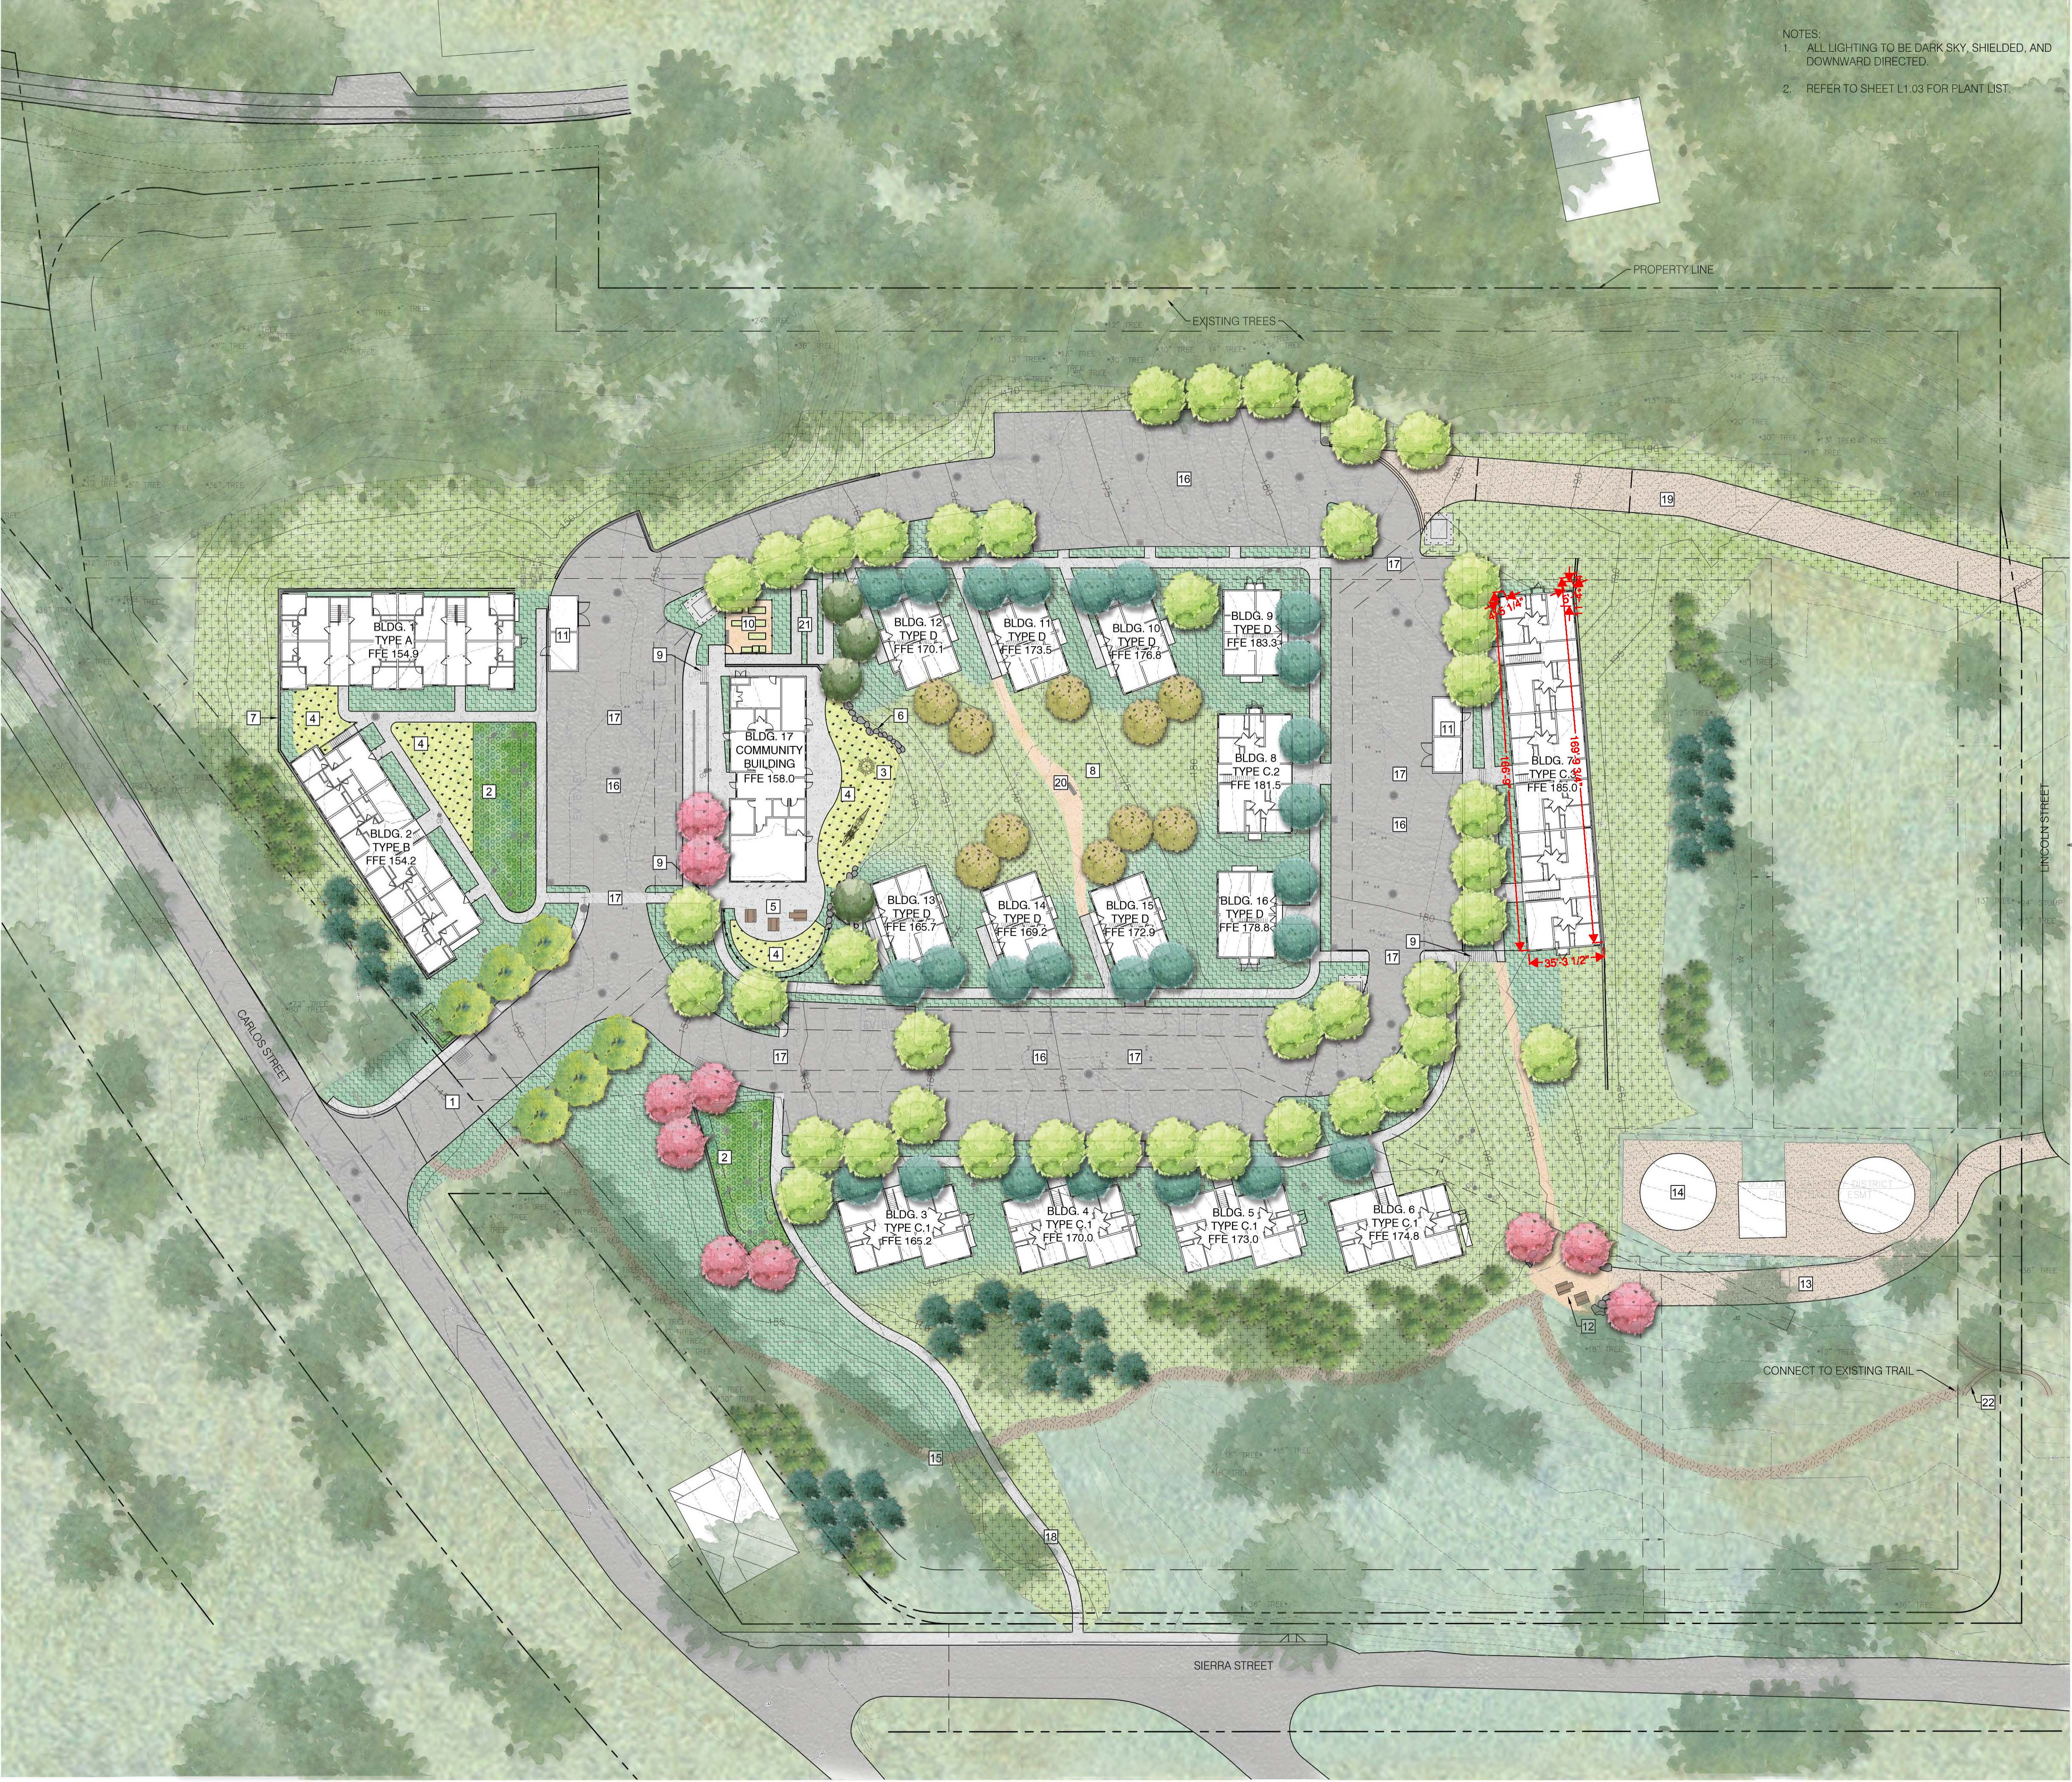

Slide 9
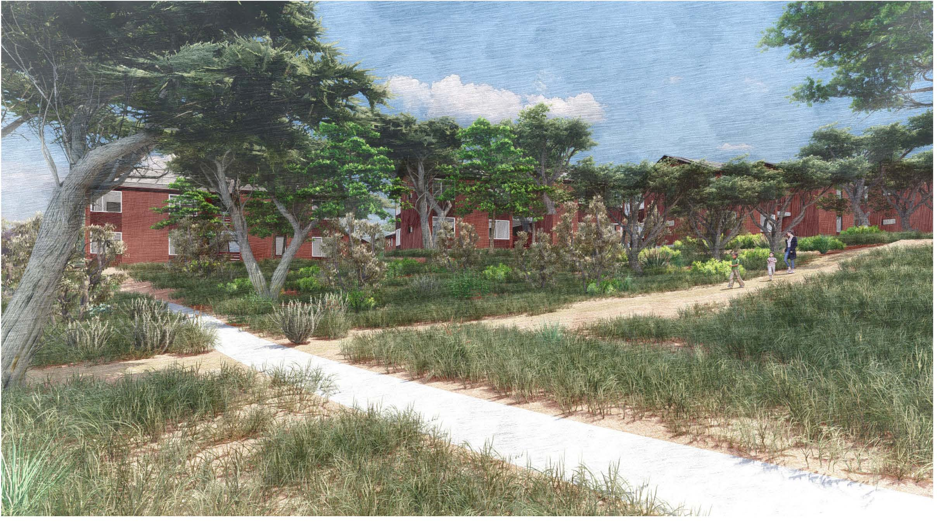

Slide 10
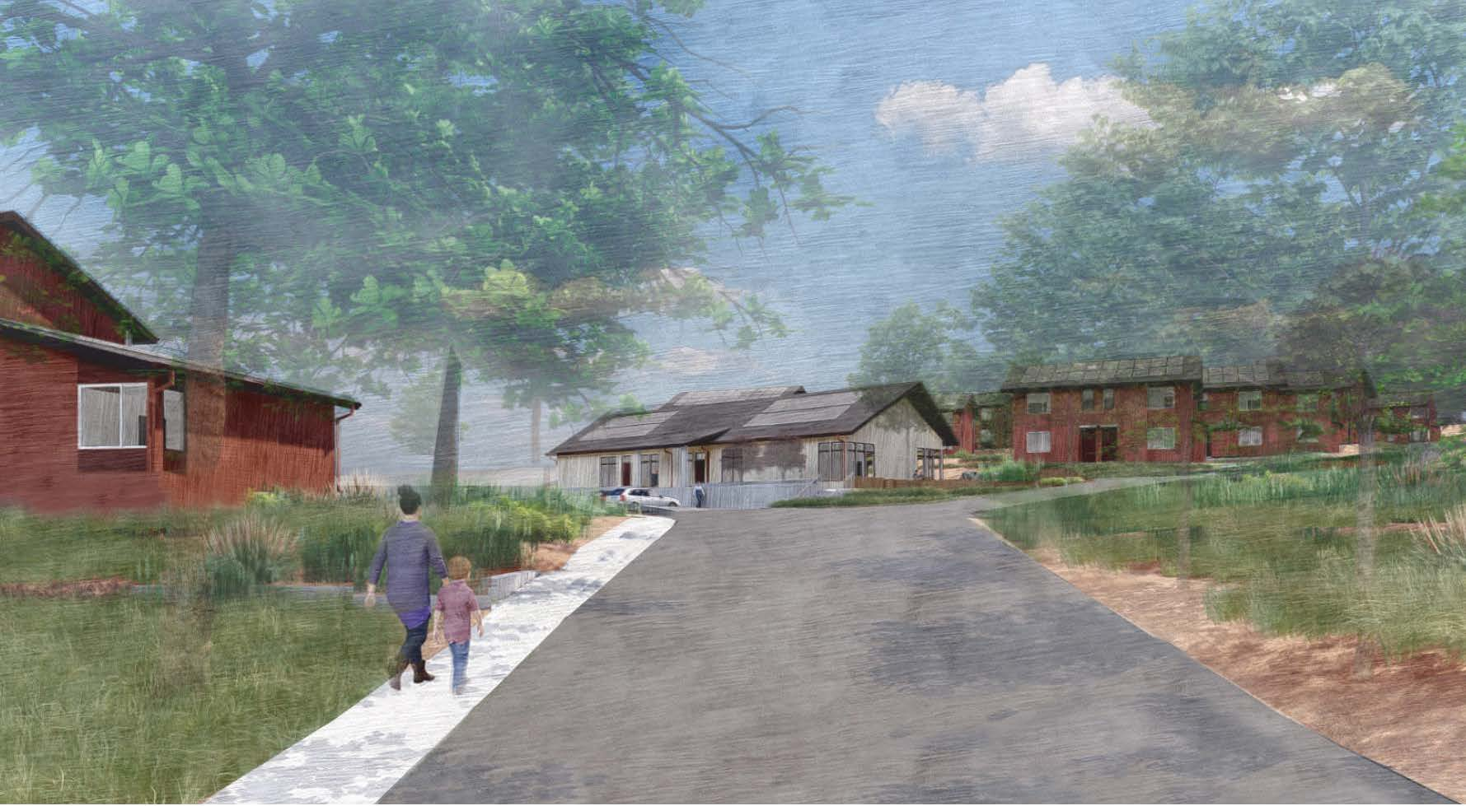

Slide 12
PRESENTATION OUTLINE
Project Location
Project Chronology
Project Description
EIR Schedule
PLANNING AND BUILDING DEPARTMENT
Notes:
12

Slide 13
EIR SCHEDULE
August 10, 2023 – Public release date of Draft EIR
September 13, 2023 – Planning Commission hearing to receive comments
September 25, 2023 – End of 45-day public comment period
December 2023 – Anticipated public release of Final EIR
PLANNING AND BUILDING DEPARTMENT
Notes:
13

Slide 14
EIR SCHEDULE
The EIR and all public review documents for this project are available for review online at:
https://www.smcgov.org/planning/cypress-point-affordable-housing-community-project
PLANNING AND BUILDING DEPARTMENT
Notes:
14

