Slide 1
PLANNING COMMISSION
Board of Supervisors Chambers
400 County Center, Redwood City
ITEM 4
Owner: ………………………….
Applicant: ………………………
File Number: .…………………..
Location: ………………………..
APN: …………………….……….
N/A
San Mateo County Planning and Building Department
N/A
Unincorporated North Fair Oaks
Various
Project Description:
A zoning map and text amendment and general plan map and text amendment to streamline, clarify, and make consistent with state law the existing NMU, NMU-ECR, CMU-1, -2, and -3 mixed use zoning regulations in North Fair Oaks, to rezone multiple R-1 and R-3 -zoned parcels along El Camino Real and Middlefield Road to the adjacent NMU, CMU-1 and CMU-3 zoning designations, and to amend the North Fair Oaks Community Plan for clarity and consistency.
PLANNING AND BUILDING DEPARTMENT
Notes:
1

Slide 2
PROJECT DESCRIPTION
A zoning map and text amendment and general plan map and text amendment to streamline, clarify, and make consistent with state law the existing NMU, NMU-ECR, CMU-1, -2, and -3 mixed use zoning regulations in North Fair Oaks, to rezone multiple R-1 and R-3 -zoned parcels along El Camino Real and Middlefield Road to the adjacent NMU, CMU-1 and CMU-3 zoning designations, and to amend the North Fair Oaks Community Plan for clarity and consistency.
PLANNING AND BUILDING DEPARTMENT
Notes:
2

Slide 3
PROJECT DESCRIPTION
  Expand high-density mixed-use residential zoning in two areas:
    El Camino/Blenheim
    Middlefield/Huntington
  Modify and improve existing mixed-use zoning regulations (NMU, CMU), design standards, and Community Plan standards to:
    Correct errors and inconsistencies
    Apply best practices, lessons learned
    Conform to new State laws
PLANNING AND BUILDING DEPARTMENT
Notes:
3

Slide 4
OUTLINE
  Zoning Expansion
  Use Regulations
  Development Standards
  Design Standards
  Parking Regulations
  Community Plan Amendments
  Summary
  Environmental Impact Report
  Recommendation
PLANNING AND BUILDING DEPARTMENT
Notes:
4

Slide 6
ZONING EXPANSION
  CMU-1 zoning expanded to adjacent R-3 zoned areas between El Camino Real and Blenheim
  CMU-3 zoning expanded to adjacent R-3 zoned areas between Middlefield and Huntington
  NMU zoning expanded to adjacent parcels east of Middlefield
PLANNING AND BUILDING DEPARTMENT
Notes:
6

Slide 8
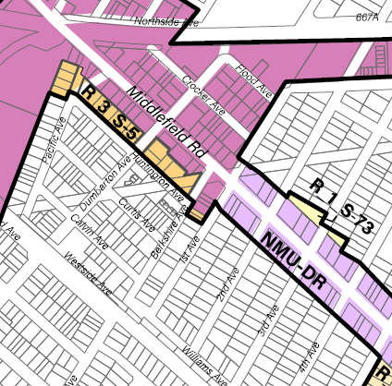

Slide 10
USE REGULATIONS
  Commercial mixed-use would continue to be required:
    On 5th Avenue
    In NMU-ECR on El Camino
    On Middlefield between Semicircular and First
  Intended to maintain commercial street frontage on primary existing commercial corridors
  In other areas, either commercial mixed-use OR 100% residential would be allowed
PLANNING AND BUILDING DEPARTMENT
Notes:
10

Slide 12
DEVELOPMENT STANDARDS
  Standardized setback and stepback requirements
    10-foot rear setback (ground level)
    Additional 10-foot stepback at or below 20 feet in height
  No change to front and side setbacks except fronting Huntington Avenue
  Huntington Avenue front setback of 5 feet with at least 5-foot additional stepback at or below 20-foot building height
    Reduces bulk of structures impinging on lower intensity residential across Huntington
PLANNING AND BUILDING DEPARTMENT
Notes:
12

Slide 13
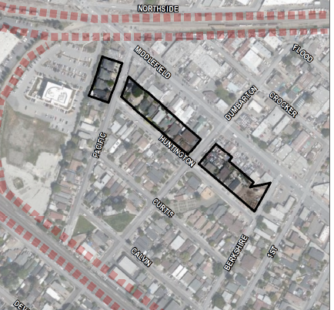

Slide 14
DESIGN REGULATIONS
  Redact Section 6565.18 of the Zoning Regulations (design standards for commercial structures on Middlefield Road)
  Amend Chapter 29 (Design Review and Site Development Permit) to incorporate only objectively applicable standards, consistent with state law
  Remove hearings and conditional use permit requirements for projects that are otherwise by-right (objectively reviewed and approved), per state law
  Remove various outdated and/or overly prescriptive design standards
PLANNING AND BUILDING DEPARTMENT
Notes:
14

Slide 15
PARKING STANDARDS
  Standardize parking requirements across districts and use types
  Lower parking requirements to match those typically required by State Density Bonus law
  Remove EV parking requirements (already covered by state law)
  NOTE: County may still be unable to require any minimum parking in NFO for many projects (AB 2097)
PLANNING AND BUILDING DEPARTMENT
Notes:
15

Slide 16
COMMUNITY PLAN AMENDMENTS
  Clarify that Floor Area Ratio (FAR) applies only to non-residential uses
    Residential intensity continues to be governed by maximum density
  Removal of Community Benefits section
      Superseded by State Density Bonus Law
  Various minor edits for clarity and consistency
PLANNING AND BUILDING DEPARTMENT
Notes:
16

Slide 17
SUMMARY
  No change in allowed heights, densities or intensities in existing CMU-1, CMU-2, CMU-3, NMU, NMU-ECR zoning districts
  No change in FAR, lot coverage, street improvement standards, or other standards
  Changes to parking consistent with state law, to the extent applicable
  Objective design standards consistent with state law
  Expansion of mixed-use/residential districts to areas adjoining northeast El Camino Real, northwest Middlefield
PLANNING AND BUILDING DEPARTMENT
Notes:
17

Slide 18
SUMMARY
  Zoning Map Amendment:
  Redesignating existing R-3 and R-1 areas to CMU-1, CMU-3 and NMU
  Zoning Text Amendment:
  Clarifying and streamlining regulations, achieving consistency with State law
  General Plan Map Amendment:
  Redesignating existing Medium Density Residential areas to Commercial Mixed Use and Neighborhood Mixed Use
  General Plan Text Amendment:
  Clarifying, streamlining, and achieving consistency with State law
PLANNING AND BUILDING DEPARTMENT
Notes:
18

Slide 19
ENVIRONMENTAL IMPACT REPORT
  A Draft Environmental Impact Report (DEIR) has been prepared
  Assesses potential impacts of the zoning and plan amendments, and provides mitigation measures
  Public comment period from April 28 to June 13
  Available at https://www.smcgov.org/planning/north-fair-oaks-rezoning-and-general-plan-amendment-project-eir
  EIR must be certified by Board of Supervisors as part of project adoption
  Two comments have been received – DPW, Caltrans
PLANNING AND BUILDING DEPARTMENT
Notes:
19

Slide 20
NORTH FAIR OAKS COMMUNITY COUNCIL
NFOCC considered the project on April 27, 2023
Voted to recommend that the Planning Commission recommend that the Board of Supervisors adopt the proposed zoning and General Plan amendments
PLANNING AND BUILDING DEPARTMENT
Notes:
20

Slide 21
RECOMMENDATION
That the Planning Commission recommend that the Board of Supervisors adopt the proposed zoning and General Plan amendments.
PLANNING AND BUILDING DEPARTMENT
Notes:
21

Slide 22
PLANNING COMMISSION
Board of Supervisors Chambers
400 County Center, Redwood City
ITEM 4
Owner: ………………………….
Applicant: ………………………
File Number: .…………………..
Location: ………………………..
APN: …………………….……….
N/A
San Mateo County Planning and Building Department
N/A
Unincorporated North Fair Oaks
Various
Project Description:
A zoning map and text amendment and general plan map and text amendment to streamline, clarify, and make consistent with state law the existing NMU, NMU-ECR, CMU-1, -2, and -3 mixed use zoning regulations in North Fair Oaks, to rezone multiple R-1 and R-3 -zoned parcels along El Camino Real and Middlefield Road to the adjacent NMU, CMU-1 and CMU-3 zoning designations, and to amend the North Fair Oaks Community Plan for clarity and consistency.
PLANNING AND BUILDING DEPARTMENT
Notes:
21

