Slide 1
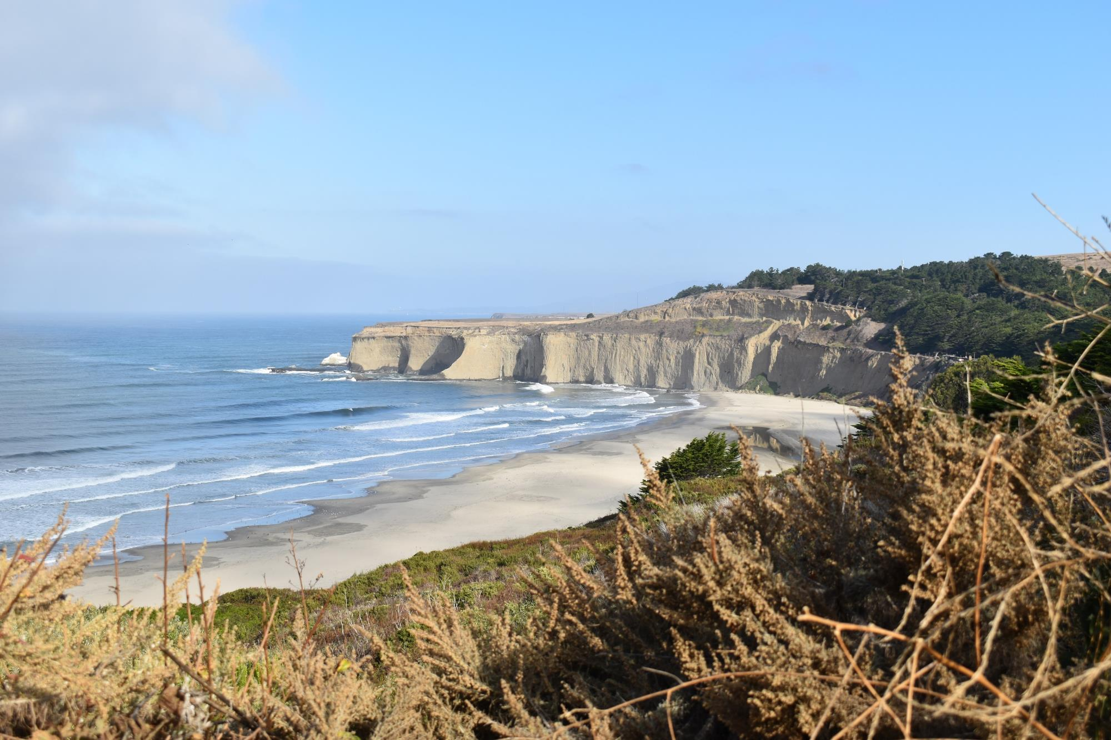




TUNITAS CREEK BEACH
Site Lighting
March 22, 2023

Slide 2
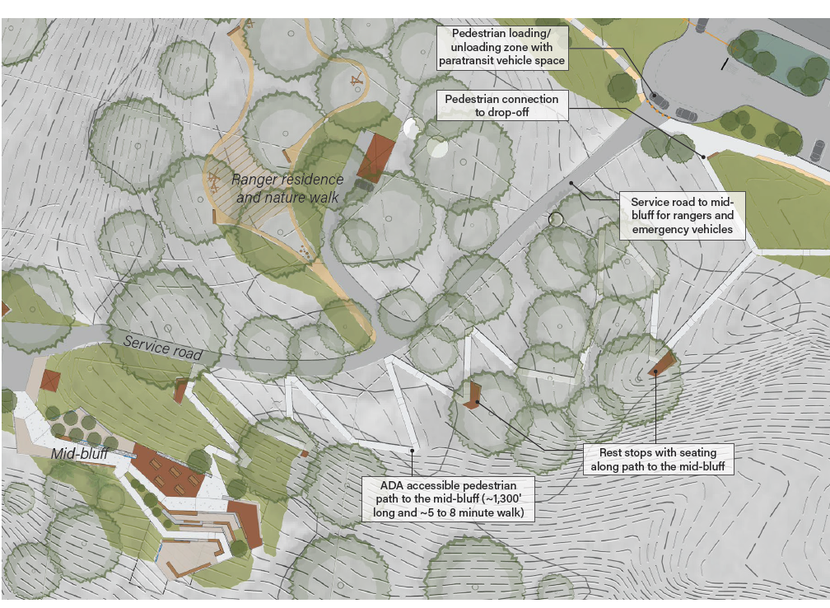
Tunitas Site Lighting
10.26.2022 Comments.
Keep the Park rural.
Key Changes.
Removed lighting at mid bluff and Ranger Residence.
Lighting Purpose.
Provide safe egress from the park at the end of the day.

Slide 3
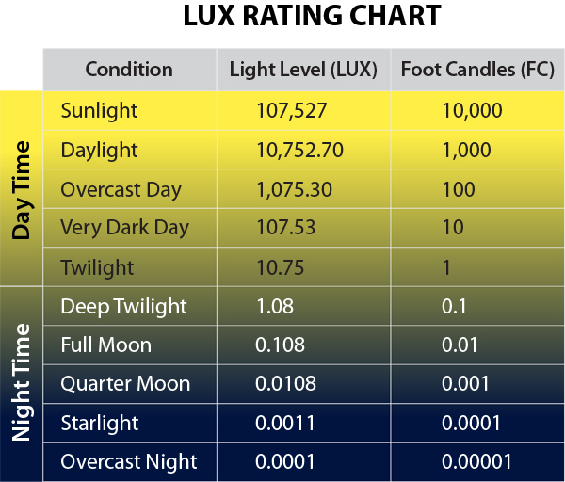
1 FC Standard For Egress (State Parks)

Slide 4
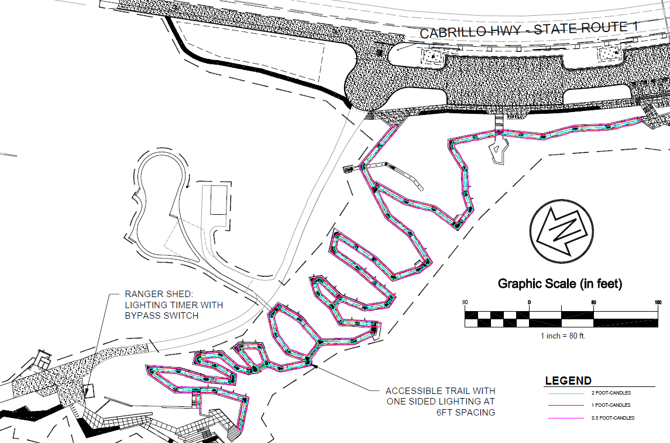
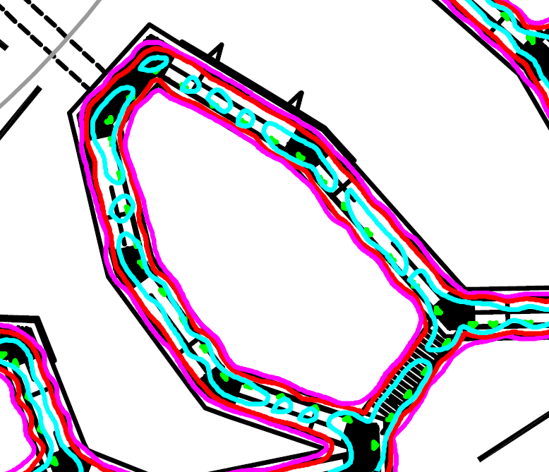
Photometric Plan
Lights active from sunset and shutoff 2 hours after activation.

Slide 5
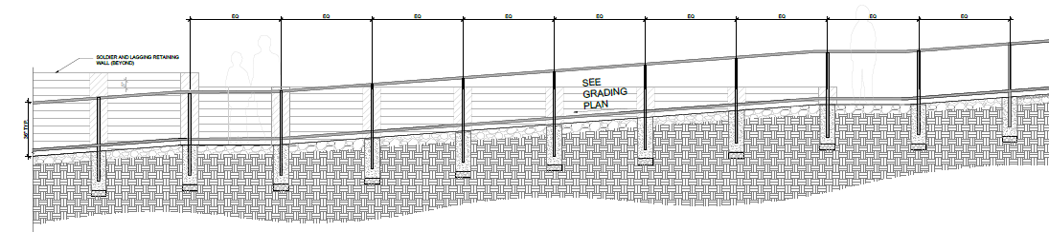
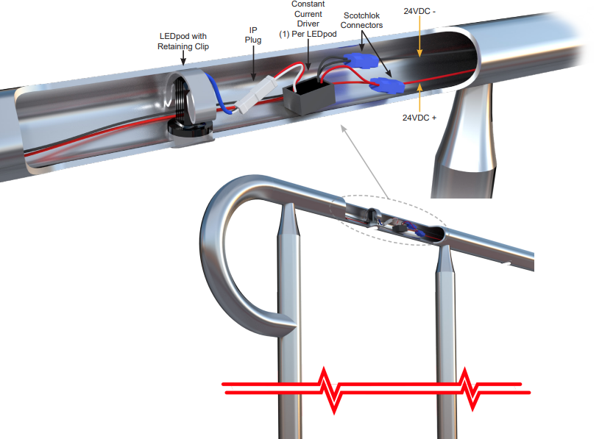
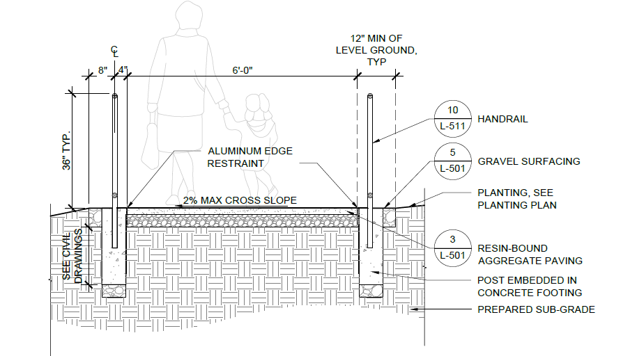
Fixture Mounting

Slide 6
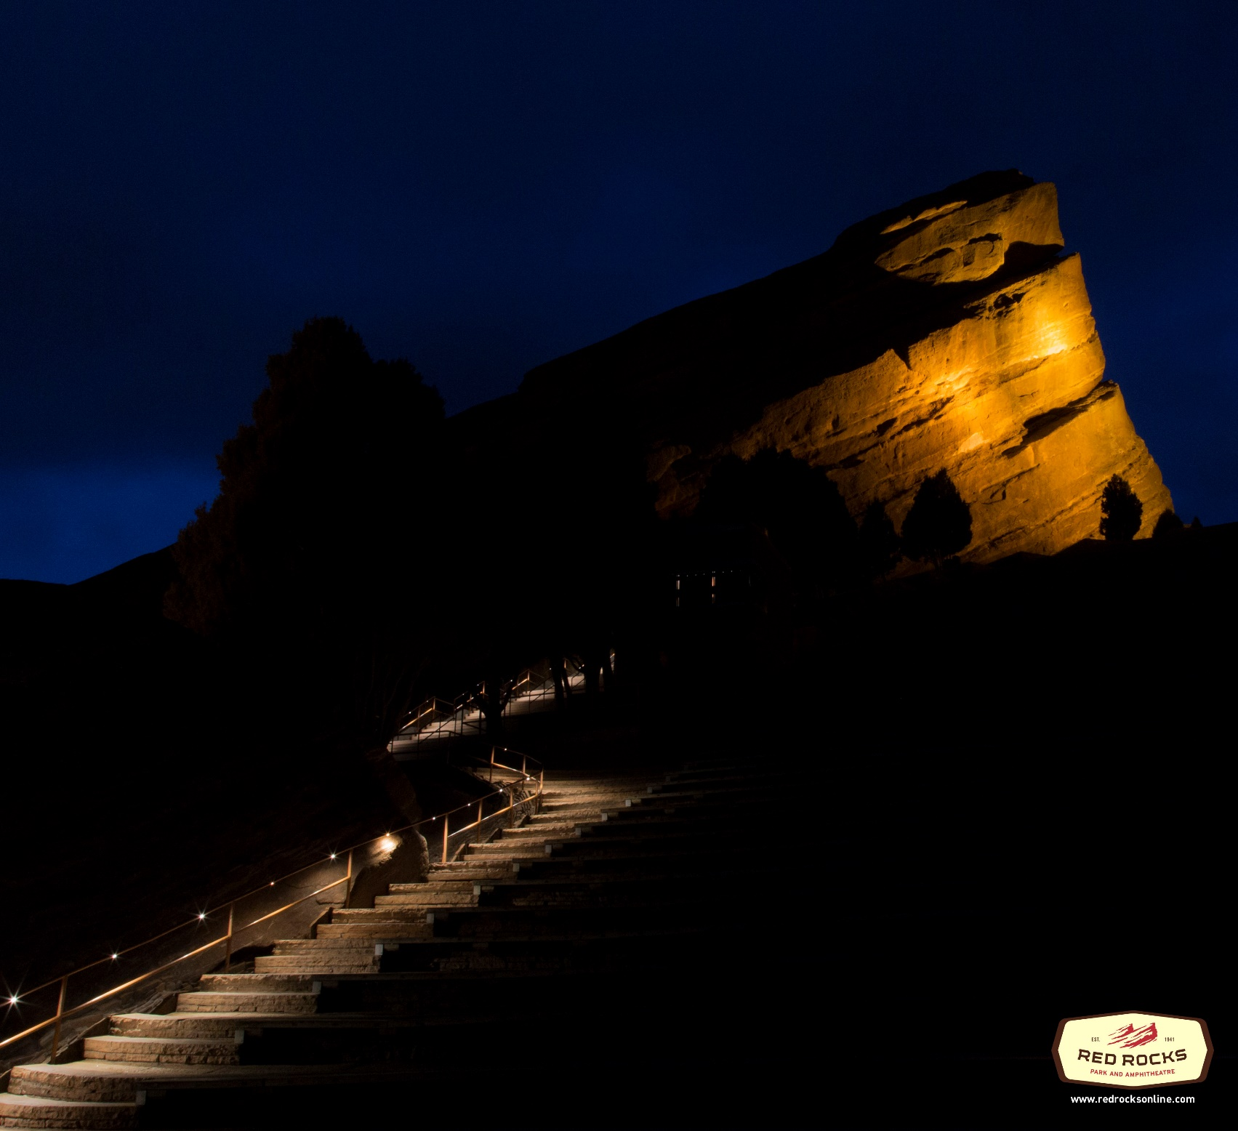
Red Rocks

Slide 7
TUNITAS CREEK BEACH
Site Lighting
March 22, 2023

Slide 8
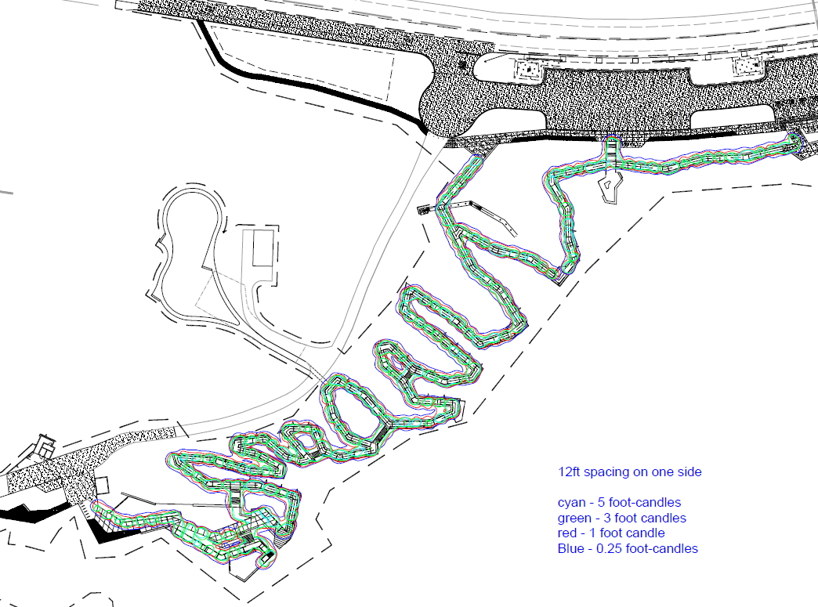
Original Lighting

Slide 9
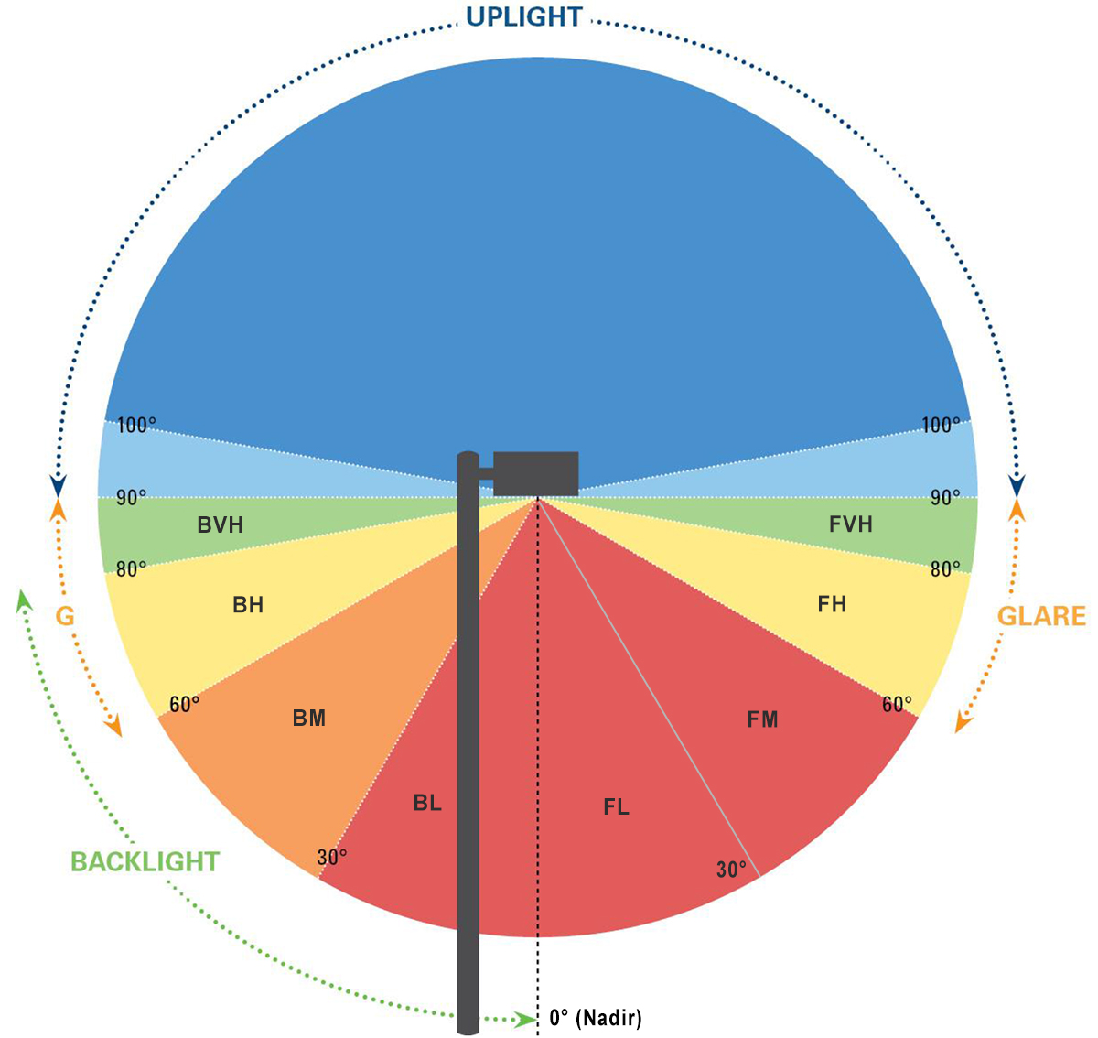
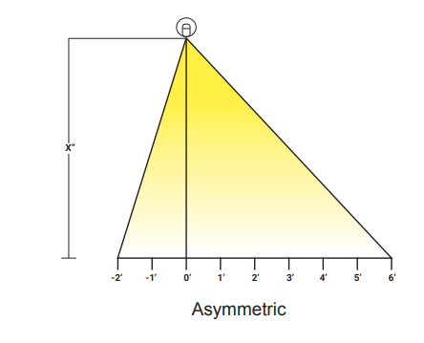
Dark Sky Friendly

Slide 10
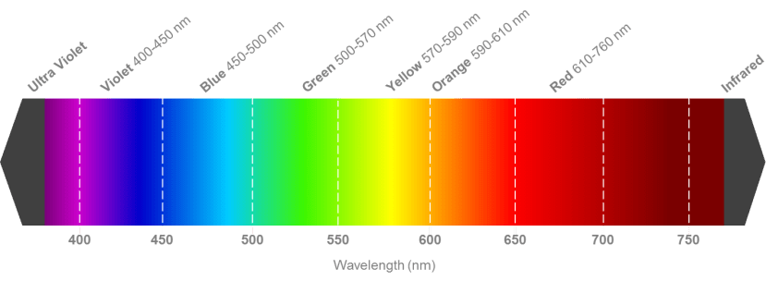
Light Wavelength
Peak Power

Slide 11
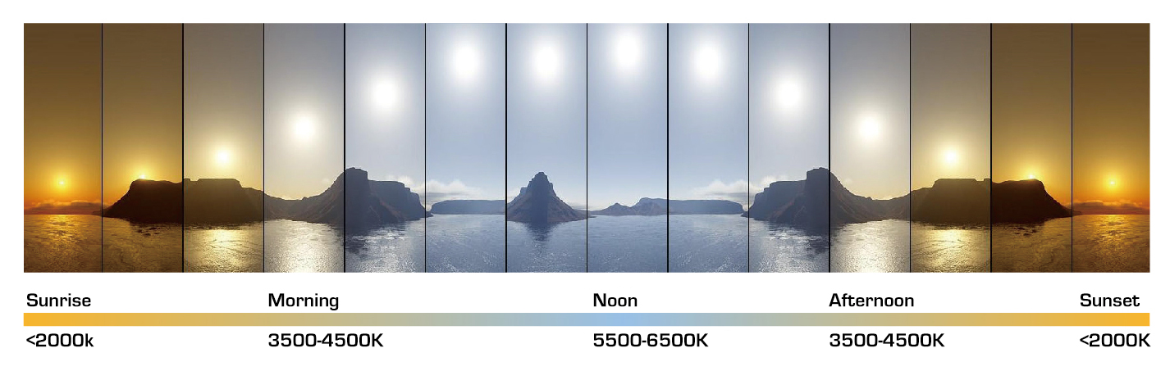
Color Temperature
3,000 k
Consistent with AMA recommendations
3,000 k
Consistent with AMA recommendations

Slide 12
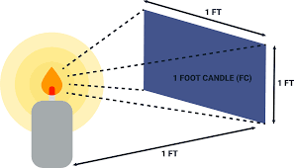
Definition of a Foot Candle

Slide 13
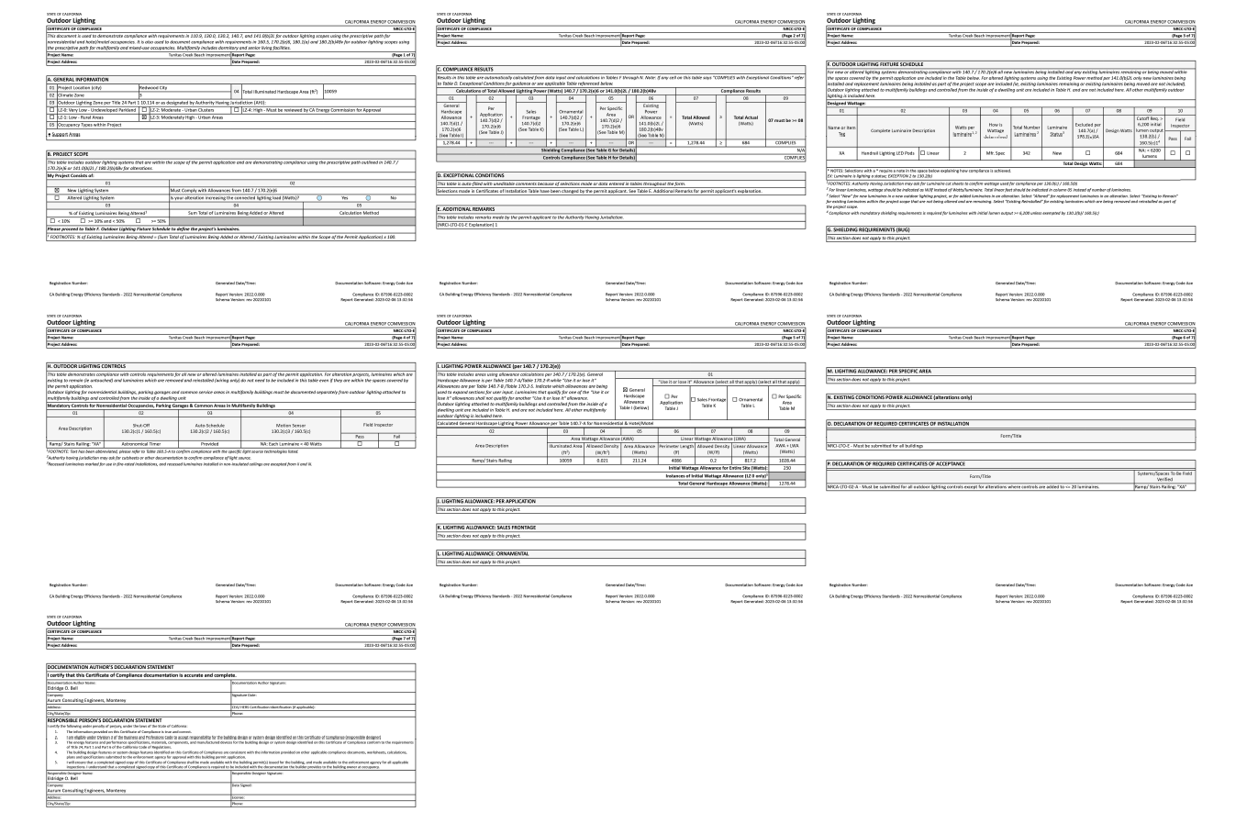
Energy Use

