Slide 1




All Things PACT Act 101
PACT ACT
OVERVIEW

Slide 2

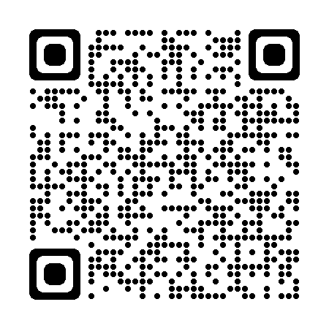
What is the PACT Act?
Vietnam
Gulf War Era
Post-9/11 Afghanistan and Iraq
The Sergeant First Class Heath Robinson
Promise to Address Comprehensive Toxics (PACT) Act of 2022
is a new law that expands VA health care and benefits for Veterans exposed to burn pits and other toxic substances. This law helps us provide generations of Veterans—and their survivors—
with the care and benefits they’ve earned and deserve.
The PACT Act :
Expands and extends eligibility for VA health care for Veterans with toxic exposures
and Veterans of the Vietnam era, Gulf War era, and Post-9/11 era.
Expands eligibility for benefits for Veterans exposed to toxic substances.

Slide 3







PACT Act Key Components
The Act expands and extends eligibility for VA health care for Veterans with toxic exposures and Veterans of the Vietnam era, Gulf War era, and Post-9/11 era.
VA will improve the decision-making process
for determining what medical conditions will be considered for presumptive status.
Every enrolled Veteran will receive an initial toxic exposure screening and a follow-up screening every five years. Veterans who are not enrolled, but who are eligible to enroll, will have an opportunity to enroll and receive the screening.
VA health care staff and claims processors will
receive toxic exposure-related education
and training.
The Act requires research studies on the mortality
of Veterans who served in Southwest Asia during
the Gulf War; Post-9/11 Veteran health trends;
and Veteran cancer rates.
The Act will help VA build a stronger, more skilled
workforce to meet the growing demand for
benefits and services.
The Act authorizes 31 new facilities across the
country, providing greater access to VA health care.

Slide 4
Gulf War Era and Post-9/11 Eligibility
If a Veteran served in any of these locations and time periods, they are eligible for the new Gulf War-related
presumptions. This includes the airspace above any of these locations.
On or After August 2, 1990:
Bahrain
Iraq
Kuwait
Oman
Qatar
Saudi Arabia
Somalia
The United Arab Emirates (UAE)
On or After September 11, 2001:
Afghanistan
Djibouti
Egypt
Jordan
Lebanon
Syria
Uzbekistan
Yemen

Slide 5
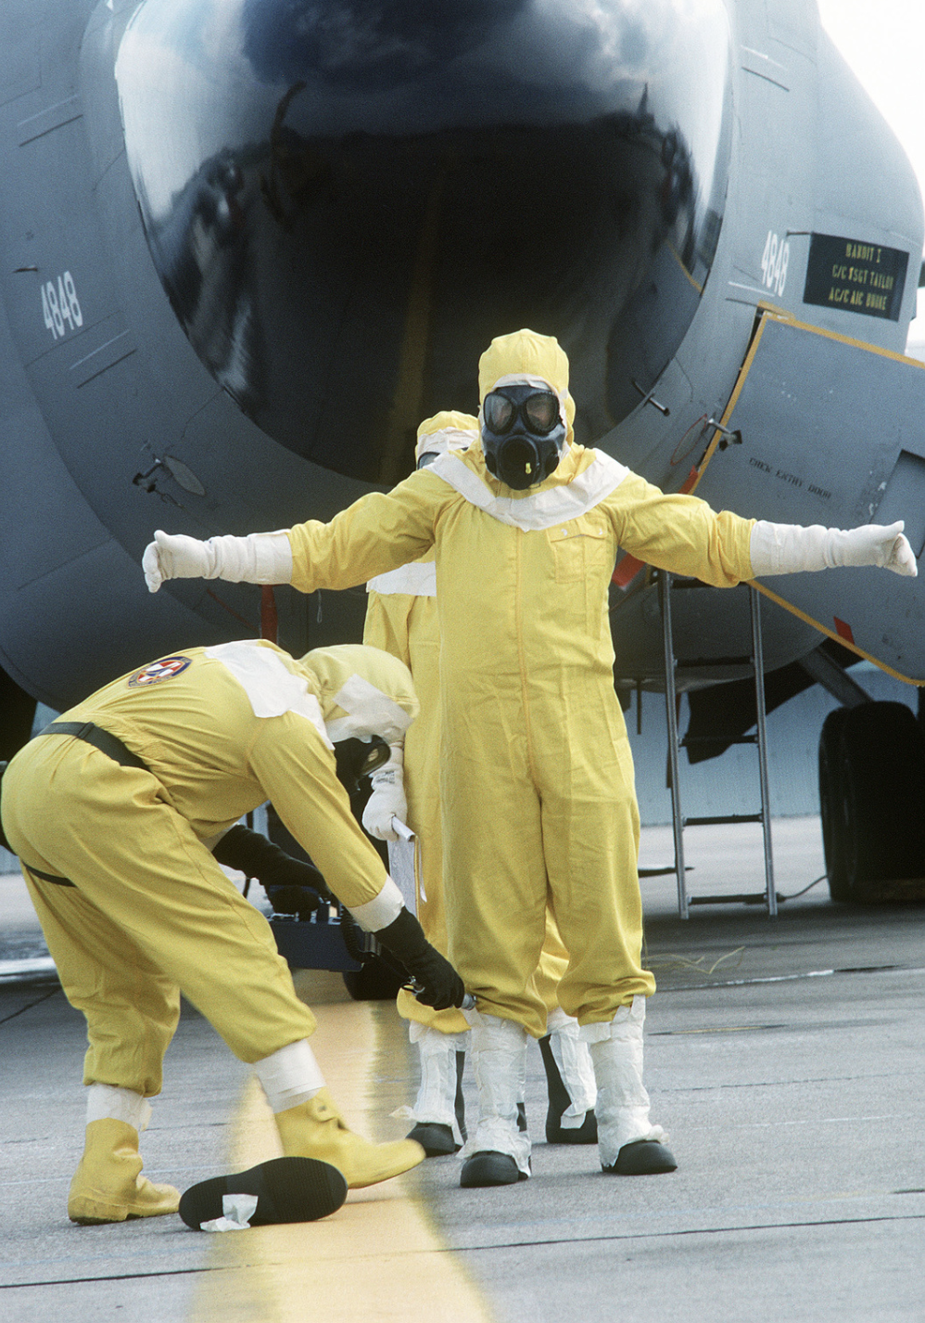
New Radiation Presumptive Locations
If you were called to respond to one of the listed cleanup and response
missions below, you may be eligible for radiation exposure presumptives
under the PACT Act.
Response Effort Dates
Cleanup of Enewetak Atoll January 1, 1977-December 31, 1980
Cleanup of the Air Force B-52
bomber carrying nuclear weapons
off the coast of Palomares, Spain
January 17, 1966-March 31, 1967
Response to the fire onboard an Air Force B-52 bomber carrying nuclear weapons near Thule Air Force Base in Greenland
January 21, 1968-September 25, 1968

Slide 6
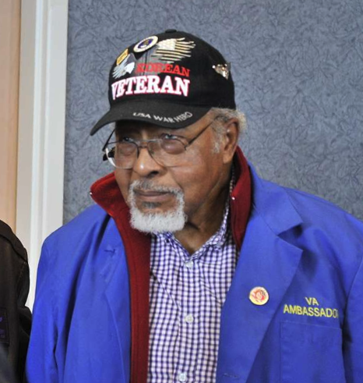
Conditions Presumed to be Service-Connected
As of August 10, 2022, a long list of new conditions are presumed to be service-connected due to various in-service toxic exposures. APPLY NOW at VA.gov/PACT to expedite your claim and benefits.
Asthma (diagnosed after service)
Brain cancer
Chronic bronchitis
Chronic obstructive pulmonary disease (COPD)
Chronic rhinitis
Chronic sinusitis
Constrictive bronchiolitis or obliterative bronchiolitis
Emphysema
Gastrointestinal cancer of any type
Glioblastoma
Granulomatous disease
Head cancer of any type
High blood pressure (hypertension)
Interstitial lung disease (ILD)
Kidney cancer
Lymphomatic cancer of any type
Lymphoma of any type
Melanoma
Monoclonal gammopathy of
undetermined significance (MGUS)
Neck cancer
Pancreatic cancer
Pleuritis
Pulmonary fibrosis
Reproductive cancer of any type
Respiratory (breathing-related)
cancer of any type
Sarcoidosis
Notes:
The full list of 23 presumptives under the law, spanning from the Vietnam Era through the Post-9/11 Era of service

Slide 7
Health Care Enrollment Eligibility
Veterans who served in the following locations and time periods can enroll in VA health care NOW:
  Republic of Vietnam (between January 9, 1962 and May 7, 1975)
  Thailand at any US or Royal Thai base (between January 9, 1962 and June 30, 1976)
  Laos (between December 1, 1965 and September 30, 1969)
  Certain Provinces in Cambodia (between April 16, 1969, and April 30, 1969)
  Guam or American Samoa or their territorial waters (between January 9, 1962 and July 31, 1980)
  Johnston Atoll, or a ship that called there (between January 1, 1972 and September 30, 1977)
Vietnam-era Veterans are now able to apply for two new Agent Orange presumptive conditions:
  Monoclonal gammopathy of undetermined significance (MGUS)
  Hypertension (high blood pressure)
Special Enrollment Period – October 1, 2022 - October 1, 2023
for Post-9/11 combat Veterans who separated or discharged between September 11, 2001 and October 1, 2013. Enrollment is free, there are no annual costs, and care may be free as well!
Notes:
In addition to Vietnam Era Veterans who can enroll in health care, RIGHT NOW there’s a Special Enrollment Period for certain post-9/11 combat Veterans (non-Vietnam). Enrollment is free, there are no annual costs, and care may be free as well! Details are at the link/QR code.
Bottom line: If you are a post-9/11 combat Veteran who has not previously enrolled in VA health care and who was separated or discharged between September 11, 2001, and October 1, 2013, Apply now under special enrollment as this window is only for one year—after that, you will need to be eligible under other criteria, which may not be immediate. This is an opportunity for more recently separated Veterans who didn’t take advantage of the 5-year window when they were discharged/separated to enroll for VA health care if they don’t meet other eligibility requirements.

Slide 8

Toxic Exposure Screening for Veterans
WHO: All Veterans enrolled in VA health care
WHAT: A quick (5-10 minute) series of questions to identify and document any potential exposures to toxins during military service
WHEN: At least one every 5 years
WHERE: VA medical centers and clinics
WHY: Supports Veteran long-term health plans and informed,
whole-health care
HOW: Veterans can ask about the screening at their next VA appointment
Notes:
Available now! As of November 8th, 2022

Slide 9
Filing Claims to Receive Benefits
Veterans can file a claim for the new presumptive conditions:
New Claim—Veteran has never filed for the presumptive condition
Supplemental Claim—the presumptive condition was previously denied but is now considered to be presumptive
If VA denied one of the new presumptive conditions in the past but the Veteran may now be eligible for benefits,
VA will try to contact them. There is no need to wait to file a Supplemental Claim.
VA is prioritizing the claims of Veterans with cancer to make sure they get timely access to the care and benefits
they need.
Pending Claims: If a Veteran’s condition was added to the list of presumptive conditions* after the claim was filed, VA will consider it on a presumptive basis.
*Presumptive conditions do not require proof that the military service caused the condition. Veterans only need to meet the service requirements and have a current diagnosis of the presumptive condition. Veterans should submit any supporting documentation to assist with their claim.
Notes:
If you file a claim within the next year—before September 2023—your claim will be retroactively dated for adjudication back to the date of the law’s enactment- August 10th, 2022!

Slide 10
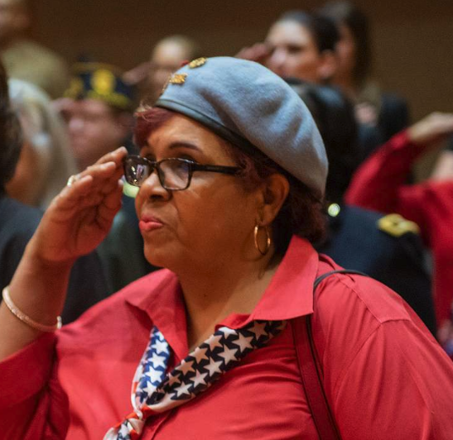

Other Affected Veterans and Survivors
What about additional benefits and care for other Veterans
and their survivors?
    Under the PACT Act, survivors may be eligible for VA benefits, including Dependency and Indemnity Compensation and Burial benefits.
    Dependency and Indemnity Compensation
    Burial Benefits
Get the care and benefits you EARNED and DESERVE!
Apply at VA.gov/PACT today.
Notes:
If you’re a surviving family member of a Veteran, you may be eligible for these benefits:
A monthly VA Dependency and Indemnity Compensation (VA DIC) payment. You may qualify if you’re the surviving spouse, dependent child, or parent of a Veteran who died from a service-connected disability.
Learn how to apply for VA DIC
A one-time accrued benefits payment. You may qualify if you’re the surviving spouse, dependent child, or dependent parent of a Veteran who we owed unpaid benefits at the time of their death.
Learn about evidence needed for accrued benefits
A Survivors Pension. You may qualify if you’re the surviving spouse or child of a Veteran with wartime service.
Learn how to apply for a Survivors Pension
You may be eligible for these VA benefits as the surviving family member of a Veteran:
Burial benefits and memorial items such as a gravesite in a VA national cemetery or a free headstone, marker, or medallion.
A burial allowance to help with the Veteran’s burial and funeral costs. You may qualify if you’re the Veteran’s surviving spouse, partner, child, or parent.
Education and training. You may qualify if you’re the survivor of a Veteran who died in the line of duty or as a result of service-connected disabilities.
Health care through the Civilian Health and Medical Program of the Department of Veterans Affairs (CHAMPVA). You may qualify if you’re the survivor or dependent of a Veteran with a service-connected disability.
A VA-backed home loan. You may qualify if you’re the surviving spouse of a Veteran.

Slide 11
When or How Should I File a Claim?
What if I have previously
been denied?
Veterans previously denied a toxic-exposure
related claim are encouraged to file a supplemental
claim. Once a supplemental claim is received, VA
will review the claim under the new law.
APPLY NOW!
For more info, visit VA.gov/PACT or call 1-800-MyVA411
Notes:
For the briefer, please reiterate going through the website to find the E-Z forms needed to file a claim and/or enroll in health care.

