Slide 1
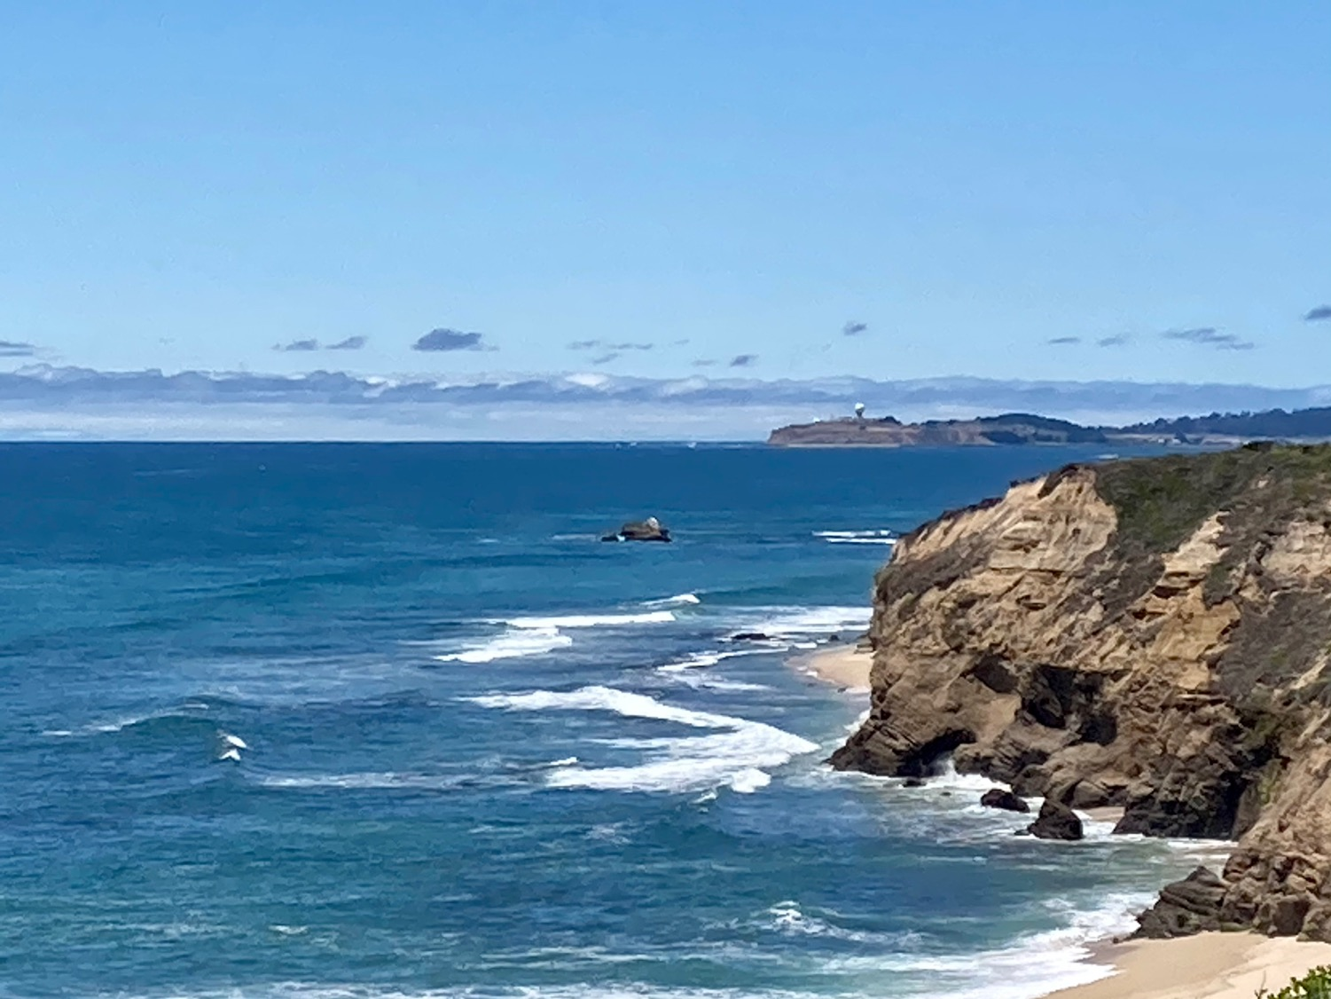


COASTAL LITERARY ARTS MOVEMENT
a Nonprofit 501(c)(3) Public Benefit Corporation
www.CoastalLit.org

Slide 2


Slide 3
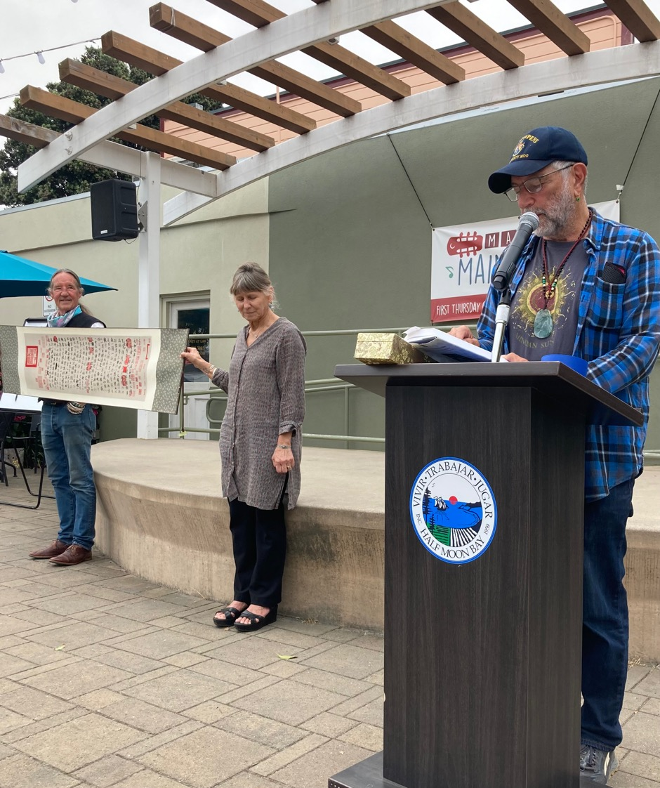
Speakers’
Space
  Poetry
  Prose
  Originals
  Favorites
  Humor
  Dance
  Multi-lingual

Slide 4
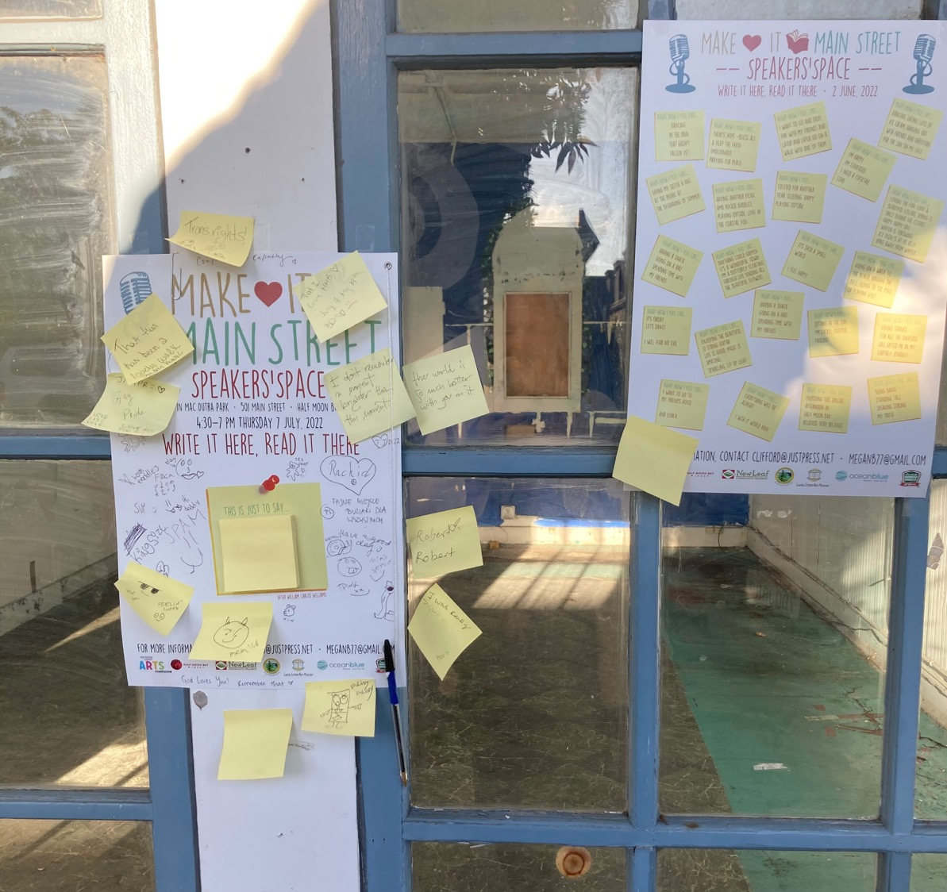
C
O
M
M
U
N
I
T
Y
P
O
E
M
S

Slide 5

Makers’ Space

Slide 6
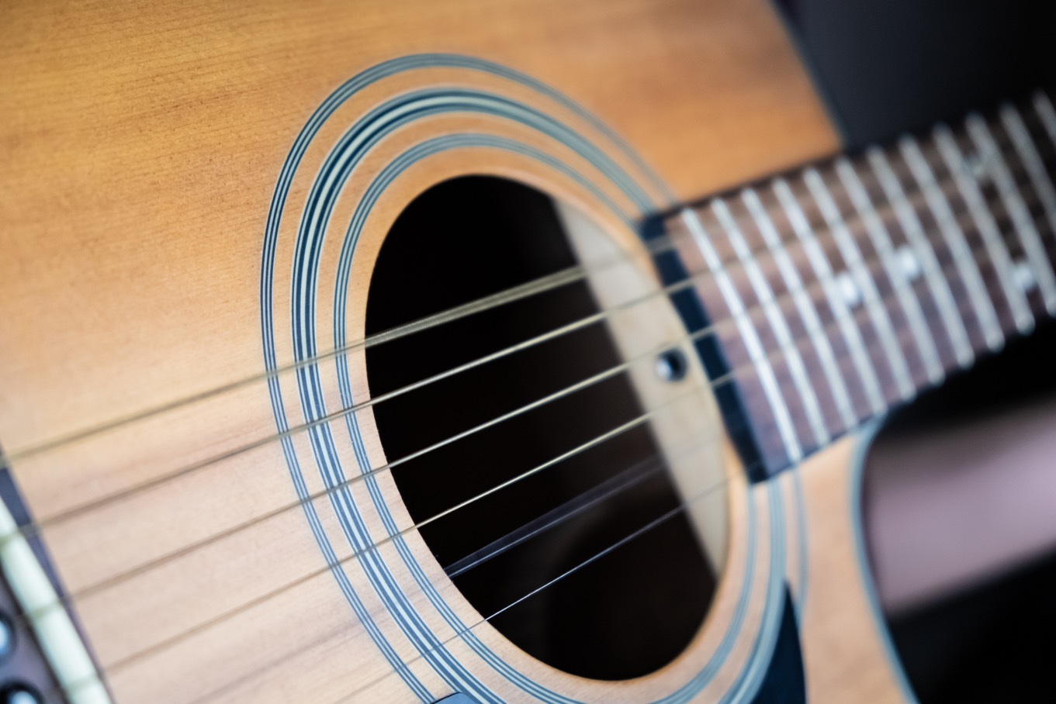
Live Music on Main Street

Slide 7
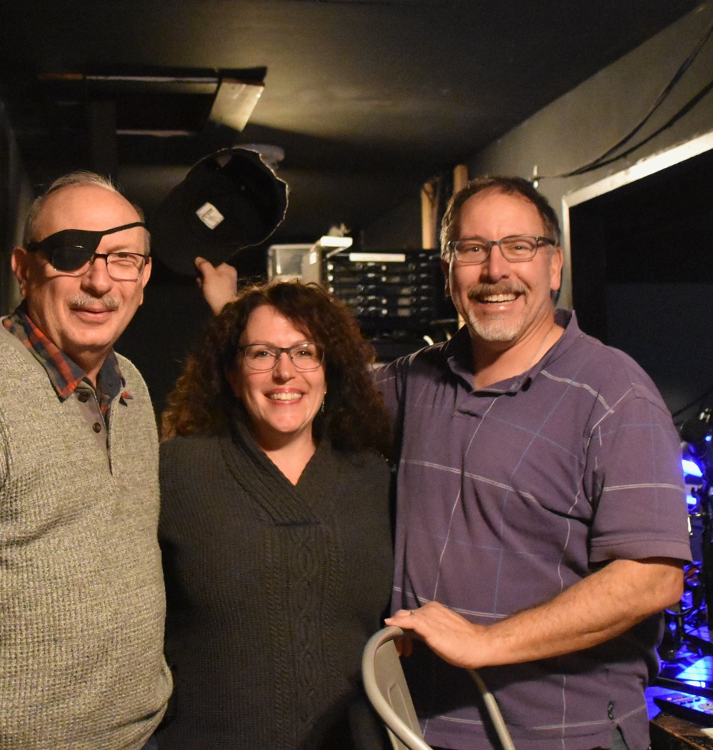
Movies
Coastal
Rep
Odd
Fellows
Hall

Slide 8


Slide 9


High Schools

Slide 10
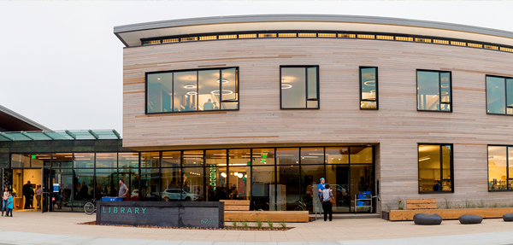

Library and Publications

Slide 11


Radio Stations

Slide 12


Thanks to:
makeitmainstreet@coastside.net

Slide 13
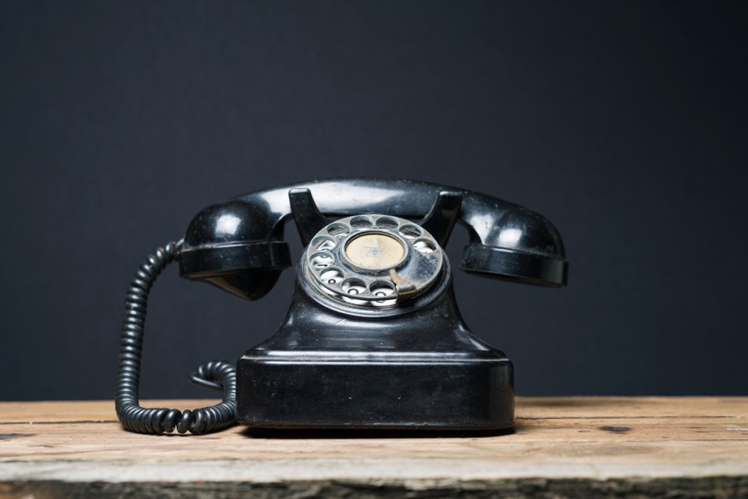
LetsTalk@CoastalLit.org
Cell: (415) 722-2626
Messages: (650) 712-1817

