Slide 1
North Fair Oaks Community Council
Owner: ………………………….
Applicant: ………………………
File Number: .…………………..
Location: ………………………..
APN: …………………….……….
Falynn and Clayton St. Dennis
Avivit Katzir
PLN2022-00052
848 15th Ave, Menlo Park, 94025
055-203-050
Project Description:
Off-Street Parking Exception (OSPx) to allow for one covered parking space, where two covered spaces are required, in conjunction with a 395.95 sq. ft. addition/remodel to the first floor and a 951.5 sq. ft. second story addition. This project proposal seeks to maintain the existing single-car garage and include one uncovered, off-street parking space in the front portion of the property as part of the development.
PLANNING AND BUILDING DEPARTMENT
Notes:
1

Slide 2
INTRODUCTION
Project Description
Project Location
Required permits and project compliance
Recommendation
PLANNING AND BUILDING DEPARTMENT
Notes:
2
basic description
Address, parcel number, neighborhood, zoning district, single car garages (note from north fair oaks plan)
Off street parking exception to allow for….
Recommendation from the north fair oaks community council

Slide 3
PROJECT DESCRIPTION
Reconfiguring the existing 899.3 sq.ft. single-family home
  First story addition/remodel- 395.5 sq.ft.
  New second story addition- 951.5 sq.ft.
Retain existing single-car garage
Propose one uncovered, off-street parking space in front yard offset of the driveway, allowing unobstructed access to existing single-car garage
PLANNING AND BUILDING DEPARTMENT
Notes:
3
first floor addition the their floor area ration 395.5 sq ft- remodeling to include ….
2nd story, (number of rooms?) 3 bedrooms 2 bathrooms

Slide 4
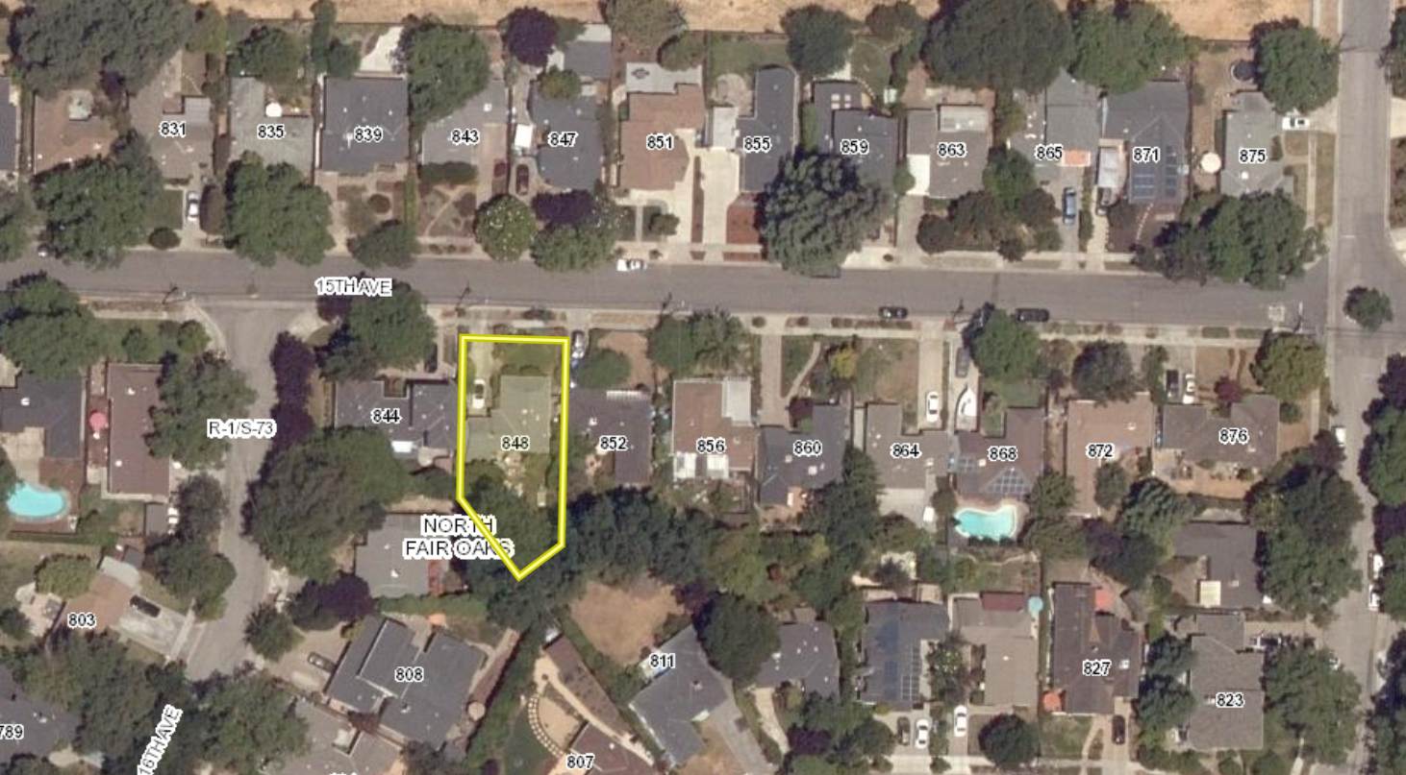
PROJECT LOCATION
PLANNING AND BUILDING DEPARTMENT
Notes:
4
Before we take a look at some of the sheets from the plan set provided by the applicant, I wanted to give you an image of the house. The street is facing the north direction

Slide 5
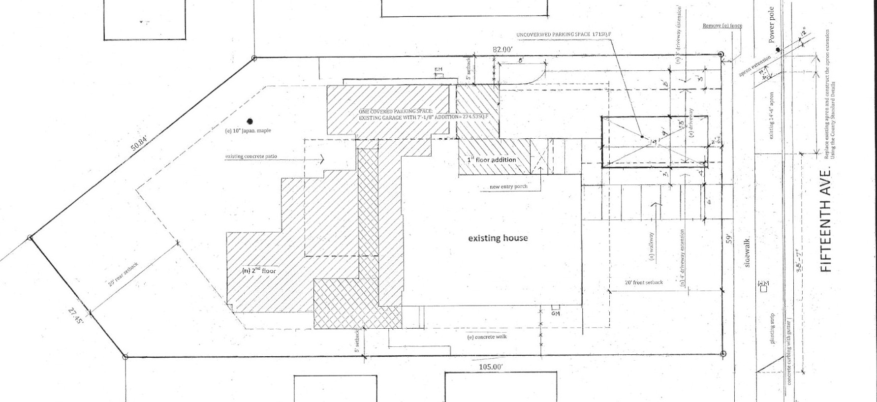
EXISTING/PROPOSED SITE PLAN
PLANNING AND BUILDING DEPARTMENT
Notes:
5

Slide 6
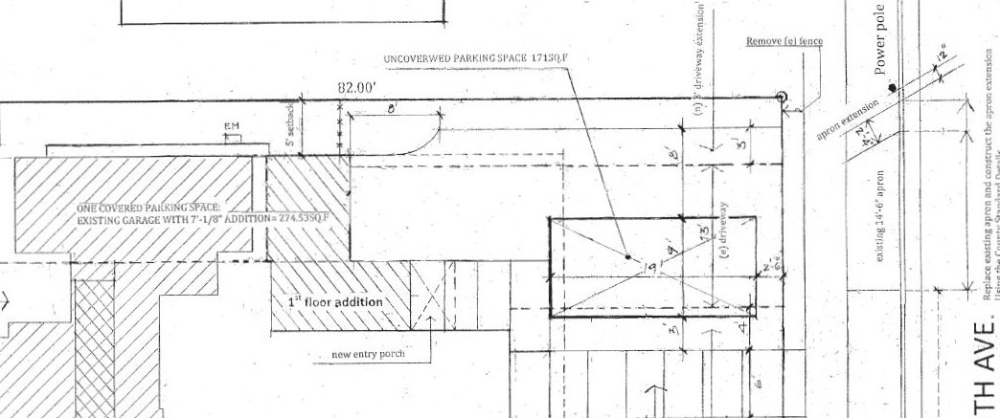
EXISTING AND PROPOSED PARKING SPACES
PLANNING AND BUILDING DEPARTMENT
Notes:
6
mention the changes needed for the uncovered parking space including 2’ 4” apron extension to existing 14’ 6” apron, removal of fence
Garage side is non conforming by less than 50%, mention what's listed in report including zoning regulation section less than 50% therefore can remain
Garage by 56 feet to from 247 to 303.8 to allow for new entry way, if went past that it would intrude with entry way, and be closer to counting towards floor area ratio, according the zoning regulations for this zoning district (cite code or FAR garage over 400 sq ft)

Slide 7
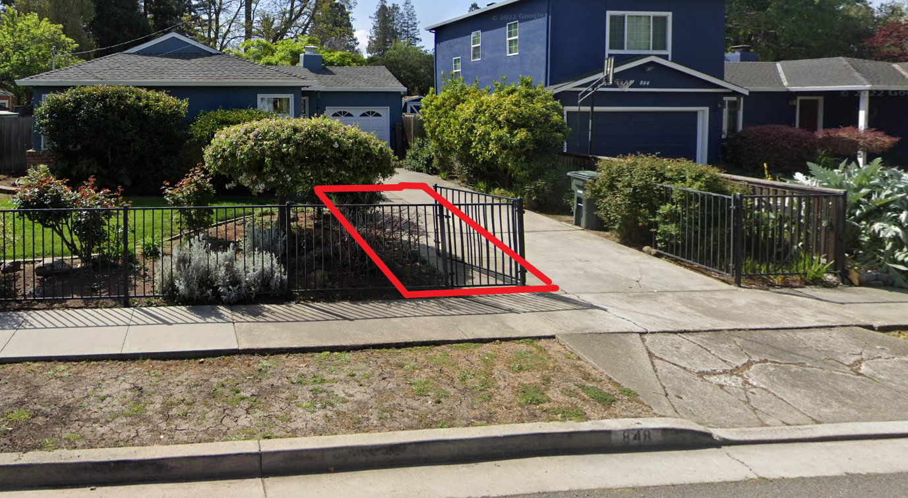
PROPOSED OFF-STREET UNCOVERED PARKING SPACE
PLANNING AND BUILDING DEPARTMENT
Notes:
7
Just offset of driveway and with the widening of the apron it access to this spot will not interfere or obstruct access to the existing covered spot in the single car garage

Slide 8
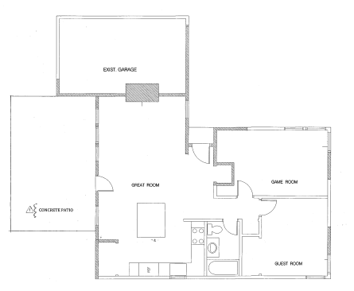
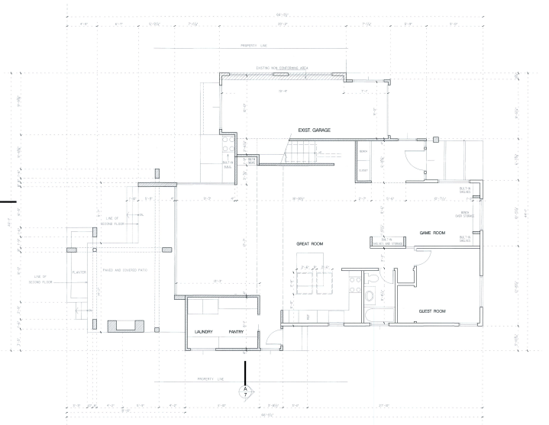
EXISTING AND PROPOSED FIRST FLOOR PLANS
PLANNING AND BUILDING DEPARTMENT
Notes:
8

Slide 9
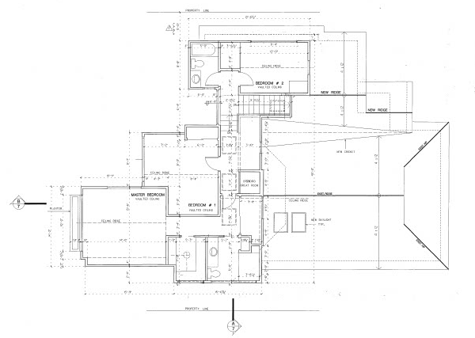
PROPOSED SECOND FLOOR PLAN
PLANNING AND BUILDING DEPARTMENT
Notes:
9
No existing second floor, development pushed towards rear avoiding disruptions to the existing home and the smaller front portion of the property. There's no existing 2nd floor plan to show this against

Slide 10
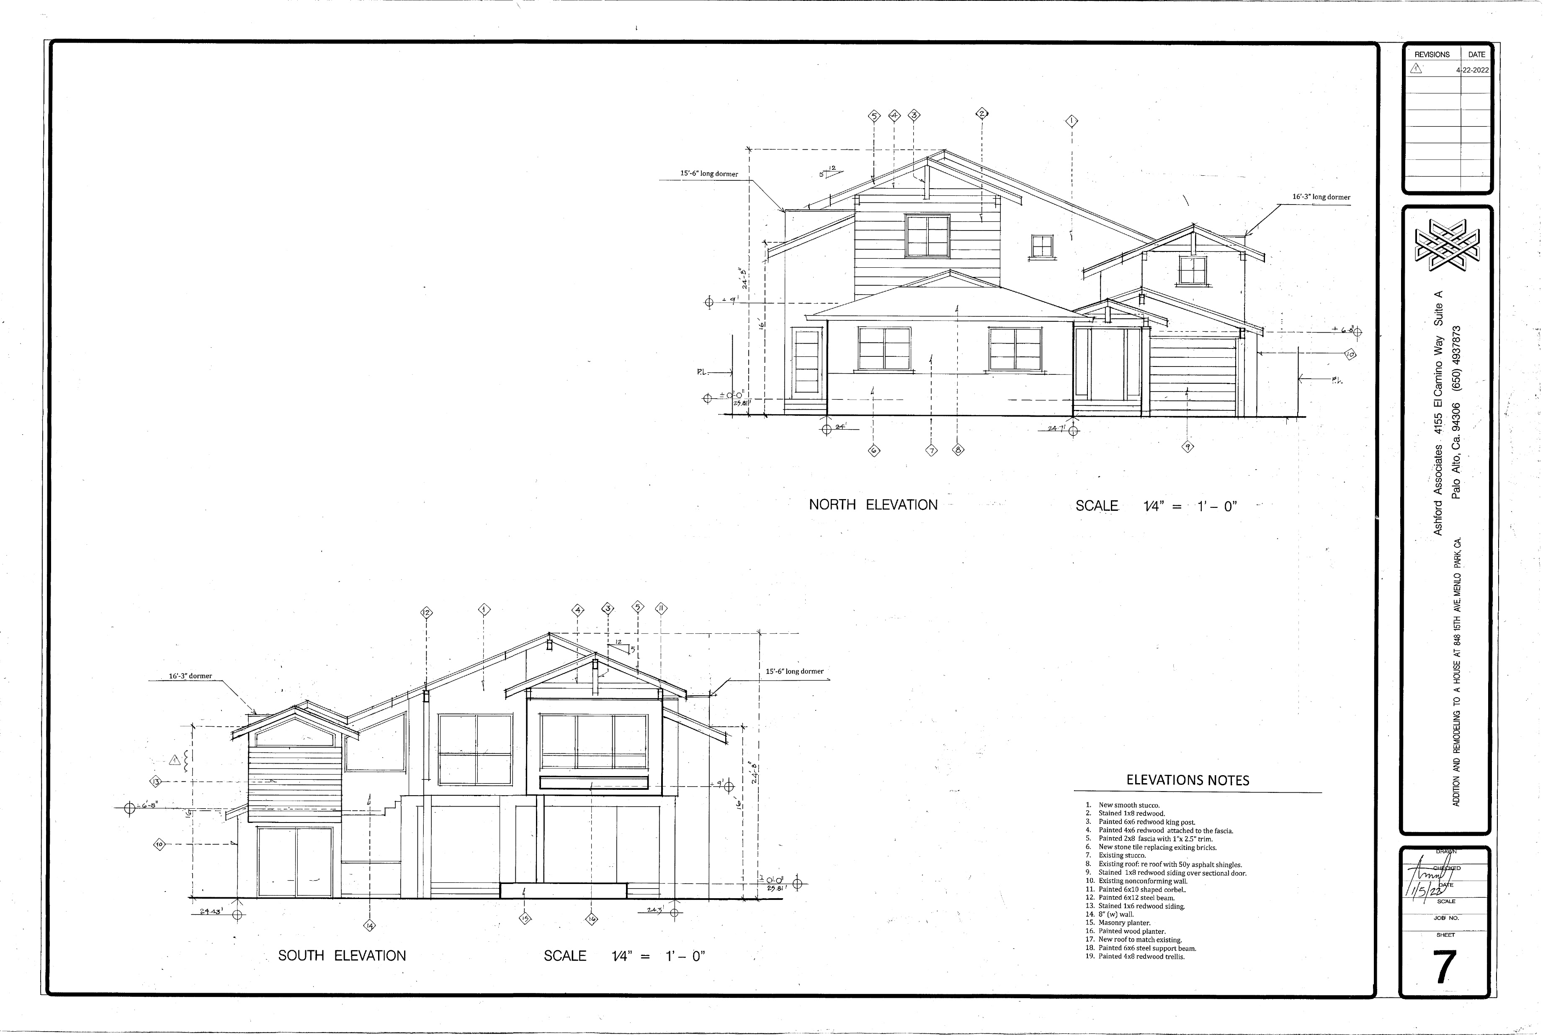
PROPOSED NORTH AND SOUTH ELEVATIONS
PLANNING AND BUILDING DEPARTMENT
Notes:
10

Slide 11
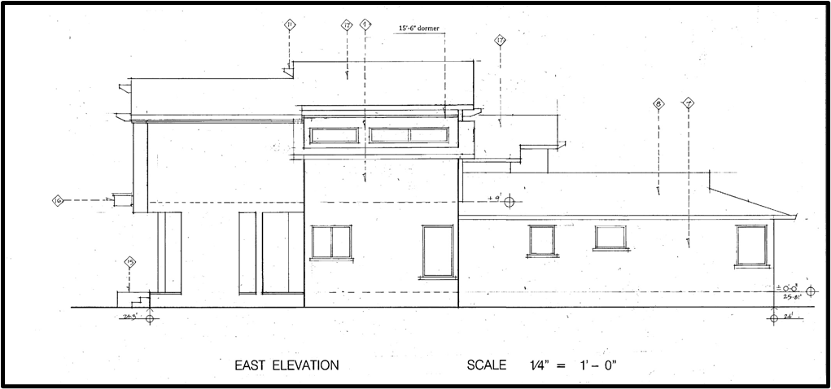
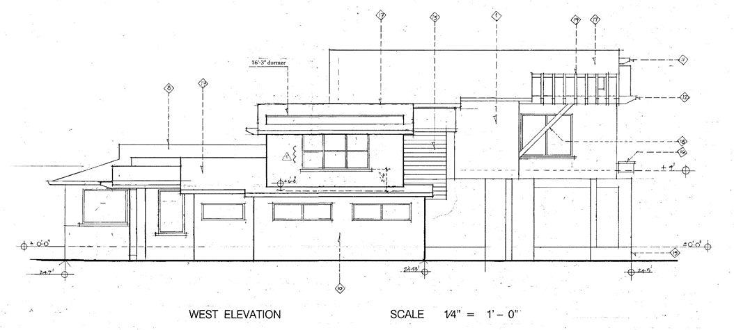
PROPOSED EAST AND WEST ELEVATIONS
PLANNING AND BUILDING DEPARTMENT
Notes:
11

Slide 12
REGULATIONS CONFORMANCE/PROJECT COMPLIANCE
General Plan
  Conforms with land use designation
Zoning Regulations
  Meets all development standards
Parking Regulations
  For each dwelling unit having two or more bedrooms, two off-street, covered spaces are required
Off-Street Parking Exception
  To allow for one covered space in existing single-family garage, and one uncovered space in front of property
PLANNING AND BUILDING DEPARTMENT
Notes:
12
General Plan identifies North Fair Oaks as an urban community and the North Fair Oaks Community Plan has designed the land use density as single family residential. This proposed project is consistent with the land use designation of this parcel and the surrounding area
-This project also complies with the development standards for its zoning district. Zoning district –R-1/S-73 meaning single family residential, north fair oaks combing district. The proposed addition meets the zoning district standards for setbacks, height, lot coverage, and floor area ratio. The proposed addition to the existing single-family dwelling does not introduce a new use to the property. Therefore, the existing single-family residence remains consistent as a permitted use in the R-1 Zoning District.
- Re read the proposed project request and additional provisions. Section 6119 of county zoning regulations, for each dwelling unit having two or more bedrooms, two off street covered spaces are required.

Slide 13
RECOMMENDATION
That the North Fair Oaks Community Council provide a recommendation to the Community Development Director for an off-street parking exception to allow for the continued use of a single-car garage and a proposed uncovered, off-street parking space, where two covered parking spaces are required, in association with a major addition/ remodel of an existing single-family residence
PLANNING AND BUILDING DEPARTMENT
Notes:
13

Slide 14
North Fair Oaks Community Council
Owner: ………………………….
Applicant: ………………………
File Number: .…………………..
Location: ………………………..
APN: …………………….……….
Falynn and Clayton St. Dennis
Avivit Katzir
PLN2022-00052
848 15th Ave, Menlo Park, 94025
055-203-050
Project Description:
Off-Street Parking Exception (OSPx) to allow for one covered parking space, where two covered spaces are required, in conjunction with a 395.95 sq. ft. addition/remodel to the first floor and a 951.5 sq. ft. second story addition. This project proposal seeks to maintain the existing single-car garage and include one uncovered, off-street parking space in the front portion of the property as part of the development.
PLANNING AND BUILDING DEPARTMENT
Notes:
14

